Slide 1






Venture Creation
New Business Venture
Nicole Williams 1802680
Digital Entrepreneurship BMMB7002
Notes:
This presentation aims to systematically assess the feasibility of a new business venture using relevant frameworks and theory.
13 seconds

Slide 2





Gap in the Market
Digital
Revolution
(OECD, 2015)
Notes:
To begin, we will be looking at the gap in the digital market. The expansion of the Digital Revolution comes with some issues, including an increased number of lawsuits due to copyrighted content (OECD, 2015). Businesses are constantly looking for web-friendly content which they can use of their website. The aim is to increase traffic and to build a bond with potential customers.
25 seconds.

Slide 3





Content Marketing
£
Notes:
There will always be a need for content marketing, therefore it is suggested that a new business venture named ContentGo is established to satisfy such needs. With the current economic and political environment being negatively impacted by the likes of Brexit and COVID-19, businesses are focusing on their online marketing to gain customers. Brexit has deterred consumers from parting with their money due to the declining rate of the Great British Pound, and not knowing if the rate will recover. Furthermore, COVID-19 has closed physical shops and forced consumers to stay at home, therefore increasing their exposure to online marketing whilst they do their shopping through the internet.
41 seconds.

Slide 4
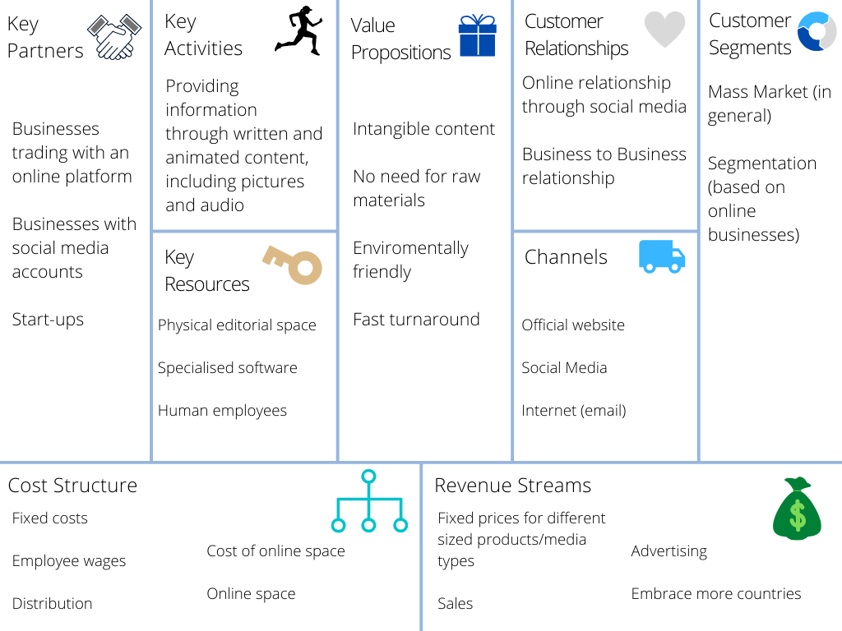
Business Model Canvas
(Osterwalder, 2013)
(Luenendonk, 2015)
Notes:
The Business Model Canvas (Osterwalder, 2013) is a widely used framework in identifying key partners, activities, resources, value propositions, customer relationships, customer segments, cost structure and revenue streams.
This approach is commonly used to change, describe, visualise and assess a business model operating within any market (Luenendonk, 2015). All of these factors contribute to the overall value a business creates and delivers to consumers.
1 minute 45 seconds.

Slide 5









Suitable Platforms
Clients Needs
Banners
GIFs
Promotions
Articles
Infographics
(Bauer, 2020)
Notes:
Suitable platforms which the content marketing will be aimed at include Youtube, Twitter, LinkedIn, Snapchat, Google, Facebook and Instagram. These social media platforms gain the most exposure (Bauer, 2020) and offer different levels of advertising; meaning even small businesses with a low budget would still be able to advertise.
Content will depend upon client needs. Such needs could include banners, GIFs, promotions, articles or infographics just to name a few.
Furthermore, effective marketing will increase traffic, therefore increase revenue for the business. Resulting in successful content marketing!
38 seconds.

Slide 6


Drivers
(Chaffey, 2019)
(Rather, Tehseen and Parrey, 2018)
Notes:
The main drivers of content marketing are the internet and technology. Current circumstances leave businesses with limited choices when trying to retain customers.
By utilising these two drivers and basing a business model upon them; paves the way for success.
Subsequently, satisfying customer needs through the incorporation of technology and the internet enhances brand loyalty and repeat custom for the business (Rather, Tehseen and Parrey, 2018).
Online Value Proposition (Chaffey, 2019) will be maximised through the satisfaction of consumer needs .
31 seconds.

Slide 7
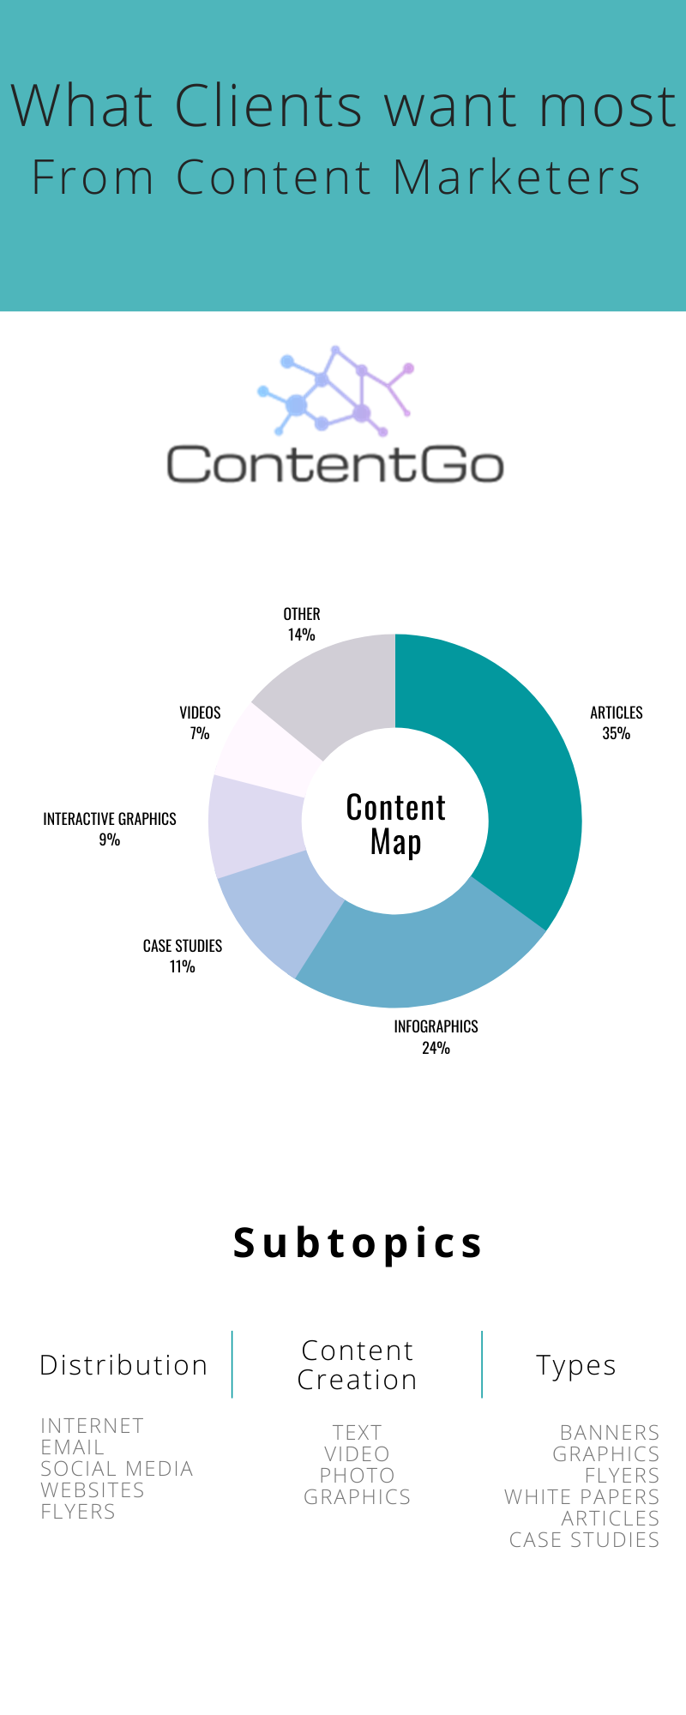
Clients
(Deloitte, 2017)
Notes:
The clients of the business include any business which requires digital content. Research suggests the main form of content clients want from content marketers are articles, followed by infographics, then case studies. These 3 mediums are all informative mediums; therefore, guidance from clients will be needed in order to direct research, application and aesthetics.
With the changing customer preferences from physical to online, brings the opportunity to market content more effectively (Deloitte, 2017). The subtopics are Distribution, Content Creation and Types. Distribution will be through the means of the internet, email, social media, websites and flyers. Content Creation includes but is not limited to text, video, photo, graphics. And types refers to banners, graphics, flyers, white papers, articles and case studies.
58 seconds.

Slide 8

Cost
Free to Use
Formats
Templates
Sizing
(Skog, Wimelius and Sandberg, 2018)
Notes:
The cost of starting ContentCo is minimal due to no physical premises being needed. Furthermore, the design process will be based on an online platform called Canva. It is free to use, contains temples, different formats and different sizing to satisfy different sized graphics such as Facebook posts or banner ads.
The main threat the digital media industry has faced and will continue to face is Digital Disruption; in particular, digital technologies. Organisations which have not been proactive in using such technologies, will see such technologies being used against them by competitors (Skog, Wimelius and Sandberg, 2018). Furthermore, fragmentation will pose a threat to those which depend on a high number of customers.
44 seconds.

Slide 9








Customer Analysis
(Perkins and Fenech, 2014)
Notes:
The digital media industry has seen a few changes over the years, including the demographic of its users. As the older generation learn the new technologies, whilst the younger generation grew up with such technologies as part of their day-to-day lives. With this in mind, the younger generation now have a certain expectation from the digital industry to react and change their business models in order to satisfy the needs of its consumers and to keep up with demand (Perkins and Fenech, 2014).
27 seconds.

Slide 10

Overall…
Economic
Digital Disruptors
Political
Notes:
Overall, the digital media industry has had to completely adapt to digital disruptors, and will need to continue to do so in the future. The multiple forces on the industry (in particular current economic and political factors) mean reactions must be appropriate and measured. With particular attention being places on digital technologies and how consumers are using such means to access content. Therefore, ContentGo needs to remain relevant and up-to-date by listening to customers and adapting to their needs and wants.
With the development of new technologies will come new capabilities which digital businesses should be able to harness and use to their advantage to ensure longevity and customer satisfaction.

Slide 11
References
Bauer, B., 2020. YouTube Advertising In 2018: Example Ad Campaigns + Best Practices. [online] The BigCommerce Blog. Available at: <https://www.bigcommerce.com/blog/youtube-advertising/> [Accessed 3 June 2020].
Chaffey, D., 2019. Online Value Proposition (OVP) Definition - What Is? | Digital Marketing Glossary. [online] Digital Insights. Available at: <https://www.davechaffey.com/digital-marketing-glossary/online-value-proposition-ovp/> [Accessed 3 June 2020].
Deloitte, 2017. Disruptions In Retail Through Digital Transformation. Reimagining the Store of the Future. [online] Deloitte. Available at: <https://www2.deloitte.com/content/dam/Deloitte/in/Documents/CIP/in-cip-disruptions-in-retail-noexp.pdf> [Accessed 23 May 2020].
Luenendonk, M., 2015. Business Model Canvas: A Complete Guide. [online] Cleverism. Available at: <https://www.cleverism.com/business-model-canvas-complete-guide/> [Accessed 3 June 2020].
OECD, 2015. Intellectual Property's Economic Impact. Chapter 5. [online] OECD, pp.209-312. Available at: <https://www.oecd.org/sti/ieconomy/Chapter5-KBC2-IP.pdf> [Accessed 23 May 2020].
Osterwalder, A., 2013. A Better Way to Think About Your Business Model. [online] Harvard Business Review. Available at: <https://hbr.org/2013/05/a-better-way-to-think-about-yo> [Accessed 3 June 2020].
Perkins, B. and Fenech, C., 2014. The Deloitte Customer Review. The Growing Power of Consumers. [online] London: Deloitte. Available at: <https://www2.deloitte.com/content/dam/Deloitte/uk/Documents/consumer-business/consumer-review-8-the-growing-power-of-consumers.pdf> [Accessed 23 May 2020].
Rather, R., Tehseen, S. and Parrey, S., 2018. Promoting customer brand engagement and brand loyalty through customer brand identification and value congruity. Spanish Journal of Marketing - ESIC, [online] 22(3), pp.319-337. Available at: <https://www.researchgate.net/publication/328768213_Promoting_customer_brand_engagement_and_brand_loyalty_through_customer_brand_identification_and_value_congruity> [Accessed 3 June 2020].
Skog, D., Wimelius, H. and Sandberg, J., 2018. Digital Disruption. Business & Information Systems Engineering, [online] 60(5), pp.431-437. Available at: <https://link.springer.com/article/10.1007%2Fs12599-018-0550-4> [Accessed 23 May 2020].

