Slide 1

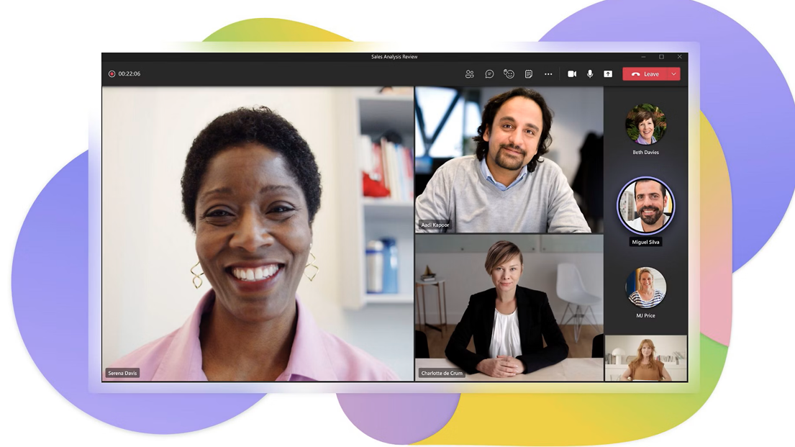
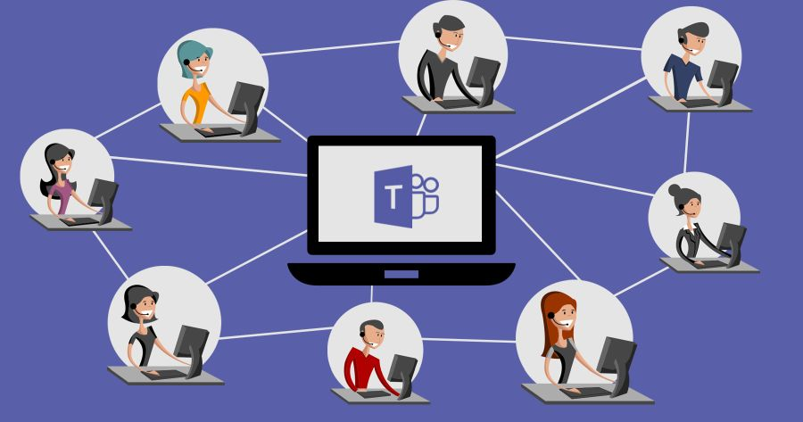
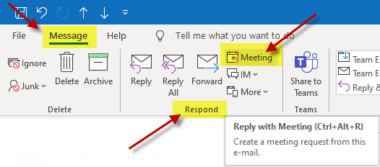
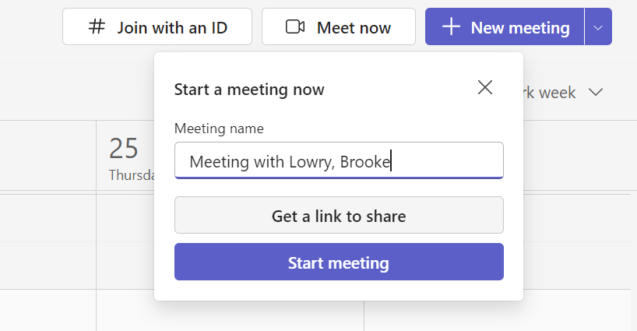
LCLM4002 Digital Skills
PATRYCJA MIKLAS ( 2426022 )
Digital Skills
Topic- How to create a new Teams meeting
Task 2 Poster
Introduction
The poster is based on topic- How to create a new Teams meeting. This guide will step user through the step of how to create a new meeting in Microsoft teams so that user can effectively schedule and manage the virtual meeting.
Step 4: Fill Meeting Details.- Once the meeting window comes up, begin to fill in the required information Title, Attendees, Start and End Time, Location (Blokdyk, 2021).
Step 5: Add Agenda or Details (Optional)- Under the timing, an option exists to add a description. Here is where user can add the meeting agenda, talking points or any instructions, which will assist the attendants to prepare.
Step 6: Recurrence (Optional)- In case user meeting is to occur on a certain frequency like once every week, then user can instruct it to recur. Microsoft Teams will make user choose between such options as daily, weekly, monthly, and even custom recurrence (Ilag, 2018).
Step 9: Join the Meeting
During the conference day, the members will be able to join the meeting after clicking the link on the calendar or email. Being the organiser, user will have an opportunity to press the 'Join' button when the meeting is about to start (Ilag, 2018).
Step 1: Open Microsoft Teams
To begin with, make sure that user have Microsoft Teams downloaded on user computer. It can be offered via either a mobile app, web-based platform or desktop application to sign in with user Microsoft 365 account (McFedries, 2022)
Step 2: Click on the Calendar.
After user are logged into Teams, the left sidebar will have an icon with the Calendar which user need to press. This brings about the calendar view where user can access user schedule, meetings, and any other events that user are involved with (Baker, 2020).
Step 3: Click on "New Meeting"
There is a button on the top right side of the calendar screen with the words New Meeting. When user click this it gives user and opportunity to enter details related to a meeting including title, people, and time (Miklas, 2025).
Conclusion
Microsoft Teams is a simple system through which one can easily create a meeting that he or she can learn with the appropriate digital capabilities. Effective organisation is one the most important factors that ensure facilitation of communication
Step 7: Select further Settings.
Here user would be able to add an additional customization to the meeting like adding a channel. User can also make user choice whether user will allow people to participate in the meeting before the host, to control meeting, and to record what is being said automatically (Blokdyk, 2021).
Step 8: Send the Invitation
Once the meeting details have been filled hit the Send button. This will also make invitations to the participants and they can join the meeting using the Microsoft Teams application or the web. They will also get the agenda, time and any other information user added to the meeting (McFedries, 2022).
References
Baker, Y. (2020). Microsoft Teams for Education: 2020 Beginner's Guide to Mastering Office 365 Microsoft Teams for Online Learning and Online Meetings. Independently published.
Blokdyk, G. (2021). Microsoft Teams A Complete Guide - 2019 Edition. 1st ed. 5STARCooks. Available at: https://www.ebay.com/itm/135182599269 [Accessed 23 Oct. 2025].
Ilag, B.N. (2018). Introducing Microsoft Teams: Understanding the New Chat-Based Workspace in Office 365. 1st ed. Apress. Available at: https://www.amazon.com/Introducing-Microsoft-Teams-Understanding-Chat-Based/dp/1484235665 [Accessed 23 Oct. 2025].
McFedries, P. (2022). Microsoft Teams Step by Step. 1st ed. Microsoft Press. Available at: https://www.microsoftpressstore.com/store/microsoft-teams-step-by-step-9780137522187 [Accessed 23 Oct. 2025].
Miklas, P. (2025). Digital Skills: How to create a new Teams meeting. University of Wales Trinity Saint David. Available at: https://www.amazon.com/Hands-Microsoft-Teams-enterprise-collaboration/dp/1839213981 [Accessed 23 Oct. 2025].
Notes:
PPT Notes
LCLM4002
Digital Skills
Task 2 Poster
Topic- How to create a new Teams meeting
Table of Contents
Introduction 3
How to create a new Teams meeting 4
Conclusion 6
References 7
Introduction
The poster is based on topic- How to create a new Teams meeting. This guide will step user through the step of how to create a new meeting in Microsoft teams so that user can effectively schedule and manage the virtual meeting.
How to create a new Teams meeting
Step 1: Open Microsoft Teams
To begin with, make sure that user have Microsoft Teams downloaded on user computer. It can be offered via either a mobile app, web-based platform or desktop application to sign in with user Microsoft 365 account (McFedries, 2022)
Step 2: Click on the Calendar.
After user are logged into Teams, the left sidebar will have an icon with the Calendar which user need to press. This brings about the calendar view where user can access user schedule, meetings, and any other events that user are involved with (Baker, 2020).
Step 3: Click on "New Meeting"
There is a button on the top right side of the calendar screen with the words New Meeting. When user click this it gives user and opportunity to enter details related to a meeting including title, people, and time (Miklas, 2025).
Step 4: Fill Meeting Details.
Once the meeting window comes up, begin to fill in the required information Title, Attendees, Start and End Time, Location (Blokdyk, 2021).
Step 5: Add Agenda or Details (Optional)
Under the timing, an option exists to add a description. Here is where user can add the meeting agenda, talking points or any instructions, which will assist the attendants to prepare. A meeting agenda must be useful in keeping the discussion on a track and make everyone well prepared.
Step 6: Recurrence (Optional)
In case user meeting is to occur on a certain frequency like once every week, then user can instruct it to recur. Microsoft Teams will make user choose between such options as daily, weekly, monthly, and even custom recurrence (Ilag, 2018).
Step 7: Select further Settings.
Here user would be able to add an additional customization to the meeting like adding a channel. User can also make user choice whether user will allow people to participate in the meeting before the host, to control meeting, and to record what is being said automatically (Blokdyk, 2021).
Step 8: Send the Invitation
Once the meeting details have been filled hit the Send button. This will also make invitations to the participants and they can join the meeting using the Microsoft Teams application or the web. They will also get the agenda, time and any other information user added to the meeting (McFedries, 2022).
Step 9: Join the Meeting
During the conference day, the members will be able to join the meeting after clicking the link on the calendar or email. Being the organiser, user will have an opportunity to press the 'Join' button when the meeting is about to start (Ilag, 2018).
Conclusion
Microsoft Teams is a simple system through which one can easily create a meeting that he or she can learn with the appropriate digital capabilities. Effective organisation is one the most important factors that ensure facilitation of communication
References
Baker, Y. (2020). Microsoft Teams for Education: 2020 Beginner's Guide to Mastering Office 365 Microsoft Teams for Online Learning and Online Meetings. Independently published.
Blokdyk, G. (2021). Microsoft Teams A Complete Guide - 2019 Edition. 1st ed. 5STARCooks. Available at: https://www.ebay.com/itm/135182599269 [Accessed 23 Oct. 2025].
Ilag, B.N. (2018). Introducing Microsoft Teams: Understanding the New Chat-Based Workspace in Office 365. 1st ed. Apress. Available at: https://www.amazon.com/Introducing-Microsoft-Teams-Understanding-Chat-Based/dp/1484235665 [Accessed 23 Oct. 2025].
McFedries, P. (2022). Microsoft Teams Step by Step. 1st ed. Microsoft Press. Available at: https://www.microsoftpressstore.com/store/microsoft-teams-step-by-step-9780137522187 [Accessed 23 Oct. 2025].
Miklas, P. (2025). Digital Skills: How to create a new Teams meeting. University of Wales Trinity Saint David. Available at: https://www.amazon.com/Hands-Microsoft-Teams-enterprise-collaboration/dp/1839213981 [Accessed 23 Oct. 2025].

