Slide 1

CRITICAL THINKING
Amanda White
2216955
ECGE4005P

Slide 2
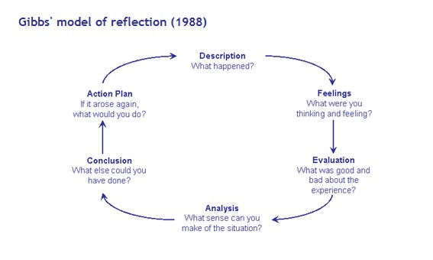
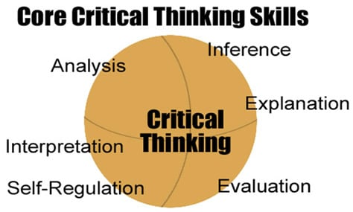
Amanda White 2216955 ECGE4005P
Reflection
Reflection is used to look back at your professional work/research, it allows you to look back and check, amend and have a deepen understanding of your learning.
(Cottrell, 2017 p.187)
Source: Gibbs Reflective Cycle, 1988)
Reflection is said to be easy in practice, its brings challenges when working with the information that you are reflecting on and your own experience. To ensure it supports your learning and with your academic work.
(Cottrell, 2017 p.187)
What is Critical Thinking
Introduction
As suggested by Cottrell S (2017 P1)
Critical thinking is a intellectual task, which gets people to use their knowledge. Learning to think in critically analytical and evaluative ways means using the brain in different ways such as attention, categorisation, selection and judgement.
According to (Cottrell, 2017 p.2)
Critical thinking gives you the tool to think and analyse you information is been given to you.
Critical thinking gets you to question ourselves which includes what is normal to be true. A statement that the world is round. How do we really know it is round. Challenging the facts around us and develop our understanding and enhance your personal knowledge of the world around us.
(Eales-Reynolds, et al. 2013)
Time-Management
Good time-management is important in Education and life because of the expectations for the ability to act on their beliefs and values through learning and personal responsibility and the level of challenge. Good management of time, emotions, attitudes, and life matter more as you progress through the course and moving forward. Self-efficacy is a broad concept; it involves such skills, qualities and attitudes .
(Cottrell, 2019 p.21)
Managing time is difficult as there are lots of aspects to consider, being a younger student their support from home has gone by moving away to study. A mature student has different responsibilities for example running a home and working.
Sticking to time management plan is important as gives you the motivation to stay focused and stay on track, it gives you time to relax and manage the other tasks you have to complete.
(Moore, et al. 2010 p.132,133)
Note-Taking
When taking notes it should provide the notes on the subject you are learning. Only take notes on the main topic not on related topics. Notes can be used in two ways supporting your learning at present and in the future.
When taking notes for the present and ongoing learning, make sure you keep them separate or give them different headings clearly labelled. After finishing the note taking it’s a good idea to read through to make sure you understand what you have written.
(Cottrell, 2017 p.135)
Note-taking is taking the main body and breaking it down into simpler form, that you have the correct information to work with. When the notes are in your own writing its easier to read and understand, only write the main points for you to remember. Using the notes you made will enable you to make the work your own.
(Cottrell, 2017 p.135)
Conclusion
To bring this poster to a close Critical Thinking is important in all areas of learning. It makes people think differently and consider other’s perspectives on the topic. My three areas has made myself think differently about learning and gaining new knowledge. They all work together to ensure that to get the most out of your learning. Critical thinking makes you think more deeply about evaluating and analysing your thoughts and of others.
Source: Maximusveritas

Slide 3

REFERENCE LIST
Cottrell, S. (2017) CRITICAL THINKING SKILLS: effective analysis, argument and reflection. 3rd edn. London: RED GLOBE PRESS.
Cottrell, S. (2017a) CRITICAL THINKING SKILLS: effective analysis, argument and reflection. 3rd edn. London: RED GLOBE PRESS.
Cottrell, S. (2017b) CRITICAL THINKING SKILLS: effective analysis, argument and reflection. 3rd edn. London: RED GLOBE PRESS.
Cottrell, S. (2017c) CRITICAL THINKING SKILLS: effective analysis, argument and reflection. 3rd edn. London: RED GLOBE PRESS.
Cottrell, S. (2019) THE STUDY SKILLS HANDBOOK. 5th edn. London: RED GLOBE PRESS.
Core Critical Thinking Skills: www.maximusvertas.com. [accessed on 15th September 2022]
Eales-Reynolds, et al. (2013) Critical Thinking Skills for Education Students. 2nd edn. Great Britain: MPG Printgroup, UK.
Gibbs Model of Reflection (1988) [image]. [accessed 12th September 2022)
Moore, S. et al. (2010) The Ultimate Study Skills Handbook: Open UP Study Skills. Glasgow: Bell and Bain Ltd.
Moore, S. et al. (2010a) The Ultimate Study Skills Handbook: Open UP Study Skills. Glasgow: Bell and Bain Ltd.
White, A. (2022) Timetable. [Photograph] (Amanda White’s own private collection).
White, A. (2022) Note Taking. [Photograph] (Amanda White’s own private collection).

