Slide 1
Study Skills-lecture
(MODULE CODE)
Chrissie Joy
c.joy@uwtsd.ac.uk

Slide 2

Aim for today
What is digital literacy?
What is cybercrime?
Different types of cybercrime
What threat does cybercrime pose?

Slide 3


Task....
Research to find out what is meant by the term digital literacy and why it is important to you as a student.

Slide 4

Digital literacy
Refers to the ability to find, evaluate, use, and create digital information and media effectively, efficiently, and responsibly.
Encompasses a range of skills and competencies required to navigate the digital world, which includes using various digital devices, platforms, applications, and online resources. Digital literacy goes beyond technical proficiency
involves critical thinking, ethical considerations, and the ability to adapt to new technologies as they emerge.

Slide 5

Key components of digital literacy
Basic Computer Skills: Proficiency in using computers, tablets, smartphones, and other digital devices. This includes knowledge of hardware, software, and operating systems.
Internet Skills: The ability to access and navigate the internet, search for information using search engines, and understand web addresses (URLs).
Information Evaluation: The skill to critically evaluate online information for accuracy, credibility, and relevance. This is especially important in an age of abundant and often unverified information.

Slide 6

Online Safety and Security: Knowledge of online threats, such as phishing scams and malware, and the ability to protect personal information while using the internet.
Privacy Awareness: Understanding how digital footprints are created and the importance of safeguarding personal information and privacy settings on social media platforms and websites.
Media Literacy: The capacity to analyse and interpret various forms of digital media, including images, videos, and audio content, while being aware of potential biases and misinformation.

Slide 7

Digital Communication: Effectively using digital tools for communication, including email, messaging apps, and social media, while adhering to proper etiquette.
Digital Citizenship: Understanding the ethical and legal responsibilities of using digital technology, including respecting copyright laws, practicing online respect, and contributing positively to digital communities.
Problem-Solving: Using digital tools to solve problems, complete tasks, and find solutions efficiently.
Adaptability: Being open to learning and adapting to new digital technologies and tools as they evolve.

Slide 8

Challenges and risks found in digital literacy
Misinformation and Fake News: As individuals access and share digital information, there's a risk of encountering misinformation, fake news, and biased content.
Privacy Concerns: Digital literacy includes understanding online privacy and security. Without proper knowledge, individuals might unknowingly share personal information online or fall victim to scams, phishing attacks, and identity theft.
Cyberbullying: In the age of digital communication and social media, cyberbullying can occur. Lack of digital literacy might lead to individuals being unaware of how to protect themselves from online harassment or how to respond appropriately.

Slide 9

Digital Divide: Not everyone has equal access to technology and the internet. Limited digital literacy skills can exacerbate the digital divide, where certain groups have less access to information, education, and opportunities.
Overreliance on Technology: Overemphasis on digital tools can lead to reduced face-to-face communication skills, a lack of critical thinking, and a dependence on technology for even basic tasks.
Echo Chambers and Polarization: Without critical digital literacy skills, individuals might confine themselves to online echo chambers, where they're exposed only to viewpoints that align with their beliefs. This can lead to polarization and a lack of understanding of diverse perspectives.

Slide 10
Online Harassment and Hate Speech: Individuals without strong digital literacy skills might inadvertently engage in or be victims of online harassment, hate speech, or offensive behaviour.
Intellectual Property Issues: Without understanding copyright laws and intellectual property rights, individuals might unknowingly violate copyright or licensing agreements when sharing or using digital content.
Digital Addiction: An inability to manage screen time and digital device use can lead to digital addiction, affecting mental and physical health

Slide 11
Types of cybercrime
Hacking: Unauthorised access to computer systems or networks to steal sensitive data, disrupt services, or plant malicious software.
Phishing: Sending deceptive emails, messages, or websites that appear legitimate to trick individuals into revealing personal information, such as passwords, credit card numbers, or login credentials.
Malware: Malicious software designed to infect computers or networks, including viruses, worms, trojan horses, ransomware, and spyware.
Identity Theft: Stealing personal information, such as social security numbers or credit card details, to commit fraud or other criminal activities.

Slide 12
Cyberbullying: Using digital platforms to harass, threaten, or intimidate individuals through messages, social media, or other online means.
Online Fraud: Engaging in fraudulent activities, such as online auctions scams, investment schemes, or pyramid schemes to deceive victims into giving away money or valuable assets.
Data Breaches: Unauthorized access to sensitive data held by organizations, resulting in the exposure of customer information, employee records, or other confidential data.
Distributed Denial of Service (DDoS) Attacks: Overwhelming a computer system or network with a flood of traffic to make it unavailable to users, disrupting services or causing financial harm.

Slide 13

Cyber Espionage: Stealing sensitive information or trade secrets from individuals, organisations, or governments for espionage or economic gain.
Ransomware: Encrypting a victim's data and demanding payment (usually in cryptocurrency) in exchange for the decryption key to restore access.
Cyberstalking: Repeatedly using digital communication tools to stalk or harass someone, causing emotional distress and fear.
Child Exploitation: Producing, distributing, or accessing explicit content involving minors, often through illegal means like child pornography.

Slide 14

Task....15 mins
Research into the "Wannacry" event and note the following:-
What was it?
What was the impact?
How did it happen?
What measures have been put in place to stop it happening again?
Wannacry documentary:-WANNACRY: The World's Largest Ransomware Attack (Documentary) - YouTube

Slide 15

What do the statistics say?

Slide 16
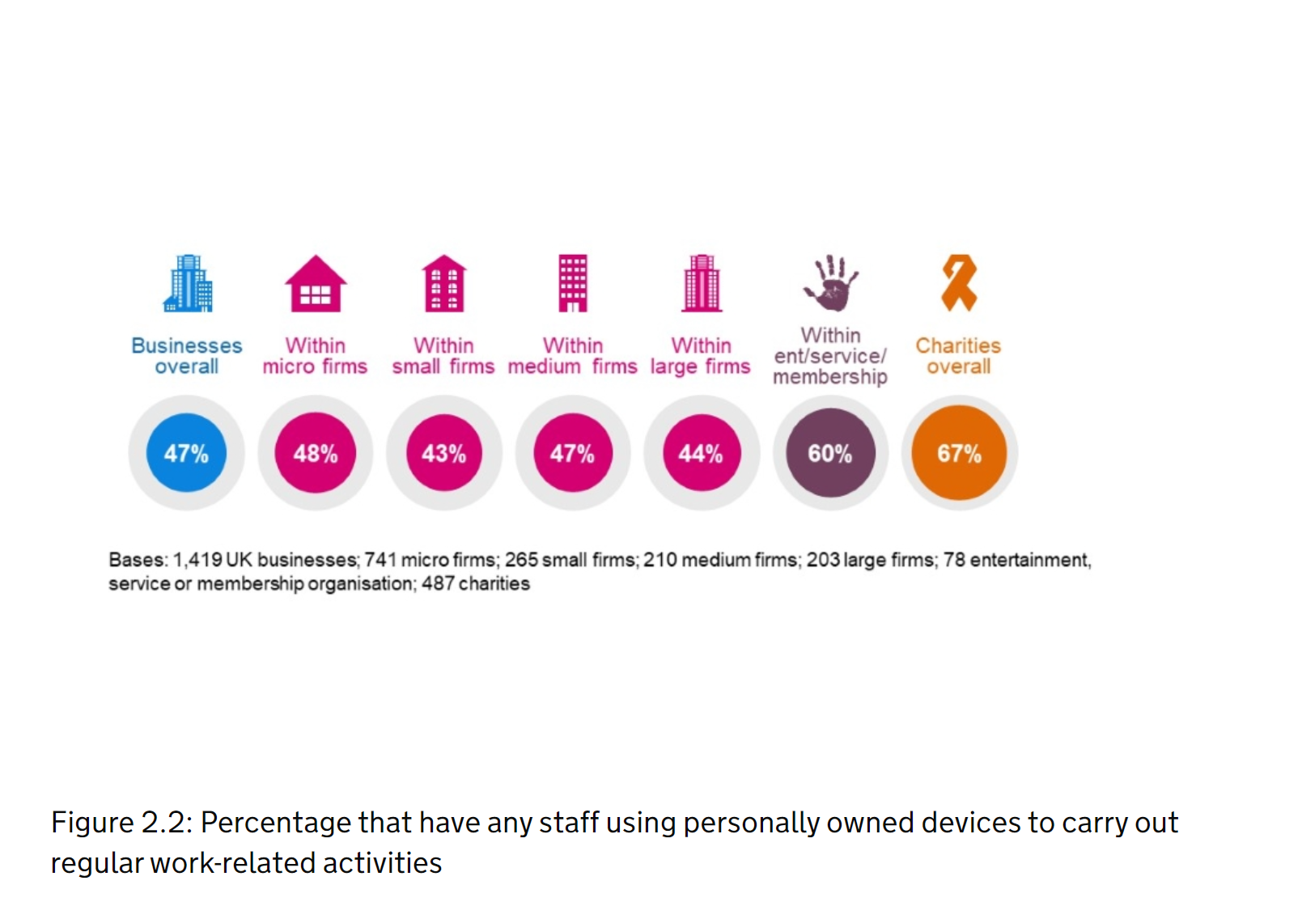
Percentage that have staff using personally owned devices to carry out regular work -related activities
(Department for digital, culture, media and sport, 2021)

Slide 17
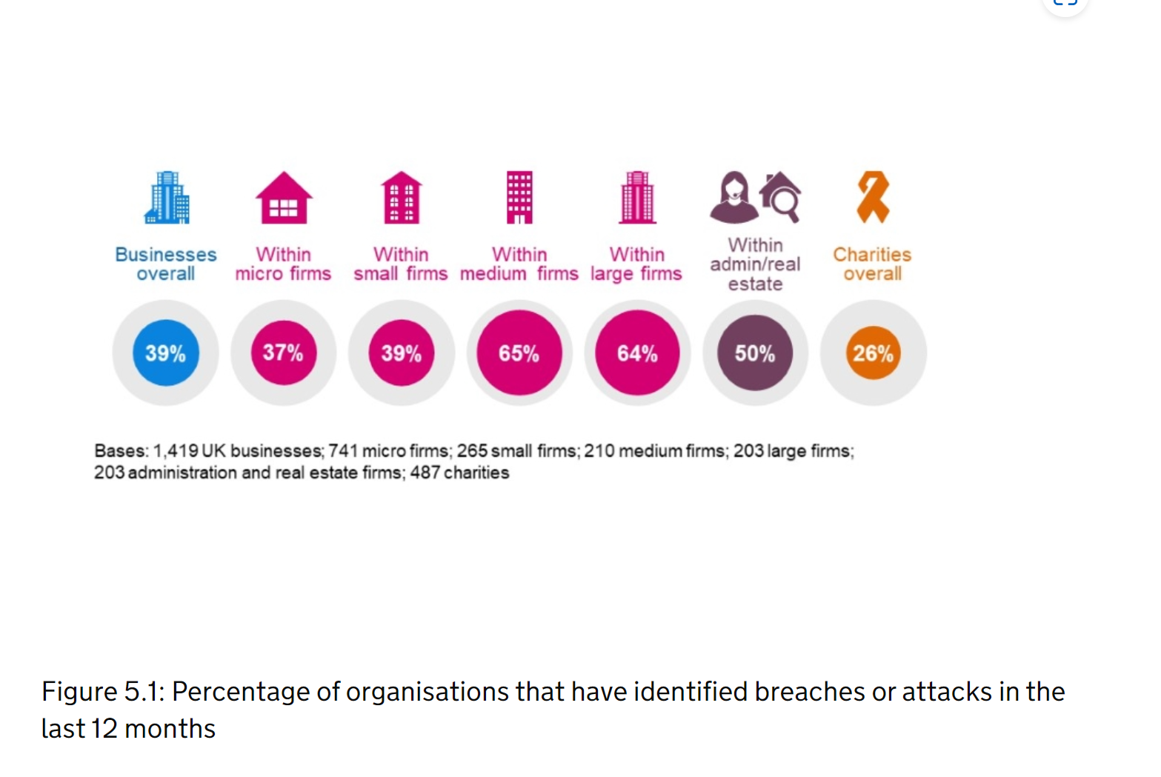
Percentage of organisation's that have identified breaches or attacks in the last 12 months
(Department for digital, culture, media and sport, 2021)

Slide 18

Task...
Research into how cybercrime may impact your chosen discipline. Consider the following:-
How does it impact the functionality of your chosen discipline area?
What threats does it pose to your chosen discipline area?
What is being done to limit threats?

Slide 19

Next session...workshop
The impacts of cybercrime
Tasks
What is a Vlog?

