Slide 1

Importance of employee Engagement Within The Hotel Industry
Student Name: Annisa Sathi
Student Number: 2119261
Module Code: BMIH4006
Module Title: Operating Hotel Facilities
Placement Tutor: Ffion Cumberpatch

Slide 2
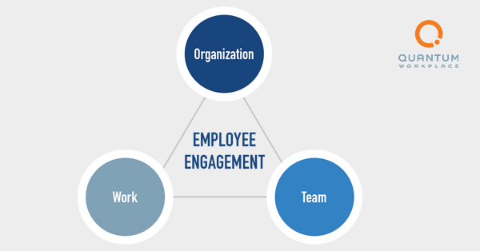
Introduction To Employee Engagement
Definition
A human resources idea that designates the side by side of interest and enthusiasm an employee senses in their profession is called employee engagement (Smith, 2022).
Employee engagement is the power of the psychological and sensitive construction that employees feel concerning their job, colleagues, and the company they work for (Ryba, 2021).

Slide 3
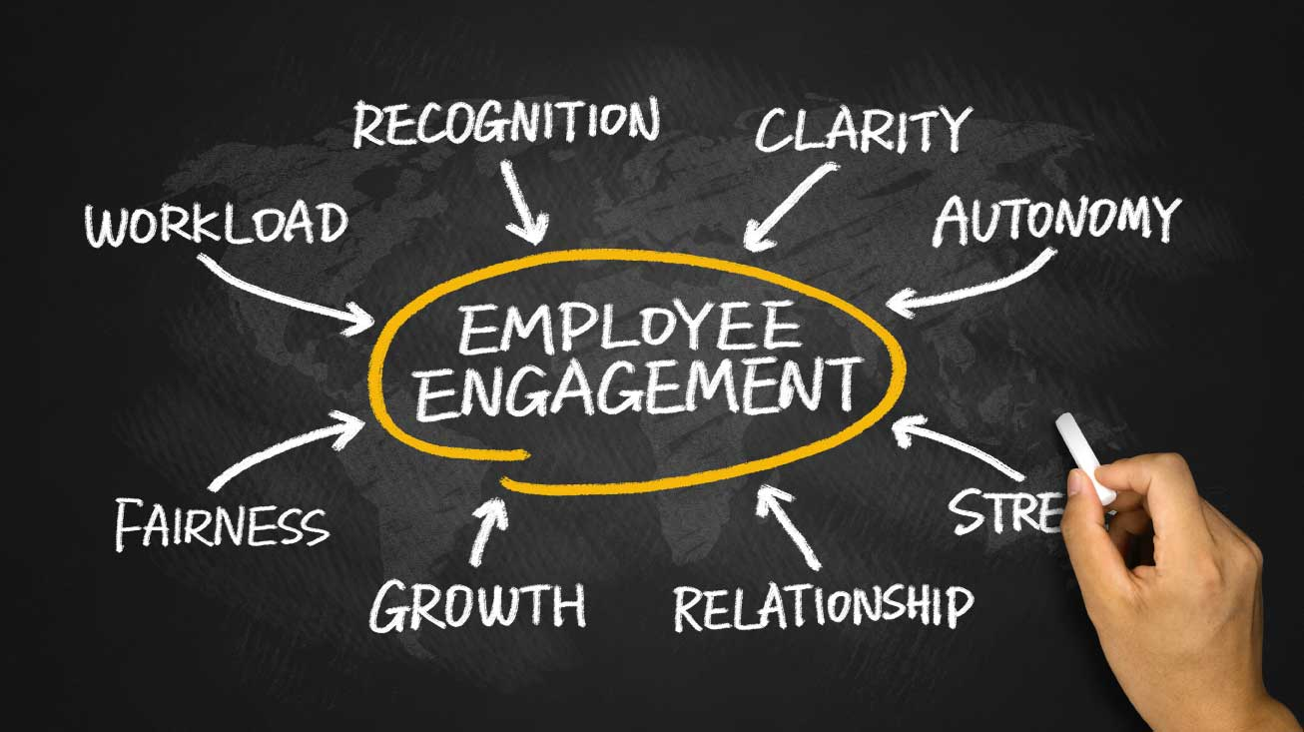
Importance of Employee Engagement
Employee engagement is the biggest core philosophy of structural victory. It nurtures a cheerier team, rises efficiency, and ultimately lifts productivity.
It expands profitability
It inspires teamwork
It shapes faith and interactions
It advances worker welfare
It generates career accomplishment
It promotes organizational philosophy
It decreases staff turnover
It progresses aptitude achievement
It appeals to and holds clients
It constructs accomplishment (Stephanou,2020).

Slide 4
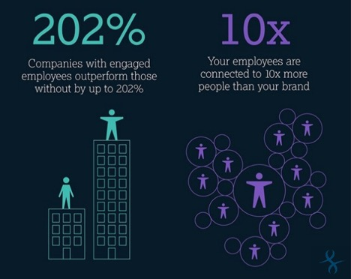
Why organizations should care about employee engagement
Corporations have known the significance of worker assignation to the upshot for decades: occupied teams are more creative, lucrative, advanced, and obviously trustworthy. Holding alone can protect up to double the yearly wage.
Gallup accounts for just 13% of staff international and around 30% in the US are betrothed. It’s unusual but it’s value chasing. Those corporations with involved employees outdone their aristocracies by 147% in salaries per stake (Spillane, 2017).

Slide 5
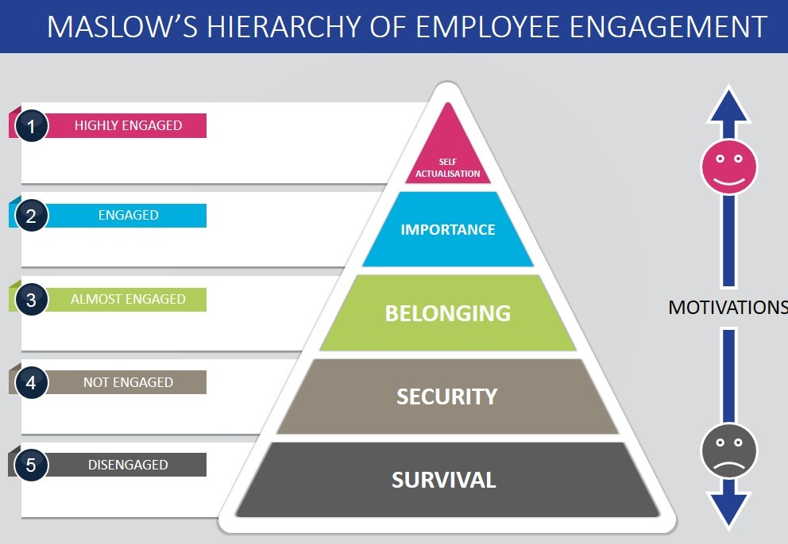
Employee Engagement Theories And Models
There are plentiful theories and models and loads are proven successful for employee engagement. Maslow, Kahn, and AON-Hewitt are among the most common employee engagement frameworks.
Maslow’s model
The theory defines that deprived of sustaining corporal, security, communal, honor, and self-actualization desires one can’t be entirely involved or glad in their job (Thompson, 2021).

Slide 6
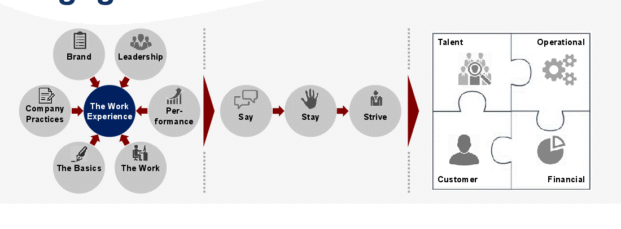
The Kahn Model
Kahn believed that winning persons through all three extents (physical, mental and emotional) would aid them a sense of security in their work, feel that their hard work is valued, and trust that they would be held in their corporeal and psychological labors (Sinclair, 2021).
The AON Hewitt model
This model pushes employee engagement a stage extra by clearly structuring this linking into their model over the idea of engagement results (Pellikaan, 2021).

Slide 7
General Employee Engagement Statistics
The subsequent information provides which share of the staff can be considered as extremely engaged, engaged, and disengaged.
Minimum 33% of the US staff, are measured engaged.
51% of gender factions can be called engaged.
Employees with fixed wages are 10% more engaged than hourly workers.
31.3% of staff pretends engaged, but their company can profit further by refining worker involvement.
51% of the US staff can be measured as engaged corporate entities.
20.8% of workers consider themselves highly involved.
16.3% consider themselves as completely detached while employed.
58% of workers are happy with their management while 26% feel unbiassed, and 14% are hopeless (Zuckerman, 2020).

Slide 8
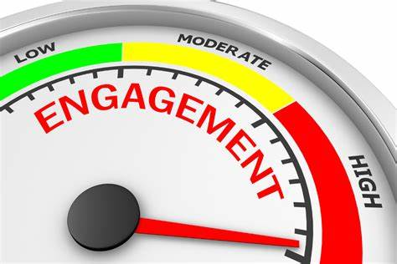
According to The 2021 Employee Experience Imperative Analyst Report by Servicenow…
Only 53% of staff agree that their company helps them cope with the stress of being employed distantly.
63% of accused show a liking to some quantity of distant job, though 15% prefer stable distant job circumstances.
62% of workers approve COVID-19 will have a substantial effect on their job involvement for ages to derive (surrounded by office staff working distantly, this rate is as in elevation as 72%) (ServiceNow, 2022).

Slide 9
Some Best Practices Of Employee Engagement
Stimulating group with significant job
Enunciating worker and business purposes
Emerging personal influences on staffs
Enlightening assortment of assumptions
Adjusting to the times
Construction on member assets
Generating an exposed and authentic feedback circle
Manufacture engagement an constant method
Inspection in next the two-year streak
Teaching supervisors to manage persons
Inspiring proficient growth
Make staffs liberty to experimentation
Design team construction events
Installing a healthiness and well-being platform
Rewarding achievements
Generating an ethos of compassion
Leading withdrawal consultations
(Chen, 2022).

Slide 10
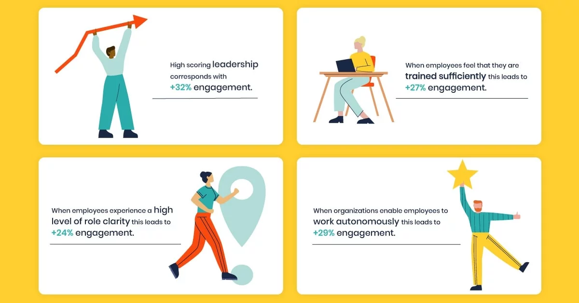
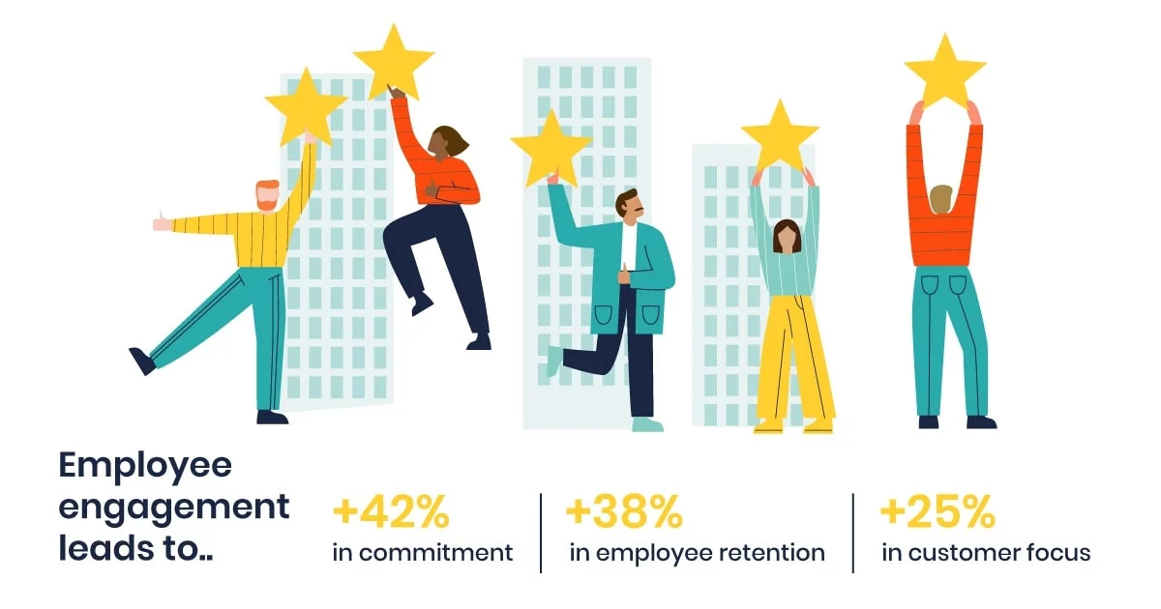
Employee engagement happens when staffs sense that their effort is encouraging and gratifying. They feel honored, encouraged by, and keenly involved with their job. They also sensation that their managers hear and care for them (Pellikaan, 2021).

Slide 11
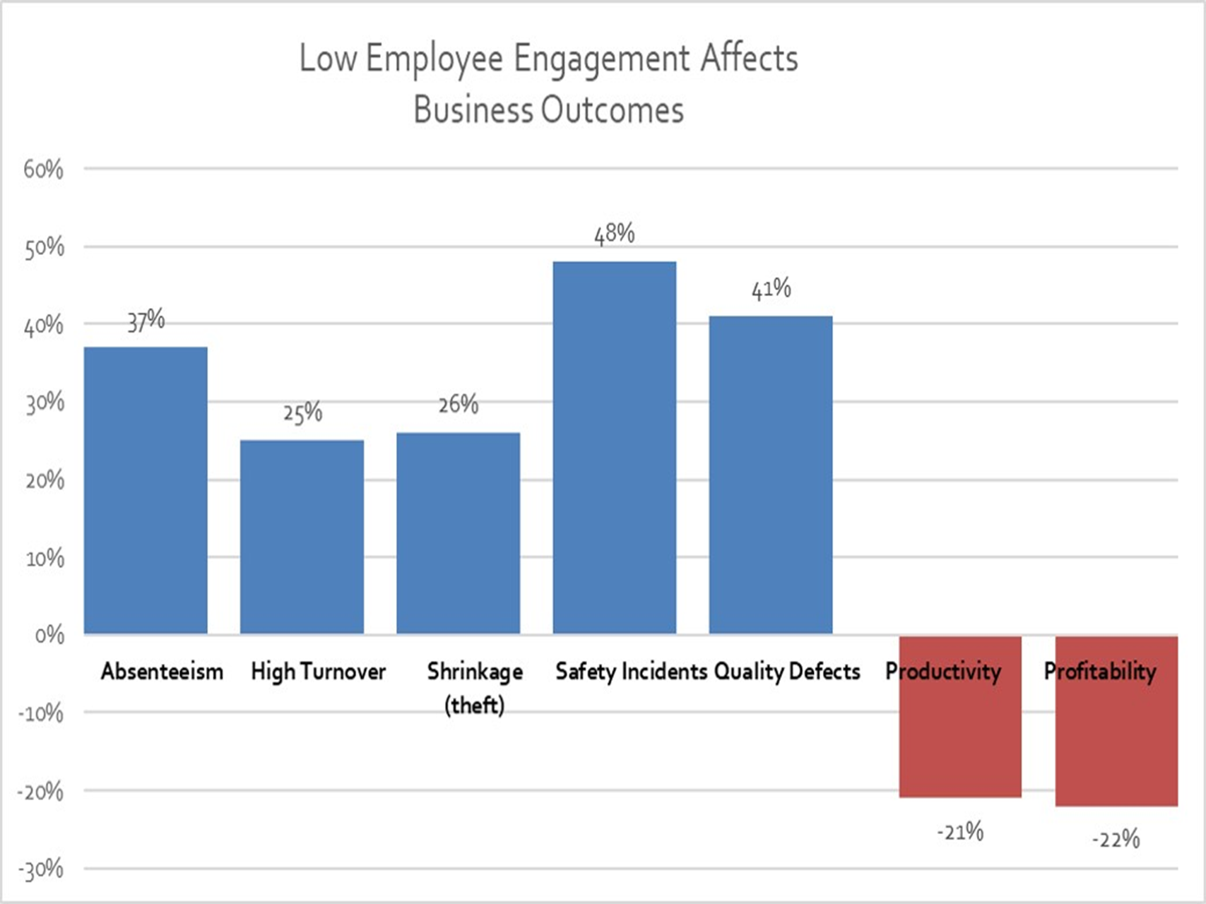
Impacts of Poor Employee Engagement
Employee engagement eventually affects a business’s foundation. Gallup Teams shows that being highly engaged brings a 10% increase in customer ratings and performs 20% better in achieving sales results. Moreover, 21% greater profitability will never be able to achieve with poor engagement (Smedley, 2021).
Recent Gallup study also established that 70% of U.S. staff are not engaged in their job and 70% of persons mention bad administrators as the coz; causing in a yearly smash to the U.S. economy of $398 billion. Businesses in the lowest quartile for engagement articles 25% upper revenue, 28% extra holdups, 41% extra security events, and 22% lesser returns (Bringelson, 2020).

Slide 12

How To Improve Employee Engagement
Effective Communication
Management Supervision
Have A People-First Philosophy
Attention On Work-life Equilibrium
Generate Honesty
Concentration On Structural Development
Finance In Training Administrators (Martin, 2021).

Slide 13
Conclusion
Employee engagement has been reflected as part of the administration concept since the 1990s and developed broadly accepted in the 2000s. Though it has its critics, typically built on exactly how hard it can be to quantity, it has been initiated to have straight relations to a business's productivity and economic strength (Smith, 2022).
The most treasured resource industry can have is its persons. Employee engagement matters so much for that reason. Retain them gratified and advanced their happiness on a constant basis, and will be assured cheerier employees and prosperous industry in the future (Stephanou,2020).
Employee engagement is essential for a creative, joyful workstation. When a corporation arranges engagement plans and possesses the team loyal and occupied by their role then the business will flourish (Chen, 2022).

Slide 14
Reference List
Bringelson, D. (2020) The hidden crisis hitting companies across the Globe, Home -. Available at: https://deberahbringelson.com/the-hidden-crisis-hitting-companies-across-the-globe/ (Accessed: December 1, 2022).
Chen, J. (2022) 18 employee engagement best practices in 2022, teambuilding.com. Available at: https://teambuilding.com/blog/employee-engagement-best-practices (Accessed: December 1, 2022).
Martin, L.M. (2021) Correlation between employee engagement and productivity, Biz 3.0. Available at: https://biz30.timedoctor.com/correlation-between-employee-engagement-and-productivity/ (Accessed: December 1, 2022).
Pellikaan, M. (2021) Five employee engagement models, Effectory. Available at: https://www.effectory.com/knowledge/five-employee-engagement-models/ (Accessed: December 1, 2022).
Pellikaan, M. (2021) The 4 drivers of employee engagement in 2021, Effectory. Available at: https://www.effectory.com/knowledge/the-4-drivers-of-employee-engagement-in-2021/ (Accessed: December 1, 2022).

Slide 15
Ryba, K. (2021) The Qwork Future: A future of work blog from Quantum Workplace, quantumworkplace.com. Available at: https://www.quantumworkplace.com/future-of-work (Accessed: December 1, 2022).
ServiceNow (2022) The 2021 employee experience imperative. Available at: https://www.servicenow.com/lpayr/employee-experience-survey.html? (Accessed: December 1, 2022).
Sinclair, S. (2021) Kahn's 3 dimensions of employee engagement: Still good to go in 2021?, Employee Engagement App. Talk Freely Limited. Available at: https://www.talkfreely.com/blog/dimensions-of-employee-engagement (Accessed: December 1, 2022).
Smedley, M. (2021) Signs of low employee engagement, DDI. Available at: https://www.ddiworld.com/blog/signs-of-low-employee-engagement (Accessed: December 1, 2022).
Smith, T. (2022) What is employee engagement? definition, strategies, and example, Investopedia. Investopedia. Available at: https://www.investopedia.com/terms/e/employee-engagement.asp (Accessed: December 1, 2022).

Slide 16
Spillane, J. (2017) Remote workforce NPS: The most important metric you're missing, Business 2 Community. Available at: https://www.business2community.com/business-innovation/remote-workforce-nps-important-metric-youre-missing-01785305 (Accessed: December 1, 2022).
Stephanou, A. (2020) 10 reasons why employee engagement is important, CareerAddict. Available at: https://www.careeraddict.com/importance-employee-engagement (Accessed: December 1, 2022).
Thompson, M. (2021) Employee engagement models and theories, WeThrive. Available at: https://wethrive.net/employee-engagement/employee-engagement-models-and-theories/ (Accessed: December 1, 2022).
Zuckerman, A. (2020) 42 employee engagement statistics: 2020/2021 data, Trends & Effects, CompareCamp.com. Available at: https://comparecamp.com/employee-engagement-statistics/ (Accessed: December 1, 2022).

