Slide 1
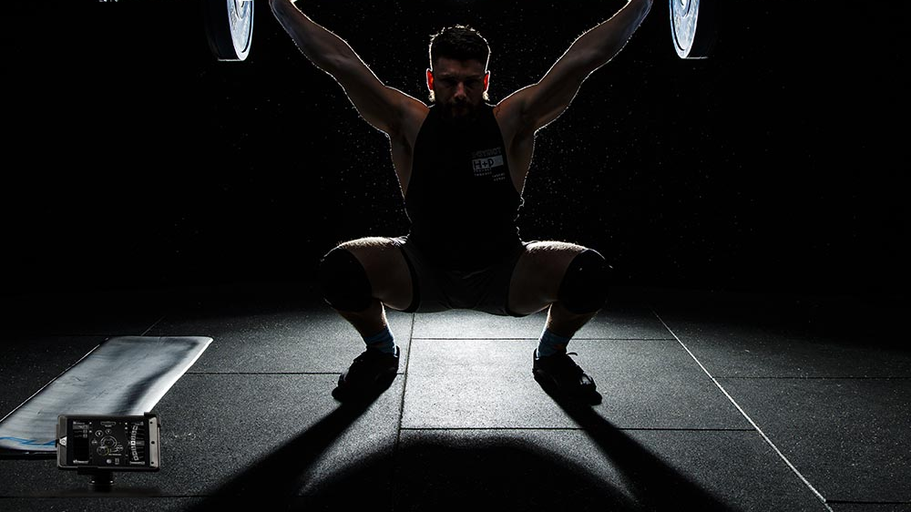
Velocity based training
Michael Sandford Student No: 2007341

Slide 2
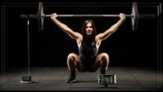
VBT - Gymaware
Measure the velocity of a barbell or person moving during exercise.
Record reps and speed.
Measure – strength, speed, power.
Mean velocity (MV) provides more valuable information compared to peak velocity for S&C coaches (Weakley et al., 2021).
Portable linear position transducer (Gymaware, 2021).
“Basically a stopwatch and tape measure in one” (Mann, 2021).
In order to control intensity in high-performance sports, it is crucial to correctly monitor velocity (Menrad & Edelmann-Nusser, 2021).
Gymaware (2021)
Notes:
Say this first then slides info - We’ll focus on Gymaware as this is the equipment I used with my participant,
It is a contemporary method of resistance training.

Slide 3
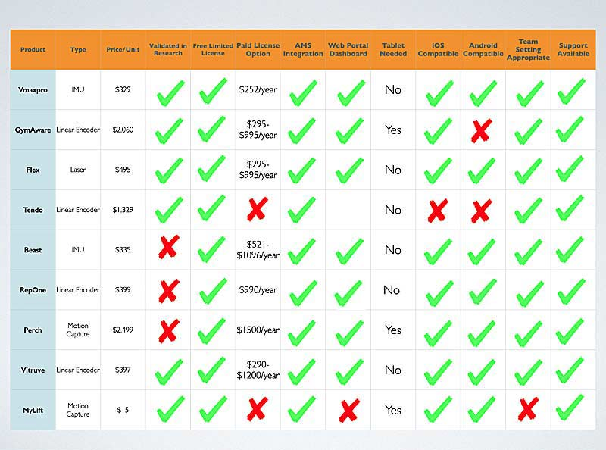
VBT Monitoring Systems as of 2021
(SimpliFaster, 2018)
Notes:
Here we can see that there is a large range of VBT equipment on the market with a range a prices. Gymaware is quite expensive.

Slide 4
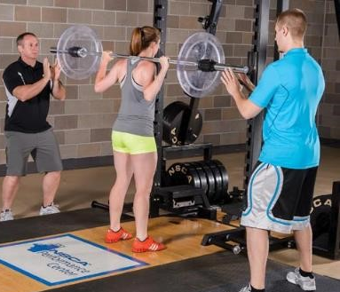
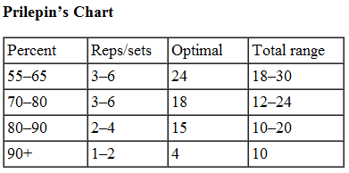
1 rep max testing
One the most widely used tests to determine strength capacity (Garcia-Ramos & Jaric, 2018).
Traditional % programmes – Prilepin’s chart (Hales, 2011).
1RM test can cause injury, especially to novices (Jovanović & Flanagan, 2014) .
1RM testing is time-consuming particularly for large groups (González-Badillo & Sánchez-Medina, 2010).
1RM can change quickly with training so can be inaccurate very quickly (González-Badillo & Sánchez-Medina, 2010; Zourdos et al., 2015; Pereira & Gomes, 2003; Helms et al., 2017; Grgic et al., 2020).
(Parker, 2019)
(precisionpowerlifting, 2020)
Notes:
Say first - Traditionally, weight training loads have been calculated from percentages of an athletes 1rep max.

Slide 5
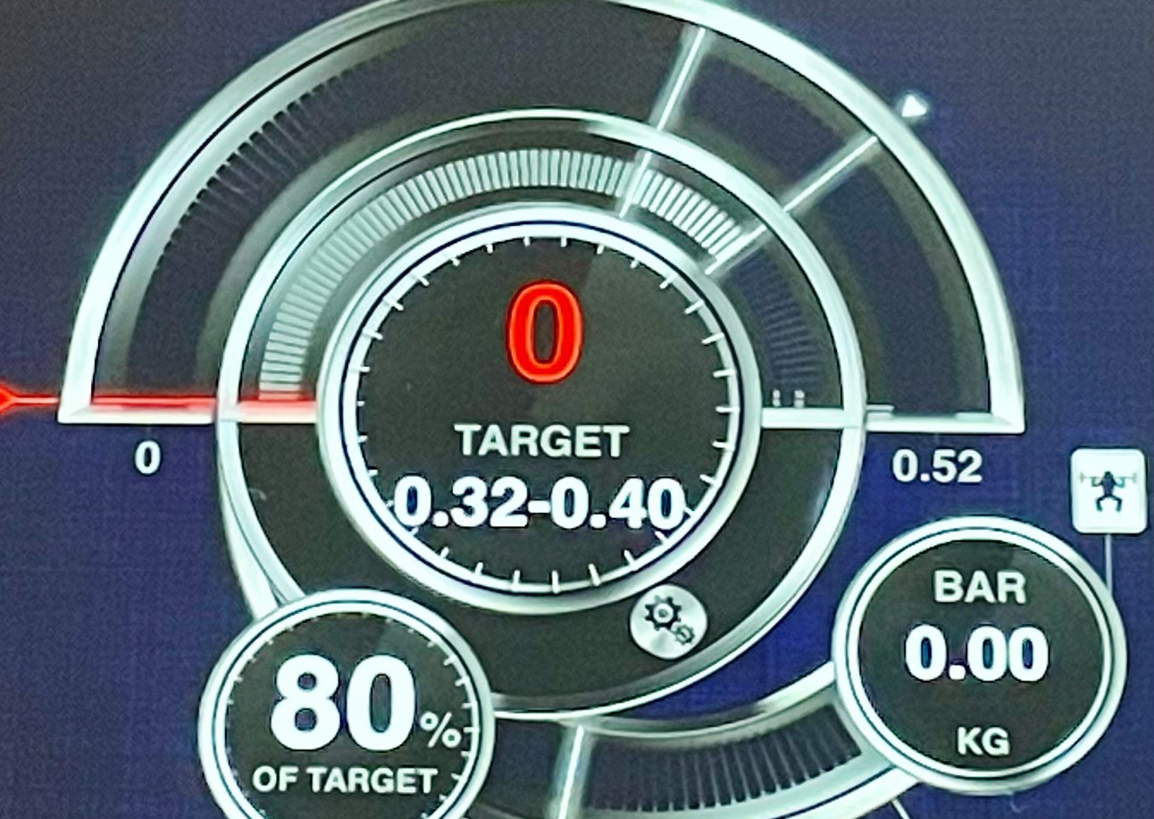
Fatigue control
Daily fluctuations in training readiness causes – nutrition, sleep, hormonal changes and stress (Zourdos et al., 2015; Pereira & Gomes, 2003; Helms et al., 2017).
Gymaware Provides real-time daily readiness feedback (Harris et al, 2010; Orange et al., 2020)
Monitor work in intended velocity zone- speed, power, strength.
Work smarter not harder.
Notes:
Work smarter not harder - for example, if we’re training speed strength and we fatigue, at some point barbell velocity will drop and we’re no longer working in our desired zone, The VBT equipment will alert us to this allowing us to work smarter. We’ll go through the velocity zones in just a second.

Slide 6
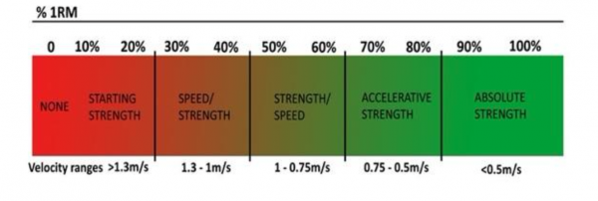
Velocity Zones
(Mash & Mann, 2020)
(Mash & Mann, 2020)
Notes:
This is critical because it allows for a more detailed, specific, effective training programme.
Some people will perform differently in each zone despite achieving the same 1 rep max
Also different sports requires different ranges - for example – a prop in rugby would need to focus on strength/speed more compared to that of a winger who may place emphasis on the speed/strength zone. VBT allows us to monitor this more accurately.

Slide 7
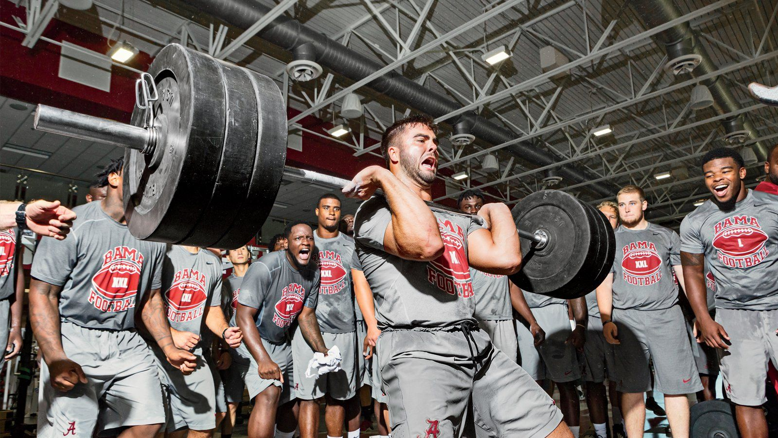
Team and group applications
Time efficient.
Different training goals.
Encourages competition.
Accounts for individual differences in velocity zones.
The coach can react in real-time.
(Mann, 2021; Caven et al., 2020; Orange et al., 2020; Ruf, Cherry and Taylor, 2018)
Notes:
The coach can react in real-time – And allow them to see if their athlete is under performing and should scale back their training for that day or whether they’re having a particularly good day and should perhaps train with a heavier load.

Slide 8
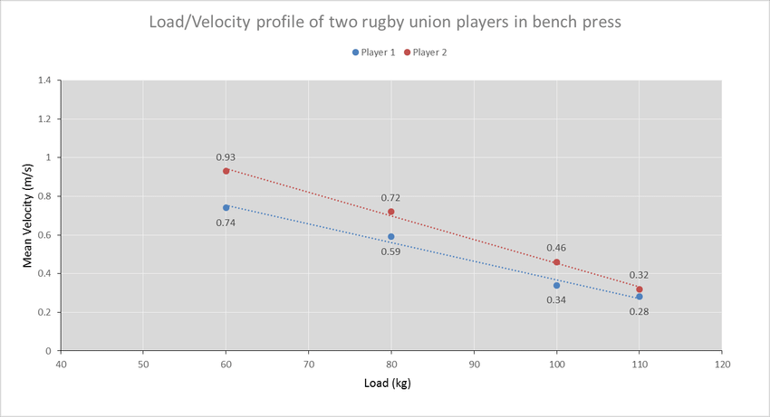
Benefit of a load velocity profile
(Jovanović & Flanagan, 2014).
Notes:
Both rugby union players with the same position have the same 1RM bench press.
Player 2 exhibits stronger velocity characteristics at submaximal loads than Player 1, which may transfer to athletic performance. You can't observe this with traditional percentage training. A load/velocity profile can assist athletes choose the correct velocity zone and coaches can track an athlete's profile to see how training impacts specific adaptations and if the program is improving adaption across the whole profile.

Slide 9
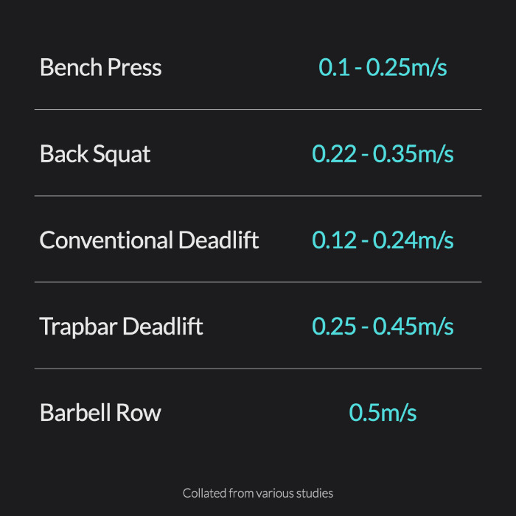
Minimum velocity threshold (MVT)
Speed of the last repetition of a set done to failure (Haff et al., 2020).
Smith machine back squat is between 0.31–0.32 m/s (Izquierdo et al., 2006).
We can see how close to failure the athlete is (Haff et al., 2020).
(www.vbtcoach.com, 2021)
Notes:
SAY FIRST - The minimal velocity threshold is the speed of the last repetition of a set done to failure, no matter how much weight is being used. MVT is different for each exercise and stays the same even when 1RM changes over time. – here we can see the different exercises.
The velocity at which failure occurs in the Smith machine back squat is suggested by Izquierdo et al., to between 0.31–0.32 m/s.
this means that by keeping track of the speed of the repetitions during the set, we can estimate how close the athlete is to failure and how hard they are working for a given set, no matter the weight used.

Slide 10
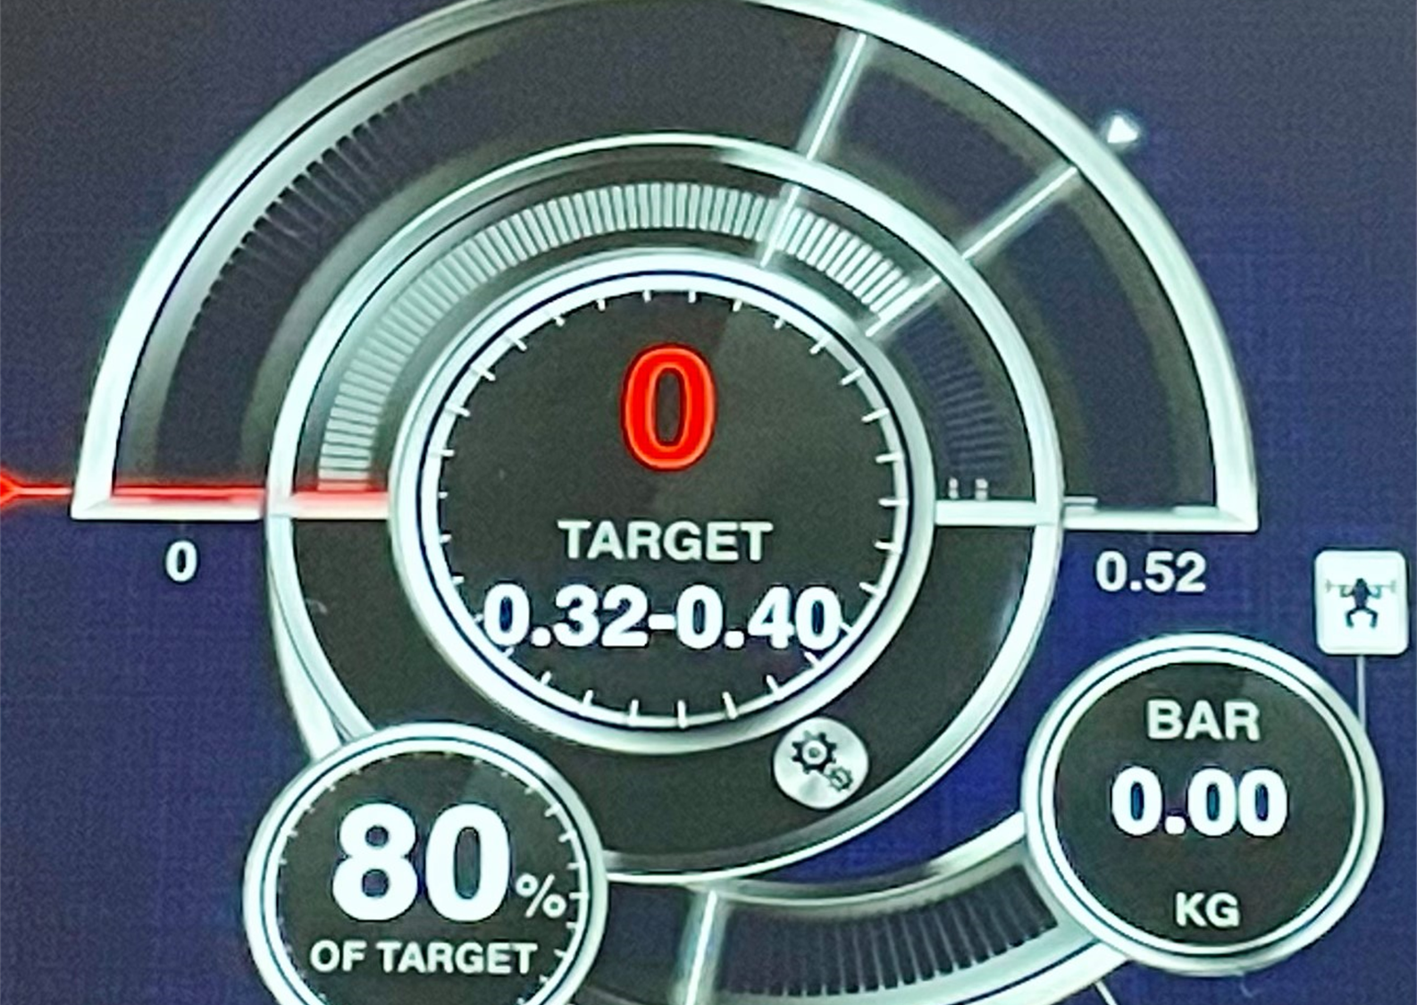
Velocity loss threshold
Quality over quantity of work.
Used to determined the end of the working set and end of the overall session (www.youtube.com, 2021)
Notes:
Velocity loss thresholds can be used to improve output quality and decrease the effect of fatigue. A study by Weakley et al., (2020) showed that velocity loss thresholds can be used to sustain velocity and power outputs during resistance training.
This was used to determined the end of the overall session if the first 2 reps of the following set did not meet the velocity threshold as suggested in research by Bryan Mann.

Slide 11
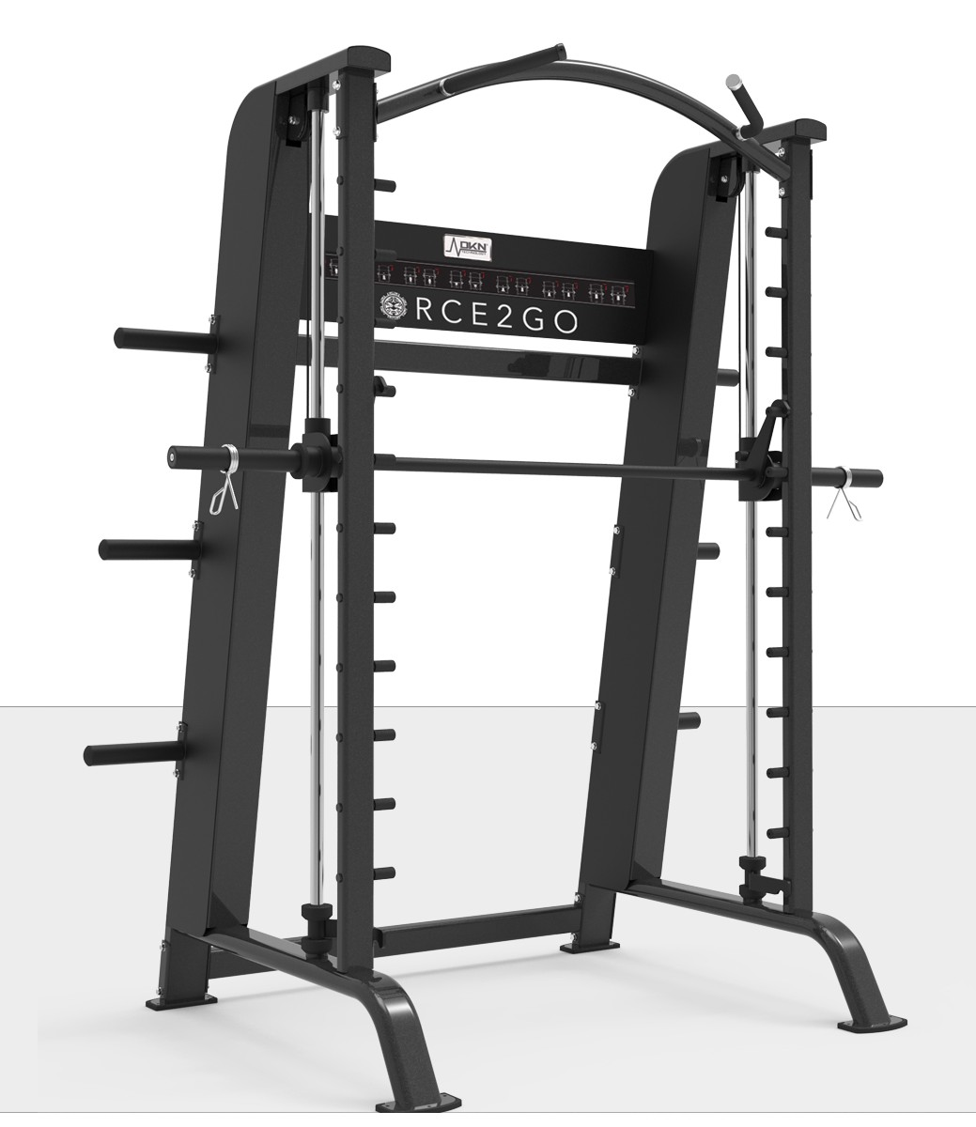
Smith Machine
Accurate
Reliable linear movements
Stability
Increase the reliability and accuracy
(Perez-Castilla et al., 2022; Conceição et al., 2016; García-Ramos et al., 2018; Jidovtseff et al., 2011; Loturco et al., 2015; Sánchez-Medina et al., 2017).
(DKN Technology, 2022).
Notes:
The use of a smith machine was employed as previous research has suggested it may increase the accuracy and reliability of the linear movements and velocity outputs. Offers stability when employing maximum concentric contraction.

Slide 12
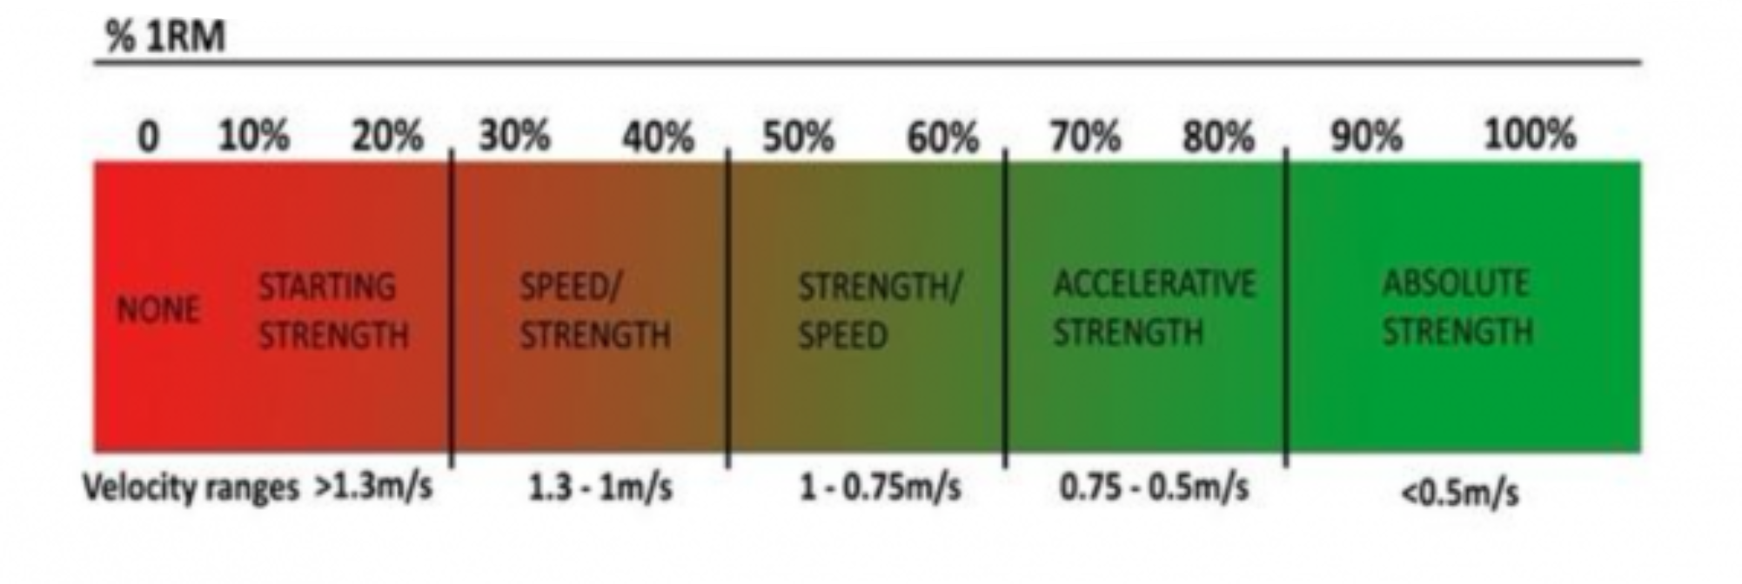
Rationale
VBT can be used to improve absolute strength (Liao et al., 2021; Zhang et al., 2022; Wadhi et al., 2018)
Mean concentric Velocity 0.35–0.15 m/s. (Fahs et al., 2019).
Włodarczyk et al., (2021) systematic review - velocity losses of 10–20% can help trigger neuromuscular adaptations and reduce neuromuscular fatigue.
(Mash & Mann, 2020)
Notes:
Based on this research, I set the velocity limit of 0.4 m/s, allowing a 20% Velocity loss threshold, making sure the 0.32-0.40 m/s range, was well within the absolute strength velocity zone.
Larger velocity loss thresholds such as 30 and 40% have been associated more hypertrophy adaptations (Pareja‐Blanco et al., 2017).

Slide 13
Participant profile
Goal – improve lower body strength focusing on squat movement using the Smith machine.
Age -41 yr old female
Weight- 63kg
Height - 1.67m
BMI – 22.6 (normal)
Moderately active
Dog walker – 30 – 45min LISS ED. 9000 step daily average
Resistance training 2x per week (upper and lower body, previously hypertrophy focused, compounds, Olympic lifts)
PAR-Q, consent to take part

Slide 14
Participant training schedule summary
MONDAY | TUESDAY | WEDNESDAY | THURSDAY | FRIDAY | SATURDAY | SUNDAY
 |  | 25.01.2023 Smith machine(SM) Back squat (BS) – 47.5kg 3RM |  |  | 28.01.2023 Upper & SM BS
 | 31.01.2023 Lower & SM BS |  |  | 03.02.2023 Upper & SM BS
06.02.2023 Lower & SM BS |  |  | 09.02.2013 Upper & SM BS
13.02.2023 Lower & SM BS |  |  | 16.02.2023 Upper & SM BS
20.02.2023 SM BS Re-test 3RM – 57.5kg
Notes:
We aimed to program at least 48 hours between sessions to allow for adequate recovery as per ACSM guidelines (ACSM, 2017) and other research (Paz et al., 2021).
Yellow blocks are the test, re-test days.

Slide 15
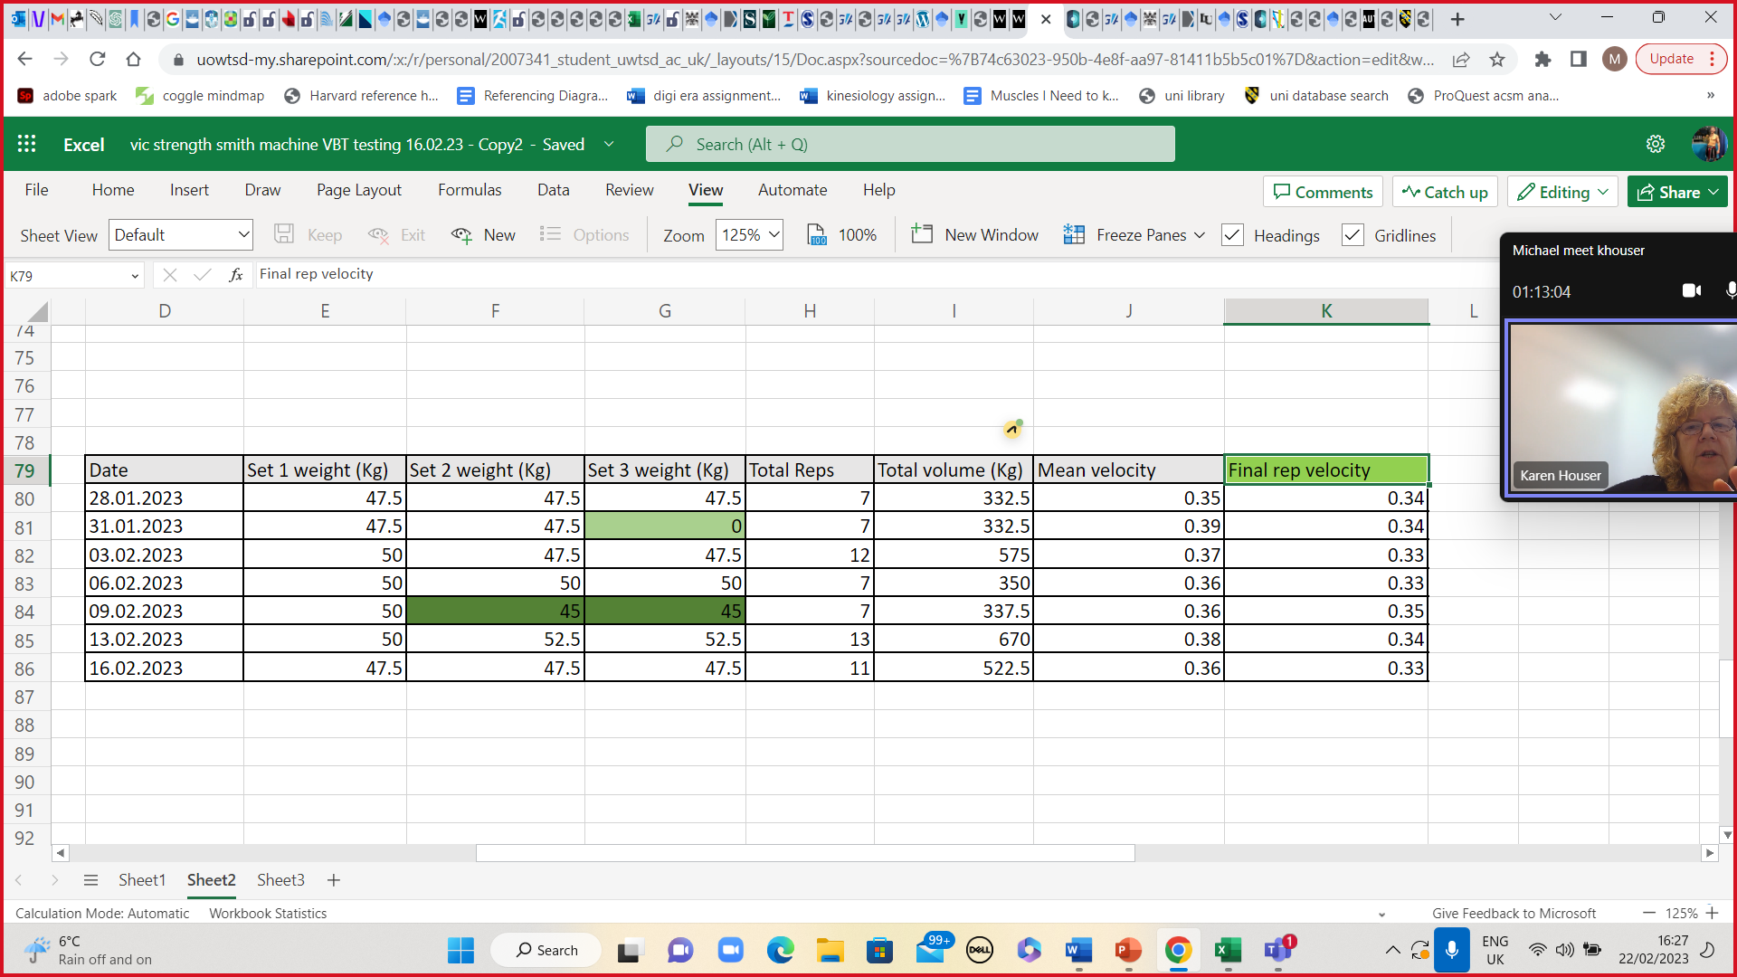
Results table
Notes:
Point out green blocks- 45 - real time feedback of daily readiness to train.
0 – We ended the session at the end of set 2 as she wasn’t hitting the required velocity zone, using traditional % training we may not have recognized this.
Final rep – Similar results to that of Izquierdo et al., 2006.

Slide 16
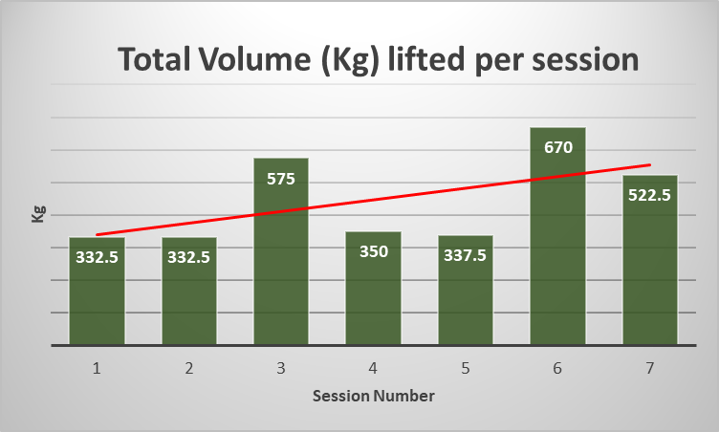
Notes:
Here we can see

Slide 17
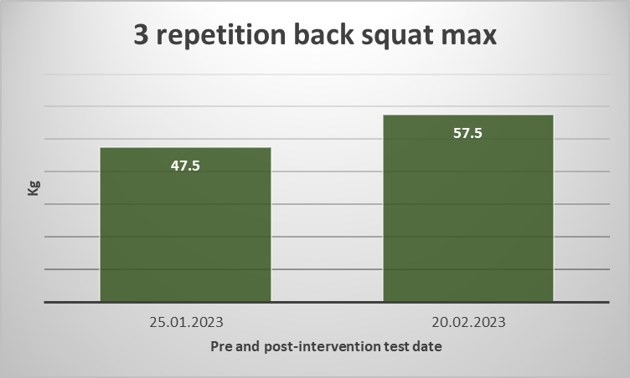
Pre intervention test & re-test

Slide 18

Anecdotal Verbal feedback from participant
“I placed pressure on myself to do my best for every rep”
“Great to see the progression and speed immediately, I looked forward to it.”
“The feedback told me I could do more even though I felt I was done.”
“I looked forward to seeing my results after each set”.
“Great motivator to push you.”
“I can’t slack off as much as I would like to.”
Notes:
From a coaching perspective the last point is interesting as we would be able to monitor closely an athlete’s performance.

Slide 19
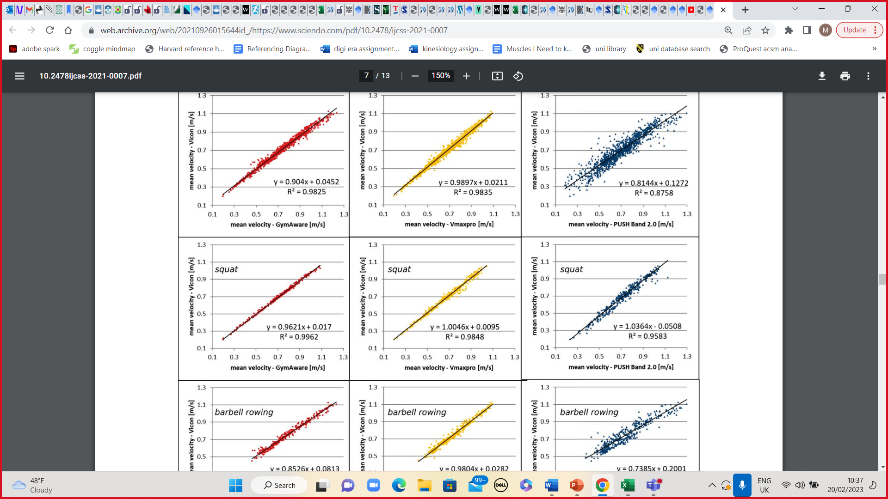
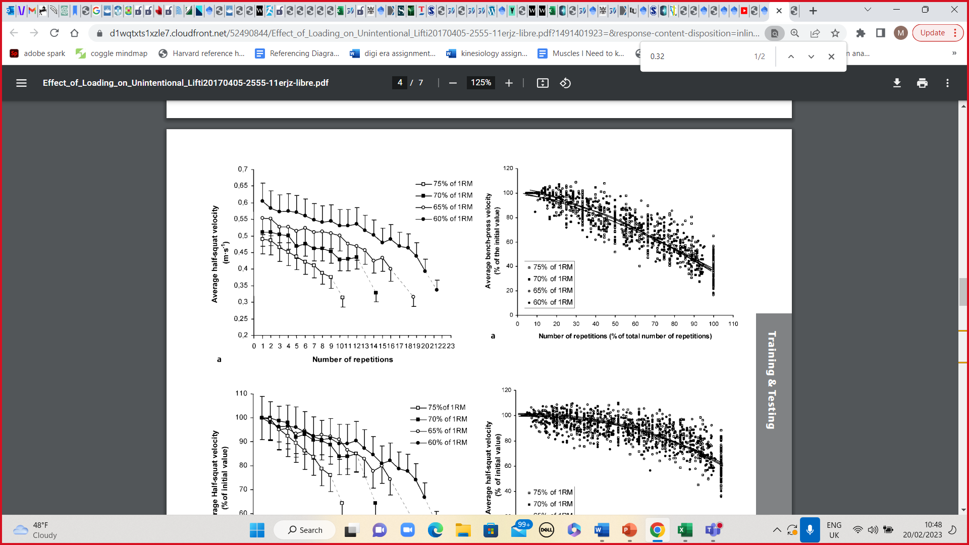
Critical evaluation
(Menrad & Edelmann-Nusser, 2021)
(Izquierdo et al., 2006)
Notes:
My study endorses much of the previous research.
Wadhi et al., (2018) showed that GymAware has been used to accurately monitor velocity and can be used to assess load during strength training, my research supports this.
My results support Menrad & Edelmann-Nusser (2021) results that GymAware equipment provides valid data determining velocity in the squat exercise. We can see the closer the data points to the line of a best fit shows a strong positive correlation.
My findings also fell in line with Izquierdo et al., (2006); and Haff et al., (2020) – my participant similarly reached failure around the suggested 0.32 m/s mark which is useful for monitoring how much work capacity is left within the person.
The data suggests that the Gymaware was useful at providing real-time daily readiness feedback as suggested by Harris (2010) and orange et al., (2020).

Slide 20

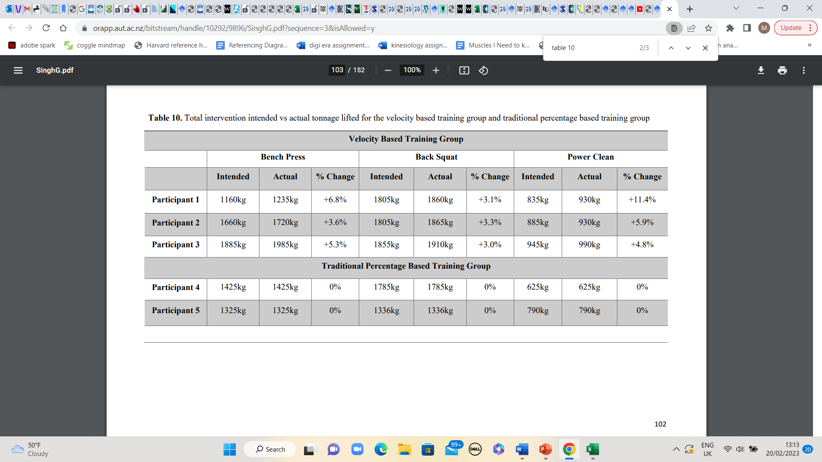

VBT Group
The VBT group’s actual total tonnage vs traditional % training. (Singh, 2016)
Participant 1
Participant 2
Participant 3
Participant 4
Participant 5
(Singh, 2016).
Notes:
Singh (2016) has shown VBT to be a method for increasing squat strength, similar to my results, and compared to traditional percentage training we should expect to see a similar comparison over a similar intervention. We can see the VBT group’s actual total tonnage that was lifted for the back squat exercise was higher compared to percentage training for their intervention period.

Slide 21
My reflection on use.
Cost.
Lack of availability at commercial gyms.
suitable for novice/beginners? – maximum intent increases risk of injury due to tendon & neuromuscular adaptation. Would technical failure be more appropriate?
Neglects technique competencies.
Practicalities- setting up, takes time getting comfortable using the equipment.

Slide 22
Future research
To see if my results can be applied to a larger and different population groups.
Monitor the effects of VBT over a longer intervention period to see if there is similar Singh (2016).

Slide 23
Conclusion
VBT can assist users in monitoring fatigue.
VBT is a viable option for improving absolute strength.
In line with current research gym-aware equipment is an attractive method for teams and coaches to better understand and monitor their athletes.
Can act as a motivator for some people as it did for my participant, supporting athlete centred, specific training goals.
Expensive and lack of availability.
Best suited to competent and experienced lifters.
Familiarisation period with the equipment.

Slide 24
Any Questions
????

Slide 25
Reference List
American College of Sports Medicine, (2017). ACSM's exercise testing and prescription. Lippincott williams & wilkins.
Conceição, F., Fernandes, J., Lewis, M., Gonzaléz-Badillo, J.J. and Jimenéz-Reyes, P., (2016). Movement velocity as a measure of exercise intensity in three lower limb exercises. Journal of sports sciences, 34(12), pp.1099-1106.
Fahs, C.A., Blumkaitis, J.C. and Rossow, L.M., 2019. Factors related to average concentric velocity of four barbell exercises at various loads. The Journal of Strength & Conditioning Research, 33(3), pp.597-605.
Garcia-Ramos, A. and Jaric, S., (2018). Two-point method: A quick and fatigue-free procedure for assessment of muscle mechanical capacities and the 1 repetition maximum. Strength & Conditioning Journal, 40(2), pp.54-66.
García-Ramos, A., Pestaña-Melero, F.L., Pérez-Castilla, A., Rojas, F.J. and Haff, G.G., (2018). Mean velocity vs. mean propulsive velocity vs. peak velocity: which variable determines bench press relative load with higher reliability?. The Journal of Strength & Conditioning Research, 32(5), pp.1273-1279.
González-Badillo, J.J. and Sánchez-Medina, L., (2010). Movement velocity as a measure of loading intensity in resistance training. International journal of sports medicine, 31(05), pp.347-352.
Grgic, J., Scapec, B., Pedisic, Z. and Mikulic, P., (2020). Test-retest reliability of velocity and power in the deadlift and squat exercises assessed by the GymAware PowerTool system. Frontiers in Physiology, 11, p.561682.
Gymaware (2021). USER GUIDE. [online] Gymaware. Available at: https://gymaware.zendesk.com/hc/en-us/article_attachments/4406435182095/GA_User_Guide_Sep_2021.pdf [Accessed 6 Feb. 2023].
Haff, G.G., Garcia-Ramos, A. and James, L.P., (2020). Using velocity to predict the maximum dynamic strength in the power clean. Sports, 8(9), p.129.
Hales, M.E., (2011). Evaluating Common Weight Training Concepts Associated With Developing Muscular Strength: Truths or Myths?. Strength & Conditioning Journal, 33(1), pp.91-95.
Notes:
CHECK REF ALPHABETICAL

Slide 26
Harris, N.K., Cronin, J., Taylor, K.L., Boris, J. and Sheppard, J., (2010). Understanding position transducer technology for strength and conditioning practitioners. Strength & Conditioning Journal, 32(4), pp.66-79.
Helms, E.R., Storey, A., Cross, M.R., Brown, S.R., Lenetsky, S., Ramsay, H., Dillen, C. and Zourdos, M.C., (2017). RPE and velocity relationships for the back squat, bench press, and deadlift in powerlifters. The Journal of Strength & Conditioning Research, 31(2), pp.292-297.
Izquierdo, M., González-Badillo, J.J., Häkkinen, K., Ibanez, J., Kraemer, W.J., Altadill, A., Eslava, J. and Gorostiaga, E., (2006). Effect of loading on unintentional lifting velocity declines during single sets of repetitions to failure during upper and lower extremity muscle actions. International journal of sports medicine, 27(09), pp.718-724.
Jidovtseff, B., Harris, N.K., Crielaard, J.M. and Cronin, J.B., (2011). Using the load-velocity relationship for 1RM prediction. The Journal of Strength & Conditioning Research, 25(1), pp.267-270.
Jovanović, M. and Flanagan, E.P., (2014). Researched applications of velocity based strength training. J Aust Strength Cond, 22(2), pp.58-69.
Liao, K.F., Wang, X.X., Han, M.Y., Li, L.L., Nassis, G.P. and Li, Y.M., (2021). Effects of velocity based training vs. traditional 1RM percentage-based training on improving strength, jump, linear sprint and change of direction speed performance: A Systematic review with meta-analysis. PLoS One, 16(11), p.e0259790.
Loturco, I., Pereira, L.A., Abad, C.C.C., Gil, S., Kitamura, K., Kobal, R. and Nakamura, F.Y., (2015). Using the Bar-Velocity to Predict the Maximum Dynamic Strength in the Half. International Journal of Sports Physiology and Performance.
Mann, B. (2021). Velocity Based Training - Dr Bryan Mann. [online] www.youtube.com. Available at: https://www.youtube.com/watch?v=EwWDmBeUFpo [Accessed 6 Feb. 2023].
Menrad, T. and Edelmann-Nusser, J., (2021). Validation of velocity measuring devices in velocity based strength training. International Journal of Computer Science in Sport, 20(1), pp.106-118.

Slide 27
Orange, S.T., Metcalfe, J.W., Marshall, P., Vince, R.V., Madden, L.A. and Liefeith, A., (2020). Test-retest reliability of a commercial linear position transducer (GymAware PowerTool) to measure velocity and power in the back squat and bench press. The Journal of Strength & Conditioning Research, 34(3), pp.728-737.
Pareja‐Blanco, F., Rodríguez‐Rosell, D., Sánchez‐Medina, L., Sanchis‐Moysi, J., Dorado, C., Mora‐Custodio, R., Yáñez‐García, J.M., Morales‐Alamo, D., Pérez‐Suárez, I., Calbet, J.A.L. and González‐Badillo, J.J., (2017). Effects of velocity loss during resistance training on athletic performance, strength gains and muscle adaptations. Scandinavian journal of medicine & science in sports, 27(7), pp.724-735.
Paz, G.A., de Freitas Maia, M., de Araújo Farias, D., Miranda, H. and Willardson, J.M., (2021). Muscle activation and volume load performance of paired resistance training bouts with differing inter-session recovery periods. Science & Sports, 36(2), pp.152-159.
Pereira, M.I.R. and Gomes, P.S.C., (2003). Muscular strength and endurance tests: reliability and prediction of one repetition maximum-Review and new evidences. Revista Brasileira de Medicina do Esporte, 9, pp.325-335.
Perez-Castilla, A., García-Ramos, A., Gijón-Nieto, L.M., Marcos-Blanco, A. and García-Pinillos, F., (2022). Reliability and concurrent validity of the PUSH Band™ 2.0 to measure barbell velocity during the free-weight and Smith machine squat exercises. Proceedings of the Institution of Mechanical Engineers, Part P: Journal of Sports Engineering and Technology, 236(4), pp.351-359.
Ruf, L., Chéry, C. and Taylor, K.L., (2018). Validity and reliability of the load-velocity relationship to predict the one-repetition maximum in deadlift. The Journal of Strength & Conditioning Research, 32(3), pp.681-689.
Sánchez-Medina, L., Pallarés, J.G., Pérez, C.E., Morán-Navarro, R. and González-Badillo, J.J., (2017). Estimation of relative load from bar velocity in the full back squat exercise. Sports medicine international open, 1(02), pp.E80-E88.
Singh, G., 2016. The influence of velocity based resistance training on neuromuscular strength and power adaptations in semi-professional rugby union and professional rugby league players (Doctoral dissertation, Auckland University of Technology).

Slide 28
Wadhi, T., Rauch, J.T., Tamulevicius, N., Andersen, J.C. and De Souza, E.O., (2018). Validity and reliability of the GymAware linear position transducer for squat jump and counter-movement jump height. Sports, 6(4), p.177.
Weakley, J., Mann, B., Banyard, H., McLaren, S., Scott, T. and Garcia-Ramos, A.,(2021). Velocity-based training: From theory to application. Strength & Conditioning Journal, 43(2), pp.31-49.
Weakley, J., Ramirez-Lopez, C., McLaren, S., Dalton-Barron, N., Weaving, D., Jones, B., Till, K. and Banyard, H., (2020). The effects of 10%, 20%, and 30% velocity loss thresholds on kinetic, kinematic, and repetition characteristics during the barbell back squat. International journal of sports physiology and performance, 15(2), pp.180-188.
Włodarczyk, M., Adamus, P., Zieliński, J. and Kantanista, A., (2021). Effects of velocity-based training on strength and power in elite athletes—a systematic review. International Journal of Environmental Research and Public Health, 18(10), p.5257.
www.vbtcoach.com. (2021). VBTcoach. [online] Available at: https://www.vbtcoach.com/blog/how-to-calculate-your-1rm-with-vbt [Accessed 17 Feb. 2023].
Www.youtube.com. (2021). Velocity Based Training - Dr Bryan Mann. [online] Available at: https://www.youtube.com/watch?v=EwWDmBeUFpo [Accessed 6 Feb. 2023].
Zhang, X., Feng, S., Peng, R. and Li, H., (2022). The Role of Velocity-Based Training (VBT) in Enhancing Athletic Performance in Trained Individuals: A Meta-Analysis of Controlled Trials. International journal of environmental research and public health, 19(15), p.9252.
Zourdos, M.C., Dolan, C., Quiles, J.M., Klemp, A., Jo, E., Loenneke, J.P., Blanco, R. and Whitehurst, M., (2016). Efficacy of daily one-repetition maximum training in well-trained powerlifters and weightlifters: a case series. Nutricion hospitalaria, 33(2), pp.437-443.

Slide 29
Picture References
DKN Technology (2022). F2G Smith Machine. [online] DKN International. Available at: https://www.dkn-technology.com/en/force2go/415-f2g-smith-machine-5412002205584.html [Accessed 14 Feb. 2023].
Gymaware (2021). USER GUIDE. [online] Gymaware. Available at: https://gymaware.zendesk.com/hc/en-us/article_attachments/4406435182095/GA_User_Guide_Sep_2021.pdf [Accessed 6 Feb. 2023].
Gymaware (2020). GymAware | Measure performance and barbell velocity in the gym. [online] GymAware. Available at: https://gymaware.com/.
Mash & Mann (2020). 5 Practical Uses of Velocity Based Training. [online] GymAware. Available at: https://gymaware.com/5-practical-uses-of-velocity-based-training/ [Accessed 6 Feb. 2023].
Parker, R. (2019). How to test your one rep max safely. [online] Human Kinetics Blog. Available at: https://humankinetics.me/2019/01/09/how-to-test-your-one-rep-max-safely/.
precisionpowerlifting (2020). Prilepin’s Chart and Powerlifting. [online] Precision Powerlifting Systems. Available at: https://precisionpowerlifting.com/2020/04/20/prilepins-chart-and-powerlifting/ [Accessed 17 Feb. 2023].
SimpliFaster. (2018). Buyer’s Guide to Velocity-Based Training and Weight Room Monitoring Systems. [online] Available at: https://simplifaster.com/articles/buyers-guide-velocity-based-training-systems/ [Accessed 9 Feb. 2023].

