Slide 1

Collaboration in action: The critical role of teamwork in achieving success
Cerys Williams (2416044)
BMPL4014

Slide 2

What is a team?
A team is a select few of individuals with a general goal, who are dedicated, each contributing their own set of unique strengths (Wood et al, 2024)
Examples of teams within the police:
Road policing teams
Neighbourhood policing
Response policing teams
Criminal Investigator teams
(College of Policing, 2024)

Slide 3

The fundamental principles of teamwork
Fundamental principles of teamwork
Effective communication
Active listening
Empathy
Effective conflict management
(Wood et al, 2024)
Other principles include:
Setting a core purpose
Trust in team members
Encouraging ownership of tasks (DEAKINco., 2023)

Slide 4
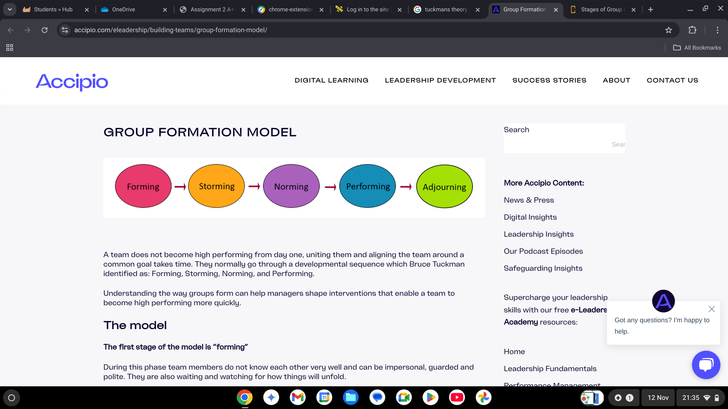
Five stages of team development – Tuckman's theory
When working in a team, researchers have found that they go through these five stages. Tuckman's theory, created in 1964, shows how new teams develop.
Forming
Storming
Norming
Performing
Adjourning / Mourning
(Wood et al, 2024)
(Accipio, 2024)

Slide 5
How does effective teamwork contribute to success within shared goals?
If there is effective teamwork, individuals are more likely too:
Dedicate themselves to achieving team goals
Be honest in discussions and encourage feedback
Engage in approaches and practices
(Scism, 2023)

Slide 6

Strategies in south wales police to improve teamwork and collaboration
Positive Action Support
Neighbourhood policing
South Wales Listens
Help Point – Swansea Wind Street
With over 2,100 staff working in South Wales Police departments, their main aim is to work as a team to enhance community safety (South Wales Police, 2024).

Slide 7
The challenges of teamwork and collaboration
Although teams can effectively work together, sometimes teams can fall apart. Teams struggle to actively reach goals due to the following:
There is a lack of shared vision
Micromanagement
Low team involvement
Conflicts are poorly managed
Certain members do not fulfil their responsibilities
(Egeland, 2019)

Slide 8

team failure- manchester arena bombing
Key findings included:
Emergency response failures
Security failures at the venue
Communication Errors
(BBC NEWS, 2022).
Issue with a lack of communication:
Leads to unstable environments
Growth of errors
Weakened team cohesion
(GOV.UK, 2023)

Slide 9

Conclusion
Shows how crucial teamwork is to achieve success
Used reliable sources to strengthen my power point
Case studies and theories to support all information
Importance of teamwork in public service organisations

Slide 10
Reference list
Accipio. 2024. Group Formation Model. Available at: https://www.accipio.com/eleadership/building-teams/group-formation-model/ (Accessed 14th November 2024)
BBC NEWS (2022). Manchester Arena Attack: Key failings of emergency response. Available at: https://www.bbc.co.uk/news/uk-england-manchester-63472531
(Accessed 14th November 2024).
College Of Policing (2024) Career Pathways. Available at: https://www.college.police.uk/career-learning/career-pathways (Accessed 4th December 2024).
DEAKINco., (2023) Key Elements of Effective Teamwork. Available at: https://deakinco.com/resource/key-elements-of-effective-teamwork/ |(Accessed 7th November 2024).
Egeland, B. (2019). Twelve characteristics of ineffective teams. Available at: https://pmtips.net/article/twelve-characteristics-of-ineffective-teams (Accessed 16th November 2024).
GOV.UK (2023). Leading for safety. Available at: https://www.gov.uk/guidance/leading-for-safety/5-communication-and-teamwork (Accessed 26th November 2024).
Scism, R. (2023) Teamwork in public safety: Key attributes and strategies for success. Available at: https://www.police1.com/chiefs-sheriffs/articles/teamwork-in-public-safety-key-attributes-and-strategies-for-success-29KqS8z3zX8P7yJg/ (Accessed 16th November 2024).
South Wales Police (2024) Police Staff Departments. Available at: https://www.south-wales.police.uk/police-forces/south-wales-police/areas/careers/careers/police-staff-roles/police-staff-departments/ (Acessed 16th November 2024).
Wood, D., Bradshaw, S., Dickens, T., Parker-McLeod, J., Davies, C. (2024) Blackstone’s Handbook for Policing Students. 18th edn. Oxford University Press. P.118. (Accessed 7th November 2024).
Wood, D., Bradshaw, S., Dickens, T., Parker-McLeod, J., Davies, C. (2024) Blackstone’s Handbook for Policing Students. 18th edn. Oxford University Press. P.118. (Accessed 14th November 2024).
Wood, D., Bradshaw, S., Dickens, T., Parker-McLeod, J., Davies, C. (2024) Blackstone’s Handbook for Policing Students. 18th edn. Oxford University Press. P.119, 121 122. (Accessed 4th December 2024).

Slide 11
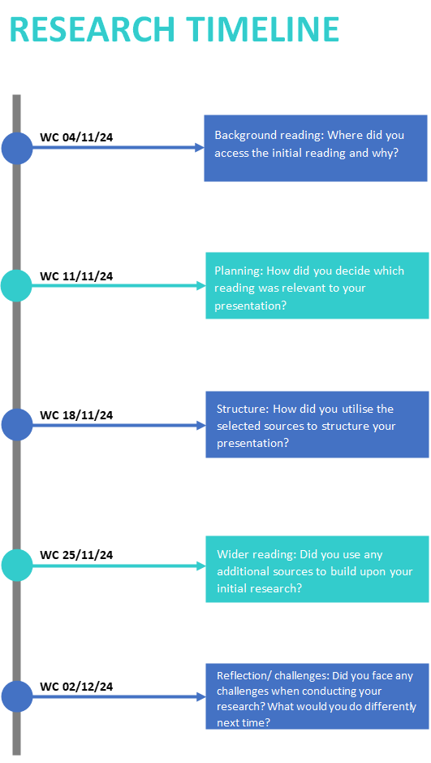
Initial reading – Blackstone's handbook
Easily accessible and provides all rounded knowledge
Deciding what reading was relevant to my presentation
Used blackstone's as it aligned with the topic of the presentation
Also used websites for balance of perceptive
Utilising the selected sources
Used main ideas from sources to determine key themes
Helped me build up my presentation
Additional sources – College of Policing YouTube videos
To enhance my knowledge and gain further understanding
Challenges I faced – Finding relevant books
I found it difficult to access books relevant to the topic of teamwork within the police

Slide 12

Thankyou! ANy Questions?

