Slide 1
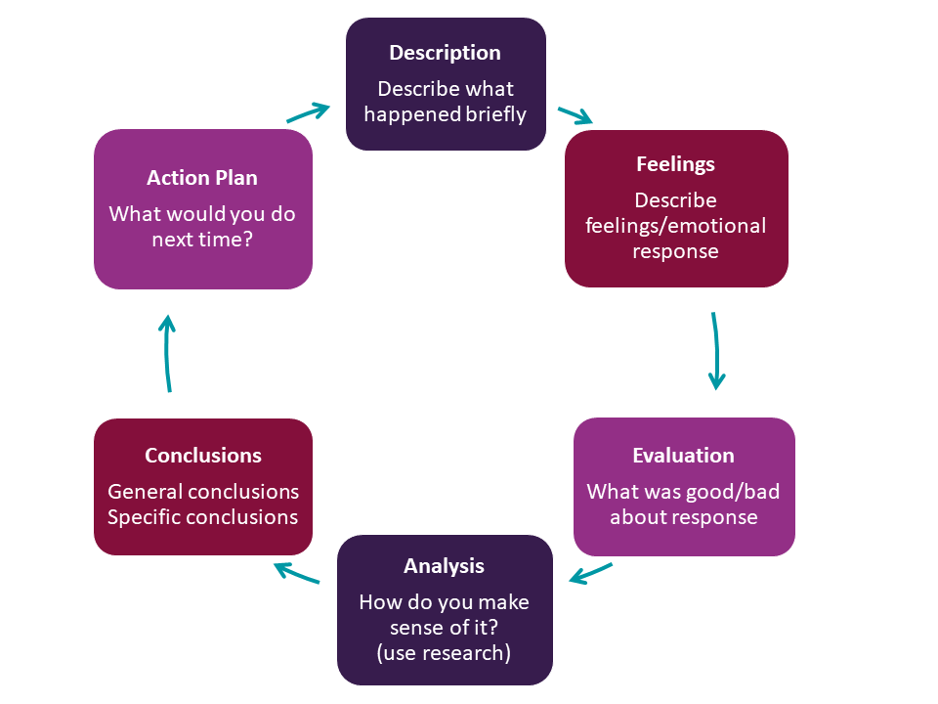
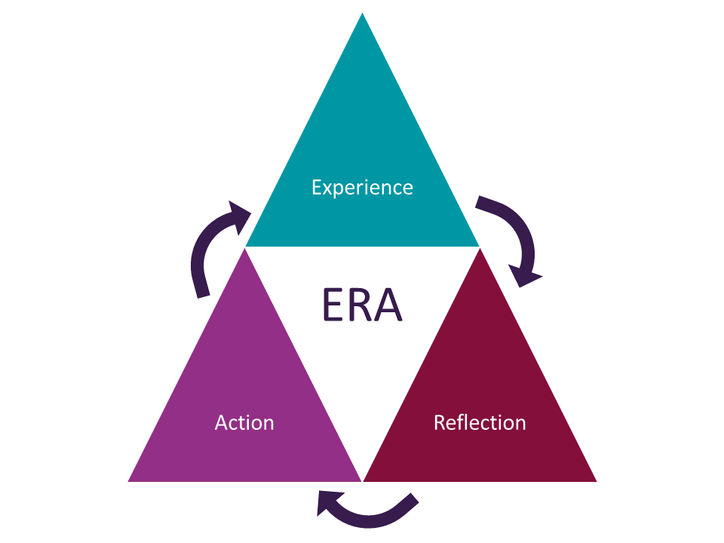
IMPORTANCE OF REFLECTIVE PRACTICE IN EARLY YEARS
2417935
ECEY4009/C
1030 words count
Reflection requires you to think deeply about your experiences, become more aware of your beliefs, values, and behaviors. It helps you identify what worked well and what did not, fostering a mindset of continuous growth and development. Reflection is a way to analyze past events, evaluate your actions, and determine how to approach similar situations differently in the future, putting these insights into practice to ensure ongoing improvement in both personal and professional capacities. Reflection can be challenging, especially if it is not done regularly. Keeping a reflective journal is recommended, as it will enhance your reflection skills, maintain a record of your thoughts, and help generate new ideas for addressing challenges.
Similarly, reflective practice is a crucial process encouraged in professional environments to enhance learning, foster personal growth, and support informed decision-making, thereby contributing to the overall improvement of the learning environment. It involves critically examining various situations, including successes, challenges, and areas for improvement. The purpose of reflective thinking is to gain deeper insights into one’s actions, decisions, and their impacts, enabling practitioners to apply these insights in practice. Reflective practice should be continuous, promoting ongoing development in personal and professional capacities.
When we think about reflective practice in the early years, it is important to start by seeing the world from children’s perspectives. Being a reflective practitioner is a characteristic of a person behavior rather than an intellectual activity ( Moom, 2006).
It is crucial to develop reflective practice in early years settings because it enhances the quality of care, emotional and social support for children, improves communication between practitioners, families, and children, increases accountability for actions, and helps solve problems by applying developmental theories.
Critical reflection in early years is an important aspect of understanding how theory supports practice.
The benefits of being a reflective practitioner include improved critical understanding and the development of essential skills to support the best outcomes in children’s development, learning, and progress. Staying up to date with the latest developments in early years education is vital, and reflective practice supports this by helping practitioners assess and adjust their approaches in line with new research, policies, and best practices. Additionally, it is one of the best ways to support children and their families.
Reflective practice is supported by several theories that provide a framework for understanding and improving the reflection process.
Theory is consistently present in professional practice and can be observed in early years settings, particularly through children's play or by applying child development theories. Several theories help in understanding reflection and its link to reflective practice. Many writers have focused on how reflection can be applied and how best to use it in present circumstances to improve learning or achieve other desired outcomes. Without testing theory, there has been a tendency towards the solidification of ideas, meaning that certain reflective concepts in literature have become widely accepted. Examples include those of Donald Schön and John Dewey.
Schön's reflective model consists of two processes:
Reflection-in-action, which involves reflecting during professional activities by considering what is happening in the moment, and
Reflection-on-action, which involves looking back on professional experiences and connecting them to relevant theories.
John Dewey, in his work on reflective practice, distinguishes between two types of actions:
Routine actions, which are automatic and not professionally active, and
Reflective actions, which involve purposefully changing routine actions into thoughtful, intentional moments of learning and improvement.
Gibbs' reflective model is designed to structure reflections and encourage us to focus on our feelings, which has six steps and provides a framework for reflection:
Description: experience you had
Feelings: how you feel about the experience
Evaluation: both sides of this experience.
Analysis: what is important about this experience
Conclusion: reflect on what you learned and how could you do it different next time
Action plan: how you would handle similar situations in the future, or any adjustments you might consider making.
The most recent reflective model is the ERA reflective cycle, created by Jasper (2013). This simple model of reflection helps us improve our understanding from experience and contains only three steps:
Experience: the experience you had
Reflection: describes a basic record of an experience using key questions such as Who, What,
Where, When, Why, and How
Action: thinking about how you will
respond to the same or different situations in the future.
Some facts to consider regarding these two models are that the structure of Gibbs' reflective model encourages a reflection process that includes six steps based on feelings and analytical components, while the ERA model has only three steps, making it easy to follow. Gibbs' model focuses on emotional awareness and critical analysis, while the ERA model emphasizes experience and taking action.​
Two key advantages of Gibbs' model are that it encourages emotional awareness and provides deep details in the reflection process. However, its complexity can overwhelm beginners with too many steps.​
In contrast, the ERA reflective model is a simple cycle that is easy to remember and allows for quick reflections for learning. However, it may lack emotional analysis and provide less detailed reflections on experiences.​
Reflective methods support learning by identifying significant experiences. Writing reflections is also recommended when facing challenging situations, as it helps identify connections between personal experiences and professional values. Among the various reflective methods, two notable models are Gibbs Reflective Cycle and ERA Reflective Cycle.
In conclusion, reflection and reflective practice are essential values that play a crucial role in early years settings. By analyzing past situations, practitioners can gain a clearer understanding of their decision-making processes and patterns, allowing them to make more informed choices in the future. Both models are designed to help practitioners critically reflect on their experiences, learn from them, and apply that learning to improve their teaching and interactions with children. The choice of model will depend on the practitioner’s personal preference, the specific context of the early years setting, and the depth of reflection required. Additionally, reflecting on accomplishments and successes can boost confidence and motivation. By recognizing their achievements, educators can build on their strengths, enhancing professional growth and contributing to better outcomes for the children in their care.

Slide 2
Reference list:
Gibbs, G. (1988). Learning by doing: A guide to teaching and learning methods. Oxford: Further Education Unit, Oxford Polytechnic.
Grammarly (2024). Grammarly. [online] Grammarly.com. Available at: https://www.grammarly.com.
Hallet, E. (2013). The Reflective Early Years Practitioner. London: SAGE Publications Ltd. Available at: https://research-ebsco-com.ezproxy.uwtsd.ac.uk/linkprocessor/plink?id=26a4e09d-f2e6-3db3-9062-a69ae87c0e82. Accessed on: 4 Oct. 2024.
Hero, L. (2023). The Essentials of the Schön Reflection Model. [online] Workplacehero.co.uk. Available at: https://workplacehero.co.uk/blog/the-sch%C3%B6n-reflection-model.
Jasper, M. (2013). Beginning Reflective Practice. 2nd ed. Andover: Cengage Learning.
Markkanen, P., Välimäki, M., Anttila, M., & Kuuskorpi, M. (2020). A Reflective cycle: Understanding Challenging Situations in a School Setting. Educational Research, 62(1), 46–62. Available at: https://www.tandfonline.com/doi/abs/10.1080/00131881.2020.1711790.
Moom (2006).
Moon, J.A. (2013). Reflection in Learning and Professional Development: Theory and practice. Routledge.
Rolfe, G., Jasper, M., & Freshwater, D. (2011). Critical reflection in practice: generating knowledge for care (Second edition). Red Globe Press.
Source: Fallin, L. (2024). LibGuides: Reflective writing: ERA. [online] libguides.hull.ac.uk. Available at: https://libguides.hull.ac.uk/reflectivewriting/era.
Source: University of Hull (2024). LibGuides: Reflective writing: Gibbs. [online] Hull.ac.uk. Available at: https://libguides.hull.ac.uk/reflectivewriting/gibbs.
The University of Cambridge (2024). Reflective Practice toolkit: Models of Reflection. [online] University of Cambridge. Available at: https://libguides.cam.ac.uk/reflectivepracticetoolkit/models.

