Slide 1
Introduction to Criminal Law and Litigation
Week 7 Acting for a Defendant (Chapter 9) – Part one
Notes:
In this chapter, you will be introduced to some of the key considerations involved in representing a client in a criminal case. You need to be aware not only of the relevant powers, offences and procedures, but also of your own professional conduct and some of the early issues that will affect a client’s case, such as how representation will be funded. You also need to be aware of your own duties around obtaining instructions and evidence.
We will consider each of these issues in turn throughout this chapter. Finally, we will examine the impact of criminal records on clients, which is another reason that carefully considered, and realistic, advice is so important.

Slide 2
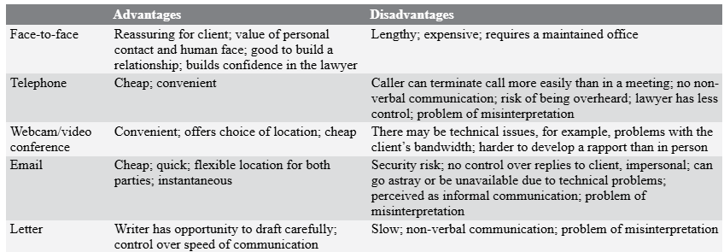
Meeting the client - methods
Notes:
The first opportunity you will have to meet your client, confirm and explain your role, and obtain information from them is in a client interview. The client interview is an opportunity for the client to meet their lawyer and decide if they wish to be represented by that person, an opportunity to ask questions and to receive advice. For the lawyer, an interview is an opportunity to receive information, ask questions and engage the client. First interviews are extremely important and can set the tone for the whole of the client/lawyer relationship.
Interviews can be conducted face-to-face, online or via telephone. Correspondence with clients to clarify instructions or provide advice can also be conducted via email or letter. The advantages and disadvantages of each form of communication are shown in Table above.
It is important to be fully prepared before meeting a client. The client may be nervous, apprehensive, angry or fearful. It is important that they are reassured and spoken to promptly and also that the lawyer is fully prepared for the interview.
Before the first in person consultation, the client should be given:
the name and status of the lawyer conducting the interview;
information on the costs for the interview; and
details of who to contact if they have a complaint.
This information can be prepared in advance and a copy should be kept on file. This gives the client the reassurance of having a contact and information in advance

Slide 3
Preparing for a client interview
Appropriate environment
Don’t pre-judge and be open to new information
Be prepared in terms of note-taking, forms (e.g legal aid , file checklists)
Meet, Seat and greet
  Friendly and put client at ease
  Appear confident
  Speak naturally, sincerely and clearly
  Avoid unnecessary barriers in the office (sitting behind a large desk)
  Establish a free-flowing conversation, listening carefully, prompting where necessary and understand the effect of both open and closed questions in an interview
  Avoid multiple questions or leading questions
  Summarise your clients instructions and ask them to add further information
  Be an active listener
  Allow for short periods of silence

Slide 4
Advice during interview
Advising a client fully can involve more than legal advice and it may include practical, non-legal solutions. Advising a client can involve considering issues such as how to fund a case; risks involved in the case; the procedures; what evidence the case needs to be proved and the services which the firm can and cannot provide. There may be other topics to cover depending upon the area of law.
Giving advice to clients can be nerve-wracking. It will be impossible to have all of the facts required from the first interview and so it must be remembered that the advice given is preliminary. If further information is required before detailed advice can be given, make it clear to the client what is required and whose responsibility it is to obtain the information. A time limit should be set when asking a client to provide further information. It is useful to list the required information in a follow up letter after the interview.
The main point about advice is that it should be well structured and clear to the client. At the start of a retainer, the probability is that only preliminary advice can be given and this should be made clear. The law should be clearly explained and then the client advised on how the law applies to their case. If there is more than one option available to the client, the options should be given clearly as well as the advantages and disadvantages of each option.

Slide 5
Concluding the interview
Ask the client if they are happy to proceed;
Ensure that they have a clear idea of the action the lawyer will take on their behalf;
Ensure that the client is clear on how they can contact the lawyer;
Confirm with the client any actions the client is required to take and the time frames for completion of these steps; and finally
Check if the client has any further questions.

Slide 6

Obtaining Adequate Funding

Slide 7

Criminal Legal Aid
Since 1 April 2013, the funding for legal services for those suspected of having committed a criminal offence or facing criminal proceedings is administered by the Legal Aid Agency (LAA)
Provides funding for defendants

Slide 8
Legal Aid, Sentencing and Punishment of Offenders Act 2012 (“ LASPO 2012”)
All firms that undertake the provision of publicly funded criminal defence work have to sign a contract with the Legal Aid Agency (LAA), the body that oversees and administers the provision of state funding for all legal work.
Criminal defence firms who hold a Standard Crime Contract with the LAA provide the vast majority of criminal defence services, but the same services are also offered by the Public Defender Service (PDS).
The PDS employs criminal defence solicitors and accredited police station advisers. Although their salaries are met by the LAA, they are independent providers of criminal defence services. There are currently four PDS offices in England and Wales.

Slide 9
LASPO 2012
In criminal cases there are several different publicly funded schemes available:
duty solicitor schemes (available to suspects detained in a police station and defendants appearing in the Magistrates’ Court);
police station advice and assistance following an arrest (non-means tested);
free standing advice and assistance (subject to eligibility);
advocacy assistance covering representation in court in very limited circumstances; and
representation orders covering the costs of representing the client in full court proceedings in the Magistrates’ Courts and before the Crown Court.
All applications for criminal legal aid for representation in the Magistrates’ Court and the Crown Court are made online using the CRM14e form and are processed by the LAA.

Slide 10

Financing the Defence
Police Station Advice and Assistance
Pre-charge Advice and Assistance
Duty Solicitor Scheme
Representation Orders
Otherwise, private funding

Slide 11
Legal advice at the police station
Entitled to own choice of solicitor if intend to pay
Otherwise – free advice provided by Criminal Defence Service under Police Station Advice and Assistance Scheme
Defence Solicitor Call Centre organise representation - Non means tested
D could have own solicitor if that firm is contracted with the Legal Aid Agency (LAA)
Telephone advice only permitted in certain circumstances – e.g non imprisonable offences; drink driving; breach of bail conditions (see earlier slides)
Contracted firms’ solicitors on a 24-hour rota for a set number of days per month
Duty solicitors must have certificate of the Law Society’s Criminal Litigation Accreditation Scheme and be qualified under Police Station Accreditation schemes

Slide 12
Legal advice away from the police station
At the police station – free
Advice given PRE-charge, away from the police station, is means tested and subject to upper maximum limit
Automatic qualification for those on certain benefits
CRM1 and CRM 14 and 15
CRM14: criminal legal aid application form - GOV.UK (www.gov.uk)

Slide 13
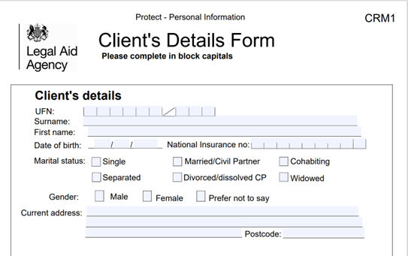
CRM1

Slide 14
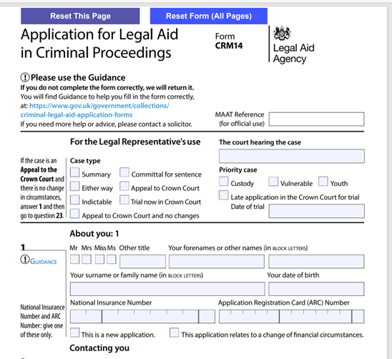
CRM 14

Slide 15
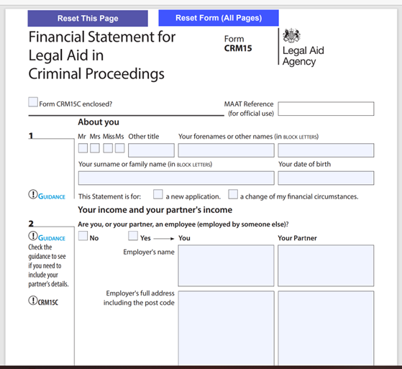
CRM15

Slide 16
Pre-Charge Engagement
A payment is also available to providers for pre-charge engagement where a suspect is under investigation, and it is agreed between the defence and police that work on disclosure can be done which might assist the investigation (such as giving access for digital evidence or providing further evidence or potential witnesses).
This is a one-off payment under the advice and assistance scheme.

Slide 17
Free standing advice and assistance
Advice and assistance allows a solicitor to undertake a strictly limited amount of work before charge or requisition, for example attending a client in the office and then writing a letter of advice. Advice and assistance is not available after charge or summons/requisition. It also covers representation in connection with an investigation by a non-police body, such as the Department of Work and Pensions, and covers a limited amount of post appeal work in connection with an application to the Criminal Cases Review Commission. Advice and assistance is subject to means testing.
Relevant forms:
CRM1 (client details form); and
CRM2 (application for advice and assistance).

Slide 18
Advocacy Assistance
Advocacy assistance is available for a few types of court hearings, which are set out on the application form, CRM3. These include representation before a Magistrates’ Court seeking to challenge a warrant of further detention and an application to vary pre-charge bail.
It also covers solicitors making representations to a court in relation to applications by the police to extend pre-charge bail. If some of these can be undertaken within the scope of the duty solicitor scheme, then they should be undertaken under that scheme. Advocacy assistance is also the legal aid scheme used by Prison Law Providers to represent prisoners at oral hearings for adjudications or oral hearings if they have a contract to provide such representation from the LAA.

Slide 19
Duty Solicitor Scheme at Court
Enables a solicitor to represent a D who:
Who is in custody
Who is charged in connection with an imprisonable offence
Is applying for bail
Is at risk of imprisonment for failing to pay a fine or obey a court order
Wishes to plead guilty to a summary or triable either way offence before Magistrates Court
On first appearance before Magistrates Court
It does not cover full trials
No means or merits test.
Notes:
Duty solicitors are accredited through a process of assessment of experience in Magistrates and Police Station representations. The starting point for an aspiring duty solicitor is usually police station accreditation and then, with the appropriate audience rights, undertaking a good 12 months plus experience in Magistrates’ Court representations. Each year duty solicitors must maintain a minimum number of police station and Magistrates’ Court appearances to remain accredited. This also requires a minimum number of weekly hours on such work: the 14 hour requirement. Duty solicitors must keep a record of their attendances and the advice which they have given.

Slide 20
Representation Order (Full Criminal Legal Aid)
Only available to a Defendant who satisfies two tests.
  Interests of Justice (Merits) test; and
  The Means test
Covers full representation in court
Application is made via an online system called Applying for criminal legal aid, which replaces the old CRM 14 and 15 process. It allows providers to be covered from the day of instruction via a virtual “date stamp” and can quickly assess means and merits. Providers need to have full details of the offences and their client’s financial position when completing the application.
For more information see https://legalaidlearning.justice.gov.uk/introduction-to-the-apply-for-criminal-legal-aid-service/.
If your client is in receipt of benefits, the process is much simpler than for those who are not as you will need to produce proof of income and liabilities.
Provided you start the process on the day on which your client appears in court, the representation order, when granted, will be backdated.
Further guidance on the online application process, including guidance on avoiding rejections of applications, is available at https://legalaidlearning.justice.gov.uk/crime/.

Slide 21
Interest of Justice Test (The Merits test)
s17 Laspo 2012 sets out the grounds by which an applicant can satisfy the interests of justice test in relation to an application for a representation order. These are set out in the left column of Table 9.3.
Note that if the offence is indictable-only (i.e. it can only be tried in the Crown Court) and has been sent for trial in the Crown Court under s51 Crime and Disorder Act 1998, the interests of justice test is automatically satisfied.
If an either-way offence fails the interests of justice test but is subsequently sent to the Crown Court, the interests of justice test is automatically satisfied at the point of sending to the Crown Court. If a defendant is charged with a summary-only or either-way offence, a representation order will be granted only if one or more of the interests of justice criteria are met. The specific interests of justice grounds relevant to a defendant’s case need to be fully set out.

Slide 22
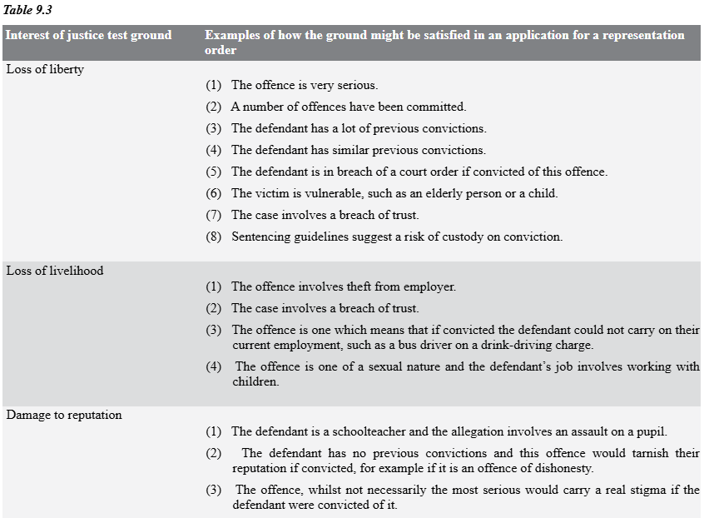
Interests of Justice Test Continued…

Slide 23
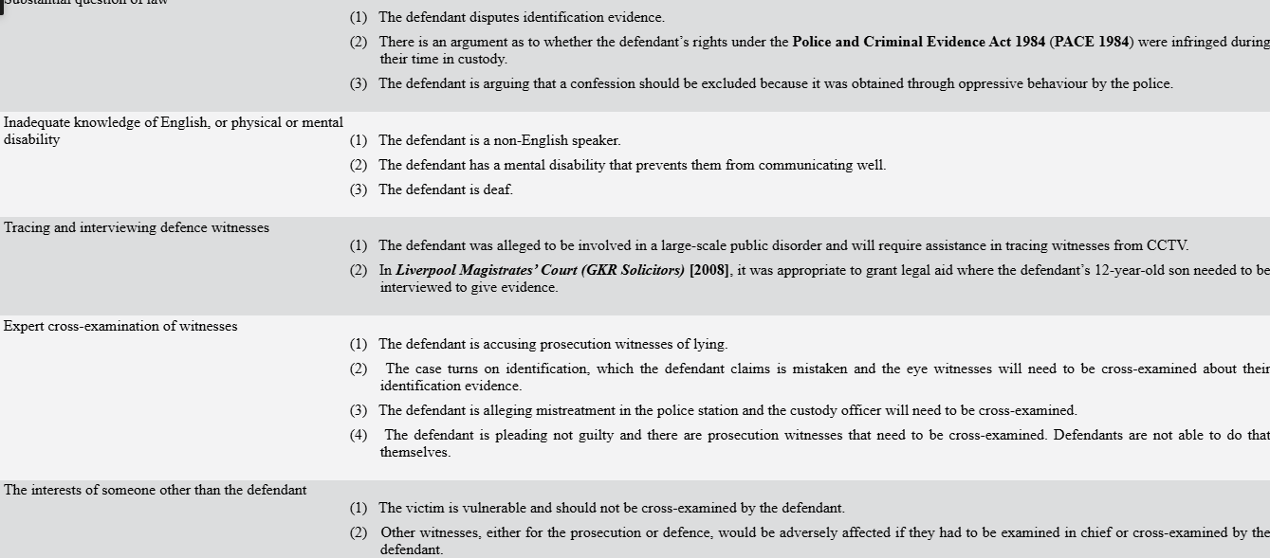
Interest of Justice Test Continued…

Slide 24
Means Test
Only income is assessed for the purposes of a representation order to cover proceedings before the Magistrates’ Court. Some defendants qualify automatically in terms of their means and do not need to satisfy the means test. They are said to be “passported” applicants. They include those:
under 18; or
in receipt of universal credit or other qualifying benefits, such as income based job seeker’s allowance.
Applicants must provide their National Insurance number if aged over 18, or proof of benefit. The application may be delayed in processing without this information. All other applicants must complete the means test, which is incorporated in the “Apply for criminal legal aid” process.
The means test comprises two elements: an initial assessment and, in some cases, a full means test.
The initial assessment determines the applicant’s weighted gross annual income or adjusted income as it is referred to in the Criminal Legal Aid Manual. This is done by taking the client’s gross annual ncome and adding to that the client’s partner’s gross annual income. This gives the gross household income.
The gross household income is then weighted to take account of the number of people in the household and this gives the adjusted income.
Once this figure is determined there are three options:
the applicant will be eligible;
the applicant will be ineligible; or
a full means test will be required.
On current figures the thresholds are as follows.
(1) If the applicant’s adjusted income is less than £12,475, the applicant passes the means test.
(2) If it is greater than £22,325, the applicant fails the means test and cannot therefore be granted a representation order to cover proceedings in the Magistrates’ Court.

Slide 25
Means Test
(3) If the applicant’s adjusted income falls between the lower and upper threshold, then a full means test must be undertaken. Under the means test, the gross household income is taken and then from that are deducted certain allowable outgoings and a living allowance. That calculation then establishes the applicant’s annual household disposable income or disposable income as it is referred to in the Criminal Legal Aid Manual. If this results in the applicant being assessed as having a disposable income of £3,398 or less they will qualify in terms of their means. If they have more than that they will not pass the means test.
The most up-to-date eligibility thresholds can be found at https://www.gov.uk/guidance/criminal-legal-aid-means-testing#full-means-testing.
Where the defendant is not automatically eligible under the means test, evidence of income is required. If the defendant is remanded in custody by the court and cannot obtain evidence of income, the requirement to provide proof of income is waived.
A partner’s income is included in the assessment of means. A partner is defined as anyone (including a person of the same sex) with whom the applicant lives as a couple. A partner’s income will not be aggregated where:
the partner is the alleged victim;
the partner is a prosecution witness; or
both are defendants and there is a conflict between them.
An applicant who fails the means test may apply for a review of the decision on the grounds of hardship using form CRM17. A hardship review may assist an applicant who has, for example, unusually high outgoings or where the case is likely to be particularly expensive.
Where a criminal lawyer represents a client at the Magistrates’ Court at the first hearing before a decision has been reached on the application for a representation order, a system of early cover provides a single payment for each client who passes the interests of justice test but fails the means test.
Applicants who are ineligible for a representation order in the Magistrates’ Court must either choose to represent themselves or pay for representation. If a defendant chooses to fund their defence privately and is subsequently acquitted, they can apply to reclaim their defence costs out of central funds, although this will be capped at legal aid rates as a result of provisions in LASPO 2012.

Slide 26
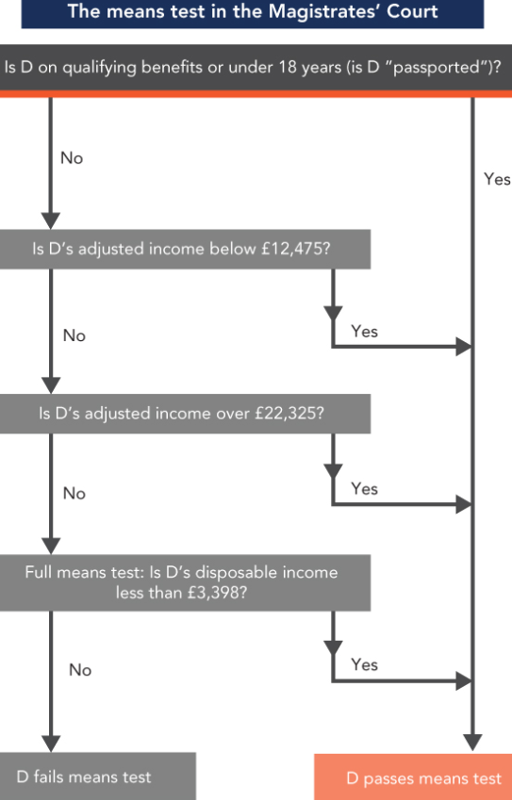
Means Test calculation
-Magistrates Court

Slide 27
Scope of the Representation Order
Full representation in Magistrates or Crown Court proceedings
Application for bail in the CC
Advice on appealing to higher court on conviction/sentence
Reasonable disbursements

Slide 28
Appealing a decision of the Legal Aid Agency
Request Administrative review - reasons in writing
1
Further appeal to Court
2
Any means change can be submitted online
3
Notes:
If the applicant fails the interests of justice test they are entitled to request an administrative review (a reconsideration). They should put their reasons in writing.
If, following the administrative review, the LAA decline to grant a representation order the applicant can ask for their appeal to be heard by the court. This application must be made in writing to the Criminal Application Team (CAT), who will arrange for it to be listed before the court.
If the applicant’s means have changed, then they can report it under the “Apply for criminal legal aid”system. So far as the Crown Court means testing is concerned, any applicant who is assessed as having to make a contribution towards their legal costs can submit a hardship review application and can ask for their contribution order to be reviewed and recalculated if they feel it has been computed in error or their circumstances have change

Slide 29
Change of Representation
If a defendant has the benefit of public funding and wishes to change representation there is a specific procedure which must be followed. This is to avoid defendants simply chopping and changing because they do not like the advice they are getting.
This is set out under the Criminal Procedure Rules (CrPR). CrPR r46.3 deals with the circumstances under which a transfer can take place. It requires a justification of the breakdown in relationship with the previous provider and requires the previous provider to provide a full description of the work they did for the defendant. r46.3 also makes clear a defendant must be made aware of the impact of the waiver of privilege for their original legal team, that is, the original team can disclose any communications or information from the client . Finally, if legal aid is withdrawn the rule makes it clear that notice must be given to the CPS.

Slide 30
Legal Aid Agency’s standard crime contract (SCC)
Any firm wishing to provide publicly funded criminal defence services must be contracted to do so by the LAA.
Privately funded criminal defence work is not governed by the LAA in any way.
Firms applying for the contract must demonstrate minimum practice standards, levels of supervision and experience among staff.
The SCC dictates the circumstances in which firms will be paid for providing publicly funded criminal defence services, and the rates at which payment is made.
Firms must periodically report contract compliance to the LAA. Failure to do so, or failing to meet certain performance indicators (such as a minimum number of attendances at the police station), can lead to sanctions being imposed on firms.
The terms of the SCC are available via the Ministry of Justice website.

Slide 31
The SCC and the Quality Mark
Firm must hold a practice quality mark which ensures certain standards of business practice, client care, case management and contract compliance.
Accreditation through either the Specialist Quality Mark (SQM)(owned by the LAA) or Lexcel (owned by the Law Society and is valid for 3 years. Firms must proactively seek and renew accreditation, and must pay for audit and accreditation costs.
Both schemes aim to ensure that law firms can provide certain standards of service in relation to:
client care;
risk management;
people management and supervision;
structure and strategy;
financial management;
information management; and
file and case management.

Slide 32
Private Funding
If D is privately funding a case that client is more likely to be able to:
ensure the same lawyer has conduct of the case throughout;
be represented on matters that would normally fall outside the scope of legal aid funding, but do relate to the case overall. E.g work conducted while waiting for the police or CPS to make a decision about the case. This can allow for witnesses to be traced and interviewed at an earlier stage in the proceedings, for example; and
have greater control over some issues in a case. E.g which expert witness to instruct, as the client will not be bound by the funding limits and procedures for obtaining expert witness reports that are set by the LAA.

Slide 33
Private Funding
If a client does wish to fund their defence on a fee-paying basis, they will need to be advised about the terms and conditions of the retainer, usually in a document that is appended to an initial client care letter, sign and return the same and provide “money on account of costs” before work commences. Counsel’s fees will be paid to the barrister via the solicitor, and this could amount to significant sums.
Clients must be regularly updated about anticipated costs and the Solicitors’ Account Rules must be complied with. Clients will need to be advised that if they are convicted, they will almost inevitably be asked to pay a contribution towards prosecution costs, and perhaps some compensation, in addition to paying their own legal fees.
Defendants who are acquitted can make an application for costs (Defence Costs Order) – but limited to legal aid rates.
Proceeds of Crime Act 2002 (money laundering) applies in relation to privately funded work

Slide 34
Private Funding
It is important to note that a defendant who is convicted may be ordered to pay just and reasonable prosecution costs, in respect of any kind of trial (s18 Prosecution of Offences Act 1985 (POA 1985)). This applies whether or not the defendant is publicly funded. Prosecution costs payable in the event of conviction are higher in the Crown Court than in the Magistrates’ Court and in either instance will be substantially higher where the defendant is found guilty after a trial.
The court can also make a wasted costs order. If there is an unnecessary or improper act or omission by the accused or the legal representative for either side, that party may be ordered to pay the costs incurred by the other party because of it, regardless of other factors in the case (s19 POA 1985).
Under s19A POA 1985, if costs are wasted through the fault of a legal representative, the court may order that representative to pay personally.
Costs orders may cover proceedings in both the court that makes the order and any court below it (s16A POA 1985).

Slide 35
Insurance Funding
Legal expenses insurance covers the cost of legal advice and representation brought against a policyholder. The insurance company covers the cost of a lawyer to defend the case. The type of costs covered will depend on the terms of the policy taken out. It is not frequently seen in criminal cases, but is most likely to be relevant to driving offences.
Before the event, insurance potentially covers future claims. It is purchased before a dispute arises and can be taken out on personal (car or home insurance) or commercial insurance.
Any insurance policy is likely to be subject to an indemnity limit, which is the maximum amount the insurer will pay for the claim (per year where that term is included). Some insurance firms will not pay legal expenses where the claimant’s case is considered to be unlikely to succeed.
Insurers may have regular contact with a particular law firm, and may encourage the claimant to use that firm for the case. It is, however, open to the claimant to instruct a firm of their choosing.

Slide 36

Any questions?
Part Two next

