Slide 1

I confirm that I have not used any AI tools in the research and creation of this assignment. I confirm that I have not presented any AI generated materials as my own work. I confirm I have copies of my drafts, notes, and other resources I used, which I may be asked to provide in evidence.

Slide 2
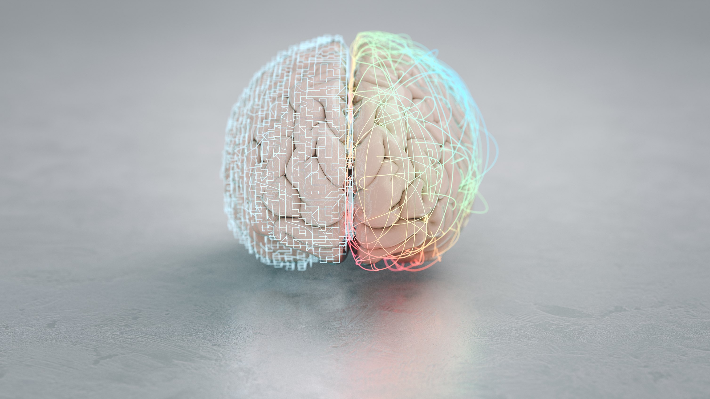
An introduction to
Borderline Personality Disorder
By Sophie Jones
(Stock Image)
Notes:
Borderline Personality Disorder more commonly referred to as BPD is a personality disorder that presents itself with a range of different symptoms. From extreme mood swings to intense feelings of emptiness, lasting anywhere form hours to days. Often leading to self-harm and in extreme cases drug and alcohol misuse (Mind, 2022).

Slide 3

History of Borderline Personality Disorder
Not formally recognised as a personality disorder until the 1980’s
(Chapman et al., 2024)
Described as ‘borderline states’ in previous years. Thought to exist somewhere between neurosis and psychosis.
(Encyclopaedia Britannica, 2026)
DSM – I in 1952 also characterised similar symptoms under schizophrenia-related categories.
(American Psychiatric Association, 1952)
Advances in psychiatric research led to BPD being recognised as a distinct disorder.
(National Center for Biotechnology Information, 2023)
(Stock Image)
Notes:
BPD was not formally categorised as a personality disorder until the 1980’s (Chapman et al., 2024).
In previous years it had been referred to as ‘borderline states’, it was thought that what we now know to be BPD sat somewhere between neurosis and psychosis (Encyclopaedia Britannica, 2024).
In 1952 the first DSM – I listed similar symptoms within schizophrenia spectrum disorder related categories. Highlighting the limited understanding of the time. (American Psychiatric Association, 1952).
Over the years significant advances in psychiatric research have led to BPD being recognised as a personality disorder in its own right (National Center for Biotechnology Information, 2023).

Slide 4

Borderline Personality Disorder (BPD) is a psychiatric condition.
Characterised by a pattern of affective instability
Simply put this means a person that has BPD often struggles with how to:
Deal with their emotions
Relate to others
Understand themselves
(Mendez-Miller et al., 2022)
(Silvia, 2019)
Notes:
BPD is categorised by a pattern of affective instability, simply put this means that people that suffer from BPD struggle to deal with their own emotions, relate to others and they often lack an understanding of themselves and why they feel the way that they do (Mendez-Miller et al., 2022).
These symptoms are the tip of the iceberg. People who suffer from BPD have a long list of things that affect their daily life, this will be discussed later in the presentation by Georgia.
Because of the broad nature of the symptoms of BPD it is often misdiagnosed as Bipolar Disorder (type 2), due to there being a crossover in many of the symptoms in both disorders (Fruzzetti, 2017).

Slide 5

People with BPD are manipulative.
(Murphy, 2025)
BPD is untreatable.
(Murphy, 2025)
People with BPD are attention seekers.
(Borderline Support UK CIC, 2024)
Common Misconceptions About Borderline Personality Disorder
BPD only affects women.
(Murphy, 2025)
BPD sufferers lack empathy.
(Borderline Support UK CIC, 2024)
Everyone with BPD is the same.
(Murphy, 2025)
(Stock Image)
Notes:
One of the most common misconceptions about BPD and there are many is that people with the disorder are manipulative. However, research has shown that behaviour seen as manipulative is basically a coping mechanism for immense emotional distress as opposed to a deliberate malicious act (CBD Online, 2024). This can lead to negative feelings towards people and healthcare settings.
Attention seeking – Some people believe that when a person with BPD behaves in an extreme way it is just them looking for attention. In reality these behaviours have been linked to a very real fear of abandonment rather than the need for attention (Borderline Support UK, 2024)
BPD is untreatable – This misconception is harmful and misguided, sometimes believed in professional settings, which contributes to the stigma surrounding BPD (Hersh, 2008). On the contrary, evidence shows that therapies like Dialectical Behaviour Therapy shows to significantly improve symptoms and quality of life (CPD Online, 2024).
BPD lacks empathy – Some people assume that people with BPD lack empathy or are uncaring. It is the opposite; sufferers of BPD feel their own and other people’s emotions very deeply. They do however struggle to express it due to their own emotional dysregulation (Borderline Support UK CIC, 2024).
BPD only affects women – This misconception is strongly linked to gender stereotypes. More women are diagnosed yearly but research suggests that this is due to diagnostic bias and the differences in how symptoms present rather than true prevalence differences (CPD Online, 2024).
Everyone with BPD is the same – There is a tendency to generalise individuals with BPD as having identical behaviours. BPD is highly diverse, symptoms vary widely in type and severity (CPD Online, 2024).

Slide 6

In Summary..
Borderline Personality Disorder is:
Complex, but understandable.
Struggles include:
Emotional sensitivity&
Challenges with self image
Changing the thinking around stigmas
It’s not a one size fits all diagnosis
Understanding Borderline Personality Disorder is not just about recognising its challenges.
Up next is Alison
(Piranka, 2020)
Notes:
In summary BPD is a complex but understandable condition, it affects individuals’ emotional sensitivity and enhances challenges with their view of themselves.
By reducing stigma and increasing understanding around BPD it will become easier to support people struggling with BPD live happier, more stable lives.
Understanding Borderline Personality Disorder is not just about recognising its challenges, but about seeing the strength behind the struggle and the real possibility for growth, healing, and a meaningful future.
Alison is up next to highlight the thoughts about what is thought to cause BPD.

Slide 7

Reference List
American Psychiatric Association. (1952). Diagnostic and statistical manual of mental disorders (1st ed.).
DSM-1 Full PDF : US Army : Free Download, Borrow, and Streaming : Internet Archive
Borderline in the ACT. (n.d.). BPD myths and facts. https://www.borderlineintheact.org.au/living-with-bpd/bpd-myths- and-facts/
Borderline Support UK CIC. (2024). Common misconceptions and stigmas. https://borderlinesupport.org.uk/lesson/common-misconceptions-and-stigmas
Borderline Support UK CIC. (2024). Stigma and societal perceptions. https://borderlinesupport.org.uk/lesson/stigma- and-societal-perceptions/
Bulat Silvia (2019) Upset and tired boy teenager sitting on the floor keeps hand to cheek looking thoughtfully and hopeless. Available at: https://www.istockphoto.com/photo/upset-and-tired-boy-teenager-sitting-on-the- floor-keeps-hand-to-cheek-looking-gm1191509927-338173847 (Accessed: 21 March 2026).
Chapman, J., Jamil, R. T., Fleisher, C., & Torrico, T. J. (2024). Borderline personality disorder. In StatPearls. StatPearls Publishing. https://www.ncbi.nlm.nih.gov/books/NBK430883/
Encyclopaedia Britannica. (2026). Borderline personality disorder. https://www.britannica.com/science/borderline-personality-disorder

Slide 8
Encyclopaedia Britannica. (2026). Borderline personality disorder. https://www.britannica.com/science/borderline- personality-disorder
Fruzzetti, A. E. (2017, October 3). Why borderline personality disorder is misdiagnosed. National Alliance on Mental Illness (NAMI). https://www.nami.org/blog/why-borderline-personality-disorder-is-misdiagnosed/
Hersh, R. (2008). Confronting Myths and Stereotypes About Borderline Personality Disorder. Social Work in Mental Health, 6(1–2), 13–32. https://doi.org/10.1300/J200v06n01_03
Mendez-Miller, M., Naccarato, J., & Radico, J. A. (2022). Borderline personality disorder. American Family Physician, 105(2), 156–161.
Mind. (2022). Experiences of borderline personality disorder (BPD). https://www.mind.org.uk/information- support/types-of-mental-health-problems/borderline-personality-disorder-bpd/experiences-of-bpd/
Murphy, N. (2025). Debunking common myths surrounding borderline personality disorder. CPD Online College. https://cpdonline.co.uk/knowledge-base/mental-health/debunking-common-myths-bpd/
National Center for Biotechnology Information. (2023). Borderline personality disorder. In StatPearls. https://www.ncbi.nlm.nih.gov/books/NBK430883/
Piranka, (2020). Human body made of entangled wires [Photograph]. iStock by Getty Images. https://www.istockphoto.com/photo/human-body-made-of-entangled-wires-gm1200775661-344087696

