Slide 1


Effective Team Working and Communication
BMSW4002
Presentation Assignment
Strategies for Effective Communication in a Business Setting.
Module Lead: Dami Pokubo
Louise Hall 2126231
Sidi Mohamed Athmani 2123160
Nerea D Cuenca Rueda 2128829

Slide 2
Content
Introduction
Theories of Communication
Channels of Communication
Barriers of Communication
The impact of Communication
Conclusions
References
Feedback

Slide 3

Introduction
We will cover various communication strategies to employ i this presentation in order to enhance communication among project participants, the restrictions, and communications channels. And also the physical barriers that Tom may have faced. Given that it was clear that Tom’s interactions with his team exhibited certain flaws.

Slide 4
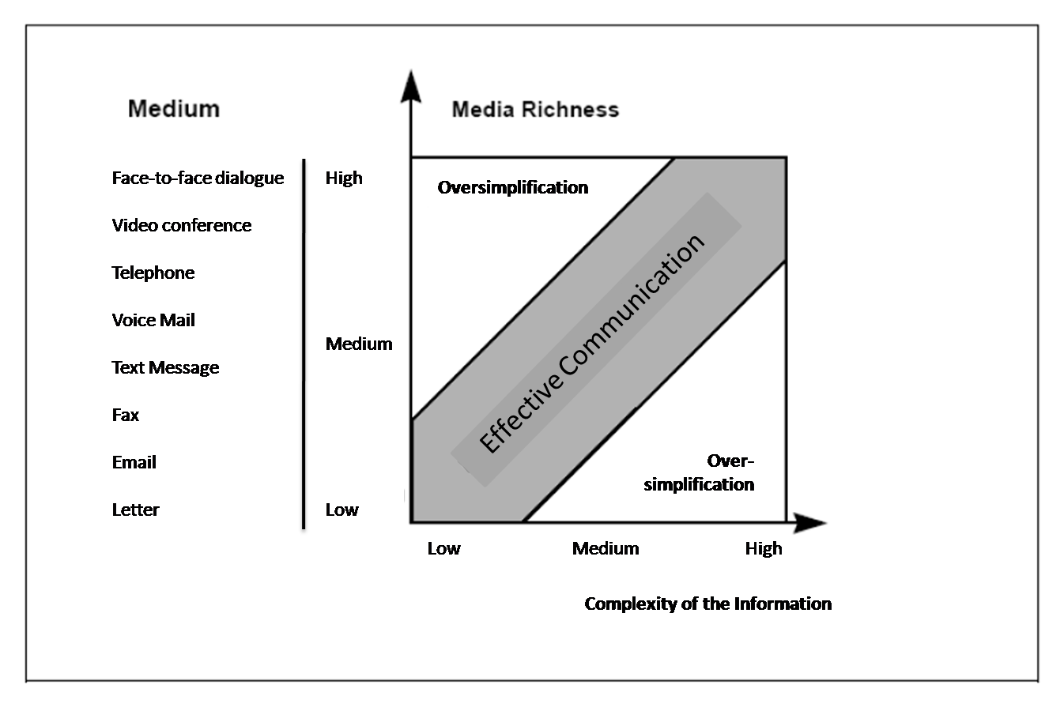

Theories of Communication
What is the theory of media richness?
Media richness theory is based on contingency theory and information processing theory (Galbraith, 1977). Early proponents of the theory were made by Daft and Lengel (1984).

Slide 5
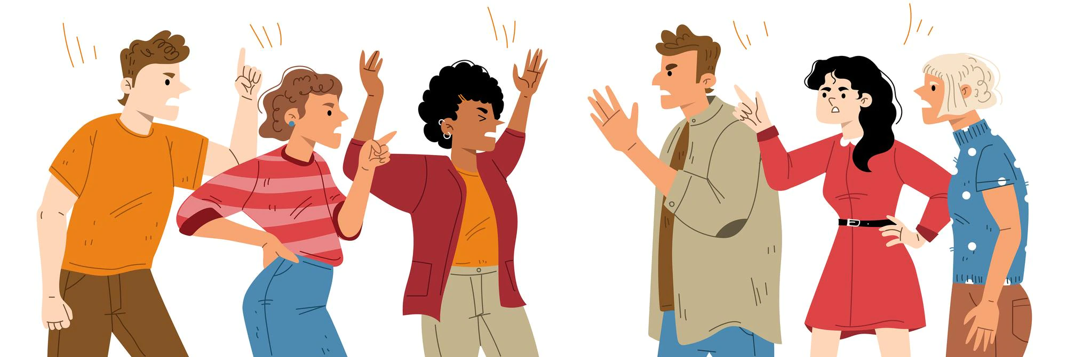
Case Study
There was no channel of communication and there were serious limits on how and how everyone communicated.
Communication was never formal throughout the project.
No effort to ensure that communication is coordinated or proper conduct is promoted.

Slide 6

Case Solution
In general, Tom should select the channel of communication that has the least chance of being misunderstood. As long as the message can be clearly understood, he should review the other benefits of each media format and select the one that makes the most sense.

Slide 7

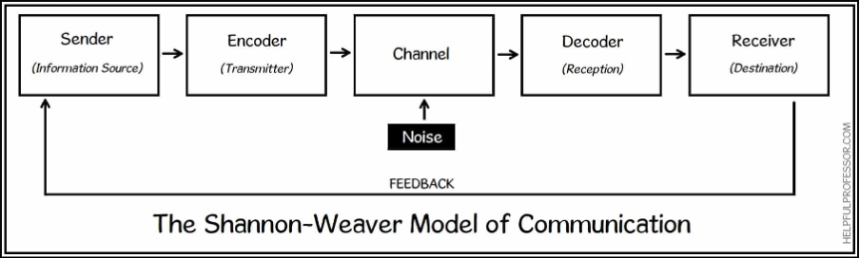
Channels of Communication
A communication channel is the process that allows transmission of a message between sender and receiver

Slide 8

Is used to communicate with other people to transfer and exchange information,data and experiences through their joint dealings and interactions
Contributes in one way or another to making administrative decisions and achieving the institutions success, effective growth and development.

Slide 9

Barriers to Effective Communication
Effective communication contributes to achieving goals through the communication process, where some information, concepts and opinions are transferred between different individuals within the community, but there are some obstacles and barriers that can face and prevent the communication process such as:
Lack of training
Language
Culture
Physical.

Slide 10

Language Barriers
Different languages and dialects affect the understanding of the two parties to the communication and their perception of the intended meaning of the speech, as each understands the phrase differently.

Slide 11

Physical Barriers
A physical barrier to communication is a physical factor or an obstacle that prevent effective exchanges between the sender and the receiver that can block moving around in the environment. (Bevin, and Jackson 196)

Slide 12

The Impact of Communication
Choose the right form of communication
Help connect with people
There are functions such as informing, persuading, regulating and motivating, among many others.

Slide 13

Conclusions
With all the data gathered for this presentation, I believe Tom’s first significant error was failing to communicate with his colleagues. There were a lot of barriers from the beginning. If Tom had implemented the right channel of communication from the start, then maybe he would have succeeded with the openings of the warehouses. The team member’s ability to collaborate on the project was hampered by the choice of an inappropriate communication route.

Slide 14
References
Bassili, J.N. (2008). Media richness and social norms in the choice to attend lectures or to watch them online. Journal of Educational Multimedia and Hypermedia, 17(4). 453-475.
Brunelle, E. (2009). Introducing media richness into an integrated model of consumers intentions to use online stores in their purchase process. Journal of Internet Commerce, 8, 222-245.
Daft, RL and Lengel, RH (1984) The wealth of information:. A new focus on managerial behavior and organization design. In: Cummings, LL & Staw, BM (Eds.), Research in Organizational Behavior 6, (191-233). Homewood, IL: JAI Press.
Dennis, A.R., Kinney , S.T., & Hung, Y.T.C. (1999). Gender differences in the effect of media richness. Small Group Research, 30(4), 405-437.
Galbraith, J. (1977). Organización Design. Reading, MA: Addison-Wesley.
Ishii, K., Lyons, M. M., & Carr, S. A. (2019). Revisiting media richness theory for today and future. Human Behavior and Emerging Technologies, 1(2), 124-131.
K Usha Rani. Journal of English language and literature 3(2).74-76,2016.
Ruben, Brebt D.(2001).”Models of Communication”. Encyclopedia of Communication and Information.
Suh, K. S. (1999). Impact of communication medium on task performance and satisfaction: an examination of media-richness theory. Information & Management, 35(5), 295-312.

Slide 15
Imagen Sources
Imagen 1https://www.freepik.es/vector-gratis/entrenador-hablando-audiencia-mentor-que-presenta-graficos-e-informes-reunion-empleados-capacitacion-empresarial-seminario-o-conferencia-ilustracion-vector-presentacion-conferencia-educacion_10172518.htm#query=negocio%20ilustracion&position=12&from_view=search&track=sph
Imagen 2https://es.vecteezy.com/arte-vectorial/10016720-diversidad-personas-mirando-hacia-arriba-y-apuntando-con-los-dedos-sonriendo-hombres-y-mujeres-personajes-indicando-hacia-arriba-en-el-cielo-buscando-nuevas-metas-concepto-plano-vector-ilustracion
Imagen 3https://www.freepik.es/vector-premium/adolescente-sorprendido-asomandose-ilustracion-plana-vectorial-marco-cuadrado-adolescente-masculino-asombrado-buscando-o-buscando-algo-realizando-gesto-idea-aislado-blanco-persona-que-mira-escondidas_34287407.htm#query=personas%20mirando%20algo&position=9&from_view=search&track=sph#position=9&query=personas%20mirando%20algo
Imagen 4https://www.freepik.es/vector-gratis/grupo-personas-enojadas-pelean-discuten_30157547.htm
Imagen 5https://www.freepik.es/vector-gratis/reunion-corporativa-empleados-personajes-dibujos-animados-que-discuten-estrategia-comercial-planifican-acciones-adicionales-lluvia-ideas-comunicacion-formal-ilustracion-concepto-seminario_11668427.htm#query=personas%20discutiendo&position=4&from_view=search&track=sph
Imagen 6https://www.freepik.es/vector-premium/persona-divertida-feliz-asomandose-mirando-detras-agujero-redondo-adolescente-curioso-mirando-furtivamente-circulo-buscando-algo-concepto-curiosidad-ilustracion-vectorial-plana-coloreada-aislada-blanco_34286853.htm#query=personas%20mirando%20algo&position=6&from_view=search&track=sph
Imagen 7https://www.freepik.es/vector-gratis/mujeres-felices-sentadas-hablando-si-dialogo-psicologo-tableta-ilustracion-plana_12291116.htm
Imagen 8https://www.freepik.es/vector-gratis/gente-plana-haciendo-preguntas-ilustracion_13297311.htm#from_view=detail_alsolike
Imagen 9https://www.freepik.es/vector-premium/ilustracion-gente-joven-hablando_19206529.htm?query=multiculturalidad#from_view=detail_alsolike
Imagen 10https://www.freepik.es/vector-gratis/par-personas-sordas-hablando-gestos-manos-oido-enorme-mudo-firmar-segundo-plano-ilustracion-vector-perdida-auditiva-comunicacion-concepto-lenguaje-senas_11671428.htm#query=personas%20hablando&position=18&from_view=keyword
Imagen 11https://www.freepik.es/vector-gratis/gente-inconformista-hablando-usando-computadoras-colaboracion_7732640.htm#query=gente%20hablando&position=7&from_view=search&track=sph
Imagen 12https://www.freepik.es/vector-premium/concepto-preguntas-frecuentes_27041304.htm#query=dificultad%20para%20hablar&position=27&from_view=search&track=sph

Slide 16
Feedback
Teamwork Evaluation | Team Responses
Who was in your team? | Louise - Sidi and Nerea
What were the key of strengths of your team? | - The ability to communicate effectively and in polite manner. - Exchange idea and achieve the goal.
What were the challenges that you overcame as a team? | - Distance working – poor communication –poor work environment – how to keep our team on track with clear instructions.
What would you do differently if you worked as a team again? | - Create an effective atmosphere- use better collaboration tools – ask team member for feedback- meet in different locations-
How would you rate your team working? Out of 10? | 5

