Slide 1
Satan in the New Testament (Part 1): Satan in the Gospels
HPRS5033/6033

Slide 2
Towards the New Testament Satan
Important developments in the Intertestamental period in terms of the concept of the Devil.
Traditions concerning ‘fallen angels’ and their leader (e.g. Semyaza; Azazel; Mastema; Belial; Satanail).
Eschatological battle between the powers of light and the forces of darkness (see DDS).
The Devil as a character who is in open rebellion against God and who is antagonistic towards humanity (see Testament of Job, Latin Life of Adam and Eve).

Slide 3
The Devil in the New Testament
The battle against Satan central to early Christian thought – the struggle between good and evil conceived in cosmic terms.
Victory over the Devil a crucial aspect of the redemption of humanity.
Jesus able to save from the power of the Devil.
The Devil plays a key role in the NT as the chief enemy of the kingdom of God.

Slide 4
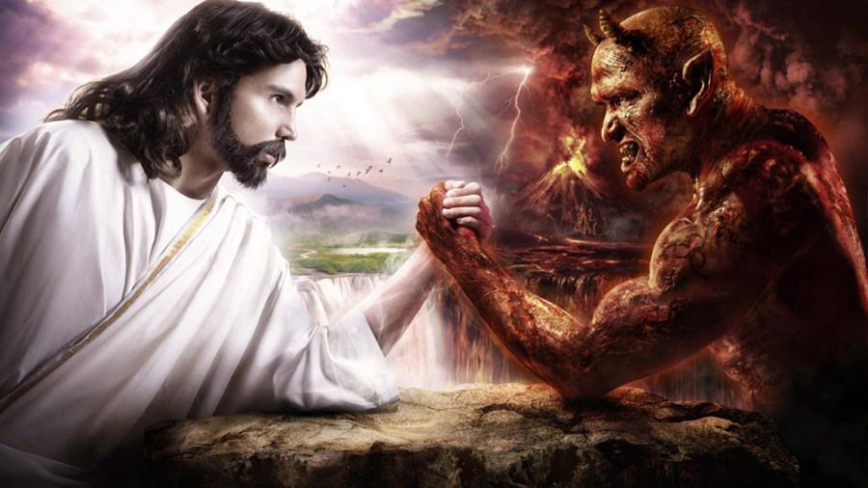
Jesus vs. Satan

Slide 5
The Devil in the New Testament
‘The Devil’ (Ho Diabolos) used 33x to denote God’s principal opponent. Note that the term does not occur in Mark, the earliest of the canonical Gospels.
Satanas is the other major term for the enemy of Jesus and the kingdom of God (also 33x). Occurs in all four Gospels.

Slide 6
The Devil in the New Testament
Ho echtros (‘the Enemy’, e.g. Matt. 13:25, 39; Luke 10:19)
Beelzebul (‘lord of the high house’, Beel = ‘Ba’al, zebul = ‘height, dwelling place’, e.g. Matt. 10:25; 12:24; Mark 3:22; Luke 11:15)
Belial (‘worthless’, 2 Cor. 6:15)
‘Ruler of this world’ (e.g. John 12:31; 14:30; 16:11)
‘The tempter’ (Matt. 4:3; 1 Thess. 3:5)

Slide 7
The Devil in the New Testament
‘The accuser of our brothers’ (Rev. 12:10)
Ho ponêros (‘the Evil One’, e.g. Matt. 13:19, 38; 1 John 5:18, see also the Lord’s Prayer in Matt. 6:13; Luke 11:4)
‘Prince of the demons’ (Matt. 9:34)
‘Prince of the powers of the air’ (Ephesians 2:2)

Slide 8
The Devil in the Synoptic Gospels: The Temptation of Jesus
Jesus’ temptation in the wilderness the first appearance of the Devil in the Synoptic Gospels (Matt. 4:1-11; Mark 1:12-13; Luke 4:1-13).
Jesus led by the Spirit into the wilderness where he is tempted by Satan (Mark 1:13) or the Devil (Matt. 4:1; Luke 4:2).
Much more extensive narrative in Matthew and Luke.

Slide 9
The Temptation of Jesus (Mark)
‘And the Spirit immediately drove him out into the wilderness. He was in the wilderness for forty days, tempted by Satan; and he was with the wild beasts; and the angels waited on him’ (Mark 1:11-13).

Slide 10
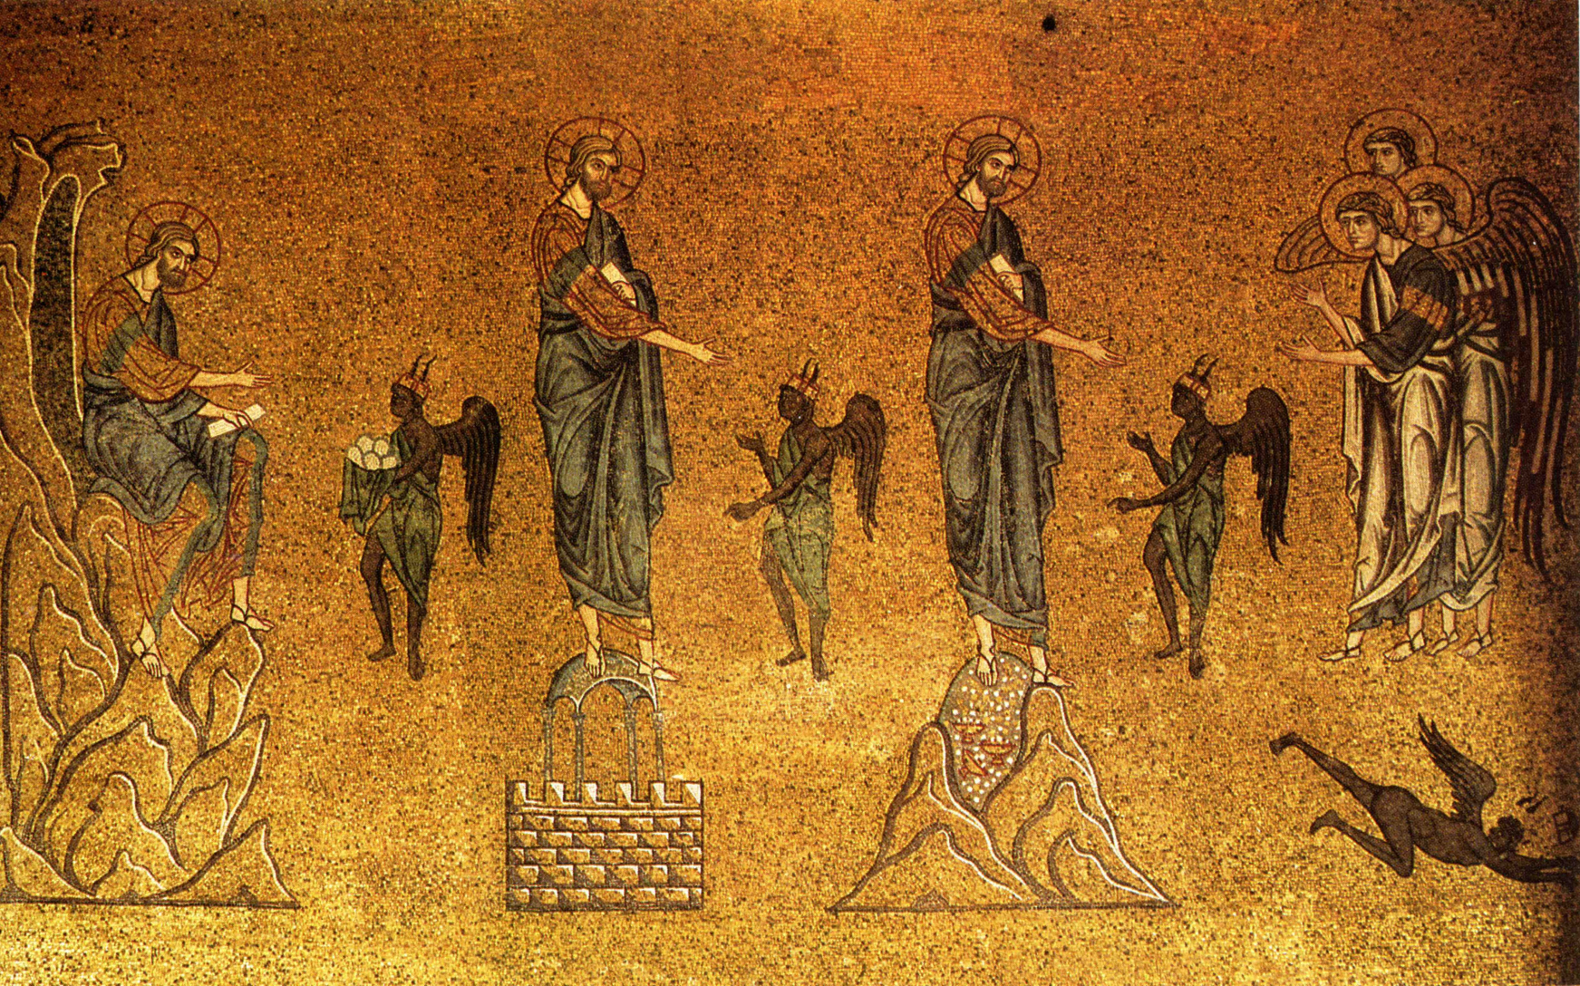
The Temptation of Jesus (Synoptic Gospels)

Slide 11
The Temptation of Jesus (Matthew)
‘The tempter came and said to him, “If you are the Son of God, command these stones to become loaves of bread”’ (Matt. 4:3).
‘Then the devil took him to the holy city and placed him on the pinnacle of the temple, saying to him, “If you are the Son of God, throw yourself down…”’ (4:5-6)
‘Again, the devil took him to a very high mountain and showed him all the kingdoms of the world and their splendour; and he said to him, “All these I will give you, if you will fall down and worship me”’ (4:8-9).

Slide 12
The Temptation of Jesus: the Satanic Plan
Satan’s aim is to separate Jesus from God.
Jesus responds by maintaining his obedience to God’s word.
The devil is portrayed as a charlatan: he quotes Scripture in one temptation (Matt. 4:6; Luke: 4:9) and claims to be in possession of ‘the kingdoms of the world’ (Matt. 4:8-9; Luke 4:5-7).

Slide 13
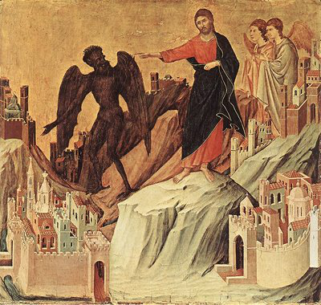
The Temptation of Jesus: Jesus’ Response
‘Jesus said to him, “Away with you Satan…” Then the devil left him, and suddenly angels came and waited on him’ (Matt. 4:10-11).
‘When the devil had finished every test, he departed from him until an opportune time (Luke 4:13) – reference to Jesus’ arrest (see 22:53)?

Slide 14
Satan as the Enemy of the Kingdom of God (Synoptic Gospels)
Two kingdoms at war with each other: God’s kingdom and Satan’s kingdom.
‘How can Satan cast out Satan? If a kingdom is divided against itself, that kingdom cannot stand’ (Mark 3:22-25).
Parables of Jesus: Satan snatches seed sown in the heart (Mark 4:15); he sows weeds among the wheat (Matt. 13:25, 28).
The fruit of his work is destroyed during harvest, i.e. the day of judgement (Matt. 13:30).

Slide 15
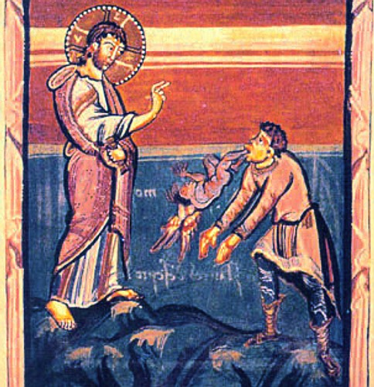
Jesus’ Exorcisms (Synoptic Gospels)
In the Synoptic Gospels, the connection between exorcisms and the arrival of God’s kingdom on earth is made explicit.
‘But if is by the Spirit of God that I cast out demons, then the kingdom of God has come to you’ (Matt. 12:28).
By exorcising demons, Jesus makes war on the kingdom of Satan and announces the coming of the kingdom of God.

Slide 16
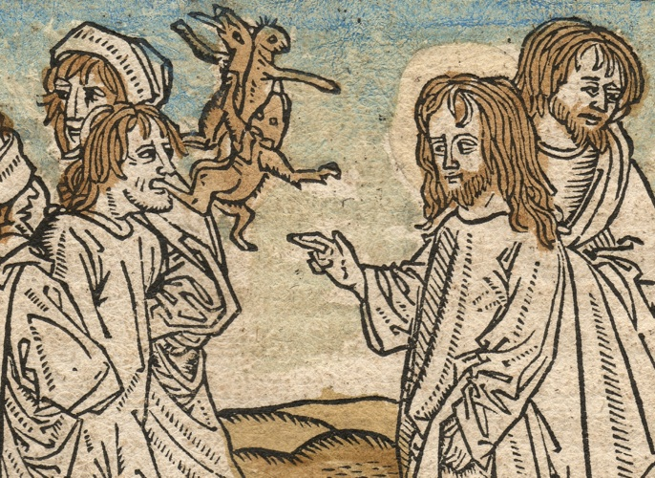
Jesus’ Exorcisms (Synoptic Gospels)
‘Exorcism’ seen as a type of healing. In each of the Synoptic Gospels a particular relationship between exorcism and healing can be discerned.
As we move from Mark to Matthew to Luke, the distinction between healing (of sickness) and exorcism becomes increasingly blurred.

Slide 17
Jesus’ Exorcisms (Mark)
In a number of places, Mark seems to distinguish between the healing of the sick and the casting out of demons (e.g. 1:32-34; 6:13).
At other times, it is unclear if Jesus is healing disease or exorcising demons (3:10-12; cf. 1:21-28; 3:10-12; 5:1-20; 7:24-30).
Physical illness explicitly attributed to demonic activity in 9:14-29.

Slide 18
Jesus’ Exorcisms (Matthew and Luke)
Matthew: demons are responsible for muteness (9:32-33) and epilepsy (17:14-21), but the author can also refer to Jesus healing disease separately from casting out demons (8:16-17; 9:35-37).
Luke blurs the boundaries between healing and demonic activity more than any other NT writer: ‘As the sun was setting, all those who had any who were sick with various kinds of diseases brought them to him…Demons also came out of many shouting, “You are the Son of God”’ (Luke 4:40-41; cf. 4:38; 6:18-19; 11:14 ).
See also the healing of a woman ‘with a spirit that had crippled her for eighteen years’ (Luke 13:10-17).

Slide 19
Jesus’ Exorcisms: Key Features
No ‘ritualistic’ features as in other Jewish exorcisms (cf. Tobit 3:7-16; Josephus, Antiquities 8:46-48).
Healing of the Gerasene demoniac: herd of swine rushes over a cliff into the sea (Mark 5:1-20; Luke 7:26-39) – ritual of relocation.
No prayers or use of a powerful (divine) name, as in Jewish exorcisms.
Jesus’ name used by others in exorcism (Luke 10:17; Acts 19:13), suggesting that Jesus had a reputation as an exorcist.

Slide 20
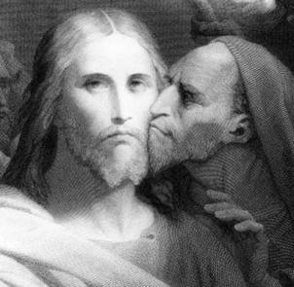
The Devil in Jesus’ Final Hours (Synoptic Gospels)
An increase in demonic activity against Jesus during the hours leading to his death, primarily through his opponents (e.g. Luke 22:3-4, 31, 52-53).
Cf. John’s Gospel (13:2, 26-30).

Slide 21
Jesus’ Death as Victory over Satan
The connection is made explicit in John’s Gospel (12:31) but is more implicit in the Synoptic Gospels.
‘My God, my God, why have you forsaken me?’ (Mark 15:34) and darkness over the land: could it appear that Satan has been victorious?
‘The earth shook, and the rocks were split. The tombs also were opened, and many bodies of the saints who had fallen asleep were raised’ (Matt. 27:51-52) – a foretaste of Jesus’ resurrection, an event which confirms victory over the Devil and the arrival of God’s kingdom.

Slide 22
The Devil in the Gospel of John
Satan (e.g. 13:27), the Devil (e.g. 13:2), the Evil One (e.g. 17:15), ruler of this world (e.g. 12:31).
In the Synoptic Gospels, the Devil often appears in personified form (e.g. Matt. 4:1-11; Luke 4:1-13), and evil or unclean spirits are able to seize people physically (Matt. 8:28-34; Mark 3:22-27; Luke 9:37-43).
In John’s Gospel, the Devil is not personified. He lurks in the shadows, operating, for the most part, through human agents (Judas is an example of this, see 13:1-4, 27; cf. 6:64, 70-71).

Slide 23
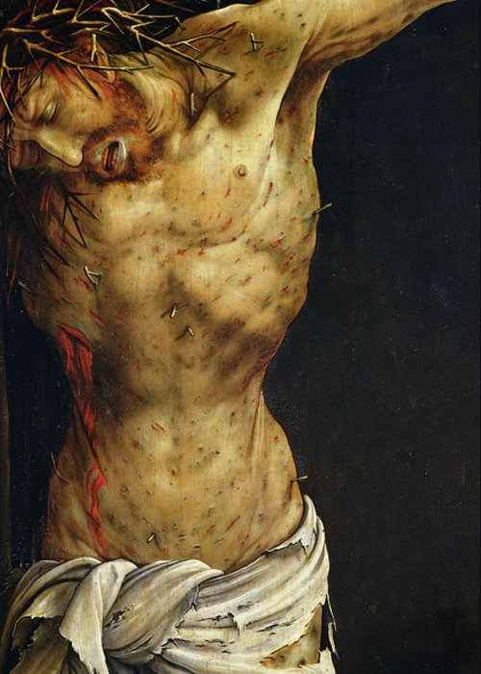
The Devil in the Gospel of John
No accounts of exorcism in John’s Gospel!
‘Now is the judgement of this world; now the ruler of this world will be driven out. And I, when I am lifted up from the earth, will draw all people to myself’ (12:31-32; cf. 16:11).
‘The Crucifixion’, Matthias Grünewald (c. 1512-16)

Slide 24
The Devil in the Gospel of John: Key Passage
‘You are from your father the devil, and you choose to do your father’s desires. He was a murderer from the beginning and does not stand in the truth, because there is no truth in him. When he lies, he speaks according to his own nature, for he is a liar and the father of lies’ (8:44).

Slide 25
The Devil in the Gospel of John: Chief Aspects
Deception: the Devil is ‘a liar’ and ‘the father of lies’. Jesus, by way of contrast, is ‘the truth’ (14:6; cf. 1:14).
Hatred: the Devil encourages hatred of God, Jesus, and the Christian community. God loves the world and sent his Son as the expression of his love (3:16). Therefore, those who belong to God love Jesus, whereas those allied with the Devil do not (cf. 7:7; 15:23)
Death: the Devil was a ‘murderer from the beginning’ and seeks the death of those who oppose him. The adversaries of Jesus show the influence of the Devil by seeking to kill Jesus for speaking the truth.

Slide 26
Satan’s Defeat in the Gospel of John
Although John refers to the Devil as the ‘ruler of this world’, it is clear that his rule will not last forever.
‘Now is the judgement of this world; now the ruler of this world will be driven out’ (12:31).
‘And when he [the Advocate] comes, he will prove the world wrong about sin and righteousness and judgement: about sin, because they do not believe in me; about righteousness, because I am going to the Father and you will see me no longer; about judgement, because the ruler of this world has been condemned’ (16:8-11).

Slide 27
Light-Darkness Dualism in John’s Gospel
The relationship between God and Satan/Good and evil is depicted as a struggle between light and darkness.
The evil one cannot overcome the power of God any more than darkness can extinguish light (1:5).
Light has a power that darkness does not (8:12).
People can become children of light by believing in the light. Those who reject Jesus have sided with the darkness – they have become children of the Devil through choice.

Slide 28
Light-Darkness Dualism in John’s Gospel
‘Jesus said to them, “The light is with you for a little longer. Walk while you have the light, so that the darkness may not overtake you. If you walk in the darkness, you do not know where you are going. While you have the light, believe in the light, so that you may become children of light”’ (12:36).
‘I have come as light into the world, so that everyone who believes in me should not remain in the darkness’ (12:46).

Slide 29
Light-Darkness Dualism in DDS
‘He has created man to govern the world, and has appointed for him two spirits in which to walk until the time of his visitation: the spirits of truth and injustice. Those born of truth spring from a fountain of light, but those born of injustice spring from a source of darkness. All the children of righteousness are ruled by the Prince of Light and walk in the ways of light, but all the children of injustice are ruled by the Angel of Darkness and walk in the ways of darkness’ (1QS 3:18-21).
‘The dominion of the Kittim shall come to an end and iniquity shall be vanquished, leaving no remnant; [for the sons] of darkness there shall be no escape. [The sons of righteous]ness shall shine over all the ends of the earth; they shall go on shining until all the seasons of darkness are consumed and, at the season appointed by God, His exalted greatness shall shine eternally to the peace, blessing, glory, joy, and long life of all the sons of light’ (1QM 1-8).

Slide 30
Summary
As the chief enemy of God, Jesus and the nascent Christian community, the Devil is central to the narrative of the 4 canonical Gospels.
Synoptic Gospels: the Devil appears to Jesus ‘in the flesh’, and demons are able to possess people physically. Exorcisms a key weapon in the fight against Satan.
John’s Gospel: the Devil carries out his designs primarily through human agents (‘the Jews’, Judas etc.). It is through the death and resurrection of Jesus that ‘the ruler of this world’ is cast out.
The nature of Jesus’ victory over Satan elaborated upon by the Early Church Fathers.

