Slide 1
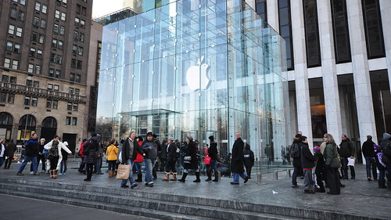
APPLE
TITLE PAGE
Program Study: BA (Hons) Business management
Modules Name and code: Introduction to Business, LCBB4014
Lectures Name: Muno Zuwirai
Student Number: (GRACE,2330971),
(CHRIS,2441744), (ELENA,2440481), (FLORINA,2326724)

Slide 2
Table of content
Expanded Global Supply Chain & Manufacturing Efficiency:
Access to Specialized Components: Sources high-tech parts globally (e.g., chips from TSMC in Taiwan, displays from South Korea/Japan).
Concentrated, Cost-Effective Assembly: Leverages massive scale and lower labor costs primarily in China (Foxconn/Pegatron) for efficient final assembly.
Just-in-Time Logistics: Relies on complex, global logistics networks for rapid component delivery and product distribution worldwide.
Swot and Pestel analysis
Vast Global Market Access & Revenue Growth:
Worldwide Sales Footprint: Sells products and services in virtually every country, significantly expanding its potential customer base.
Revenue Diversification: Reduces dependence on any single market (e.g., strong growth in China, India, Europe alongside North America).
Localization Strategies: Adapts products (keyboards, power adapters), software (languages, features), marketing, and retail stores to local cultures and regulations.

Slide 3
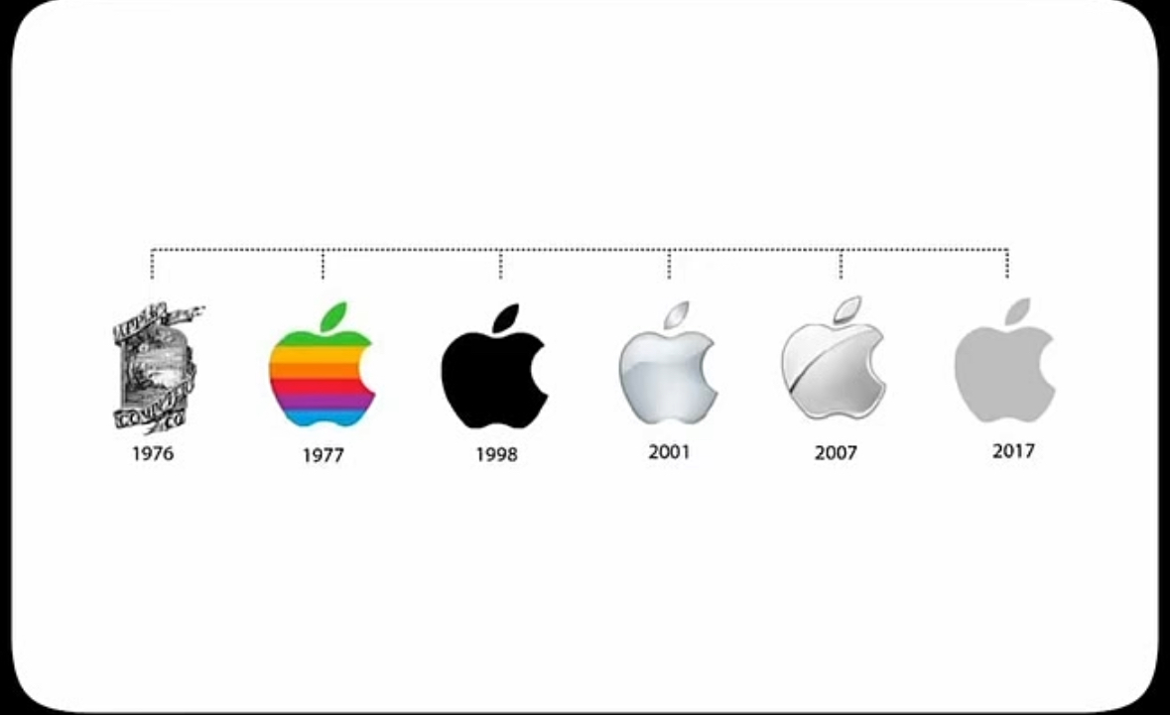
Overview of Apple Company
(type of company, size, structure, annual revenues, products and services). 2441744
The Apple brand is a multinational technology company that designs not only phones but also a range of electronic devices, such as (Laptops, Computers, iOS Software Updates, iTunes and Apple Music). It develops and sells consumer electronics, software, and online services. It is one of the largest technology companies in the world, with a complex structure led by a CEO and a board of directors.
Apple’s annual revenues are in the hundreds of billions of dollars.
Their main products include iPhones, iPads, iMacs or MacOS, Apple Watches, AirPods, and services like the App Store, iCloud, and Apple Music.
Apple (April 16, 2025)
Ellen Terrell (2023)

Slide 4

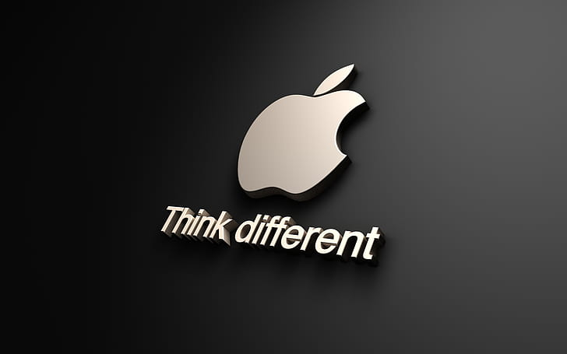
Overview of Apple Company
(type of company, size, structure, annual revenues, products and services).
2441744
Apple sets itself apart from competitors through its focus on premium design, user experience, and a tightly integrated ecosystem. While companies like Samsung, Google and others offer a wider range of devices and open-source software, Apple emphasises simplicity and seamless integration across its hardware and software. This approach often leads to strong brand loyalty and higher customer satisfaction.
The Vision Pro is an Apple mixed-reality headset, that blends augmented and virtual reality experiences. It features a high-resolution display for each eye, advanced spatial audio, and hand and eye tracking for intuitive negatives. It’s designed for immersive entertainment, productivity, and communication, allowing users to interact with digital content in a 3D motion capture. Apple (2024). Apple Vision Pro
This Photo by Unknown Author is licensed under CC BY-NC

Slide 5

SWOT ANALYSIS
APPLE
STRENGHTS: Strong global recognition. Apple being a popular brand and good recommended have good selling all around the world. Pérez (2021)
WEAKNSSES: Limited products, Apple depends a lot in Iphones, compering to other brands as Samsung offers a lot options.
OPPORTUNITIES: Seeking opportunities as giving service like Apple TV, Apple pay, Apple music, Icloud and others.
THREATS: Technological change, Apples uses to change the system and add new apps all the time, if apple fails with new a system probably will affect the whole company. (Sheridan, n.d.2025)
2330971
Swot Analysis is a help decision making tool to identify the internal and external, involving: strenghts, weakness, opportunities, threats.
(BBC,2025)

Slide 6
PESTEL ANALYSIS APPLE 2330971
PESTEL is a useful tool to understand the macro-environment to order operations in a business as strategic plan. (RapidBI, 2025)
POLITICAL | ECONOMIC | SOCIAL | TECHNOLOGICAL | ENVIROMENTAL | LEGAL
GLOBAL OPERATIONS - international tariffs and trade wars (U.S-CHINA) | INFLATION & RECESSION RISK | LIFESTYLE INTEGRATION -Keeping clients with innovations premium products like apple music | LEVEL OF INNOVATION -Apple keep leading (vision pro) or new products like (pro max) | ENVIROMENTAL POLICIES | ANTI TRUST LAWS -App store policies & market dominances.
GOVERMENT POLICY | ECONOMIC GROWTH | BRAND LOYALTY | TECHNOLOGICAL INCETIVES | E- WASTE MANAGEMENT –Carbon neutral supply and products by 2030. Apple Inc. (2023) | PRIVI-CY LAWS
TRADE RESTRICTION | INTEREST RATES -Apple earns globally, so impacts revenue. | DIVERSE WORKFORCE EXPECTATION | TECHNOLOGICAL AWARENESS -expanding service ,makes revenue and new policies. | GREEN ENERGY | PATENT LAW-SUIT

Slide 7
Complex Global Regulatory & Political Environment:
Complex Global Regulatory & Political Environment:
Diverse Regulations: Navigates varying laws on taxation, data privacy (GDPR in EU), consumer protection, environmental standards, content moderation, and intellectual property across all markets.
Geopolitical Tensions: Highly vulnerable to trade wars (e.g., US-China tariffs), sanctions, and political instability impacting supply chains and market access (e.g., Russia exit). Requires careful geopolitical navigation.
Tax Scrutiny: Faces pressure and investigations regarding global tax strategies and profit allocation (e.g., EU state aid cases).

Slide 8
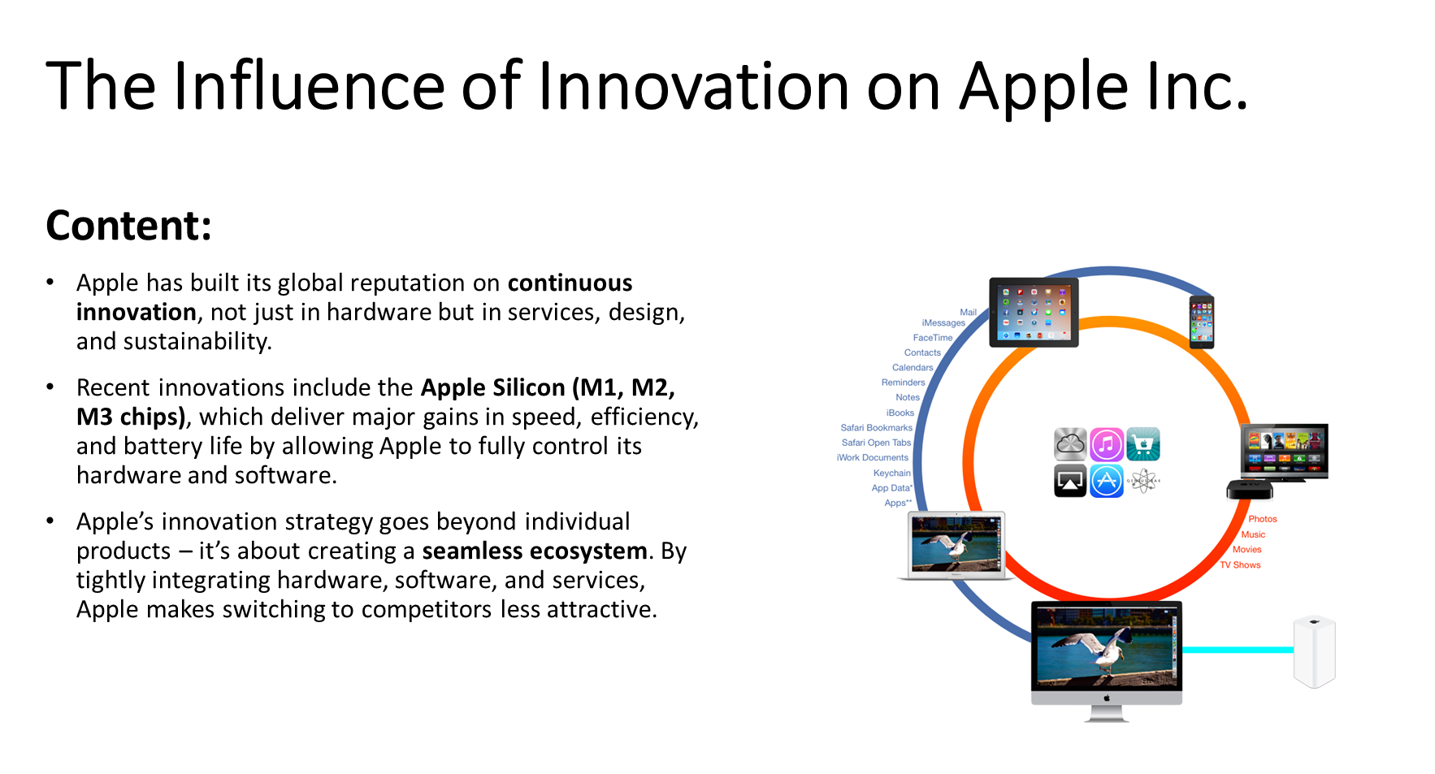
Innovation has always been a core part of Apple Inc.’s identity. From the launch of the original Macintosh in 1984 to the iPhone revolution in 2007, Apple has consistently set itself apart by creating new technologies or dramatically improving existing ones. This commitment to innovation remains a key reason for the company’s continued success in a highly competitive global technology market.
One of Apple’s most significant innovations in recent years has been its move toward designing its own hardware. The introduction of Apple Silicon, starting with the M1 chip, marked a major shift from Intel processors in Macs. These chips significantly improved performance and battery life, allowing Apple to control both hardware and software development more tightly. This level of integration gives Apple a unique advantage—it can optimize the user experience in ways that most competitors cannot.

Slide 9
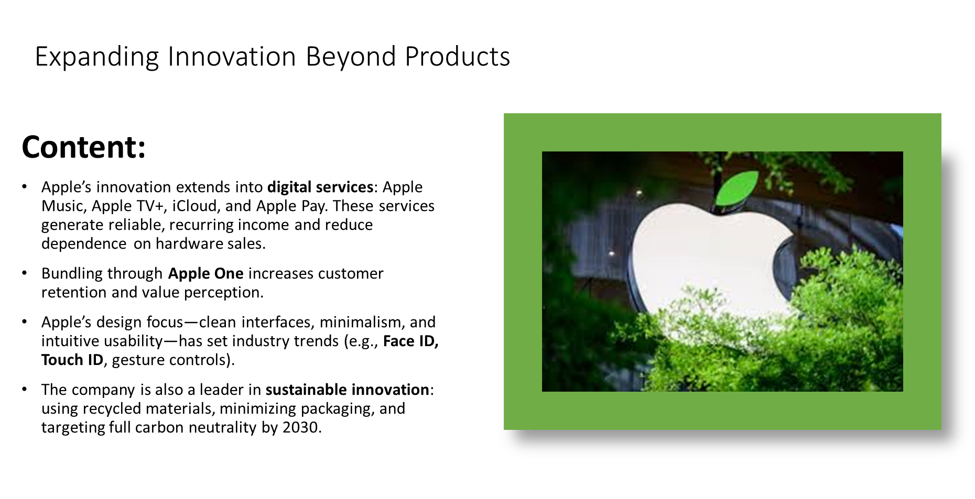
Digital Services
In addition to hardware, Apple continues to innovate through its ecosystem of products and services. Devices such as the iPhone, iPad, Mac, Apple Watch, and AirPods are all designed to work seamlessly together. Features like Handoff, AirDrop, and iCloud storage allow users to switch between devices effortlessly. This ecosystem model not only improves convenience for users but also encourages customer loyalty. Once people become accustomed to the Apple experience, they are more likely to stay within the brand and purchase more products and services.
Innovation at Apple also extends into the services sector. Over the past decade, Apple has expanded into digital content and cloud-based services, including Apple Music, Apple TV+, iCloud, and Apple Pay. These services have become a major source of revenue and are less dependent on the sale of physical products. The bundling of services under Apple One offers additional value to customers while strengthening the company's subscription-based business model.Another important area where innovation plays a role is sustainability. Apple has made strong environmental commitments, such as using recycled materials in its devices and aiming for carbon neutrality across its entire supply chain by 2030. These efforts reflect growing consumer demand for more ethical and environmentally responsible companies, and Apple’s focus on this area helps improve its public image and build trust.

Slide 10
RECOMMENDATIONS AND CONCLUSION
2441744
Based on Apple's external environmental and internal analysis we recommend Apple to:
To reduce revenues
Product: the last iPhone (if you’re looking to upgrade your phone).
Service: Apple Music (if you’re into streaming music).
Camera Quality: (Look for high megapixel counts and advanced features like night mode and cinematic mode).
Processor: (Newer processors; Like the A16 Bionic, which offers faster performance and better energy efficiency
Storage: (Choose enough storage for your photos, videos and apps 128GB or more is recommended).
Screen size: (Decide if you prefer a smaller, more pocketable size or a larger screen for better viewing).
Battery Life: (Check reviews for real-world battery performance to ensure it meets your daily needs).
Apple is a global leader in technology and innovation so still on and in future success, apple shows that it knows how to innovate and adapt globally.

Slide 11
REFERENCE LIST
Apple Inc. (2023).Supplier List
Kraemer , K. L., Linden, G., & Dedrick, j.(2011) Capturing Value in Global Networks AppleApple Inc. (2023). Supplier List. https://www.apple.com/supply-chain/
Kraemer, K. L., Linden, G., & Dedrick, J. (2011). Capturing Value in Global Networks: Apple’s iPad and iPhone. UC Irvine. PDF Link:
https://www.statista.com/statistics/263401/global-apple-iphone-sales-since-3rd-quarter-2007/
Apple swot analysis and PESTEL.
Apple Inc. (2023) Environmental Progress Report 2023. Apple. Available at: https://www.apple.com/environment/pdf/Apple_Environmental_Progress_Report_2023.pdf (Accessed: 14 June 2025).
BBC Bitesize (n.d.) Business case study: Apple. Available at: https://www.bbc.co.uk/bitesize/guides/zkdc7nb/revision/5 (Accessed: 13 June 2025).
Pérez, L. (2021) Strategic analysis of Apple Inc. [Report]. University of Technology of Madrid. Available at: https://demo.dspacedirect.org/server/api/core/bitstreams/c5fcc52d-13fe-4a94-ae78-24f2a820a312/content (Accessed: 13 June 2025).
RapidBI (n.d.) PESTLE Analysis. Available at: https://rapidbi.com/pestle/ (Accessed: 13 June 2025).
Sheridan, N. (n.d.) Apple SWOT Analysis: Strengths, Weaknesses, Opportunities, and Threats. Latterly.org. Available at: https://www.latterly.org/apple-swot-analysis/ (Accessed: 13 June 2025).
Levy, S. and Montevirgen, K. (2025). Apple Inc. [online] Britannica. Available at: https://www.britannica.com/money/Apple-Inc.
‌ Wright, G. (2024). What is Apple? [online] TechTarget. Available at: https://www.techtarget.com/whatis/definition/Apple.
‌ Richardson, A. (2008). The founding of Apple Computer, Inc. [online] Library of Congress. Available at: https://guides.loc.gov/this-month-in-business-history/april/apple-computer-founded.
Apple Support. (2024). Password security recommendations. [online] Available at: https://support.apple.com/en-gb/guide/security/sec7f0432063/web [Accessed 14 Jun. 2025].
‌‌ Xue, M. (2018). Made in China: The Story of Foxconn and Apple. Harvard Business School Case Study.
Apple (2024). Apple Vision Pro. [online] Apple (United Kingdom). Available at: https://www.apple.com/uk/apple-vision-pro/.
finance.yahoo.com. (n.d.). Apple Inc. (AAPL) Analyst Ratings, Estimates & Forecasts - Yahoo Finance. [online] Available at: https://finance.yahoo.com/quote/aapl/analysis/.
Wikipedia. (2023). Apple Inc. [online] Available at: https://en.wikipedia.org/wiki/Apple_Inc.#Notes.
Apple Inc. (2023). Apple Reports Fourth Quarter Results. Apple Newsroom. https://www.apple.com
Harvard Business Review. (2021). How Apple Is Organized for Innovation. https://hbr.org/2021/11/how-apple-is-organized-for-innovation

Slide 12
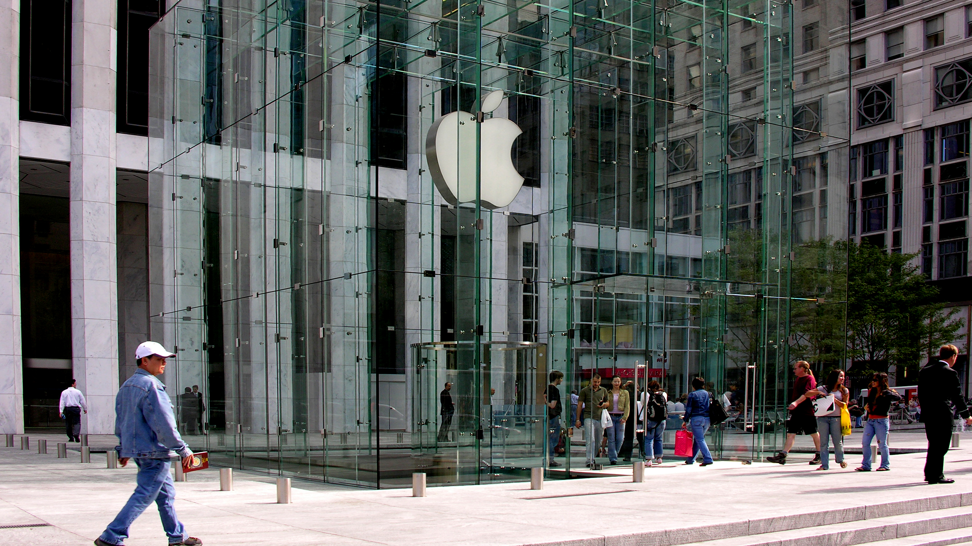
THANK YOU FOR YOUR TIME!!!!
:)
CCYYSA.

