Slide 1


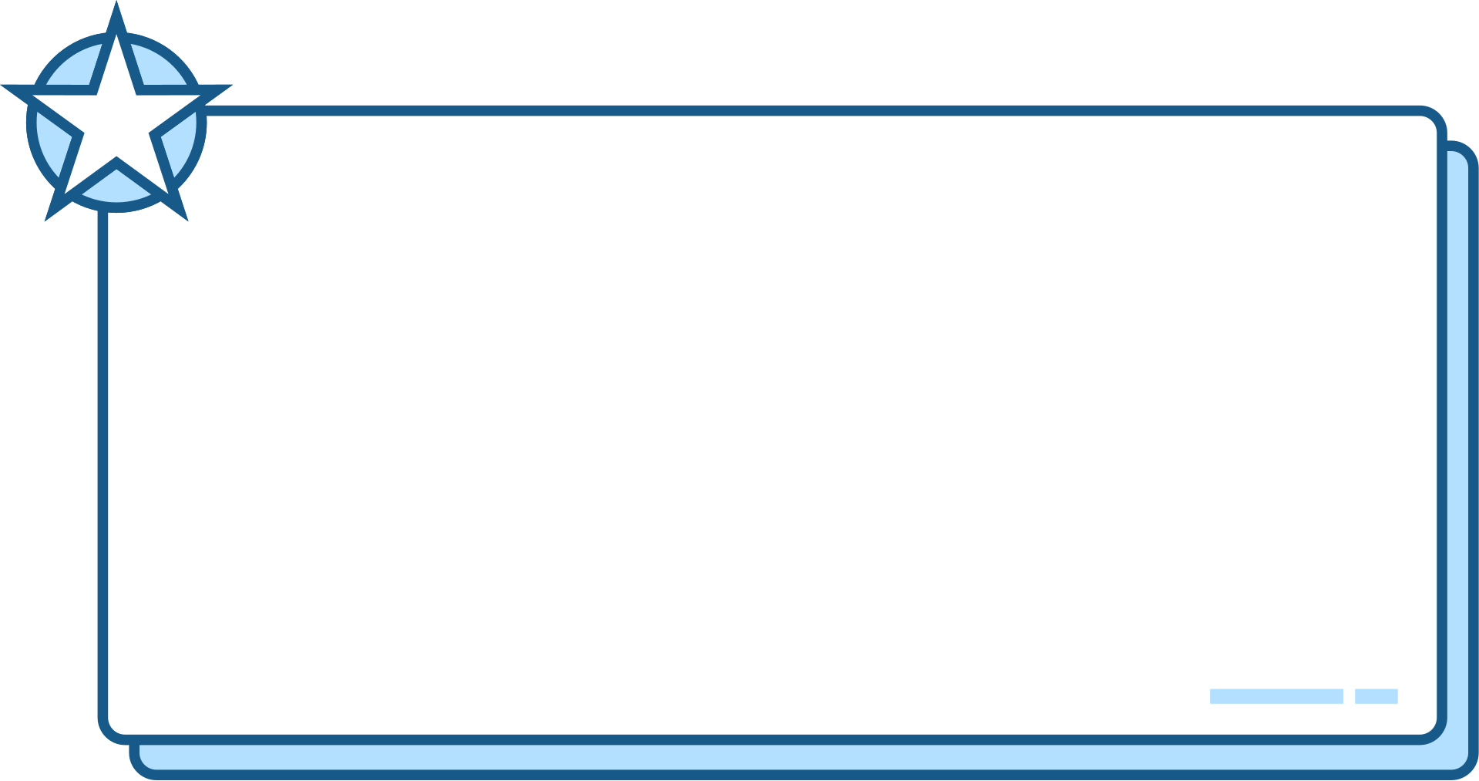


1
MODULE CODE: LCLM 4002
MARIVIC A OMANA
Student ID: 2335159
DIGITAL SKILLS
TITLE: Using Canva informative poster
Hyperlinks
Hyperlinks navigate the specified URL that provides a direct access on the specific content of the link.
This Hyperlink uses HTML codes that directs the individual to the related destination of the link.
2
PURPOSE
It is to navigate the search engine of the individual, allowing the user to jump to the online content and can be used to link different sections of documents to deliver quick navigations.
Hyper
links
3
FACTS
Function is to create a shortcut that jumps to another location. It resembles a Treelike structure that gives access to sites and give out small related pieces to the search engine of the individual.
4
CONCLUSION
Hyperlinks are mostly essential for the search engine and for web navigation, allowing quick access to similar sources of the (SEO) as it is a powerful tool for navigation and interaction.

