Slide 1
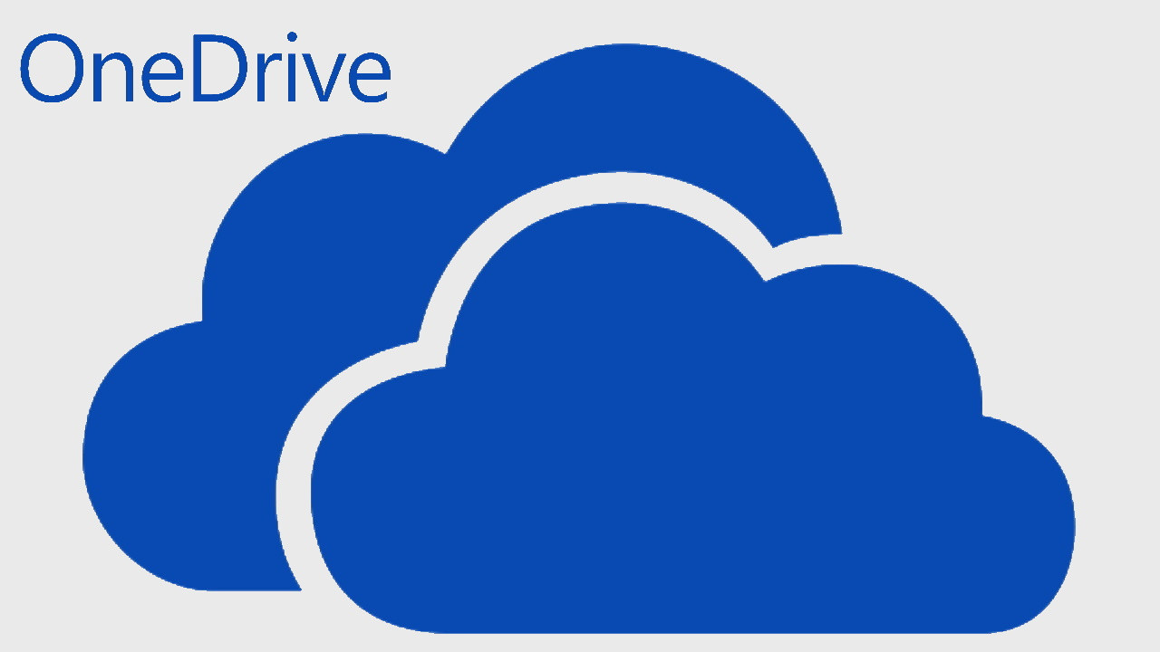
How to share a file via one drive
Option 1: Share via OneDrive on the Web Go online to OneDrive: Visit https://onedrive.live.com and sign in with your Microsoft account. Find your file or folder: Navigate to the file/folder you want to share. Choose the item: Hover over it and click the circle that appears to select it. Click “Share”: In the top toolbar, you'll find a Share icon—a person with a plus sign. Choose your sharing options: Anyone who receives the link can access it (you can switch between View and Edit). If it is a work/school account, people in your organization restrict access to coworkers or students. Specific people — only the people you specify can access it. Set permissions (optional): Allow editing or restrict to view only. Password or an expiration date should be set. Send or copy the link: To share manually (such as via email or chat), click the Copy link. You can also share directly from OneDrive by entering email addresses and clicking Send.

