Slide 1

Group Introduction
Digital tools are increasingly important in health and social care. This presentation focuses on how Microsoft 365 applications can support Greenfield Home Care Agency. The presentation will cover:
Microsoft Excel and organisation efficiency.
Microsoft Teams and communication.
Digital literacy and digital safety.
These tools support safe, effective and coordinated care.
(NHS Digital, 2023)

Slide 2

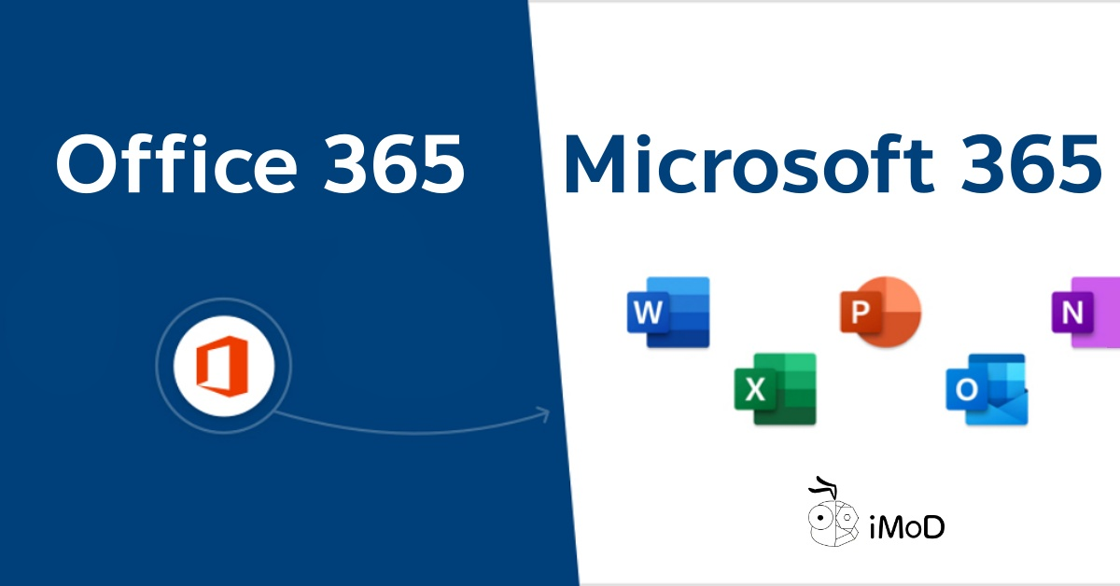
Using Microsoft Excel to Improve Efficiency at Greenfield Home Care Agency
Group Member 1
Module: Digital Skills and Research Methods LCHS4007
Case Study: Greenfield Home Care Agency
Alishba Khan
2522168

Slide 3

Why Excel at Greenfield
Greenfield supports older adults in the community.
Staff include carers, nurses, coordinators and admin staff.
Daily tasks include:
Staff scheduling.
Recording care visits.
Tracking service user information.
(Microsoft, 2024)

Slide 4

Current Practise at Greenfield and How Excel Will Improve Efficiency
Currently:
Use of paper records and manual systems.
Risk of duplication and human error.
Information not always updated in real time.
(NHS Digital, 2023)
How it will improve:
Digital staff rotas.
Automated calculations.
Shared access through Microsoft 365.
(Microsoft, 2024)
ThePhoto by PhotoAuthor is licensed under CCYYSA.

Slide 5

Practical Use of Excel and Benefits of Excel
Weekly schedules.
Visit logs.
Colour coding and formulas.
(Greenhalgh et al., 2017)
Benefits:
Saves time.
Improves organisation.
Easy to manage and accessible.
(Microsoft, 2024)

Slide 6

Limitations of Excel and Digital Safety
Tr​aining required.
Risk of data entry errors.
Data protection responsibilities.
(UK Government, 2018)
Digital Safety:
Password protection.
Access controls.
GDPR compliance.
(UK Government, 2018)

Slide 7

Using Microsoft teams to improve communication at green fields home care agency
Group member two
Module: digital skills and research methods
Case study: greenfield home care agency.
Areeba khan
2523434

Slide 8
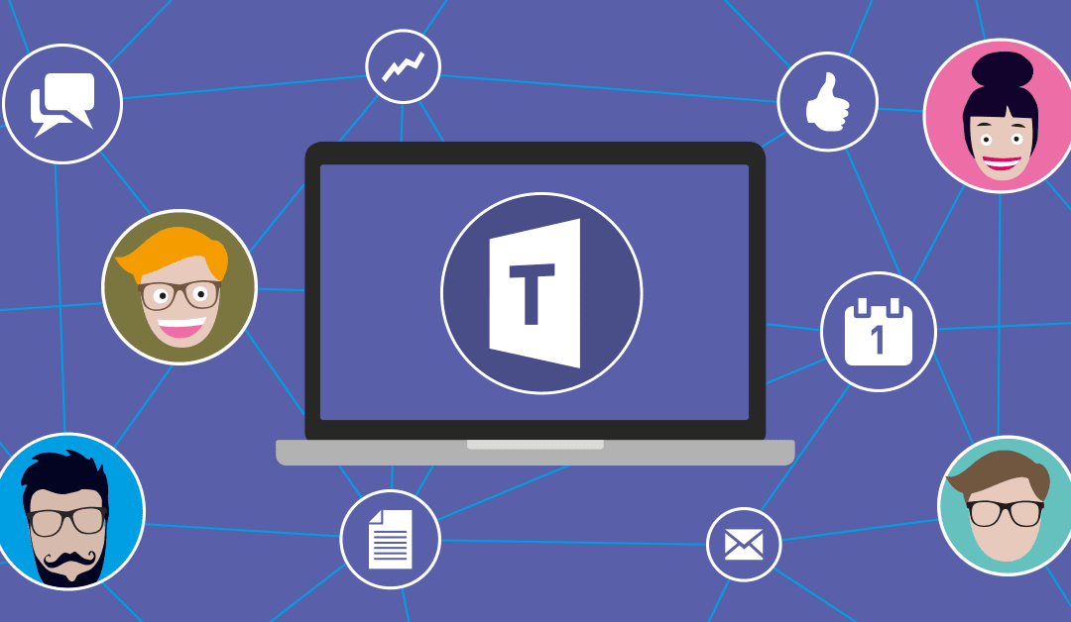
What is Microsoft Teams?
Microsoft teams is a collaboration tool that lets staff:
Send messages quickly.
Make voice and video calls.
Share files securely.
Work in group channels.
It works fully with Microsoft 365.
(Microsoft, 2024)

Slide 9
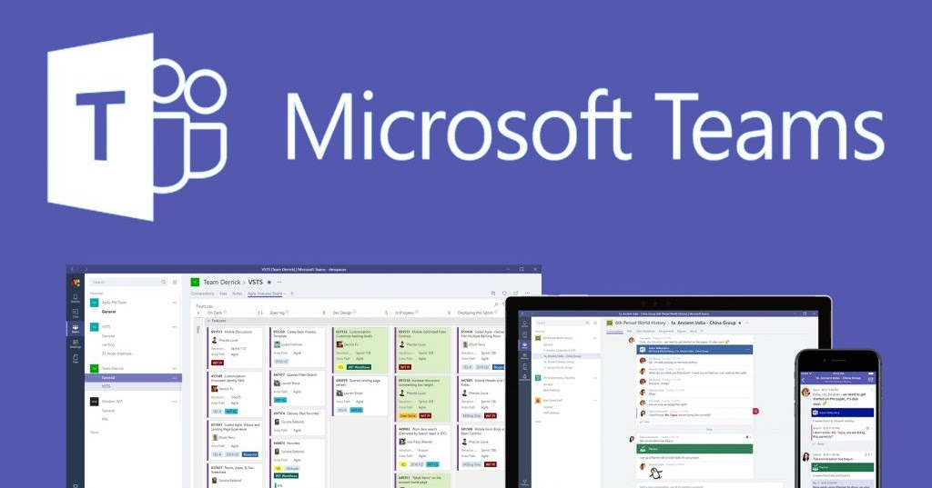
Challenges, Limitations and Advantages of Microsoft Teams
Challenges and limitations:
St​aff may require digital skills training.
Overuse of notifications can be distracting.
Reliance on internet access.
Risk of inappropriate information sharing if not managed correctly.
Clear policies are required.
(UK Government, 2018)
Advantages:
Faster communication than email.
Supports teamwork.
Accessible on all devices.
Integrates with Excel, One Drive and Outlook.
(Microsoft, 2024)
ThePhoto by PhotoAuthor is licensed under CCYYSA.

Slide 10

Digital Literacy and Safety
To ensure safe use of Teams:
Strong passwords and two-factor authentication.
Restricted access to channels.
Staff training on appropriate use.
Compliance with GDPR when sharing care information.
This protects service user confidentially.
(UK Government 2018)

Slide 11

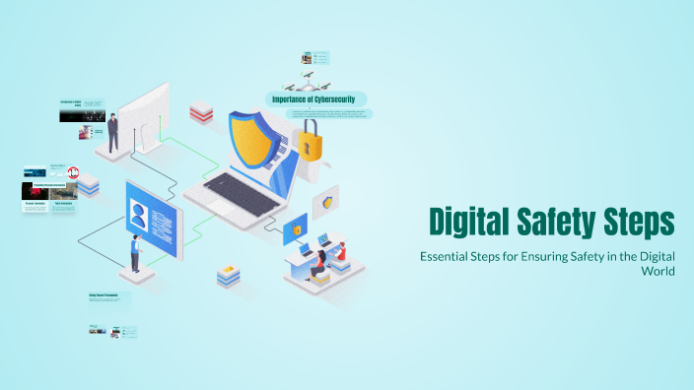
Digital Literacy & Digital Safety In a Care Home
Group Member 3
Module : Digital Skills and Research Methods LCHS4007
Case Study: Greenfield Home Care Agency
Mehhak Arif
2522167

Slide 12

Why Digital Safety Matters at Greenfield
Greenfield handles:
Personal data.
Health and care records.
Risks include:
Data breaches.
Unauthorised access.
Human error.
Poor digital safety can harm service users and the organisation.
(UK Government. 2018)

Slide 13


Digital Safety Plan (Part 1)
Secure Access
At Greenfield staff should:
Use strong passwords as well as unique. never use the same passwords for different work accounts.
Enable two factor authentication use a phone number or security key as the second verification step.
Lock devices when not in use, you can use a pin, password or biometric lock for example like finger prints or Face ID for unlocking.
Log out of shared devices and don't stay logged in or save logins.
This reduces unauthorised access.
Confidentiality and compliance.
Update policies every year, check and revise digital safety rules each year to match current laws like (GDPR) and best practises.
Name a safety lead, get someone like a data protection officer to watch over compliance and handle questions.
Train every year: give staff refreshers on confidentiality rules and legal duties, especially for protecting care residents information.
(UK Government, 2018)

Slide 14


Digital Safety Plan (Part 2)
Email awareness:
Only access data needed for their role, do not open browsing files and folders or systems that are not relevant to tasks
Sending sensitive data to the wrong person.
Staff should also include"
Avoid using public Wi-Fi for work tasks.
Store files securely using one drive.
Double check recipients before sending information.
Report suspected data breaches at once.
Follow organisational data protection policies.
Data management
Clear rules for storing data: only keep data confidential information on work systems that are safe and locked. Do not save it on personal phones, laptops, or unsafe online storage.
Back up data often:
Set up automatic daily copies of important data and keep these copies in a various places so they are safe if something goes wrong.
Rule for keeping data: Decide how long to keep each type of data when you do not need it anymore cut it so no one can retrieve you
Teaching staff how to handle data right: make sure they know how to mark confidential information clearly and only share it with people who are allowed to see it using safe ways.
(NHS Digital, 2023)
ThePhoto by PhotoAuthor is licensed under CCYYSA.

Slide 15

Staff Training and Responsibility
Regular digital safety training is essential
Staff must:
Understand GDPR responsibilities.
Follow Greenfields digital policies.
Keep skills up to date.
Digital safety is a shared responsibility.
(JISC, 2022)

Slide 16
Group Conclusion
This presentation explored how Microsoft 365 tools can support digital working at Greenfield Home Care Agency.
Microsoft Excel can improve efficiency by supporting staff rotas, visit logs and record management.
Microsoft Teams can enhance communication between carers and office staff working across different locations.
Digital Literacy and Digital Safety are essential to ensure data protection, GDPR compliance and safe practise.
When supported by staff training and clear organisational policies, digital tools can improve coordination, reduce errors and support high-quality care delivery.

Slide 17
References
Greenhalgh, T., Wherton J., Papoutsi, C., Lynch, J., Hughes, G., A'Court, C., Hinder, S., Fahy, N. and Procter, R. (2017)
Beyond adoption: a new framework for theorizing and evaluating nonadoption, abandonment, and challenges to the scale-up of health and care technologies. Journal of medical internet research 19(11), e367.
JISC (2022)
Digital literacy framework. Available at https://www.jisc.ac.uk (Accessed: 13 February 2026).

Slide 18
Microsoft (2024)
Microsoft 365 overview. Available at: https://www.microsoft.com (Accessed: 13 February 2026).
NHS Digital (2023)
Digital transformation in health and social care. Available at: https://digital.nhs.uk (Accessed: 13 February 2026).
UK Government (2018)
Data Protection Act 2018. Available at https://www.gov.uk
(Accessed: 13 February 2026).

