Slide 1
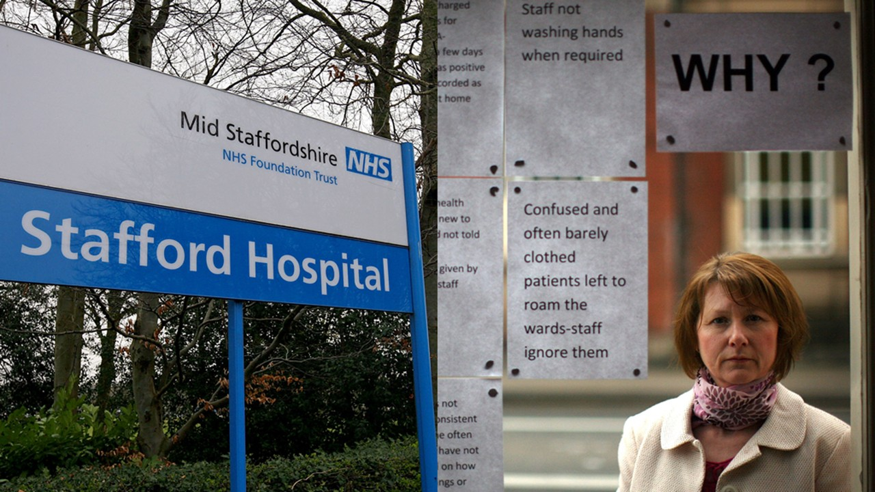

MID STAFFORDSHIRE NHS FOUNDATION TRUST (UK)
Component 1- Individual Presentation
LCHS7006 Quality Assurance and Service Improvements
STUDENT NAME: Vaishali
STUDENT ID:
lecturer’s name

Slide 2
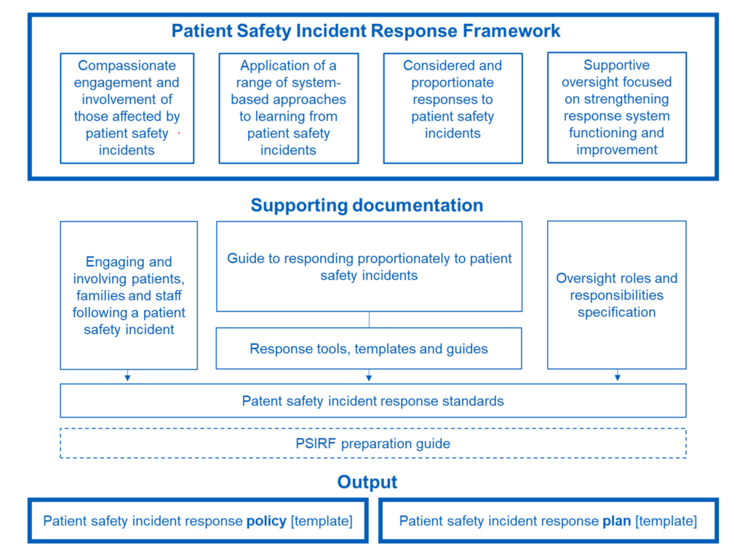
INTRODUCTION
The case study demonstrated how poor governance can result in avoidable harm to patients when routine care is not properly delivered
The Francis Report said a board “did not listen sufficiently to its patients and staff” (TSO, 2013, p.3)
This presentation applies the Swiss cheese model, RCA, and systems theory to explain aligned failures
It links the case to current NHS learning policy, especially PSIRF as shown in Figure 1
Figure 1: PSIRF Framework overview and documents (associated)
(Source: NHS England, 2022)
Notes:
The introduction explains how weak governance, unsafe culture and poor oversight allowed harm to develop over time. It also sets out the frameworks used to analyse the case and link it to wider quality management issues.

Slide 3
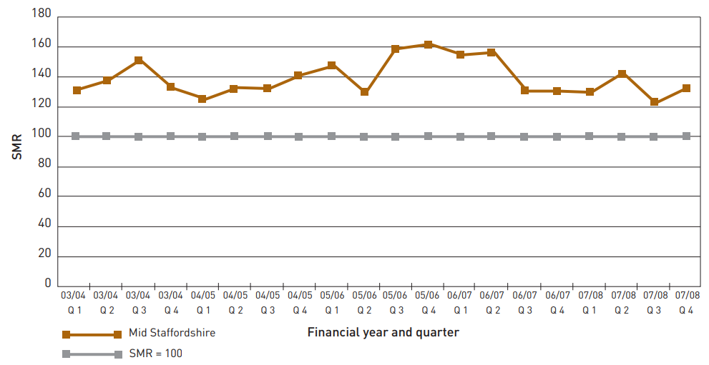
CASE STUDY BACKGROUND
The inquiry covered care from January 2005 to March 2009 at Stafford Hospital (TSO, 2013)
Concerns were heightened in 2007 when mortality rates and complaints were raised
SMRs in quarterly periods varied from 121 to 160, which always was higher than the expected 100
The Trust had about 3,000 employees and served about 32,0000 people (Healthcare Commission, 2009)
Figure 2: Quarterly SMR for “aged 18 and over” (emergency admissions)
(Source: Healthcare Commission, 2009)
Notes:
During this time, the issues of mortality, complaints, and warning signs were becoming increasingly visible. The background shows that organisational priorities were placed above safe and compassionate care.

Slide 4
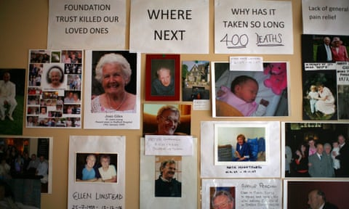
MAIN QUALITY CONCERNS IDENTIFIED
Poor nursing standards, weak training, and low morale caused missed observations (Francis, 2013)
Complaints were not used as learning data, so repeated harm patterns stayed hidden, representing “complete failure of leadership” (Campbell, 2013)
The report found secrecy, defensiveness, and “tolerance of poor standards” (TSO, 2013)
Figure 3 represents a memorial gallery created for the victims of Stafford hospital scandal
Figure 3: Memorial Gallery of patient deaths at Stafford hospital
(Source: The Guardian, 2015)
Notes:
The main quality concerns were poor staffing, weak nursing standards, and missed patient observations. Complaints were not used properly for learning, so repeated harm was not addressed. A culture of secrecy and defensiveness allowed poor standards to continue.

Slide 5
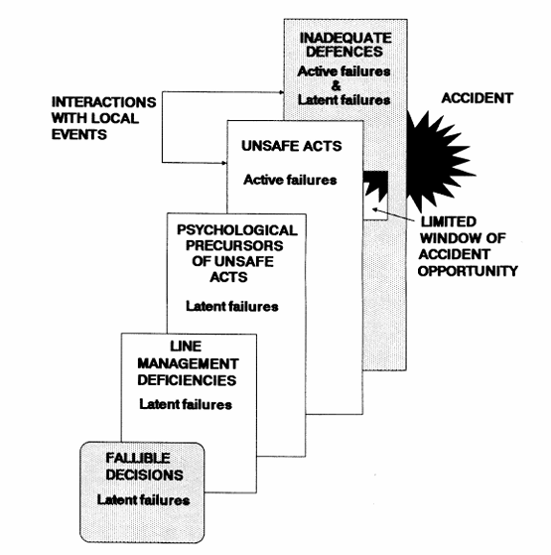
ROOT CAUSES: LATENT FAILURES (SWISS CHEESE MODEL)
Board level fallible decisions [Figure 4] prioritised finance and targets over safety, driving latent failure in policy context
Management thinking’s domination of cost cut needs led to staff cuts and a chronic shortage of skilled people after the 2006 to 2007 crisis (Boseley, 2010a)
For example, the 2010 inquiry linked these failures to 400 to 1200 excess deaths over 3 years (Boseley, 2010a)
Barriers fail when organisational holes are aligned before harm occurs to patients by design (Reason, 1990)
Figure 4: Human contributions and production elements of accidents
(Source: Reason, 1990)
Notes:
The first part of the “Swiss cheese model” shows latent failures at the organisational level. Board priorities, financial pressure, and bad strategic decisions left weaknesses before the harm to patients occurred.

Slide 6
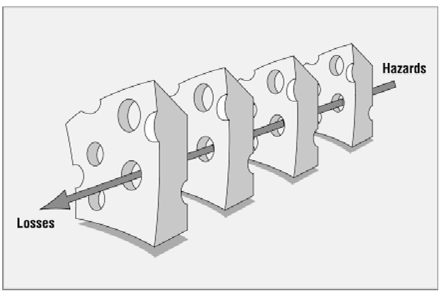
ROOT CAUSES: ACTIVE FAILURES (SWISS CHEESE MODEL)
Psychological precursors included “culture of complacency”, degrading patient treatment, and whistleblower being blocked from speaking up (Boseley, 2010a; Ramesh, 2013)
Reason (2000) states accidents occur when holes in multiple defences line up
Mid Staffordshire exhibited “a total system failure” (Lintern, 2011)
Active failures included missed observations and failure to respond to patient deterioration (Healthcare Commission, 2009)
Figure 5: Swiss cheese model
(Source: Reason, 2000)
Active failures are unsafe acts which directly violate defences and cause harm [Figure 5]
Notes:
Unsafe acts such as missed observations and failure to respond to deterioration let harm pass through the remaining defences. Staff behaviour was influenced by a system which tolerated poor practise and poor escalation.

Slide 7
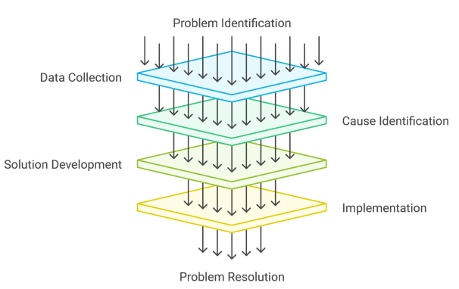
ROOT CAUSE ANALYSIS
RCA [Figure 6] is an organised method for retrospective reconstruction of events, separating the active and latent errors
In this case, RCA would trace staffing decisions, escalation delays, complaint handling and board oversight
It is directed toward system learning, requiring identifying the “specific fault location”, as well as fault cause through full “system fault diagnosis” (Liu et al., 2025)
Liepelt and Kirchhoff (2025) used 9 managers, noting follow-up to be essential for sustainable learning
Figure 6: Root Cause Analysis
(Source: Six Sigma, 2026)
Notes:
RCA looks at what happened, why it happened and where the system broke down. In this case, it would focus on staffing decisions, escalation failures, complaint handling, and board oversight. The purpose is not blame alone but learning and prevention.

Slide 8
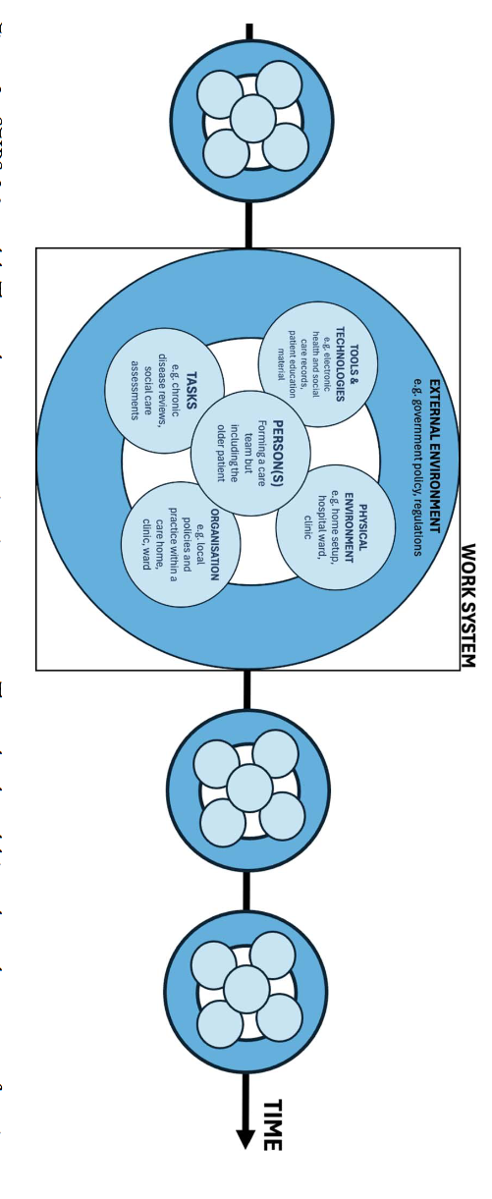
SYSTEMS THEORY
Figure 7: Bloom’s Taxonomy for Semi-structured Interviews
(Source: Adopted from Fiveable, 2025)
Systems theory considers harm as an emergent phenomenon of interacting technical, social and organisational parts (Kimsey et al., 2025)
Figure 7 denotes a work system following the systems theory, accounting for “health and social care” improvement, particularly in older people
The model fits Mid Staffordshire because governance, staffing, culture, and process failures interacted dynamically
Atalla, Bahr and El-Sayed’s (2025) study of 289 critical care nurses across 10 ICUs found “strong positive correlations…between systems thinking and patient safety competencies”
Notes:
Systems Theory describes harm as the outcome of the interaction of parts rather than one event. At Mid Staffordshire, governance, staffing, culture, and clinical processes influenced each other and produced predictable failure. This makes the case suitable for a systems-based interpretation of quality breakdown.

Slide 9
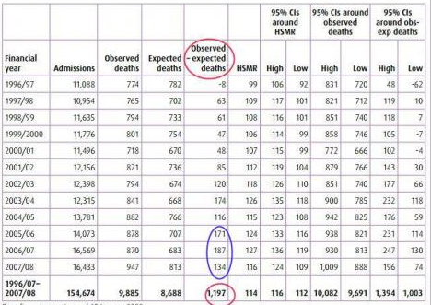
POLICY ISSUES CONTRIBUTING TO THE FAILURES
National policy favoured finance and foundation trust status over safety, based on paternalism (Lynas, 2015)
Francis making 290 recommendations after systemic governance failure (TSO, 2013)
The trust responded weakly to mortality concerns [Figure 8]
Whistleblowing and complaints systems hid risk from board oversight (While, 2015; Bolsin et al., 2011)
Figure 8: Observed – expected deaths (Mid Staffordshire Hospital)
(Source: Full Fact, 2013)
Notes:
Weak whistleblowing and complaints policies meant that concerns were not escalated and acted on effectively. Inadequate leadership and staffing policy choices weakened service delivery across the hospital.

Slide 10
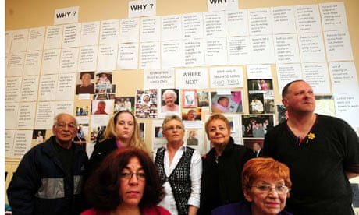
IMPACT ON QUALITY
Patients received poor hygiene, nutrition, dignity, and communication (TSO, 2013)
Relatives [Figure 9] were left to take patient “sheets home to wash” to provide basic care expected from the hospital (Boseley, 2010b)
Defective audit blocked learning, so unsafe practice continued, there being no system to identify failure
Quality dropped from safe treatment to suffering, with the inquiry describing appalling suffering and standards (Boseley, 2010b)
Figure 9: Tribute wall and Relatives of Patients who died
(Source: Boseley, 2010b)
Notes:
The impact on quality was severe because patients experienced poor hygiene, missed needs, and loss of dignity. Safety monitoring failed, so deterioration was not identified or managed in time. Learning systems were weak, which meant unsafe practise was allowed to continue without correction.

Slide 11
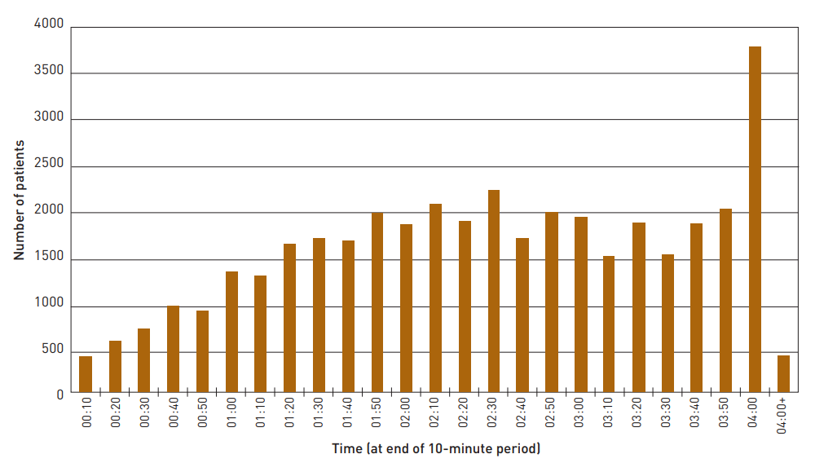
IMPACT ON EFFICIENCY
Avoidable harm increased bed use, rework, and escalation (While, 2015)
Figure 10 identifies the concerning marked drive in relation to patient admitting/discharge/transfer in the “last 10 minutes” prior 4-hour targets
Staff shortages resulting in lower throughput and wasted scarce clinical capacity
Litigation, regulation, and investigations drained money from services, linking savings pressure to unsafe care (TSO, 2013)
Figure 10: Patient number distribution by A&E total time
(Source: Healthcare Commission, 2009)
Notes:
The impact on efficiency was also great as avoidable harm consumed staff time and hospital resources. Care had to be redirected toward handling complaints, managing deterioration, and dealing with investigations. This reduced productivity and diverted capacity away from direct patient care.

Slide 12
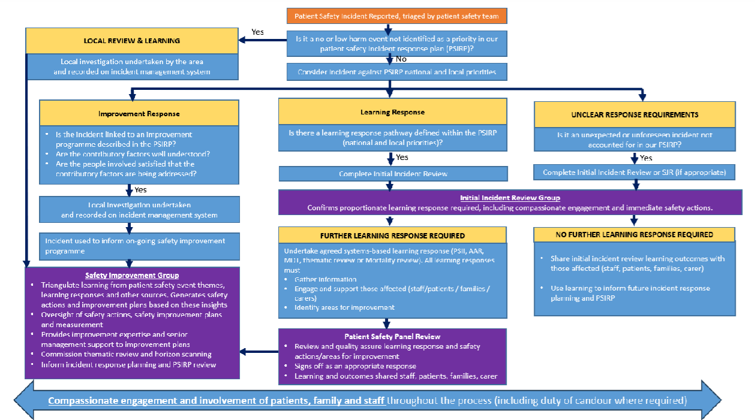
IMPACT ON EQUITY
Equity is further exacerbated when vulnerable patients have less voice, less advocacy and slower escalation (Haskell, 2025)
An example of this is: PSIRF’s explicit inclusion of patients, families, staff, carers in incident response and learning [Figure 11]
Cross system integration gaps exclude social care learning (Newman et al., 2025)
Unequal access to safe care leads to disparities in experience, outcomes and institutional trust
Figure 11: Process of Learning Response Decision-making
(Source: NHS, 2024)
Notes:
The impact on equity was felt most by vulnerable patients who had less power to challenge poor care. Less voice or less advocacy was associated with a higher probability of delayed escalation and unmet needs in patients. Unequal access to safe care created more disparities between outcomes and trust.

Slide 13
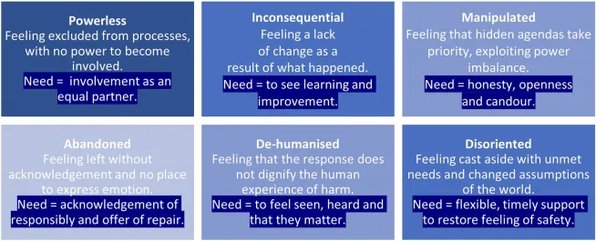
CONCLUSION
Mid Staffordshire: how governance failures could become clinical harm across an entire service
Figure 12 identified the 6 different types of harm subject to being experienced by patients and their families in relation to safety incidents
RCA will organise the report in terms of causes, contributory factors, and corrective actions
Systems theory will explain why the harm was predictable, interconnected, and repeatable
Figure 12: Six Compounded Harm Types (and underlying Needs)
(Source: Ramsey et al., 2024)
Notes:
The conclusion is that Mid Staffordshire demonstrates the extent to which governance failure can become a widespread clinical harm. The case shows how poor systems, weak policy and unsafe culture can do damage together to quality, efficiency and equity.

Slide 14
STRUCTURE FOR COMPONENT 2

Slide 15
REFERENCE LIST
Atalla, A.D.G., Bahr, R.R.R. and El-Sayed, A.A.I. (2025) ‘Exploring the hidden synergy between system thinking and patient safety competencies among critical care nurses: a cross-sectional study’, BMC nursing, 24(1), p.114. Available at: https://doi.org/10.1186/s12912-025-02717-6.
Aujla, N., Tooman, T., Arakelyan, S., Kerby, T., Hartley, L., O’Donnell, A., Guthrie, B., Underwood, I., Jacko, J.A. and Anand, A. (2024) ‘New horizons in systems engineering and thinking to improve health and social care for older people’, Age and Ageing, 53(10), p.afae238. Available at: https://doi.org/10.1093/ageing/afae238.
Bolsin, S., Pal, R., Wilmshurst, P. and Pena, M. (2011) ‘Whistleblowing and patient safety: the patient’s or the profession’s interests at stake?’, Journal of the Royal Society of Medicine, 104(7), pp. 278-282. Available at: https://doi.org/10.1258/jrsm.2011.110034.
Boseley, S. (2010a) Key findings of inquiry. The Guardian. Available at: https://www.theguardian.com/global/2010/feb/24/mid-staffordshire-nhs-francis-inquiry [Accessed: 20 March 2026].
Boseley, S. (2010b) Mid Staffordshire NHS trust left patients humiliated and in pain. The Guardian. Available at: https://www.theguardian.com/society/2010/feb/24/mid-staffordshire-hospital-inquiry [Accessed: 20 March 2026].
Campbell, D. (2013) Mid Staffs hospital scandal: the essential guide. The Guardian. Available at: https://www.theguardian.com/society/2013/feb/06/mid-staffs-hospital-scandal-guide [Accessed: 20 March 2026].
Francis, R. (QC) (2013) ‘Mid Staffordshire–some reflections for clinicians’, Trends in Urology & Men’s Health, 4(6), pp. 17-20. Available at: https://doi.org/10.1002/tre.362.
Full Fact (2013) How many people died “unnecessarily” at Mid Staffs? Home/Health. Available at: https://fullfact.org/health/how-many-people-died-unnecessarily-mid-staffs/ [Accessed: 20 March 2026].
Haskell, H. (2025) ‘The voice that is missing: the evolving role of patients and families in escalation of care’, In Textbook of Rapid Response Systems: Concept and Implementation (pp. 3-14). Cham: Springer Nature Switzerland. Available at: https://doi.org/10.1007/978-3-031-67951-3_1.
Healthcare Commission (2009) Investigation into Mid Staffordshire NHS Foundation Trust. Investigation. Available at: https://webarchive.nationalarchives.gov.uk/ukgwa/20110504135228/http://www.cqc.org.uk/_db/_documents/Investigation_into_Mid_Staffordshire_NHS_Foundation_Trust.pdf [Accessed: 20 March 2026].
Hughes, H. (2023) ‘Public inquiries, patient safety and the implementation gap’, Future Healthcare Journal, 10(1), pp. 7-9. Available at: https://doi.org/10.7861/fhj.2023-FR103.
Kimsey, M., Besharov, M., Casasnovas, G. and Höllerer, M.A. (2025) ‘Thinking in systems: From ceremonial to meaningful use of systems perspectives in organization and management research’, Academy of Management Annals, 19(2), pp. 736-762. Available at: https://doi.org/10.5465/annals.2022.0081.
Liepelt, S. and Kirchhoff, R. (2025) ‘Hospital managers’ experiences of conducting a root cause analysis: a case study following a sentinel event’, Frontiers in Health Services, 5, p.1566335. Available at: https://doi.org/10.3389/frhs.2025.1566335.
Lintern, S. (2011) Mid Staffordshire was a total system failure. The Guardian. Available at: https://www.theguardian.com/healthcare-network/2011/dec/07/mid-staffordshire-total-system-failure [Accessed: 20 March 2026].
Liu, X., Liu, J., Yang, X., Wu, Z., Wei, Y., Xu, Z. and Wen, J. (2025) ‘Fault root cause analysis based on Liang–Kleeman information flow and graphical lasso’. Entropy, 27(2), p.213. Available at: https://doi.org/10.3390/e27020213.
Lynas, K. (2015) ‘The leadership response to the Francis report’, Future Hospital Journal, 2(3), pp. 203-208. Available at: https://doi.org/10.7861/futurehosp.2-3-203.
Newman, C., Mason, C., Brittain, K., Dawson, P., Spencer, M., Sykes, K., Waring, J., Young-Murphy, L. and Scott, J. (2025) ‘Patient Safety Incident Reporting Framework (PSIRF) Standards: Co-Production of Adaptations for the Care Home Sector to Improve Cross-System Integration’, Journal of Long Term Care, pp. 66-80. Available at: https://doi.org/10.31389/jltc.358.
NHS (2024) Patient Safety Incident Response Policy. Imperial College Healthcare. Available at: https://www.imperial.nhs.uk/-/media/website/about-us/publications/icht-patient-safety-incident-response-framework-psirf-policy--feb-24-v1--external.pdf [Accessed: 20 March 2026].
NHS (2025) NHS patient safety strategy – progress update – April 2025. NHS England. Available at: https://www.england.nhs.uk/patient-safety/the-nhs-patient-safety-strategy/nhs-patient-safety-strategy-progress-so-far/ [Accessed: 20 March 2026].
NHS England (2025) Patient Safety Incident Response Framework. Patient safety Publication. Available at: https://www.england.nhs.uk/long-read/patient-safety-incident-response-framework/ [Accessed: 20 March 2026].
Ramesh, R. (2013) NHS culture at Mid Staffs that tolerated low standards and sold patients short. The Guardian. Available at: https://www.theguardian.com/society/2013/feb/06/nhs-mid-staffs [Accessed: 20 March 2026].
Ramsey, L., Hughes, J., Hazeldine, D., Seddon, S., Gould, M., Wailling, J., Murray, J., McHugh, S., Simms-Ellis, R., Halligan, D. and Ludwin, K. (2024) ‘Humanising processes after harm part 2: compounded harm experienced by patients and their families after safety incidents’, Frontiers in Health Services, 4, p.1473296. Available at: https://doi.org/10.3389/frhs.2024.1473296.
Reason, J. (1990) ‘The contribution of latent human failures to the breakdown of complex systems’, Philosophical Transactions of the Royal Society of London. B, Biological Sciences, 327(1241), pp. 475-484. Available at: https://doi.org/10.1098/rstb.1990.0090.
Reason, J. (2000) ‘Human error: models and management’, Bmj, 320, pp. 768-770. Available at: https://doi.org/10.1136/bmj.320.7237.768.
Six Sigma (2026) Root Cause Analysis Methods. Certification/Training. Available at: https://www.6sigma.us/root-cause-analysis-methods/ [Accessed: 20 March 2026].
The Guardian (2015) Mid Staffordshire NHS trust to face criminal charges over deaths. News. Available at: https://www.theguardian.com/society/2015/oct/15/mid-staffordshire-nhs-foundation-trust-criminal-charges [Accessed: 20 March 2026].
TSO (2013) Report of the Mid Staffordshire NHS Foundation Trust: Public Inquiry. HC 947, London: The Stationery Office. Available at: https://assets.publishing.service.gov.uk/media/5a7ba0faed915d13110607c8/0947.pdf [Accessed: 20 March 2026].
While, A. (2015) ‘Can we learn from the Mid-Staffordshire Inquiry or is it always someone else’s problem?’, London journal of primary care, 7(2), pp. 23-24. Available at: https://doi.org/10.1080/17571472.2015.11493431.

Slide 16

THANK YOU

