Slide 1
MNIST
Dataset for
Classification

Slide 2
What MNIST Dataset Is
(Modified National Institute of Standards and Technology database)
Yann LeCun, Corinna Cortes, Christopher J.C. Burges
It is a set of 70,00 handwritten digits.
Consider it the “hello world” of ML
Each digit is 28x28 greyscale bits=784 features.
Each feature has an integer value between 0 and 255.
Full details here:
  http://yann.lecun.com/exdb/mnist/

Slide 3
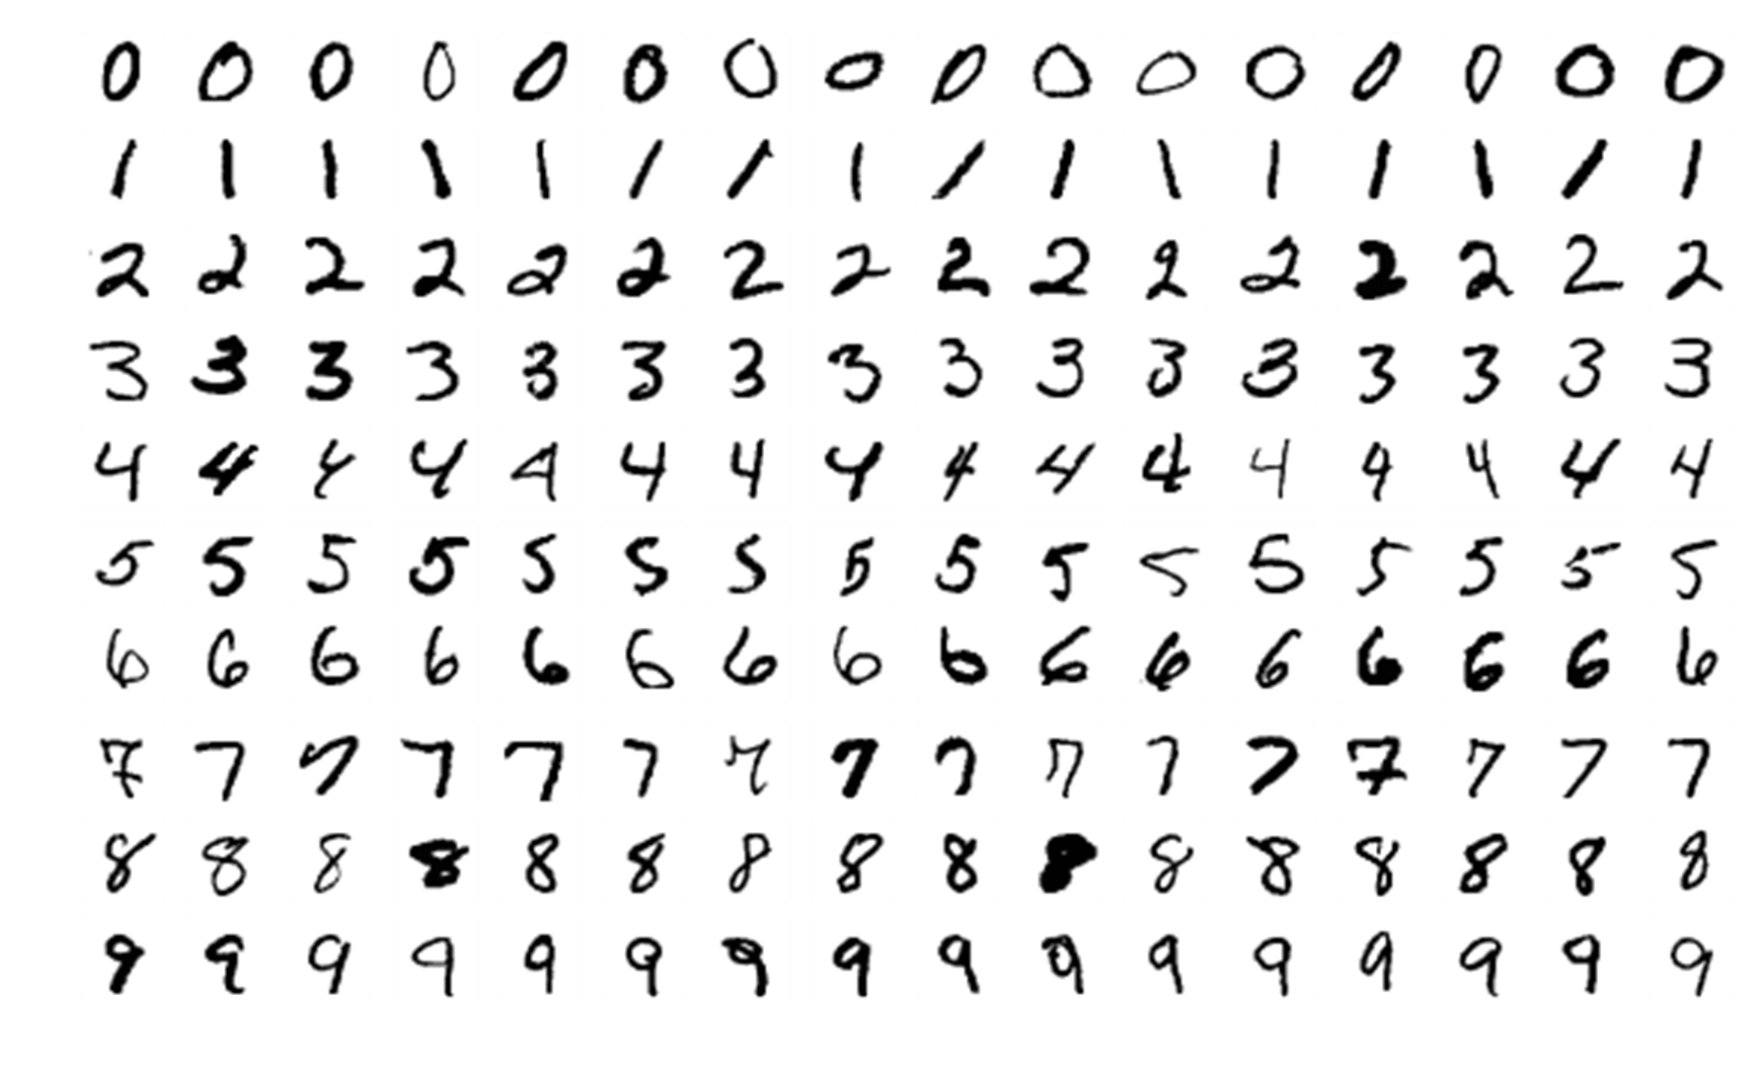
What MNIST Dataset Is

Slide 4
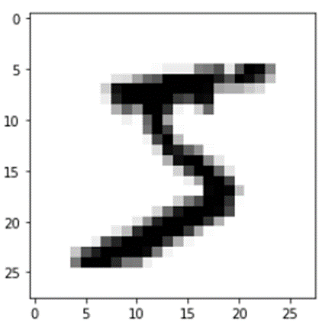
Downloading MNIST Dataset
from sklearn.datasets import fetch_openml
mnist= fetch_openml('mnist_784', version=1)
mnist.keys()
#dict_keys(['data', 'target', 'frame', 'categories', 'feature_names', 'target_names', 'DESCR', 'details', 'url’])
mnist["DESCR"]
X,y=mnist["data"], mnist["target"]
import matplotlib
import matplotlib.pyplot as plt
digit=X[0]
imgDigit=digit.reshape(28,28)
plt.imshow(imgDigit,cmap='binary')
plt.axis='off'
plt.show()

Slide 5
Exploring MNIST Dataset
Scikit-Learn has a copy of the MINST dataset
Explore this dataset.
Have a look at the Jupyter notebook - ROC and AUC.ipynb
Things to try:
  Investigate how you would train another classifier and evaluate it using ROC curves and AUC.
  Compare them.

