Slide 1

“Tiny Bites, Mighty Growth”
“Nourishing Infants with the Health-Promoting Dietary Intervention”
Place: Public Community hall, Newham

Slide 2
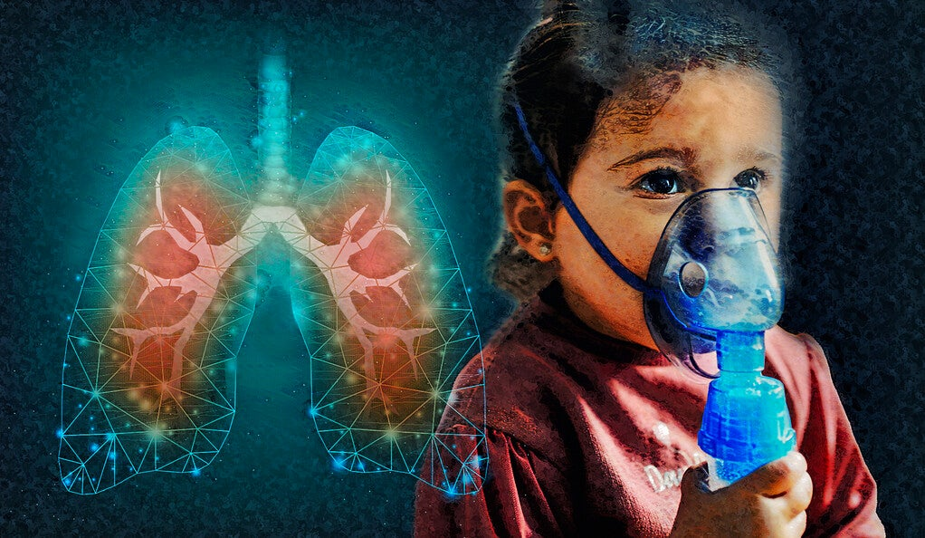

Aim is to control Cystic Fibrosis in new generation (Infants- 6- to 8-month-old babies)
The program is focused to collaborate with the parents to share an effective dietary plan to their children who are suffering from cystic fibrosis. During this program we are going to collect data from the parents about their children through a survey mobile application.
Individuals with cystic fibrosis (CF) can benefit from a customized diet plan that addresses the complex nutritional issues related to this inherited illness (Bell et al., 2020). Therefore, the dietary recommendation will be based on their age, stage and their daily absorption of nutrients.
A continuous change on dietary plan will be their based on the parents’ responses about their Childrens’ health to make them healthy and to make a healthy society. In addition to meeting a person's unique nutritional demands, a personalized diet plan that includes continuing nutrition counseling improves quality of life by encouraging a comprehensive and long-term approach to health management in the context of cystic fibrosis (McDonald et al., 2020).

Slide 3
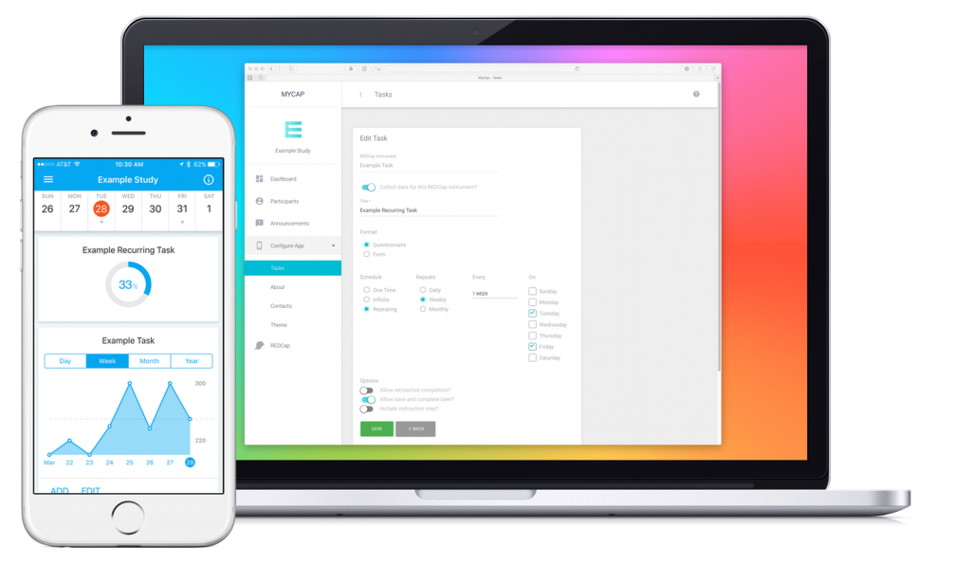

“MyCYF”, it is a mobile application through which the survey will be conducted among the parents during this program to collect data regarding the health conditions of the children suffering from cystic fibrosis
Through this mobile application we will collect our required data to form an effective dietary plan for the children. At the very beginning of this program the mobile application will be installed the participants device and that will consist our survey questions.
As it is a digital technology to collect data from the participants therefore it will avoid the geographical barriers and the risks regarding the human error (Brynjolfsson and Collis, 2019). The process of Realtime data collection also will help us to access and analyses the collect data in a very short period.

Slide 4
Reference List
Bell, S.C., Mall, M.A., Gutierrez, H., Macek, M., Madge, S., Davies, J.C., Burgel, P.R., Tullis, E., Castaños, C., Castellani, C. and Byrnes, C.A., 2020. The future of cystic fibrosis care: a global perspective. The Lancet Respiratory Medicine, 8(1), pp.65-124.
McDonald, C.M., Alvarez, J.A., Bailey, J., Bowser, E.K., Farnham, K., Mangus, M., Padula, L., Porco, K. and Rozga, M., 2021. Academy of nutrition and dietetics: 2020 cystic fibrosis evidence analysis center evidence-based nutrition practice guideline. Journal of the Academy of Nutrition and Dietetics, 121(8), pp.1591-1636.
Brynjolfsson, E. and Collis, A., 2019. How should we measure the digital economy. Harvard business review, 97(6), pp.140-148.

Slide 5


