Slide 1
ECAD5007/C
Lles a Llythrennedd Emosiynol
Emotional Wellbeing and Literacy
12/03/20
Carys Jennings
Nanna Ryder
Notes:
Cofrestr
Y sesiwn hon yn adeiladu ar y wybodaeth a gyflwynwyd yn sesiwn 2 (datblygiad emosiynol - Erikson, adfyfyrio ar brofiadau PAP a.y.y.b.).

Slide 2
Nod
Aim
Archwilio’r cysyniadau o les emosiynol a llythrennedd emosiynol
Ystyried rhai o’r ffactorau allweddol sydd yn dylanwadu ar hyn
Trafod pwysigrwydd lles emosiynol ar gyfer dysgu a datblygiad
Ystyried rhai strategaethau cefnogi posib
Explore the concepts of emotional wellbeing and emotional literacy
Consider some of the key factors that impact on this
Discuss the significance of emotional wellbeing for learning and development
Consider some possible support strategies
Notes:
Sut fyddech chi’n diffinio lles emosiynol?
Ydy llythrennedd emosiynol yr un peth neu ydy e’n wahanol? Beth sy’n wahanol?
Os ‘llythrennedd’ emosiynol yw’r nod, ydy hwn yn cael yr un sylw mewn ysgolion a llafar/darllen/ysgrifennu? Estyn ddim yn mesur hyn a.y.y.b.
(trafodaeth/post-it’s a.yy.b.)

Slide 3
Lles emosiynol yw…
Emotional wellbeing is …
‘... knowing who you are and where you fit in and feeling good about yourself… developing respect for others, social competence and a positive disposition to learn’ (Burrell & Riley, 2005, p.35)
children who are ‘rich in potential, strong, powerful, competent and, most of all, connected to adults and other children’ (Malaguzzi, 1993, p.10)
Notes:
Trafod y dyfyniadau hyn.
Ydy’r rhain yn cwmpasu’r cyfan? Oes rhywbeth ar goll?
Ystyried bod hyn llawn mor bwysig i ni fel oedolion/athrawon ac ydy ar gyfer plant.

Slide 4
Rhai elfennau allweddol
Some key components
hunaniaeth
gwydnwch
agwedd
hunan-hyder a hunan-fri
ymddygiad
hunan-reolaeth
ffurfio a chynnal perthnasau
gofal personol
cymryd cyfrifoldeb
parch
annibyniaeth
creadigrwydd
identity
resilience
attitude
self-confidence and self-esteem
behaviour
self-regulation
form and hold relationships
personal care
take responsibility
respect
independence
creativity
Notes:
Esbonio’r rhain a pham maent yn bwysig.
Edrych ar t.80&81 Canllawiau Cwricwlwm i Gymru (2020) i weld ble mae’r elfennau hyn yn cael eu cynnwys

Slide 5
Gall lles emosiynol gwael ddylanwadu ar…
Poor emotional wellbeing can impact on …
iechyd meddwl
mental health
sgiliau cymdeithasol
social skills
cyfranogiad
participation
cyrhaeddiad
achievement

Slide 6
Beth all effeithio ar les emosiynol plant?
What can affect children’s emotional wellbeing?
Ymlyniad
Profiadau Niweidiol Mewn Plentyndod (ACEs)
Anghenion Dysgu Ychwanegol (ADY)
Arall?
Attachment
Adverse Childhood Experiences (ACEs)
Additional Learning Needs (ALN)
Other?

Slide 7
Ymlyniad
Attachment
Bowlby (1969)
(Perry & Pollard, 1997)
Notes:
Trafod ymlyniad mam a’i phlentyn a gwahanol fathau o ymlyniad (cadarn , osgoi, teimladau cymysg (ambivalent))
Esbonio effaith hyn yn yr hirdymor – Diffyg ymlyniad yn effeithio ar sgiliau cymdeithasol, rhyngbersonol a.y.y.b.
Anodd dadwneud y profiadau cynnar ond gallant ddysgu sut i greu perthynas/ymlyniad gydag oedolyn allweddol tu hwnt i’r cartref e.e. Meithrinfa/Ysgol
Ymchwil yn dangos y cyswllt rhwng tlodi ac ymlyniad – diffyg sgiliau rhianta.

Slide 8
Profiadau Niweidiol Mewn Plentyndod
Adverse Childhood Experiences
‘Mae Profiadau Niweidiol yn ystod Plentyndod (ACE) yn brofiadau llawn straen sydd yn digwydd yn ystod plentyndod sydd yn niweidio plentyn yn uniongyrchol (e.e. cam-drin rhywiol neu gorfforol) neu’n effeithio ar yr amgylchedd lle maent yn byw (e.e. tyfu i fyny mewn tŷ gyda thrais domestig)’ (Bellis et al 2016)
https://www.estyn.gov.wales/sites/www.estyn.gov.wales/files/documents/Knowing%20your%20children%20%20supporting%20pupils%20with%20adverse%20childhood%20experiences%20cy_1.pdf
‘Adverse Childhood Experiences (ACEs) are stressful experiences occurring during childhood that directly harm a child (e.g. sexual or physical abuse) or affect the environment in which they live (e.g. growing up in a house with domestic violence)’ (Bellis et al 2016)
https://www.estyn.gov.wales/sites/www.estyn.gov.wales/files/documents/Knowing%20your%20children%20%20supporting%20pupils%20with%20adverse%20childhood%20experiences.pdf
Notes:
Rhestru’r gwahanol gategoriau o ACEs ac esbonio sut y maent yn effeithio ar ddatblygiad.
Y Plentyn: Cam-drin llafar, corfforol, rhywiol
Yr aelwyd:
Rhieni’n gwahanu
Trais domestig
Salwch meddwl
Cam-drin alcohol
Defnyddio cyffuriau
Carcharu
Straen ( y goleuadau traffig – Cadarnhaol, Rhesymol, Gwenwynig)
Edrych ar hyn mewn mwy o fanylder ym Mlwyddyn 3.

Slide 9
Anghenion Dysgu Ychwanegol (ADY)
Additional Learning Needs (ALN)
Anhwylder Ymddygiadol, Emosiynol a Chymdeithasol
Cyflwr Sbectrwm Awtistiaeth
ADHD
Anhwylderau bwyta
Afiechyd meddwl e.e. gor-bryder
Disgyblion Mwy Abl a Thalentog
Emotional, Behavioural and Social Disorder (EBSD)
Autistic Spectrum Condition
ADHD
Eating disorders
Mental ill-health e.g. anxiety
More Able and Talented Pupils

Slide 10
Beth felly yw llythrennedd emosiynol?
So what is emotional literacy?
(Claude Steiner, 1979)
‘To be emotionally literate is to be able to handle emotions in a way that improves your personal power and the quality of your life … and equally important the quality of the life of the people around you. Emotional literacy helps your emotions work for you instead of against you’ (Steiner, 1979)
Notes:
Llythrennedd = datblygu’r gallu i adnabod llythrennau a synau
Llythrennedd emosiynol = adnabod gwahanol deimladau a sut I ddelio gyda nhw
‘Building Blocks’ deallusrwydd emosiynol
Llythrenned Emosiynol yn cynnwys:
Adnabod teimladau
Rheoli emosiynau
Datblygu empathi
Datrys problemau emosiynol
Rhyngweithio yn emosiynol
Ydy hyn felly yn ddibynnol ar oedran? E.e. meddyliwch am gamau Piaget, Erikson a.y.y.b.
Ydy Idris yn ffitio i fewn fan hyn?

Slide 11
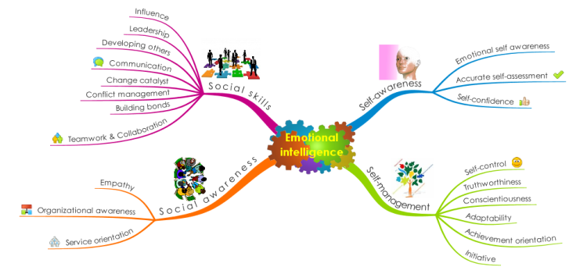
Datblygu gwydnwch
Developing resilience
Goleman (1995)

Slide 12
Sut allwn ni gefnogi’r plentyn felly?
So how can we support the child?

Slide 13
Egwyddorion allweddol Laever
Laever’s key principles
Parch at y plentyn Respect for the child
Ansawdd gofal a darpariaeth Quality of care and provision
Grym arsylwi The power of observation
Rhyngweithio oedolion Adult interaction

Slide 14
Gwyliwch hwn!
Watch this!
https://www.youtube.com/watch?v=Ahg6qcgoay4
Notes:
Pwysleisio pwysigrwydd arsylwi ar beth sydd yn mynd ymlaen yn y cefndir.

Slide 15
Graddfa Lles Leuven
Leuven Wellbeing Scale
Level | Well-being | Signals
1 | Extremely low | The child clearly shows signals of discomfort: is angry, cries, screams, looks sad or frightened, hurts him/herself or others, doesn’t respond to the environment and avoids contact.
2 | Low | The posture, facial expression and actions indicate that the child does not feel at ease. However, the signals are less explicit than under level 1 or the sense of discomfort is not expressed the whole time.
3 | Moderate | The child has a neutral posture. Facial expression and posture show little or no emotion. There are no signals indicating sadness or pleasure, comfort or discomfort
4 | High | The child shows obvious signs of satisfaction (as listed under level 5). However, these signals are not constantly present with the same intensity.
5 | Extremely high | During the observation episode, the child enjoys, in fact it feels great: looks happy and smiles, is spontaneous and expressive, talks to him/herself and sings, is relaxed and open, engaging with the environment and is lively and expresses self-confidence and self-assurance.
Notes:
Rhannu copiau o Raddfa Leuven ac esbonio – addas i bob oed nid CS yn unig.
Hanner y grwp i edrych ar broffil Ella a phenderfynu ble mae hi ar y raddfa. Cyfiawnhau hyn.
Hanner arall i edrych ar broffil Idris a gwneud yr un peth.

Slide 16
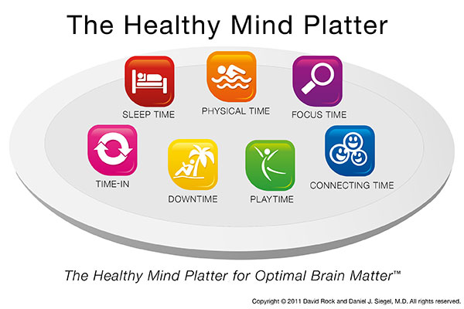
Addysgu’r meddwl/Educating the mind
(Siegel, 2011)
Notes:
Esbonio’r cyswllt rhwng y meddwl, yr ymennydd a’r perthnasau sy’n datblygu.
Yn dilyn y fideo, myfyrwyr I greu amserlen bersonol o’u ‘Healthy Mind Platter’ hwy eu hunain. Oes agweddau sydd angen ystyriaeth bellach?

Slide 17
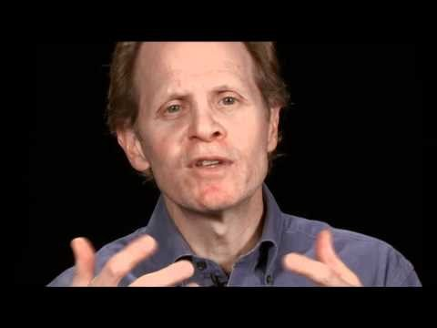

Slide 18
Strategaethau cefnogi
Support strategies
(Wellbeing Classroom Project - Whittington et al. 2015)
Cymuned ddysgu ddiogel, cynhwysol sy’n seiliedig ar ymddiriedaeth
Datblygiad proffesiynol athrawon
Addysgu sgiliau emosiynol a chymdeithasol
Cefnogaeth gan asiantaethau arbenigol
Cynnwys rhieni
Athrawon yn adfyfyrio
A safe and inclusive learning environment built on trust
Teacher professional development
Teach social and emotional skills
Support from expert agencies
Include parents
Teacher reflection

Slide 19
Beth am eich PAP chi?
What about your PTE?
Notes:
Cyfeirio’n ol at y llyfryn y gwnaethon nhw gwblhau yn sesiwn 2 wythnos ddiwethaf.
Cyfle i drafod a rhannu profiadau.

Slide 20
Cefnogaeth bellach
Further support
CYMRAEG
SEAL (Cynradd) https://hwb.gov.wales/repository/resource/8da29064-8aaf-47b9-9937-8d9610f2a744/cy (Cynradd)
Gwasanaethau Iechyd Meddwl Plant a'r Glasoed (CAMHS)
Rhaglen ‘Law yn Llaw at Blant a Phobl Ifanc’ - https://www.eventsforce.net/nliah/media/uploaded/evnliah/event_686/newsletter_1_august_2015__welsh_.pdf
ENGLISH
SEAL (Primary) - https://hwb.gov.wales/repository/resource/8da29064-8aaf-47b9-9937-8d9610f2a744/en
Children And Adolescent Mental Health Services (CAHMS)
Together for Children and Young People (T4CYP) - http://www.wales.nhs.uk/documents/Framework%20For%20Action.pdf

Slide 21
Tasg Gyfeiriedig 2
Directed Task 2
Ymchwiliwch i ymyrraethau i gefnogi datblygiad emosiynol disgybl CA2.
Dewiswch 1 ymyraeth (efallai byddwch am ei ddefnyddio fel sail i’ch aseiniad).
Paratowch rhyw 2-3 munud o gyflwyniad yn rhoi trosolwg o’ch ymyrraeth i’w gyflwyno i’ch cyfoedion mewn gweithgaredd marchnad pâr neu grŵp bach ar Fawrth 18fed.
Research interventions to support the emotional development of a pupil in KS2.
Choose 1 intervention (you may want to use this as a basis for your assignment).
Prepare a 2-3 minute presentation providing an overview of your intervention to present to peers in a paired/small group market place activity on March 18th.

