Slide 1
Personnel Resourcing and Development
Level 5 IHM Lecture 2
Samantha Birdsell

Slide 2
Aims
To develop student knowledge and understanding of the principal internal and external environmental contexts of contemporary organisations within which HR professionals and workers interact to service customer demands and expectations.
This module will also explore the connection and the implications in professional practice.
https://www.youtube.com/watch?v=xNgQOHwsIbg

Slide 3
Learning Outcomes
Upon the successful completion of this module, the student should be able to demonstrate the ability to:
1. Demonstrate a critical understanding of the managerial and business environment within which personnel professionals work and analyse how resourcing an organisation is influenced by internal and external factors that determines a firms need to Recruit, Select, Socialise, Performance Manage and Mobilise people to meet and exceed their objectives and sustain competitive advantage.
2. Effectively communicate the links between personnel development and positive organisational outcomes evidenced in contemporary research and practiced by organisations committed to developing an engaged and talented workforce in possession of the appropriate skills, attitudes and experiences that enables them to sustain life-long employment

Slide 4
Indicative Content
The role of personnel professionals within varying sectors and within small, medium and large enterprises.
Internal (SWOT) and external (PESTLE) environments that impact upon the work of personnel professionals, managing and initiating change for improvement.
Major features of national and international employment markets from which organisations source and mobilise staff; how employment markets are evolving and/or changing.
Staffing processes employed by organisations and how these are now influenced by technology; ensuring such processes are administered lawfully; fairly; efficiently and effectively.
Socialising personnel into the organisation; managing diversity; building the business activist.
Processes of managing performance; innovating new working practices; delivering outstanding customer service; breeding an environment where talent may grow.
Individual learning styles; retention and levels of engagement of individuals within firms.
Linkages between individual and organisational learning.
Traditional and contemporary means of professional development; coaching and mentoring; continuous professional development.
Ethics and professionalism; commitment to equality of opportunity; managing diversity.

Slide 5
Level 4 Placement
Placement Feedback Form

Slide 6
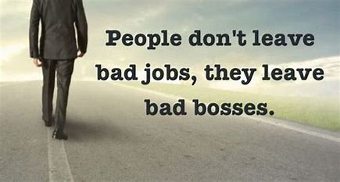
People leave People not companies…
Article – Lighthouse - Why People Leave Managers, not Companies (and what to do about it)
https://getlighthouse.com/blog/people-leave-managers-not-companies/

Slide 7
Discussion
Your own perspective on what constitutes a Good or a Bad example of ‘employer’.
What experiences do you have with Good versus Bad Employment?
What was your training? Did you have a good Induction experience?
Were you happy in your employment? And Why ?
How does your experience from placement tie into the series of questions above?

Slide 8
My Hotel Journey
My Portfolio of Hotels and their Staffing Structure

Slide 9
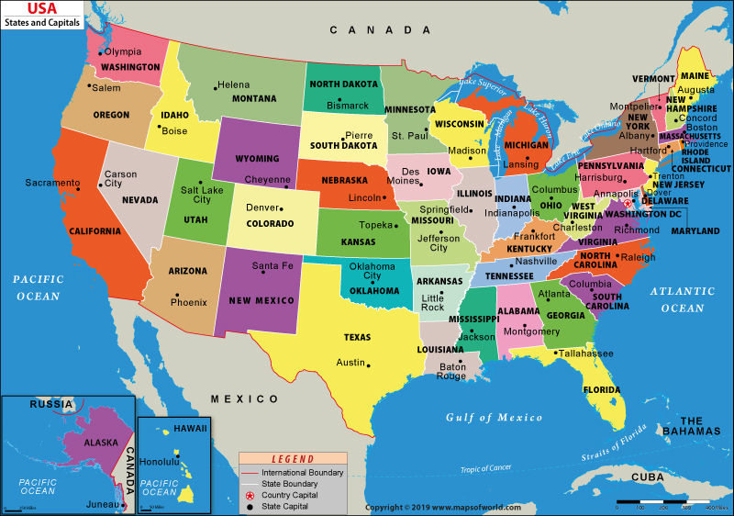

Slide 10
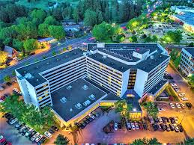
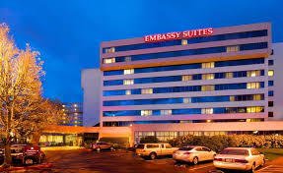
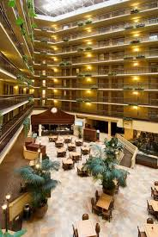
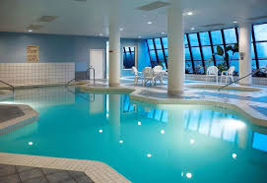
Embassy Suites Hotel by Hilton - Washington Square – Portland, Oregon
Front Office Manager (3 Years) for a Full Service 354 Room Property with 24,000 square feet of meeting space.

Slide 11
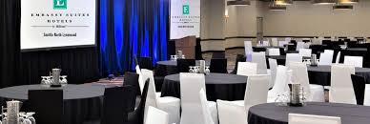
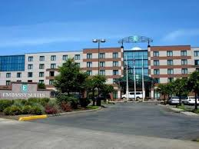
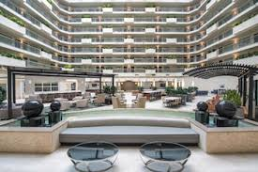
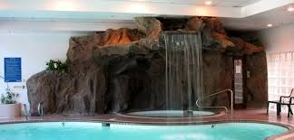
Embassy Suites Hotel by Hilton - Seattle North Lynwood – Seattle, Washington
Front Office Manager (5 Years) for a Full Service 240 Room Property with 10,000 square feet of meeting space

Slide 12

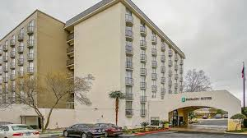
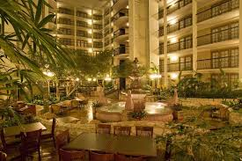
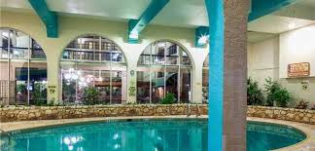
Embassy Suites Hotel by Hilton - San Antonio Northwest – San Antonio, Texas
Assistant General Manager (3 years) for a 216 room property with 5,500 square feet of meeting space

Slide 13
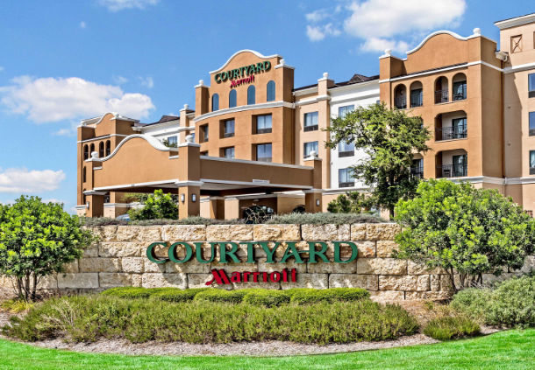
Courtyard by Marriott – San Antonio SeaWorld
Westover Hills – Texas
General Manager (7 Years)

Slide 14
Achievements
179 rooms, 8,000 square feet of meeting space, $6 million in annual Room Revenue and $1.5 million in Food & Beverage Revenue.
* 100 employees including 10 department heads.
Evening Food and Beverage Satisfaction" Award 2014 given to top 3 out of 1000 hotels in the Courtyard by Marriott Brand.
"President's Award" Winner 2013 for Excellence in Leadership - Kpartners Hospitality.
Marriott Gold Circle Award Winner 2014 for Overall Satisfaction.
Marriott Silver Circle Award Winner 2010 2011 2012 2013 for Overall Customer Satisfaction.
Trip Advisor Hall of Fame Award Winner 2011-2015.

Slide 15
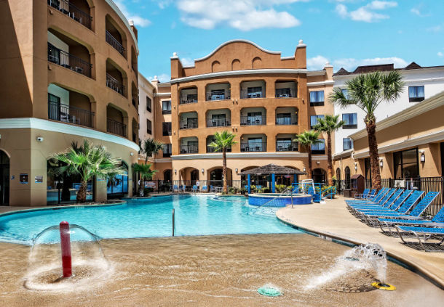

Slide 16
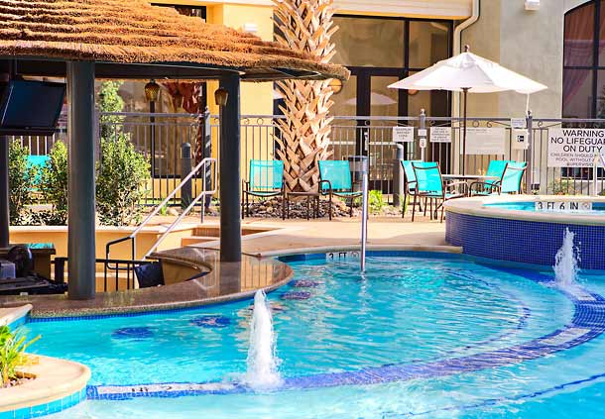

Slide 17
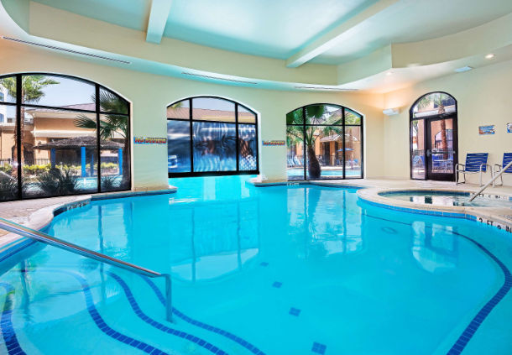

Slide 18
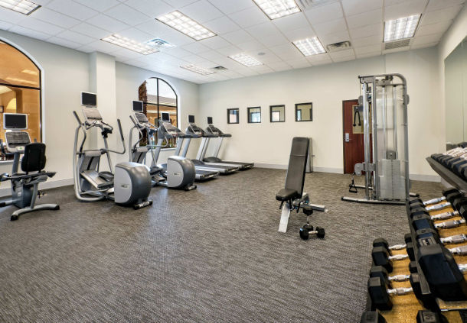

Slide 19
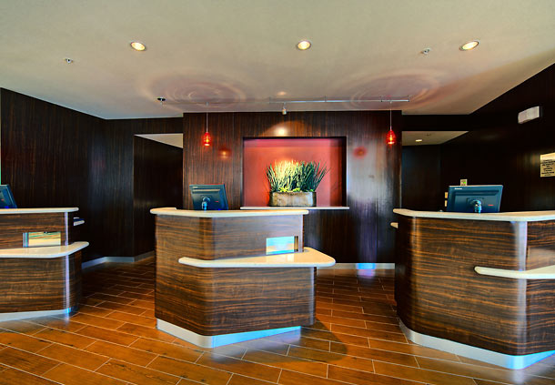

Slide 20
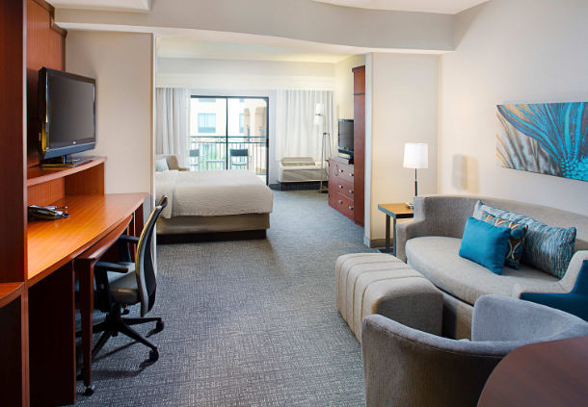


Slide 21
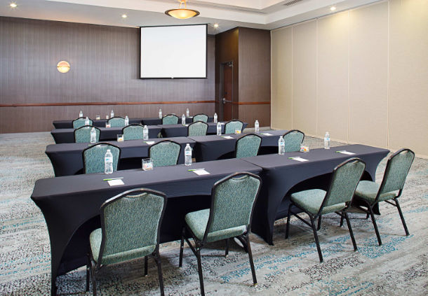

Slide 22
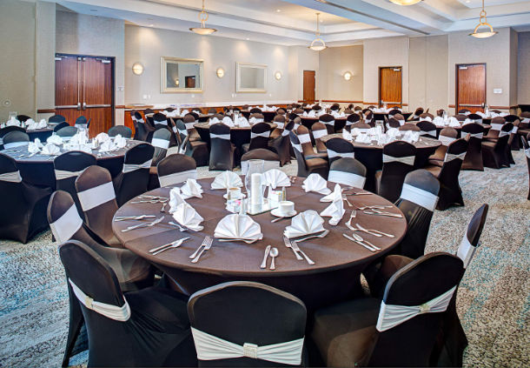

Slide 23
Above Property Leadership of 15 hotels:
Marriott:
Courtyard By Marriott San Antonio, Texas
Fairfield Inn & Suites San Antonio, Texas
Fairfield Inn & Suites San Angelo, Texas
Courtyard by Marriott Westchase Houston, Texas
Residence Inn W University Houston, Texas
Residence Inn W University Houston, Texas
Courtyard by Marriott W University Houston, Texas
Courtyard by Marriott Medical Centre Houston Texas

Slide 24
Cont..
IHG – Intercontinental Hotels Group
Holiday Inn Cotulla, Texas
Staybridge Suites Laredo, Texas
Staybridge Suites San Angelo, Texas
Hilton:
Homewood Suites San Antonio, Texas
Hampton Inn & Suites Houston, Texas
Homewood Suites Colorado Springs, Colorado
Hilton Garden Inn Colorado Springs, Colorado

Slide 25













Slide 26
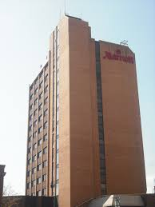
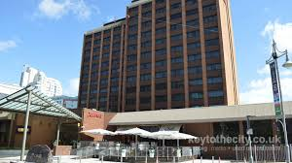
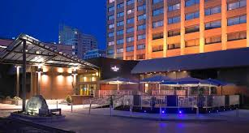
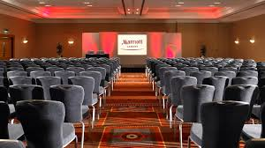
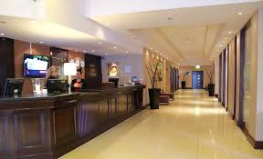
Cardiff Marriott 184 rooms
Operations Manager (2 Years)

Slide 27
Evolution of Human Resources
External and Internal Factors that impact an Organisation

Slide 28

Modern Day HR…
Modern HR professionals are leaders in their organizations.
The specialists sponsor the organizational mission, vision, values and goals among staff members, and they monitor and adjust organizational activities to ensure the success of various initiatives.
Human resource specialists contribute to enterprises by managing the most important asset of any organization, the people who complete the daily tasks that result in productive outcomes.
Their work aids in the global success of their organizations.

Slide 29


Slide 30
Different types of Companies
Private – sole traders, partnerships, companies (Ltd, plc). Small to medium enterprises (SME’s – meet 2 out of 3 criteria - less than 250 employees/turnover of £25m/gross assets of £12.5m), large (global companies). Operate for profit or are social enterprises.
Public – central government, local and regional government, public service providers, publicly owned corporations (BBC, Royal Mail). Largely funded by taxpayer and subject to a degree of public accountability. Increasingly being run like commercial businesses with targets, having to compete in internal and external markets.
Voluntary (third) sector – co-operatives, charities, pressure groups, controlled by boards of trustees and are subject to the law of trust, chartered bodies such as universities, professional bodies. Not for profit and not subject to direct government control or company law.

Slide 31

Organisational Size
Small/Micro: with less than 10 employees
Small to Medium: with less than 250 employees
Large: with more than 250

Slide 32
Organisational Orientation
Organisational orientation is split between production or service
A product is a physical, tangible item
A service is intangible and consumed at the point of delivery
Orientation can also be considered by reference to activities –
Primary: e.g. agriculture, mining
Secondary: e.g. manufacturing, production
Tertiary: e.g. services, finance, health

Slide 33
The Role of Management
Management
  The planning, organising, leading, and controlling of human and other resources to achieve organisational goals effectively and efficiently.
Managers
  The people responsible for supervising the use of an organisation’s resources to meet its goals.
Resources are organisational assets
  People
  Skills
  Knowledge
  Information
  Raw materials
  Machinery
  Financial capital (McGraw-Hill, 2004)

Slide 34
Hotel Management is Organised by Function
Finance
Sales & Marketing
Operations – Front Office; Food & Beverage; Housekeeping; Leisure Club
Revenue Management
Human Resource Management
Engineering
General Manager
Supported by Area Team; Risk management, Quality management, Customer Care, Performance Management

Slide 35
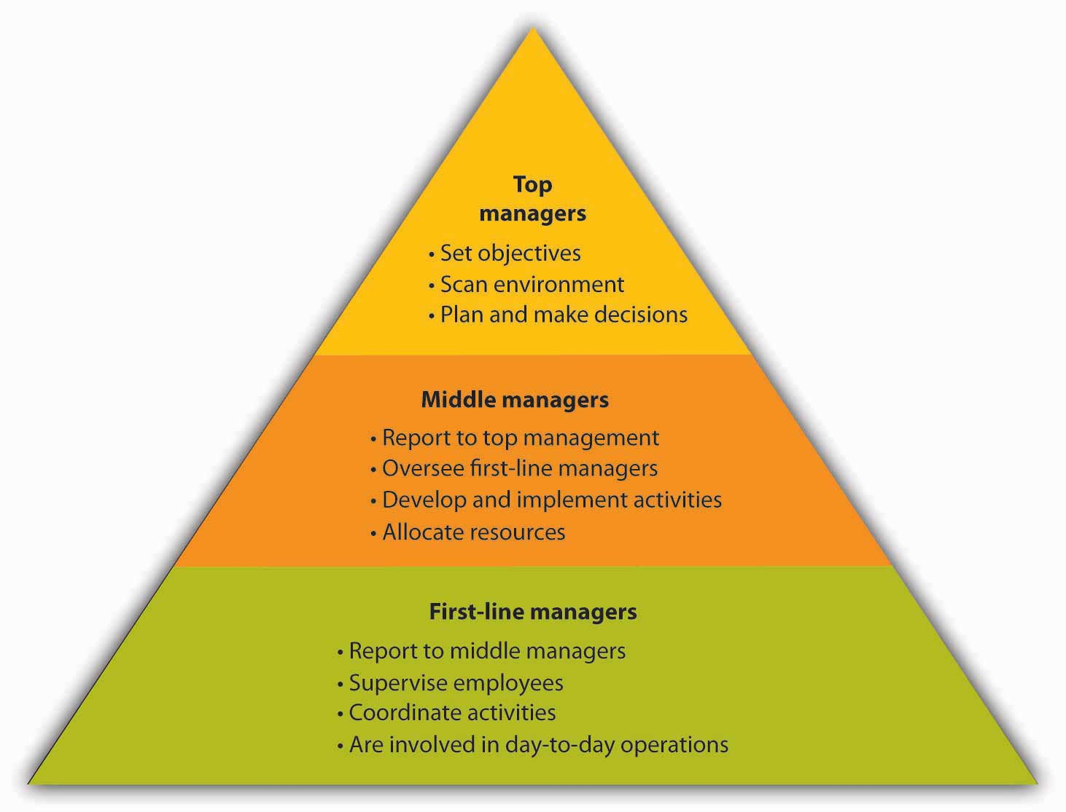
Types of Managers

Slide 36
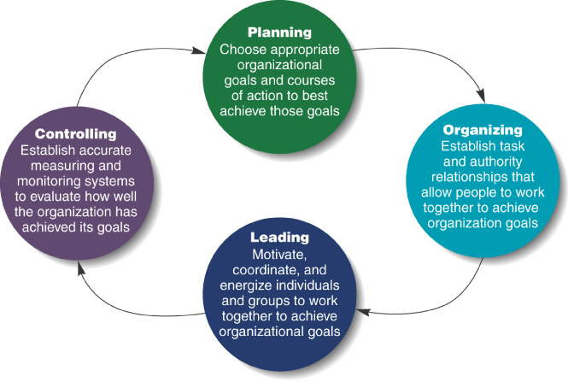
Four Functions of Management –
Henri Foyol

Slide 37
Stakeholders
Interests must be taken into account when managers are making decisions. A reasonable balance must be struck and broad principles of fairness observed by managers.
Stakeholders include - customers, shareholders, owners, managers and their staff, suppliers, the community.
HR customers/stakeholders – employees, professional colleagues (HR, finance, communications team), line managers, senior managers, executive boards, unions, government officials, community.
Stakeholder perspective places a requirement on HR to act as champions for effective and fair people management. Example - communicate employee concerns to managers.
Helps ensure achievement of objectives and effective change initiatives.

Slide 38
Purpose
The purpose of the HR Function is to support the delivery of the organisation’s strategy and objectives through the effective management of people and performance.
As such an organisation’s HR strategy and all activities should be clearly aligned with the strategy and objectives of the business.
(Wilkinson and Taylor, 2016).

Slide 39
Objectives of the HR Function
The core purpose and activities of the HR function evolve in response to developments in the business environment but do not change radically from one decade to another.
At its heart, Human Resource Management is about attracting and retaining people with the required skills and experience and then seeking to develop them, maximise their performance, involve and engage them in the work of the organisation.

Slide 40
History of HRM
From personnel management to HRM.
Change towards end of 20th Century –
notion that non-monetary factors could have a bigger impact on productivity and motivation than wages.
HR went from being passive to dynamic. People seen as a valuable resource, rather than cogs in a machine.
Further change at end of century - due to increased free market competition at a global level, growth of technology and knowledge based industries, the importance of people to company success was elevated.
From cogs to resources to assets – people were now a valuable source of competitive advantage.

Slide 41
Working for Marriott
An employee perspective

Slide 42
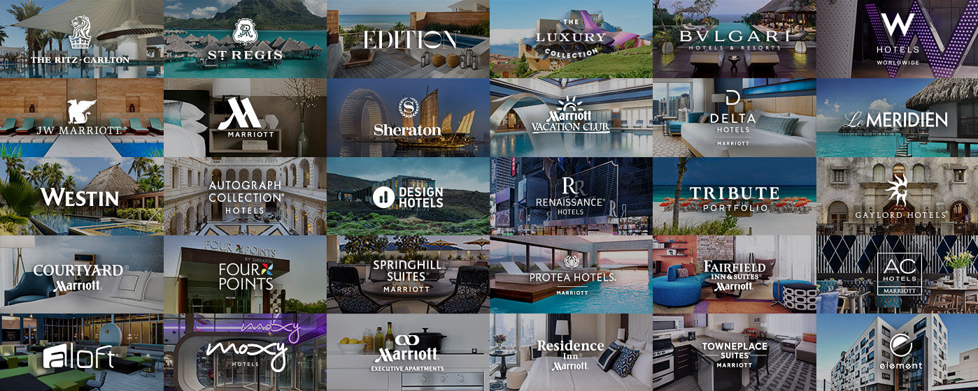

Slide 43
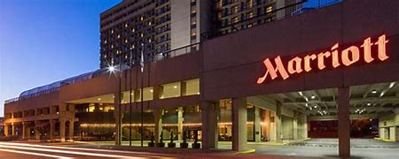
Working for Marriott
Hear from associates how Marriott’s culture of putting people first has transformed into a global movement called TakeCare, and how that has empowered them on their career journey.
https://www.youtube.com/user/MarriottJobs

Slide 44
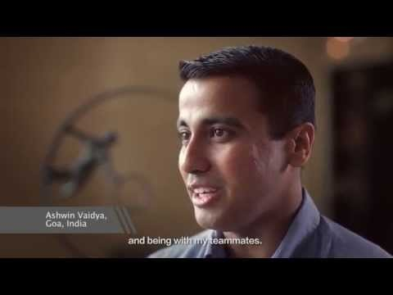
Working for Marriott International

Slide 45
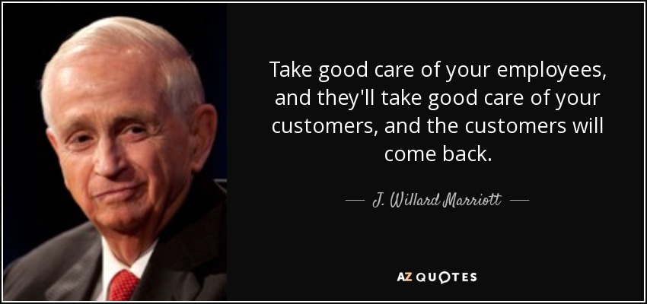

Slide 46
People Leave People…
Why do people stay with Marriott?
The videos discuss their enjoyment working for the company - Marriott..
Who are the people of Marriott..
The investment of Marriott into the training of the management and being the
‘bosses’ of the organization.
Taking care of your employees is key !
How does HR support this function and ensuring they ‘all ‘walk the talk;
Training.. Communication.. Leadership… socialising…..
Inspecting what you are expecting… how does this happen…?

Slide 47
Profession for the Future
CIPD Video
https://peopleprofession.cipd.org/profession-map/core-purpose
For more information, visit:
https://www.cipd.co.uk/news-views/future-profession

