Slide 1
MSc
Policing (Operational & Strategic Leadership)
Lesson:
Leadership & Multi - Agency working
MSc Plismona (Arweinydd Weithredol a Strategol)
Gwers: Arweiniaeth a Gweithio Aml-asiantaeth

Slide 2

Lesson Outcomes
What is multi-agency working?
Overview of the history of ‘multi-agency’ partnerships
The 5 C’s of multi agency working
The ladders of participation
Leadership Challenges of multi agency working
Other Police partnerships
JESIP
Notes:
Working with others plays a key role in delivering policing services – on a local, regional, national and international level
However the process of working with others , which is referred to in a whole host of different ways is often challenging for a number of reasons which we will look at today and hopefully you will share your experiences as we go through the lesson.
So today were going to be covering the following:

Slide 3
It’s all in the name
Collaboration
Multi-agency working
Multi-agency partnerships
Partnership working
Notes:
Let’s begin by considering the different ways that working with others is referred to.
Can you name some?
There are a number of words and phrases that are used to describe multi-agency working for example:
Collaboration
Multi-agency partnerships
Partnership working
Inter agency working
Others include
Multi disciplinary, multi=professional, inter disciplinary and inter professional
Are there any others that you come across in your roles?
Each of these terms will be used in different contexts depending on the issue at hand.
Multi-agency is more prevalaent in child protection and vulnerable adult spheres , whereas partnership working appears more in community safety and crime reduction
And collaboration is more often tha not mentioned when we work with other forces

Slide 4

Collaboration
“ Collaboration is a form of collective action and governance that brings together agencies to work across organisational boundaries to solve problems that can’t be addressed by any single agency or organisation”.
(Resetar et al, 2020)
Notes:
How would you define ‘collaboration’
Chat box answers
Resetar et al, 2020 describe it as a form of
Within the Cambridge dictionary it is described as - the act of working together with other people or organisations to create or achieve something

Slide 5

Collaboration
Ways in which 2 or more organisations can work together
Informal networks, joint delivery, full ‘merger’
Can last for a fixed time or permanent
Mutual advantage
Notes:
Collaboration covers a variety of ways that 2 or more organisations can work together
Options range from informal networks and alliances through to joint delivery of projects to a full merger
Collaborative working can last for a fixed period of time or can form a more permanent arrangements
But what these options have in common is that they involve some sort of exchange for mutual advantage that ultimately benefits end users
Within policing that benefit is of course for the benefit of the public
Collaborative working has been on the policing agenda for many years and has seen great dividends as a result – this has mainly been driven by the drive for effectiveness and efficiency and as a result of government policy

Slide 6

The Opportunities of Collaboration
Deliver new, improved or integrated services
Make efficiency savings through shared costs
Develop a stronger united voice
Share knowledge, skills and information
Notes:
Source : NVCO.org.uk
What do we see as the benefits of collaboration?
Here are some others

Slide 7

Multi-agency partnerships/Partnership working
“ where practitioners from more than one agency work together jointly, sharing aims, information, tasks and responsibilities in order to intervene early to avoid problems from arising’ (Cheminais, 2008)
“ A cooperative relationship between 2 or more organisations to achieve a common goal” (Berry et al, 2011)
Notes:
So lets now turn to ‘Multi-agency’ partnership
How would you define it?
Open up to class
Partnership working between agencies , both statutory and non-statutory has become increasingly important feature of the way in which crime problems are addressed at all levels – local, regional, national and to some extent international.
There are a range of ways in describing what constitutes partnership working however in its simplest form it is seen as a ‘cooperative relationship between 2 or more organisations to achieve a common goal’.
Partnerships are built on the premise that no one single agency can deal with or be responsible for dealing with complex safety and crime problems.
Source – https://uk.sagepub.cpm/sites/default/files/upm-binaries/25240_01_Cheminais_ch_01.pdf
Berry et al 2011 Research Report 52 – The effectiveness of partnership working in a crime and disorder context

Slide 8

History
1965 – Cornish Committee on the Prevention and Detection of Crime
The Morgan Report 1991
Children’s Act 1989
Crime & Disorder Act 1998
Comprehensive Spending review 2010
Notes:
Multi-agency partnership working in general is not a new development. As early as the mid 19th Century health & social services were working together to try and reduce poverty .
Within crime reduction a multi agency approach has been visible since the 1960’s with most being undertaken on an informal and small scale basis, however at that time it was rooted in a crime prevention approach and its origins can be found in the Cornish Committee on the Prevention and Detection of crime which reported its findings in 1965.
This committee had a partnership philosophy as its central theme and can be seen as the starting point for working in a community safety context.
The most significant milestone was the publication of the Morgan Report in 1991 which was critical in shaping community safety and the development of partnerships. It linked local authorities with the police and others in a multiagency approach to tackle crime. Its adoption however varied across the country.
It wasn’t until the 1980’s that the foundations of multi-agency partnership working were laid.
Significant pieces of legislation such as the Children’s Act 1989 and later the Crime and Disorder Act established the statutory requirements for inter-agency collaboration and joint working in relation to Children and Young persons ( Under the Children’s Act) and other crime related matters under the crime & Disorder Act – the emphasis was clearly directed at requiring professionals to work together.
Policing partnerships have increased dramatically since the implementation of the Crime & Disorder Act 1998, the comprehensive spending review in 2010 saw a 20% cut to police budgets and as a result police forces were nudged into considering how they could effectively and efficiently consider providing a level of service that met the public s needs.
Policing partnerships began to form in many sectors of policing both on an operational and organisational level.
As you know, today policing partnerships are wide spread and continue to increase as policing and other statutory and non statutory agencies face new and emerging crime threats and issues.

Slide 9

Early problems
Lack of information sharing
Duplicated work
Poor co-ordinated activities
‘buck passing’
Lack of continuity
Inconsistent levels of service provision
Unclear accountability
Notes:
Despite the introduction of Government legislation and initiatives to promote closer multi-agency partnership working, in the early years there existed a number of problems:
According to researchers ( e.g. Rita Cheminaise, 2008) such problems manifested in things such as
A lack of information sharing across agencies and services ( this became a significant issue when child protection investigations went wrong)
Duplicated assessments within organisations/agencies to identify needs and provision of services
Poorly coordinated integrated activities across agencies
Too much ‘buck passing’ and referring on clients between agencies
A lack of continuity and inconsistent levels of service provision
Unclear accountability

Slide 10
5C’s of Multi-agency partnership working
Coexistence
Co-operation
Co-ordination
Collaboration
Co-ownership
Notes:
Academics will suggest that there are 5 degrees of multi-agency partnership working:
All beginning with a C
Can anyone guess as to what they may be:
1.Coexistence – the requirements to have clarity between practitioners from different agencies as to what and with whom
2. Co-operation - where practitioners from different agencies share information and recognise the mutual benefits and value of partnership working, that is the pooling of of collective knowledge, skills and achievements available
3.Co-ordination – where partners plan together, share some roles and responsibilities, resources and risk taking accepting the need to adjust and make some changes to improve services and thereby avoiding overlapping
4.Collaboration – this refers to the longer term commitments between partners with organisational changes that bring about shared leadership, control, resources and risk-taking. Partners from different agencies agree to work together on strategies or projects each contributing to achieving shared goals
5. Co-ownership – here practitioners from the different agencies commit themselves to achieving a common vision, making significant changes in what they do and how they do it

Slide 11

Ladder of Participation - Wilcox
5. Supporting
4. Acting Together
3. Deciding together
2. Consultation
1. Information
Notes:
David Wilcox an academic, produced a ladder of participation in 2000 which related to the involvement of citizens in planning processes in the USA. The original version which was produced in 1969 by an academic called Sherry Arnstein had 8 stages.
Wilcox’s ladder has 5 stages. Stage 1 has the lowest involvement of participation or control where as stages 3 to 5 have the higher degrees of participation and control – according to Wilcox they are examples of substantial participation and true partnership working
5 stages are:
5. Supporting – this involves helping others to do what they want within a supportive framework which may offer resources as well as advice
4. Acting together – here the different interested parties decide what is best, and forming a partnership to carry it out
3. Deciding together – encouraging team practitioners to provide additional ideas and options and jointly deciding which is the best way forward
2. Consultation – identify problems, offering a number of options, solutions and listening to feedback from others
1. Information – telling the team and others what is planned

Slide 12
Ladder of participation
5. Collaboration & full partnership
4. Co-ordination & Co-operation in practice
3. Implementing projects & service plans
2. Planning action
1. Information exchange
Notes:
Source Percy-smith 2005 p28-29 ( cited in Cheminais p6-7)
Gster et al offers their ladder of multi-agency partnership working:
Again it is a 5 stage ladder based on Wilcox’s
5. Collaboration and full partnership – this involves separate and distinct roles but shared values and agenda. Pooled resources blurred boundaries, continuously developing to meet changing needs. Less powerful partners are supported to play a full role
4. Coordination & cooperation in practice – involving active coordination processes, the coordinator knows what’s going on , draws on each partner as appropriate, helps nurture developmental and cooperative culture and involves and supports new partners
3. Implementing projects and services – jointly or separately takes action on agreed plans, identified monitoring methods and review processes, mutual feedback on successes/failures
2. Planning action – involves identifying local and service needs where cross boundary working is needed and could be effective. Decide upon local priorities and needs, agree different partnership contributions and decide upon actions and processes. Identify the need for new partners
1. Information sharing – involves mutual learning, knowledge of what each partner does and could do, openness about decision making processes, new methods of accessing information including IT

Slide 13
8 Building blocks
Legal powers, responsibilities & policies
Governance
Information sharing
Identity management
Messages, events & transactions
Infra-structure
Agreed statement of Intent
Sustainability
Notes:
When looking at multi-agency working and its dynamics, Rita Cheminais (2008) puts forward 8 essential building blocks needed for effective multi-agency working
Which are :

Slide 14

Multi-agency partners
Who are the ‘partners’ that you currently work with in your roles ?
Notes:
Who are the partners that you work with?
Open to class to give examples in their respective roles

Slide 15
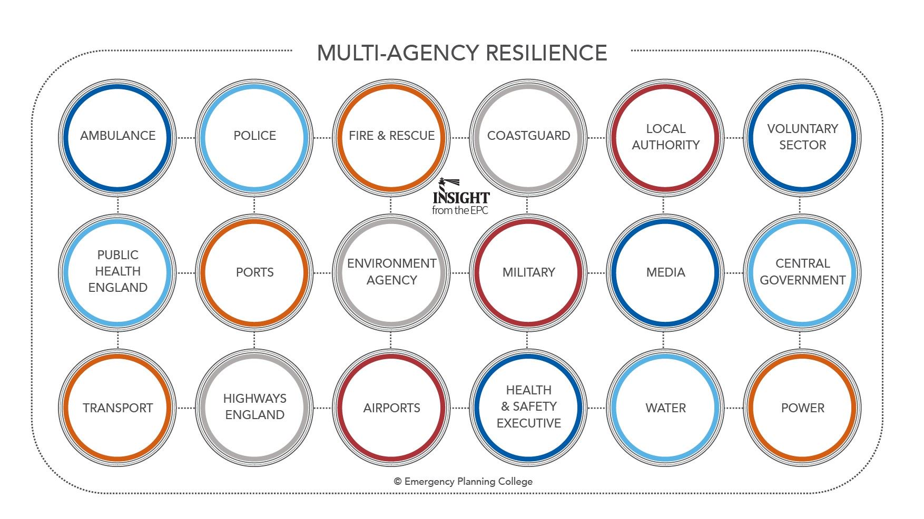

Slide 16
Benefits of partnership working - on crime
Partnership working
Identifying & defining problems
Creative & target interventions
2 is better than 1
Resources and new ideas
Maximise impact
New & different interventions
Notes:
A research paper issued by the Home office which considered the effectiveness of partnership working within a crime and disorder context listed the following as benefits of partnership working
Berry et al 2011 – adapted from Rosenbaum 2002
Partnerships are better at identifying and defining problems of greatest concern in communities
Partnerships are better at developing creative and targeted interventions ( because of the diverse nature of the group who all bring different approaches)
Multiple interventions are generally more effective than single agency intervention – with potentially higher levels of interbention
Partnerships bring more resources and new ideas to problem solve
Multiple interventions are likely to maximise the impact on any particular target audience
Exposure to new and different interventions may bring about new benefits

Slide 17
Benefits of partnership working – ‘activity’
Increased accountability
Reduce duplication
Public/private links
Public awareness
Strengthen local community organisations
Transformational
Notes:
Rosenbaum 2002 also identified several additional benefits of partnership ACTIVITY over and above the impact that partnerships can have on crime and crime reduction
These are:
Increased accountability of organisations
Reduce duplication and fragmentation of services
Build public and private links
Increase public awareness
Serve to strengthen local community organisations
Transformational – in that they are altering the way agencies do business (e.g. data driven decision making , emphasis on particular matters)
In some instances
Clear leadership
Good communication and informations haring
Sharing of resources
Joint training
Clear aims and well defined roles and responsibilities

Slide 18

Leadership Challenges - multi-agency partnership working
In your opinion , what would you say are the current leadership challenges of multi-agency/partnership working?
Notes:
Task

Slide 19

Challenges
Constant re-organisation and frequent staff turnover
Uncertainty about funding and sustainability
Difficulties in ensuring equity from partners agencies
Different professional ideologies and agency culture
Notes:
From research the following are also noted

Slide 20

Leadership Challenges
How can these challenges be addressed?

Slide 21

Partnerships between policing organisations
Police Act 1996
Policing & Crime Act 2009
Police Reform and Social Responsibility Act 2011
Notes:
I’m just going to quickly touch upon another ‘partnership’ that policing are part of and that is partnerships between policing organisations.
There has been much dialogue that police forces should be merged – just look at Wales for example where it has been an agenda item before and may well be for the future.
Although the conversations have been held in Wales and other areas of the UK where the opportunity to merge have been considered, they have yet to come to fruition except of course in Scotland.
However police forces are encouraged to work more closely together in part through legislative changes including
The Police Act 1996 which was then amended by the Policing & Crime Act 2009 and then the Police Reform and Social Responsibility Act 2011
A significant proportion of police collaboration involve partnerships between police services in a single region and most are based around protective services but are increasingly now involving more specialist functions as well as back office services
What partnerships exist in South Wales/DPP/GWP
A familiar partnerships involve the ROCU’s which not only look at policing partnerships but have now looked at expanding to be more multi agency with staff being embedded from DWP, HMRC, CPS, Border Force, GAIN networks, prisons etc.
We’ve looked at some of the challenges in Multi-agency partnerships – but what about police partnerships – are they free of any challenges ?

Slide 22

Challenges of Police Partnerships
In your opinion what leadership challenges do police partnerships pose?
Notes:
What challenges do police partnerships pose for leadership?
How do you think they can be addressed or overcome?

Slide 23

Police & Private Security Industry partnership
“ The mixed economy of public and private providers of policing has expanded dramatically’ (Munk, Skins, Loftus & Rice, 2015)
Partnership working varies
(Noaks, 2008) – police unwillingness to acknowledge roles
(White & Gill, 2013) – key barriers
(Gill, 2013) – trust
Regulation & accountability
Notes:
Another partnership that may be worth considering is the Police and private security industry partnership
Research undertaken by a team of academics who undertook an evidence review of policing partnerships in 2015 highlighted that the mixed economy of public and private policing has expanded dramatically( N8 Policing Research Partnership – Loftus, Skinns, Munk & Rice 2015).
Private security operates across a host of different areas including leisure activities, events, shopping centres industrial parks and local neighbourhoods. It has been referred to as the dominant form of policing and the potential to make a significant contribution to local crime prevention and community safety partnerships.
HMIC reported in 2011, 12 and 2013 that in the climate of austerity and in light of regulation the opportunities for the private sector partnering with the police has gained renewed momentum.
Their Research revealed that The level of partnership working varies , partnerships are poorly coordinated, under-developed, insecure and short-lived.
Relations between the police and private sector ranged from cooperation to indifference and hostility
Other academics raise other points on this partnership
Noaks (2008) identified an unwillingness by the police to acknowledge any role performed by th e private guards abd a situation of confrontation .
White & Gill 2013 identified key barriers to public/private partnerships as conflicting agendas, ideologies and culture
Gill 2013 also highlights a lack of trust as an explanation for the lack of information sharing and intelligence
Research also suggests that the increasing presence of private security in public and semi-public soaces may raise the issue of accountability and regulation

Slide 24
Police & Academic Partnership
Police - Accountability function
Academics – explanation and understanding of crime
Collaborations – SIPR, UPSI, What Works (CoP)
Challenges
Police
Accountability
Academics
Understanding and explanation
Public needs
Rich data
Notes:
So lets touch upon this relationship which has gained a lot of momentum in recent years.
For the police – external research performs an accountability function
For the academics – they can assist the police in explaining and understanding crime
Academics such as Stanko 2009, suggest that academic analysis can assist the police in understanding what the public wants from the police whilst the police are a rich source of data for academics
There are already some well established partnerships – such as the Scottish institute for policing research, the University of South Wales’s Police science institute and the College of policing ‘what works centre for crime reduction'
Key Challenges for this partnership have been identified through– differences in culture and methods of working, language and dissemination of research. Despite these challenges there is opportunity for both organisations to reap benefits if they could see beyond these challenges.

Slide 25
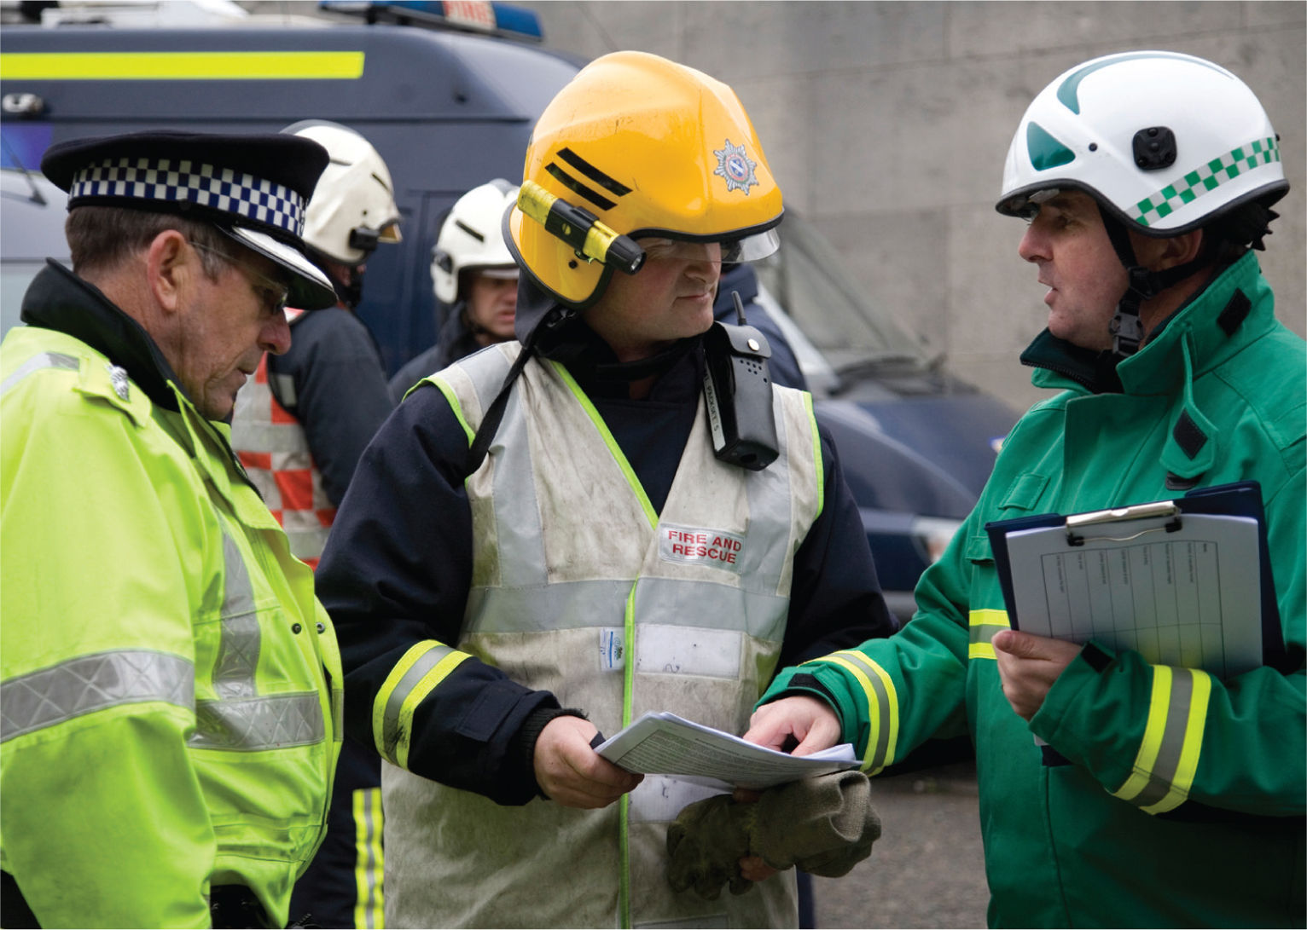
Leadership in Multi-agency response in major incidents/civil emergencies
JESIP – the Joint Emergency Services Interoperability Programme
Aim: to ensure that blue light services are trained and exercised together as effectively as possible at all levels of command in response to major or complex incidents.
Notes:
Finally we will look at Leadership in multi-agency response in major incidents or civil emergencies.
Some fo you will already be familiar with JESIP – the joint emergency services interoperability programme
JESIP was established in 2012 following a report by ACPI, Chief Fire Officers Association and the Associaition of Ambulance Chief Executives
Its aim is to ensure that blue light services are trained and exercised together as effectively as possible at all levels of command in response to major or complex incidents
Events over recent years have shown the need for emergency services to work together as effectively as possible during major, serious and catastrophic incidents or events. However reviews following such incidents as the July 2005 bombings, the Uk wide floods in 2014 and the shooting up in Cumbria in 2010 all reported gaps and failings in the inter-operability between the services.

Slide 26
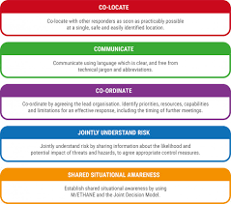
Principles for Joint working
Co-locate
Communicate
Co-ordinate
Jointly understand risk
Shared situational awareness
Notes:
JESIP’s principles for joint working support the development and implementation of a multi-agency response and provides a structure during that response

Slide 27

JESIP
Link : https://www.jesip.org.uk/
Video : https://www.jesip.org.uk/downloads/jesip-major-incident-awareness-animation/
Notes:
The websoite provides a whole host of information that will assist in such operational matters and if you haven’t visited it before it may be worth you looking at it

Slide 28

Leadership challenges
What are the leadership challenges within partnership working during major incidents/civil emergencies?
Notes:
But let’s look at the challenges that such major incidents bring to police leaders.
What do you think they are?

Slide 29

Leadership challenges
How can you address these challenges?

Slide 30

To conclude…
“ While partnership working can foster a collective sense of purpose, with benefits for crime prevention and economic savings, a key disadvantage is that as policing partnerships become increasingly diverse, issues of governance and accountability intensify”,
Notes:
The issues of partnership working, collaboration or multi agency working, whichever terminology is used has very similar challenges that all agencies must face and seek to address.
We must always be aware that the factors that inhibit and encourage partnership working and the challenges faced by leaders are manifold and the level of engagement and interaction between the police and their partners varies considerably across the board, Academia paints a mixed picture of relationships but do put forward solutions from lessons learnt that are there at the disposal of others to consider and implement.
Looking ahead there is scope for further academic intervention to explore how effective partnership practices can be achieved and implemented – a good dissertation topic for someone!!
Loftus, Skinns et al sum it up quite well
“ While partnership working can foster a collective sense of purpose, with benefits for crime prevention and economic savings, a key disadvantage is that as policing partnerships become increasingly diverse, issues of governance and accountability intensify”
And that now links us nicely into next weeks lesson which is about accountability.

Slide 31

Sources
List of all sources used for this lesson and some additional documents can be found on Moodle

Slide 32
Lesson Outcomes
What is multi-agency working?
Overview of the history of ‘multi-agency’ partnerships
The 5 C’s of multi agency working
The ladders of participation
Leadership Challenges of multi agency working
Other Police partnerships
JESIP
Notes:
Working with others palys a key role in delivering policing services – on a local, regional, national and international level
However the process of working with others , which is referred to in a whole host of different ways is often challenging for a number of reasons which we will look at today and hopefully you will share your experiences as we go through the lesson.
So today were going to be covering the following:

Slide 33

Cwestyniau?

