Slide 1
LCBB6004
Strategic Management and Sustainability
Week 8
Strategic Sustainability

Slide 2
Learning Objectives
Outline the main elements of green strategy and sustainability and explain their importance.
Define and explain the additional elements involved in analysing the green strategy environment.
Outline the impact on strategy options, strategy choice and implementation from the perspective of green strategy and sustainability.
Appreciate how a firm’s values, principles, and pursuit of corporate social responsibility can help define its strategy and support its creation of value.

Slide 3
The Balanced Scorecard—Measures that Drive Performance
BSCs
https://hbr.org/1992/01/the-balanced-scorecard-measures-that-drive-performance-2
Video: Harvard Business Review
A balanced scorecard is a strategic management performance metric that helps companies identify and improve their internal operations to help their external outcomes. It measures past performance data and provides organizations with feedback on how to make better decisions in the future.
Video

Slide 4
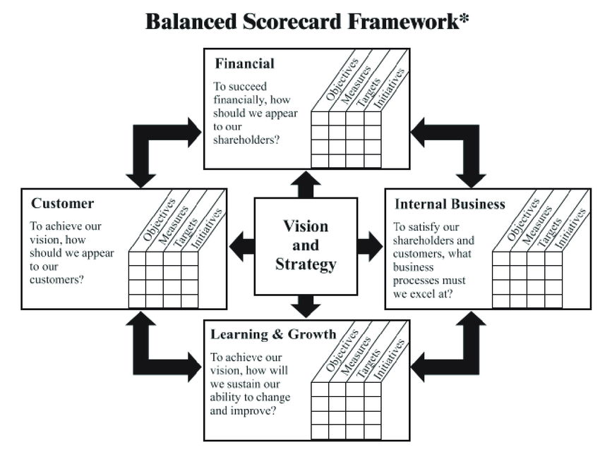

Slide 5
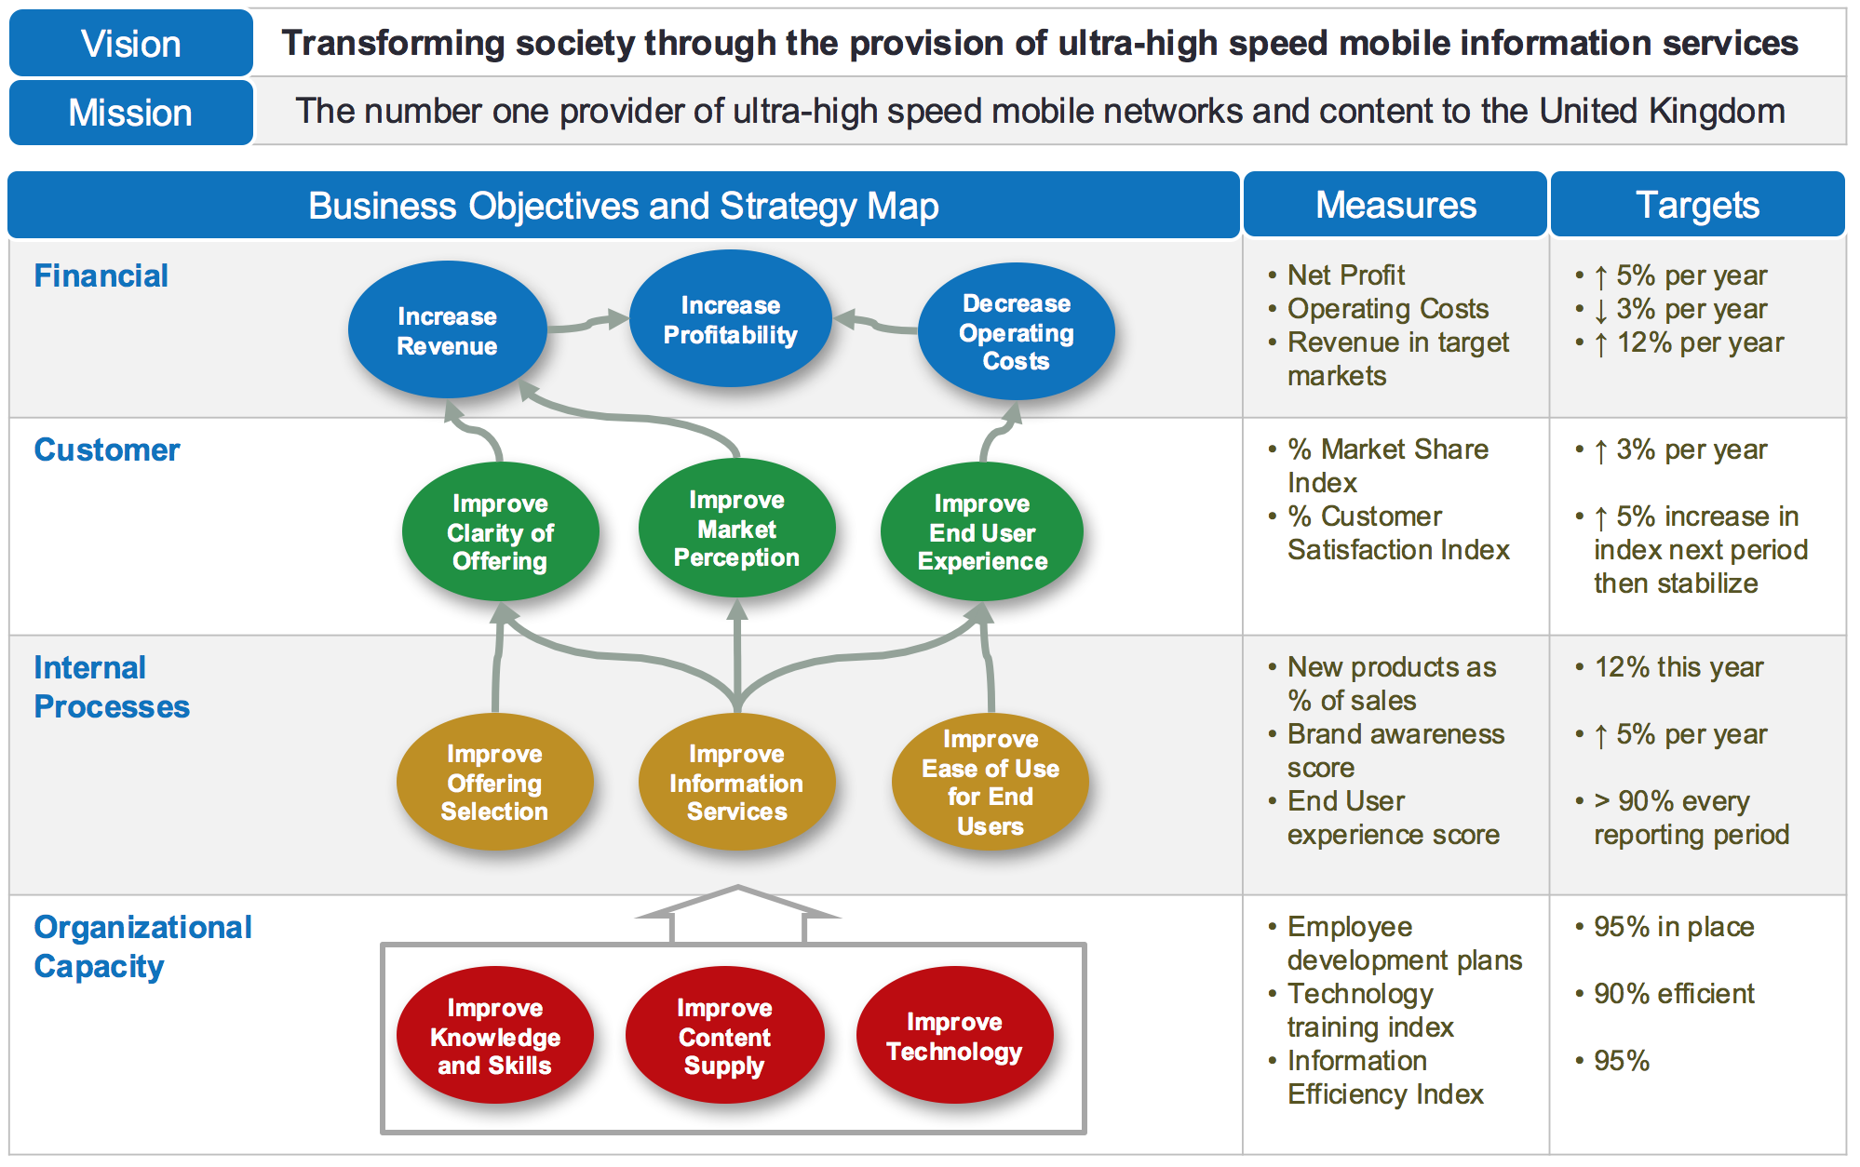

Slide 6
Strategic Sustainability
Strategic Sustainability examines how organisations can implement environmental sustainability science, theories, and ways of thinking to become more competitive.
Strategic Sustainability offers a comprehensive coverage of firm-natural issues related to the environment, ranging from critical drivers to strategic options at hand.
Leading businesses and corporations are evaluated on many aspects of their performance (e.g., product quality, ethical standards, and reputation in the community).
Corporate policies, involving employees and day-to-day operations, can have positive impacts on sustainability. Other “green” practices (e.g., recycling, purchasing recycled materials, and being a good steward of resources such as freshwater) also contribute to emissions reductions and environmental sustainability.

Slide 7
Green Strategy and Sustainability
Green strategy and the broader topic of sustainability concern those activities of the organisation that are focused on both sustaining the earth’s environment and developing the business opportunities that will arise from such additional activities.
Green strategy delivers positive results for leading companies.
There are three main factors to be addressed in analysing the green strategy environment:
    government legislation and directives;
    business opportunities;
    customer and consumer perceptions and pressure for change.

Slide 8
Green Strategy and Sustainability: The Main Topics
There are seven issues that companies need to consider:
  Effective use of energy with moves towards electrification. Safe and sustainable energy sources are essential. In practice, this will move organisations away from gas and oil towards other ways of generating energy.
  Sustainable use of natural resources. There is a need both to use renewable resources where possible and to use non-renewable resources in a careful and planned way.
  Protection of the biosphere and the development of carbon neutral organisations. Many companies are targeting the lower use of carboniferous fuels like oil and gas over the next few years.
  Country self-sufficiency. Countries need to become less reliant on importing energy where possible.
  Greater energy and resource efficiency. In both the production and the use of energy, many national governments and individual companies are researching and investing in more efficient sources of power generation.
  Reduction and disposal of waste. Green strategy needs to include waste minimisation, recycling where possible and special strategies with regard to hazardous waste.
  Change of attitudes and lifestyles. To achieve major change, a major shift in public attitudes is essential.

Slide 9
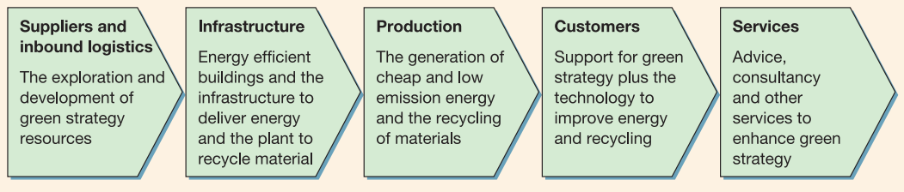
The Green Strategy Value Chain
The green strategy value chain seeks out ways of reducing energy, lowering carbon content and adopting recycling policies, not only within the organisation but also with suppliers and customers. In addition, the green strategy value chain will involve every element and function, including those that perhaps do not always feature highly in many value chain analyses.

Slide 10
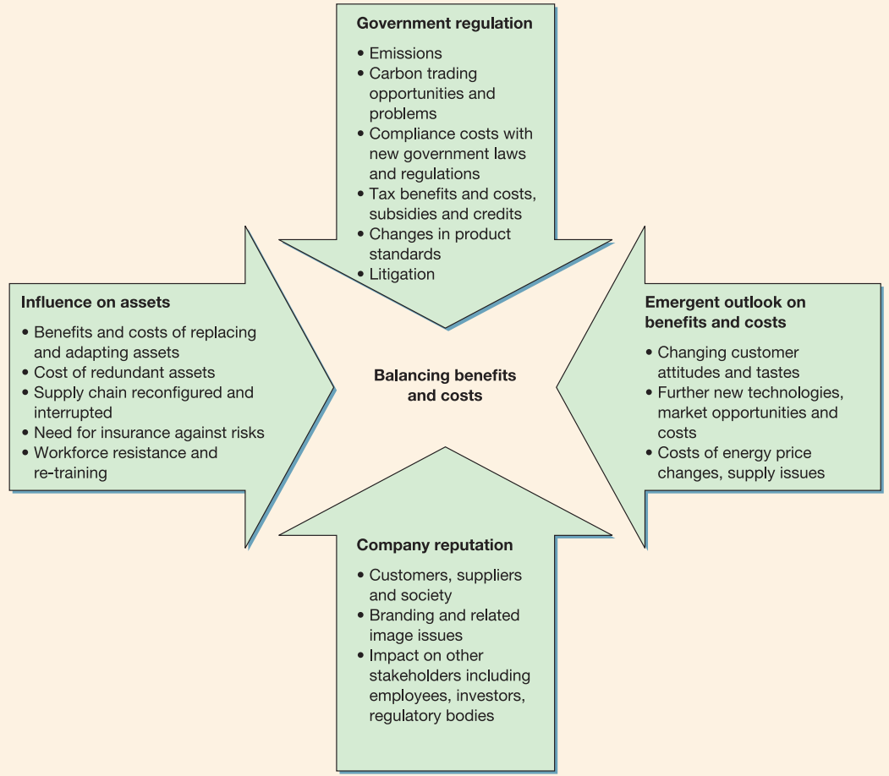
Green Strategy Value Chain: Benefits and Costs
From a green strategy perspective, green strategies will bring benefits both for the organisation and for its wider stakeholders – for example, employees, shareholders and the local community.
It is important to be realistic about the adoption of green strategy policies: there will be costs as well as benefits to the organisation.

Slide 11
What Is Corporate Social Responsibility (CSR)?
Corporate social responsibility (CSR) is a self-regulating business model that helps a company be socially accountable to itself, its stakeholders, and the public. By practicing corporate social responsibility, also called corporate citizenship, companies can be conscious of the kind of impact they are having on all aspects of society, including economic, social, and environmental.
To engage in CSR means that, in the ordinary course of business, a company is operating in ways that enhance society and the environment instead of contributing negatively to them.
https://www.investopedia.com/terms/c/corp-social-responsibility.asp

Slide 12

Example:
https://www.stmedia.co.uk/blog/great-corporate-social-responsibility-videos/

Slide 13

Lego ends Shell partnership following Greenpeace campaign
https://www.theguardian.com/environment/2014/oct/09/lego-ends-shell-partnership-following-greenpeace-campaign

Slide 14
Corporate Social Responsibility
Corporate social responsibility (CSR) is the commitment by organisations to behave ethically and contribute to economic development while improving the quality of life of the workforce and their families as well as the local community and society at large.
Three reasons why CSR might also be in the interests of a company:
  The sustainability argument - CSR is in firms’ interests due to a mutual interest in sustaining the ecosystem.
  The reputation argument - CSR enhances a firm’s reputation with consumers and other third parties.
  The license-to-operate argument - to conduct their businesses firms need the support of the constituencies upon which they depend.

Slide 15
Business Ethics: Definition, Principles, Why They're Important
Business ethics studies appropriate business policies and practices regarding potentially controversial subjects, including corporate governance, insider trading, bribery, discrimination, corporate social responsibility, fiduciary responsibilities, and much more. The law often guides business ethics, but at other times business ethics provide a basic guideline that businesses can follow to gain public approval.
https://www.investopedia.com/terms/b/business-ethics.asp

Slide 16
Business Ethics
Good ethics is good business. Bad ethics can derail even the best strategic plans.
The term ethics refers to accepted principles of right or wrong that govern the conduct of a person, the members of a profession, or the actions of an organisation.
Business ethics are the accepted principles of right or wrong governing the conduct of businesspeople.
The ethical issues that strategic managers confront cover many topics, but most are due to a potential conflict between the goals of the enterprise, or the goals of individual managers, and the fundamental rights of important stakeholders, including stockholders, customers, employees, suppliers, competitors, communities, and the general public.

Slide 17
Behaving Ethically
Managers can and should do at least seven things to ensure that basic ethical principles are adhered to and that ethical issues are routinely considered when making business decisions:
  favour hiring and promoting people with a well-grounded sense of personal ethics
  build an organisational culture that places a high value on ethical behaviour
  make sure that leaders within the business not only articulate the rhetoric of ethical behaviour but also act in a manner that is consistent with that rhetoric
  put decision-making processes in place that require people to consider the ethical dimension of business decisions
  use ethics officers
  put strong governance processes in place
  act with moral courage

Slide 18
Sources:
Fogel, D. S., 2016. Strategic Sustainability: A Natural Environmental Lens on Organizations and Management. New York: Routledge.
Grant, R. M., 2018. Contemporary Strategy Analysis. 10 ed. NJ : John Wiley & Sons, Inc.
Hill, C. W. L., Schilling, M. A. & Jones, G. R., 2017. Strategic Management, Theory. 12 ed. Boston: Cengage Learning.
Johnson, G. et al., 2017. Exploring Corporate: Text and Cases. 11 ed. Harlow: Pearson Education Limited.
Lynch, R., 2015. Strategic Management. 7 ed. Harlow: Pearson Education Limited.

