Slide 1
LCBB4000
Academic Skills
Sergiu Diaconu

Slide 2
Table contents
Code of conduct
Introduction
Overview of the company
Achievement of the company
Evaluation of Unilever’s business strategy
Unilever’s response to customer satisfaction
Unilever employed strategies in a post-pandemic era
Recommendations
Conclusion
References

Slide 3
Code Of Conduct
FAIRNESS DILIGENCE
We will be ethical and take into account the time, We will work diligently, thoroughly, and with
expertise, experience, and unique conditions reasonable timelines in providing out best
required in delivering the presentation. presentation.
PROFESSIONALISM COMPETENCE
We will act in a manner that demonstrates admirable We will commit to acquire , maintain
professional conduct. We will operate with integrity, and continually improve the professional
trustworthiness, courtesy and diligence knowledge and skills required to effectively
provide the most effective presentation.

Slide 4
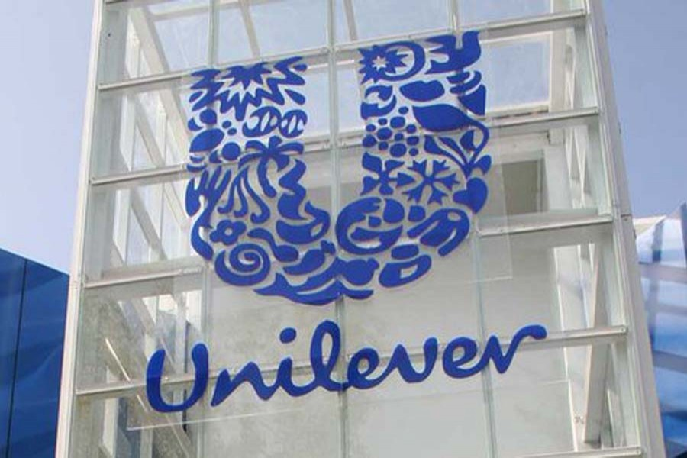
Introduction
Skills like rational and critical reflection rely on more advanced abilities like academic writing, presenting skills, and referencing. Study skills, also known as academic proficiency or study tactics, are methods to better one's learning. Capturing and remembering new material, as well as preparing for and doing well on tests, are all aspects of the broader category of "study skills." the following presentation will illustrate the marketing strategies of Unilever company with respect to customer satisfaction.
Notes:
Skills like rational and critical reflection rely on more advanced abilities like academic writing, presenting skills, and referencing. Study skills, also known as academic proficiency or study tactics, are methods to better one's learning. Capturing and remembering new material, as well as preparing for and doing well on tests, are all aspects of the broader category of "study skills." the following presentation will illustrate the marketing strategies of Unilever company with respect to customer satisfaction.

Slide 5

Overview of the company
A world leader in numerous different categories of consumer goods, the British-Dutch multinational business Unilever is headquartered in London. The Dutch parent firm Unilever NV and the British parent company Unilever PLC are both partners in the organization that they created together. The two firms have been operating as if they were a single entity thanks to a series of agreements that date back to the year 1930 (Pandey et al., 2021).
Both London and Rotterdam serve as the primary locations for Unilever's headquarters.
Unilever moves up to the 99th spot on the list of the most valuable corporations in the world with this market capitalization (Fithry et al., 2021).
Notes:
A world leader in numerous different categories of consumer goods, the British-Dutch multinational business Unilever is headquartered in London. The Dutch parent firm Unilever NV and the British parent company Unilever PLC are both partners in the organization that they created together. The two firms have been operating as if they were a single entity thanks to a series of agreements that date back to the year 1930 (Pandey et al., 2021). However, they are governed by the same board of directors even though they function separately. Both London and Rotterdam serve as the primary locations for Unilever's headquarters. As of July 2022, the total market value of all of Unilever's shares is 117.38 billion dollars (Hoekstra and Leeflang, 2020). Unilever moves up to the 99th spot on the list of the most valuable corporations in the world with this market capitalization (Fithry et al., 2021).

Slide 6
Overview of the company
Unilever was formed from the merger of two companies on September 2, 1929, by the British soap manufacturer Lever Brothers and the Dutch margarine firm Margarine Unie.
In 1997, the specialized chemicals branch of Unilever was sold to ICI by the company. In the 2010s, the company, which was led by Paul Polman, shifted its focus from food brands that were experiencing slow growth to those that were related to health and beauty.
Notes:
It is common practice to determine the worth of a publicly-traded company by looking at the company's market capitalization, often known as the "market cap," which is the total value of the company's outstanding shares according to the current market.
Unilever was formed from the merger of two companies on September 2, 1929, by the British soap manufacturer Lever Brothers and the Dutch margarine firm Margarine Unie. When it stopped concentrating only on the manufacture of products produced from oils and fats, the company began a period of expansion and diversification that lasted throughout the second half of the twentieth century. Unilever is comprised of three core business divisions, which are beauty and personal care, home care, and foods and drinks. Research and development are carried out by the company in a variety of nations throughout the world, including the United States of America, China, India, the Netherlands, the United Kingdom, and the United Kingdom (Wade and Shan, 2020). In 1997, the specialized chemicals branch of Unilever was sold to ICI by the company. In the 2010s, the company, which was led by Paul Polman, shifted its focus from food brands that were experiencing slow growth to those that were related to health and beauty.

Slide 7

Achievement of the company
Addressing social problems
Targeting customer response
Building women’s social security
Broaden core values

Slide 8
Achievement of the company
In the aftermath of Covid-19, Unilever CEO Alan Jope reaffirmed the company's commitment to making a sustainable living the norm for the world's 8 billion people and advocated for concerted action to address the issues of social inequality and climate change.
Problems including climate change and social exclusion, as well as more general issues like waste and packaging, sex equality, human rights, and fair price, will be prioritized. The Compass will be more comprehensive, all-encompassing, and far-reaching than ever before; it will be anchored by the same rigor as the USLP (Fithry et al., 2021).
Notes:
In the aftermath of Covid-19, Unilever CEO Alan Jope reaffirmed the company's commitment to making a sustainable living the norm for the world's 8 billion people and advocated for concerted action to address the issues of social inequality and climate change. The Unilever Compass is predicated on the idea that brands with a purpose flourish, organizations with a purpose endure, and individuals with a purpose prosper. The Unilever Compass is a set of 15 multi-year initiatives that represent the breadth of Unilever's company and broader ecosystem and are grounded in our three core values (Hasna, 2022). Each top priority will have its own set of lofty goals, as well as its own set of programs and initiatives. Problems including climate change and social exclusion, as well as more general issues like waste and packaging, sex equality, human rights, and fair price, will be prioritized. The Compass will be more comprehensive, all-encompassing, and far-reaching than ever before; it will be anchored by the same rigor as the USLP (Fithry et al., 2021). Eventually, more information will be made public. Unilever has various initiatives aimed at boosting women's economic security and professional prospects, but it has been challenging to assess the true extent of these initiatives' success (Suwadji et al., 2021). Similarly, the complexity of many of the worldwide supply networks we acquire from has made it more difficult to achieve our sustainable procurement goals.

Slide 9
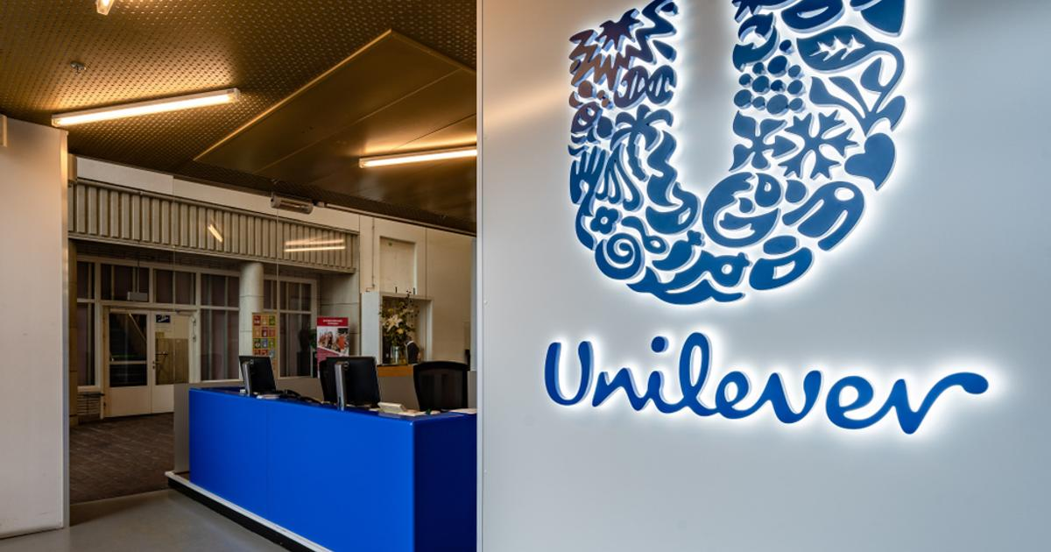
Achievement of the company
The Unilever Compass is a set of 15 multi-year initiatives that represent the breadth of Unilever's company and broader ecosystem and are grounded in our three core values (Hasna, 2022). Unilever has various initiatives aimed at boosting women's economic security and professional prospects, but it has been challenging to assess the true extent of these initiatives' success (Suwadji et al., 2021).
Notes:
In the aftermath of Covid-19, Unilever CEO Alan Jope reaffirmed the company's commitment to making a sustainable living the norm for the world's 8 billion people and advocated for concerted action to address the issues of social inequality and climate change. The Unilever Compass is predicated on the idea that brands with a purpose flourish, organizations with a purpose endure, and individuals with a purpose prosper. The Unilever Compass is a set of 15 multi-year initiatives that represent the breadth of Unilever's company and broader ecosystem and are grounded in our three core values (Hasna, 2022). Each top priority will have its own set of lofty goals, as well as its own set of programs and initiatives. Problems including climate change and social exclusion, as well as more general issues like waste and packaging, sex equality, human rights, and fair price, will be prioritized. The Compass will be more comprehensive, all-encompassing, and far-reaching than ever before; it will be anchored by the same rigor as the USLP (Fithry et al., 2021). Eventually, more information will be made public. Unilever has various initiatives aimed at boosting women's economic security and professional prospects, but it has been challenging to assess the true extent of these initiatives' success (Suwadji et al., 2021). Similarly, the complexity of many of the worldwide supply networks we acquire from has made it more difficult to achieve our sustainable procurement goals.

Slide 10
Evaluation of Unilever’s business strategy
Unilever, one of the world's strongest and wealthiest corporations and owner of several recognizable brand names, acknowledged that its product is utilized by people everywhere. Unilever has begun competing on a global scale by penetrating new markets with its well-known brands. Unilever's global strategy is superior to localized strategies for entering and competing in international markets because it allows the company to more effectively streamline its operations and concentrate on creating a consistent brand image across regions (Wade and Shan, 2020).
Notes:
Unilever, one of the world's strongest and wealthiest corporations and owner of several recognizable brand names, acknowledged that its product is utilized by people everywhere. Dove, Sun Silk, Clear, Pond's, Vaseline, Magnum, Rexona, and Lux are eight of Unilever's most well-known worldwide trademarks. When the company originally set out to compete globally, it expanded into just a handful of foreign countries (Pandey et al., 2021). After establishing a foothold in a number of areas, Unilever has begun competing on a global scale by penetrating new markets with its well-known brands (Wade and Shan, 2020). It's a testament to Unilever's ability to create enduring identities for its brands.
When a company expands into new markets throughout the world, corporate strategy takes on more importance. Unilever is stepping up its attempts to expand its presence in emerging markets, where it already has deep roots (Bettencourt, 2022). Unilever is positioned favorably to take advantage of the anticipated expansion in the areas (Hoekstra and Leeflang, 2020). Unilever's performance during its three-hundred-year existence has been impacted by the significant events of the day, including economic booms and busts, wars, shifts in consumer preferences, and technological developments. And throughout, they've developed items that aid people in making the most of their lives by reducing the amount of time spent on menial tasks, enhancing their health and well-being through better nutrition, and facilitating their ability to take pleasure in cooking, cleaning, and caring for themselves and their possessions (Fithry et al., 2021). The Vitality mission is leading us into a new stage of growth, building on the groundwork laid by the road to the Growth plan at the turn of the millennium.

Slide 11
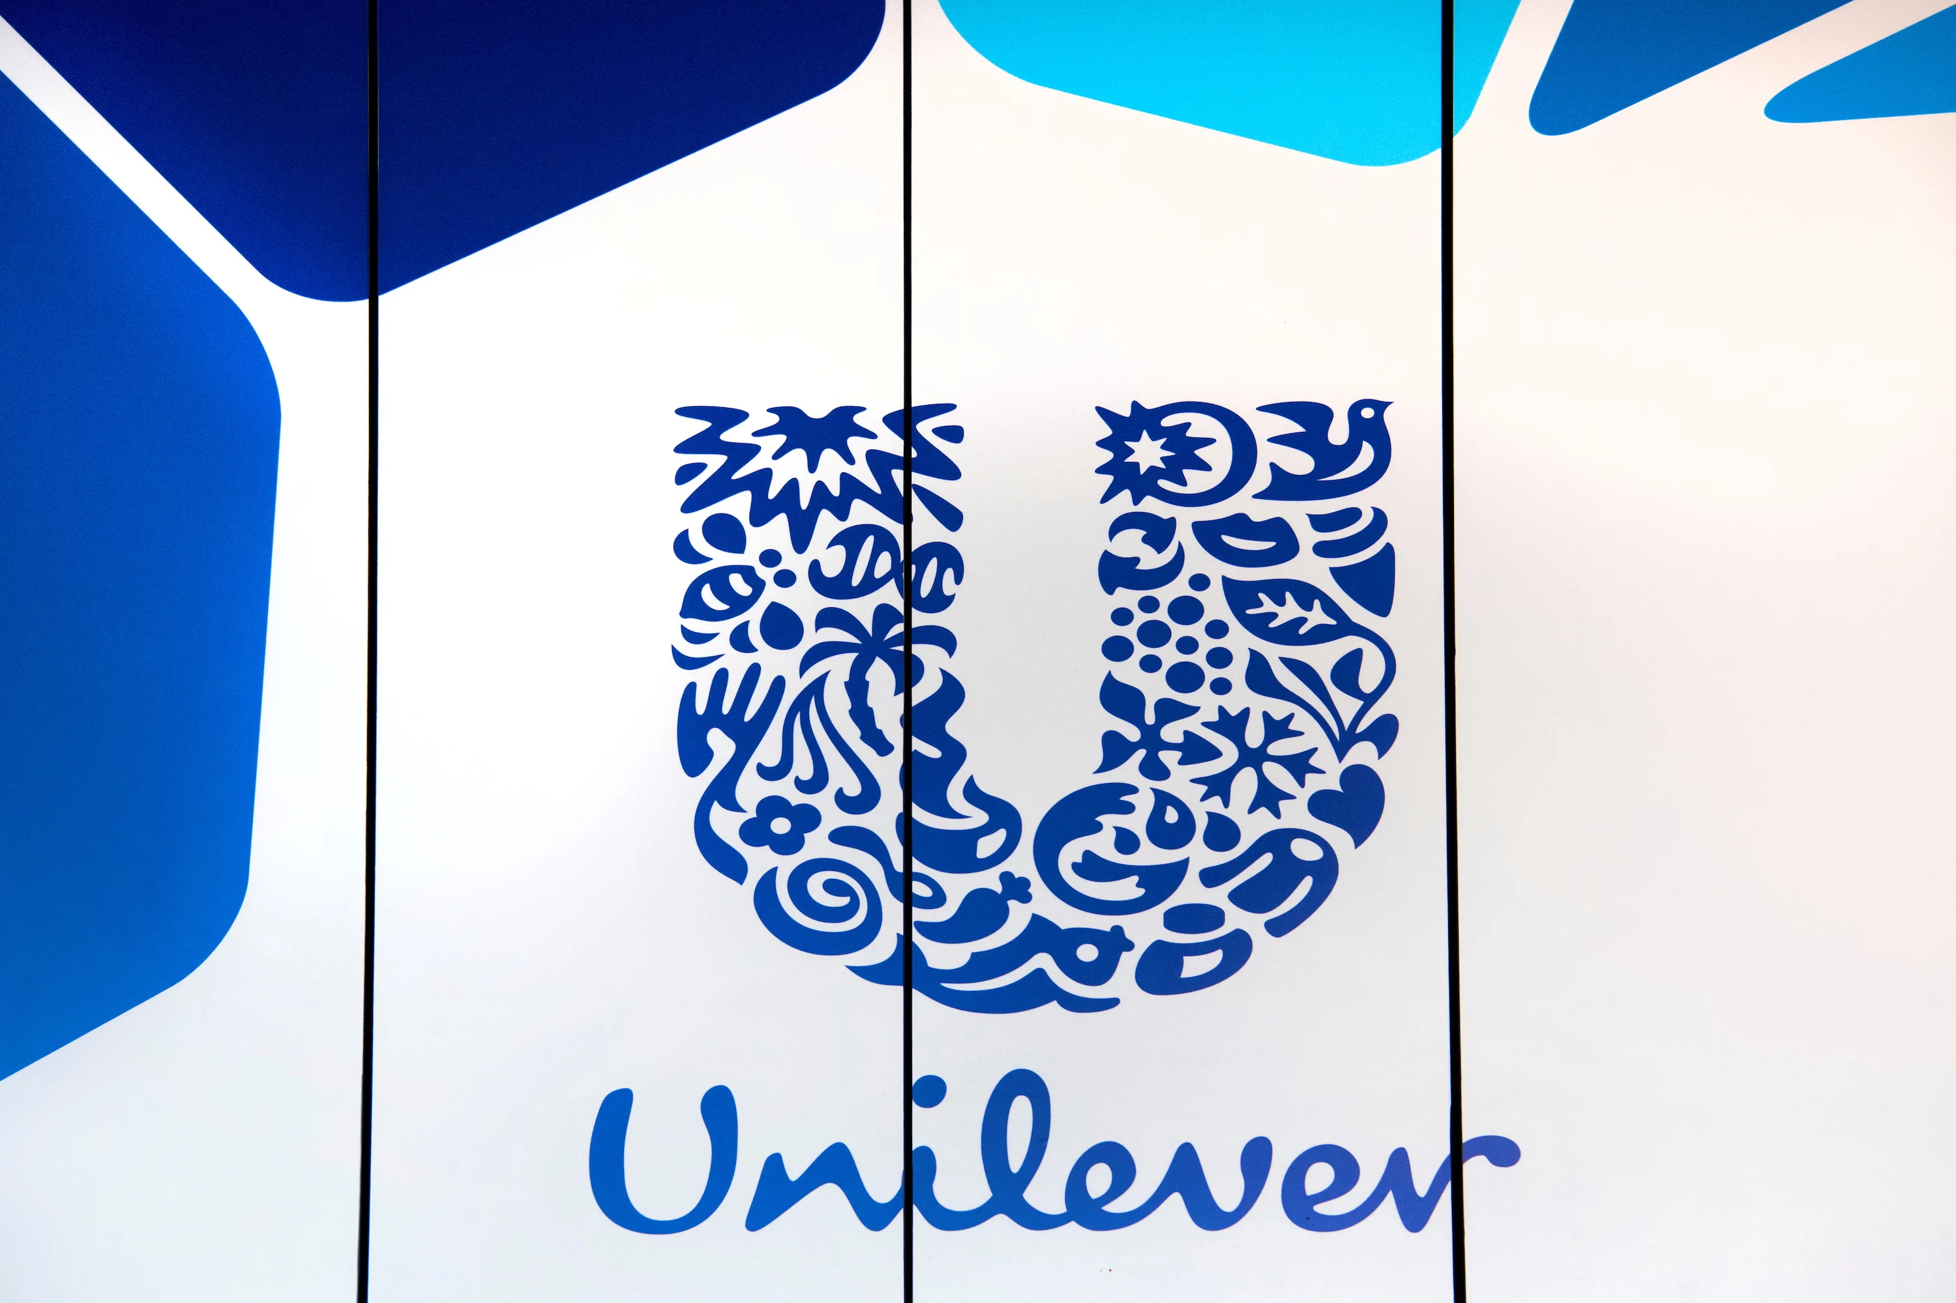
Evaluation of Unilever’s business strategy
Unilever is positioned favorably to take advantage of the anticipated expansion in the areas because of its strong distribution network in both conventional and contemporary retail outlets and its proficiency in adapting successful global brand ideas to suit local markets (Hoekstra and Leeflang, 2020).
Unilever's performance during its three-hundred-year existence has been impacted by the significant events of the day, including economic booms and busts, wars, shifts in consumer preferences, and technological developments.
Notes:
Unilever, one of the world's strongest and wealthiest corporations and owner of several recognizable brand names, acknowledged that its product is utilized by people everywhere. Dove, Sun Silk, Clear, Pond's, Vaseline, Magnum, Rexona, and Lux are eight of Unilever's most well-known worldwide trademarks. When the company originally set out to compete globally, it expanded into just a handful of foreign countries (Pandey et al., 2021). After establishing a foothold in a number of areas, Unilever has begun competing on a global scale by penetrating new markets with its well-known brands. Unilever's global strategy is superior to localized strategies for entering and competing in international markets because it allows the company to more effectively streamline its operations and concentrate on creating a consistent brand image across regions (Wade and Shan, 2020). It's a testament to Unilever's ability to create enduring identities for its brands.
When a company expands into new markets throughout the world, corporate strategy takes on more importance. Unilever is stepping up its attempts to expand its presence in emerging markets, where it already has deep roots (Bettencourt, 2022). Unilever is positioned favorably to take advantage of the anticipated expansion in the areas because of its strong distribution network in both conventional and contemporary retail outlets and its proficiency in adapting successful global brand ideas to suit local markets (Hoekstra and Leeflang, 2020). Unilever's performance during its three-hundred-year existence has been impacted by the significant events of the day, including economic booms and busts, wars, shifts in consumer preferences, and technological developments. And throughout, they've developed items that aid people in making the most of their lives by reducing the amount of time spent on menial tasks, enhancing their health and well-being through better nutrition, and facilitating their ability to take pleasure in cooking, cleaning, and caring for themselves and their possessions (Fithry et al., 2021). The Vitality mission is leading us into a new stage of growth, building on the groundwork laid by the road to the Growth plan at the turn of the millennium.

Slide 12

Unilever’s response to customer satisfaction
Why customer response is important?
A client is someone who buys a company's goods or services. To those who practice current marketing principles, the consumer is of paramount significance (Wade and Shan, 2020). Because consumers' preferences are always evolving, marketing's ultimate goal is to cater to consumers' desires and requirements. Customers in the modern-day take in the whole picture (Yaakub, 2008). Consumers' choices are heavily influenced by factors such as their post- and pre-purchase evaluations, the information they gather from reviews and other customers, the information they gather from various media sources, and the evaluations they conduct of possible alternatives to the original product (Pandey et al., 2021).
Notes:
The consumer is one of the most vital parts of every successful company. In today's business world, the client is seen as the most important asset. A client is someone who buys a company's goods or services. To those who practice current marketing principles, the consumer is of paramount significance (Wade and Shan, 2020). Because consumers' preferences are always evolving, marketing's ultimate goal is to cater to consumers' desires and requirements. Customers in the modern-day take in the whole picture (Yaakub, 2008). Consumers' choices are heavily influenced by factors such as their post- and pre-purchase evaluations, the information they gather from reviews and other customers, the information they gather from various media sources, and the evaluations they conduct of possible alternatives to the original product (Pandey et al., 2021).

Slide 13
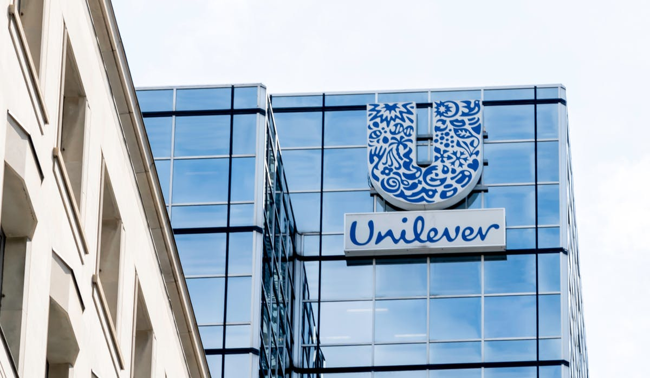
Unilever’s response to customer satisfaction
Customers are Unilever's first concern, and the company's core principles are centered on serving the public's best interests via the provision of excellent goods and services. Additionally, Unilever's commitment to quality has helped the company win and keep loyal consumers. When it comes to satisfying its customers, Unilever stands apart (Bland et al., 2020).
Notes:
Customers are Unilever's first concern, and the company's core principles are centered on serving the public's best interests via the provision of excellent goods and services. Additionally, Unilever's commitment to quality has helped the company win and keep loyal consumers. When it comes to satisfying its customers, Unilever stands apart (Bland et al., 2020). This may be seen in the development of cutting-edge items aimed squarely at present-day consumers. Unilever is similarly receptive to feedback on customer displeasure. The Unilever consumer voice is accessible through customer service and allows users to provide feedback on products, raise questions, and provide suggestions. In this regard, Unilever has shown its commitment to providing excellent customer service (Hoekstra and Leeflang, 2020).

Slide 14
Unilever’s response to customer satisfaction
Customers might be rewarded for their loyalty by receiving event-specific pamphlets or mementos. Unilever often opens a booth at various events and advertises its goods to the public in an effort to keep its loyal client base happy. The advertising of a new ice cream flavor in a Magnum container, for instance, or the promotion of a product at a reduced price is highly tempting (Wubs et al., 2008).
Notes:
Customers might be rewarded for their loyalty by receiving event-specific pamphlets or mementos. Unilever often opens a booth at various events and advertises its goods to the public in an effort to keep its loyal client base happy. The advertising of a new ice cream flavor in a Magnum container, for instance, or the promotion of a product at a reduced price is highly tempting (Wubs et al., 2008). In addition, Unilever often offers surprises to its consumers in the form of gifts, such as lifebuoys, Sunsilk diamond necklaces, etc., as raffle winners.

Slide 15
Unilever employed strategies in a post-pandemic era
Feasible engagement with distributors
Partnerships
Sustaining their market claims
Building market network
Enhancing their hygiene campaign
Promising products

Slide 16
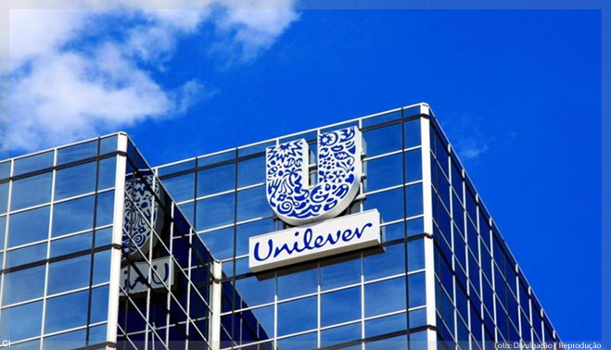
Unilever employed strategies in a post-pandemic era
Unilever is a worldwide corporation that began as a partnership between the margarine firm Margarine Uni and the British soap manufacturer Lever Brothers. With the goal of fostering cooperation during this unprecedented epidemic, Unilever is happy to provide everyone with information about its own procedures and preventative measures (Pandey et al., 2021). However, Unilever cannot anticipate all of the local and unique risks and conditions that a customer would experience in the normal course of business.
Notes:
Unilever is a leading fast-moving consumer goods (FMCG) corporation, with over 400 brands available in over 100 countries. In the eight decades since its founding in 1930, the firm has established itself as a global leader in the consumer products industry (Wade and Shan, 2020). Unilever is a worldwide corporation that began as a partnership between the margarine firm Margarine Uni and the British soap manufacturer Lever Brothers. With the goal of fostering cooperation during this unprecedented epidemic, Unilever is happy to provide everyone with information about its own procedures and preventative measures (Pandey et al., 2021). However, Unilever cannot anticipate all of the local and unique risks and conditions that a customer would experience in the normal course of business. Because of these factors, the materials are being supplied in good faith for the sole purpose of providing information to the general public, and we are not making any claims, warranties, or guarantees as to their accuracy, completeness, efficacy, or validity (Murphy, 2018).

Slide 17
Unilever employed strategies in a post-pandemic era
Unilever has made this feasible via its engagement in the network of distributors. Both high-end and more reasonably priced options may be found within the company's offerings. Unilever is the world's largest consumer goods company, and it has made a number of significant investments, including acquiring the American ice cream giant Breyers from Kraft (Fithry et al., 2021). Unilever's strength is its lucrative supply chain network.
Notes:
Unilever has made this feasible via its engagement in the network of distributors. Both high-end and more reasonably priced options may be found within the company's offerings. Unilever is the world's largest consumer goods company, and it has made a number of significant investments, including acquiring the American ice cream giant Breyers from Kraft (Fithry et al., 2021). Unilever's strength is its lucrative supply chain network.

Slide 18
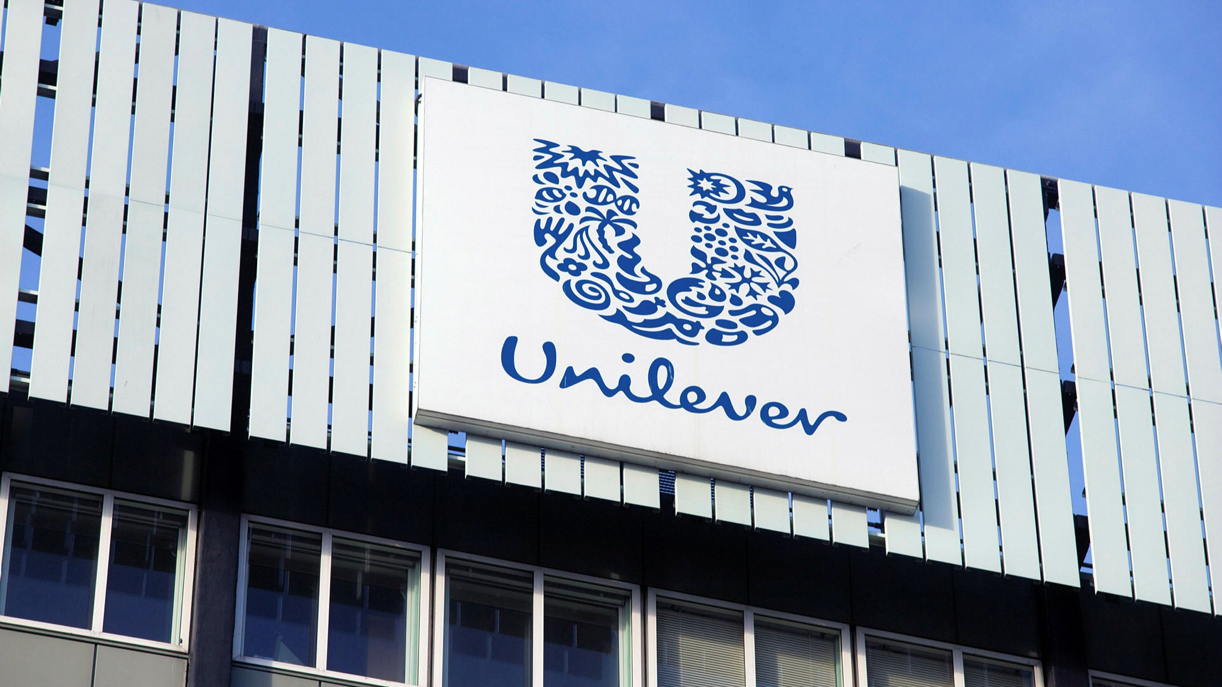
Unilever employed strategies in a post-pandemic era
Entering a new market and creating innovative goods bodes well for Unilever's bottom line since the company can diversify its packaging offerings without compromising its commitment to ecological sustainability (Fithry et al., 2021). Since Unilever already has a solid reputation in the marketplace and business world, its brands will continue to see strong sales even as the market as a whole benefits from the influx of new health product options (Wheelen and Hunger, 2022).
Notes:
The world is evolving and living toward more meaningful and sustainable forms of consumption where people individually raise their obligations to constantly maintain healthy and cleanliness. This demonstrates their desire to preserve a sustainable living society (Lakada et al., 2017). Unilever has effectively accomplished and strengthened the lifestyles of millions of people even despite this worldwide epidemic.
One billion individuals have been exposed to the government and Unilever's hygiene program targeting the coronavirus (COVID-19). The United Kingdom government and the British company Unilever have completed their effort to decrease the spread of COVID-19 by providing guidance, hygiene products, and access to handwashing facilities to one billion individuals in underdeveloped nations (Wade and Shan, 2020). In addition, it has significant potential to manufacture health goods by engaging in some innovation, which might attract customers given the need for health enhancement items (Bland et al., 2020). There's a potential that if they make their firm greener and more sustainable, they'll be able to attract more customers who care about the environment. More sales of established items to emerging markets are one way for Unilever to expand its customer base and boost its bottom line. For those who want low-calorie beverages yet like the flavor of tea, Unilever offers the Lipton brand (Sim et al., 2016). This is a once-in-a-lifetime chance to significantly boost both revenue and brand recognition. By providing customers with so many options, Unilever has become the go-to brand for many people.
Entering a new market and creating innovative goods bodes well for Unilever's bottom line since the company can diversify its packaging offerings without compromising its commitment to ecological sustainability (Fithry et al., 2021). Since Unilever already has a solid reputation in the marketplace and business world, its brands will continue to see strong sales even as the market as a whole benefits from the influx of new health product options (Wheelen and Hunger, 2022). When looking for ways to boost productivity inside the organization, Unilever should also consider product innovation. In order to compete with rivals and prevent copying, the company is urged to maximize the benefits of its product-development assets.

Slide 19
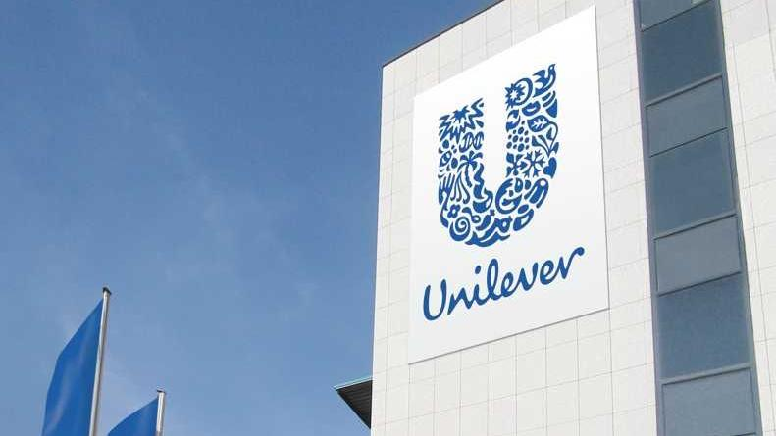
Recommendations
Unilever should increase community involvement and social support by advocating for constructive social industrialism (Hasan and Hakeem, 2013). Unilever, for instance, may provide young people with the opportunity to acquire the employability and entrepreneurial skills they need by hosting seminars on these topics (Christian, 2012).
Notes:
Products of Unilever suffer from imitation, which is one of the company's flaws. Even if Unilever invests considerably in its product development methods, its competitors will copy its successful items like Dove and Rexona. During the current Covid-19 epidemic, Unilever might increase its advertising of antibacterial and antiviral personal care and hygiene products (Bland et al., 2020). New clients may be attracted via social media and other forms of promotion in a short amount of time with little effort. Many individuals may be reached via the use of advertisements in various mediums such as newspapers, television, and posters. Unilever should increase community involvement and social support by advocating for constructive social industrialism (Hasan and Hakeem, 2013). Unilever, for instance, may provide young people with the opportunity to acquire the employability and entrepreneurial skills they need by hosting seminars on these topics (Christian, 2012). Promotion of the company's wares might be sped up significantly by doing so.

Slide 20
Conclusion
Consumers may not realize that their favorite Unilever items originate from their local supermarket since Unilever is primarily a producer of food and consumer goods. Since Unilever is a food and consumer goods firm, its products are frequently offered in supermarkets and grocery shops where customers are seldom aware that the items originate from Unilever. The business took preparations to deal with the epidemic and maintain its market share.
Notes:
Consumers may not realize that their favorite Unilever items originate from their local supermarket since Unilever is primarily a producer of food and consumer goods. Since Unilever is a food and consumer goods firm, its products are frequently offered in supermarkets and grocery shops where customers are seldom aware that the items originate from Unilever. The business took preparations to deal with the epidemic and maintain its market share.

Slide 21
References
Pandey, R., Massand, A., Mulya, V.T., Sin, L.G., Naresh, V.P., Zamara, F.B., Kee, D.M.H., Zamri, S.K.B., Azmi, N.A.S.B., Hamdan, N.N.B.M. and Aditi, A., 2021. The Impacts of Covid-19 on Unilever. Journal of the Community Development in Asia (JCDA), 4(1), pp.34-43.
Fithry, A.N.I., Hariyanto, M.I.Z.P. and Utami, E.S., 2021. The Impact of Consumer Behaviour Megashift on Unilever's Product Strategy During COVID-19 Crisis. UNEJ e-Proceeding, pp.61-65.
Hoekstra, J.C. and Leeflang, P.S., 2020. Marketing in the era of COVID-19. Italian Journal of Marketing, 2020(4), pp.249-260.
Wade, M. and Shan, J., 2020. Covid-19 Has Accelerated Digital Transformation, but May Have Made it Harder Not Easier. MIS Quarterly Executive, 19(3).
Bland, A.R., Roiser, J.P., Mehta, M.A., Sahakian, B.J., Robbins, T.W. and Elliott, R., 2020. COVID-19 induced social isolation; implications for understanding social cognition in mental health. Psychological medicine, pp.1-2.
Hasna, S., 2022. Analysis of Blue-Chip Stock Price Movement Before and During the Pandemic Covid-19. International Journal of Social and Management Studies, 3(1), pp.144-157.
Suwadji, S.A., Suryaningsum, S. and Pamungkas, N., 2021, December. Analysis of the Financial Performance of the Largest Consumer Goods Company in Indonesia Before and During the Covid-19 Pandemic (Case Study at PT. Unilever Indonesia Tbk). In Journal of International Conference Proceedings (JICP) (Vol. 4, No. 3, pp. 539-550).
Bettencourt, A.S.D.A., 2022. Market share as a key sensitive factor to Unilever-s profitability (Doctoral dissertation).
Yaakub, N.S., Mohd Susaimi, N.D. and Mohd Salleh, N.N., 2008. Unilever Company.
Wubs, B., 2008. International business and national war interests: Unilever between Reich and empire, 1939-45. Routledge.
Murphy, P.E. and Murphy, C.E., 2018. Sustainable living: unilever. In Progressive Business Models (pp. 263-286). Palgrave Macmillan, Cham.
Lakada, M.N., Lapian, S.J. and Tumiwa, J.R., 2017. Analyzing The Financial Statement Using Horizontal–Vertical Analysis To Evaluating The Company Financial Performance Period 2012-2016 (Case Study at PT. Unilever IndonesiaTbk). Jurnal EMBA: Jurnal Riset Ekonomi, Manajemen, Bisnis dan Akuntansi, 5(3).
Sim, S., King, H. and Price, E., 2016. The role of science in shaping sustainable business: Unilever case study. Taking Stock of Industrial Ecology; Clift, R., Druckman, A., Eds, pp.291-302.
Wheelen, T.L. and Hunger, J.D., 2011. Concepts in strategic management and business policy. Pearson Education India.
AMAN, M., 2017. AN ASSESSMENT OF SERVICE QUALITY IMPRESSION ON CUSTOMER SATISFACTION IN THE OF CASE UNILEVER ETHIOPIA (Doctoral dissertation, St. Mary's University).
Hasan, M.N. and Hakeem, G., 2013. TO STANDARDIZE OR TO ADAPT: A WEBSITE’S DILEMMA IN THE CONTEXT OF ONLINE CUSTOMER SATISFACTION: A Comparative Study of Unilever & Adhuli Website’s in the Bangladeshi Market.
Christian, J.V., 2012. CORRELATION ANALYSIS OF PRODUCT QUALITY IMPROVEMENT TOWARD CUSTOMER SATISFACTION OF UNILEVER HOME CARE PRODUCTS (Doctoral dissertation, President University).

