Slide 1

Module: Managing Business Information
Module code: LCLM5004
Student Name: Victor Hugo Da Silveira Pedrosa
Student ID 2422018
Topic: Real-World Case Studies: Present examples of companies using these systems, detailing challenges, solutions, and ethical issues. Assess their impact on business performance and key takeaways.
"Enterprise Resource Planning in Practice: The IKEA Case Study"
Lecture: Amitave Banik

Slide 2
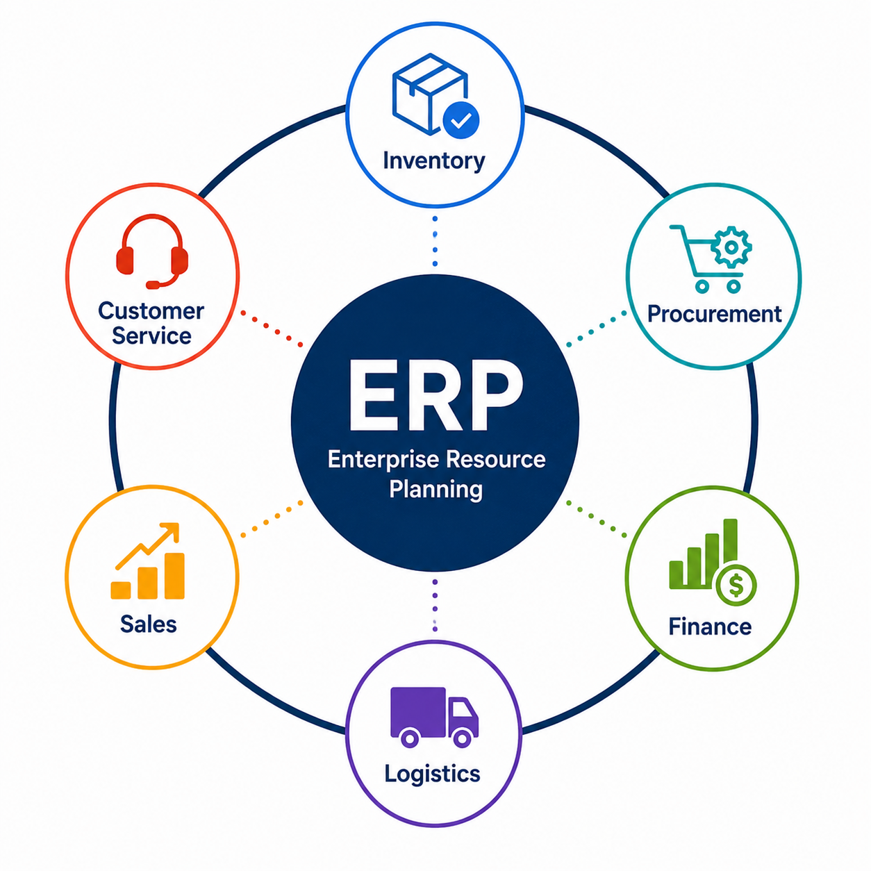
Real-World Case Study: IKEA's ERP Transformation
As a global retailer operating in more than 60 markets, IKEA manages millions of customer orders, products, suppliers, and logistics activities every year. To coordinate these complex operations, IKEA uses integrated Enterprise Resource Planning (ERP) systems that connect business functions through a shared information platform.
ERP enables real-time data sharing across departments, supporting inventory management, procurement, finance, logistics, and customer service.
ERP integrates business processes into one connected system, improving collaboration and operational efficiency.
(SAP, 2024; IKEA, 2024)

Slide 3
Business Challenges and ERP Solutions
Challenge | ERP Solution | Ethical Consideration
Global supply chain complexity | Integrated real-time inventory | Data privacy
Demand forecasting | Shared business data | Cybersecurity
Cross-functional communication | Centralised information | Responsible AI
Inventory visibility | Automated reporting | Employee data protection
ERP improves efficiency, but organisations must ensure transparent data governance and responsible use of digital technologies.
(Oracle, 2024; SAP, 2024; Laudon and Laudon, 2024)

Slide 4
Business Performance and Key Takeaways
Key Takeaways
ERP integrates business processes into one platform.
Real-time information improves managerial decisions.
Digital transformation strengthens organisational performance.
Ethical data management is essential for sustainable business success.
Business Impact
✔ Improved inventory visibility
✔ Faster decision-making
✔ Better customer experience
✔ More efficient supply chain
✔ Reduced operational costs
IKEA demonstrates how ERP supports digital transformation by combining operational efficiency with data-driven decision-making.
(IKEA, 2024; SAP, 2024; Laudon and Laudon, 2024)

Slide 5
References
IKEA (2024) IKEA Annual and Sustainability Report 2024. Available at: https://www.ikea.com/global/en/our-business/how-we-work/annual-summary-and-sustainability-report/ (Accessed: 09 July 2026)
Laudon, K.C. and Laudon, J.P. (2024) Management Information Systems: Managing the Digital Firm. 18th edn. Harlow: Pearson.
Oracle (2024) What is Enterprise Resource Planning (ERP)? Available at: https://www.oracle.com/erp/what-is-erp/ (Accessed: 09 July 2026).
SAP (2024) What is ERP? Available at: https://www.sap.com/products/erp/what-is-erp.html (Accessed: 09 July 2026).

