Slide 1
Business plan
Student name: Kenval Arthur Smith
Student ID: 2322276
Module name: Entrepreneurship
Module code: LCBB5013
Assignment Title: Task 2 – Business Plan Presentation
Lecturer name: Trinh Nguyen Thi Ngoc
Submission Date: 13th July 2026

Slide 2
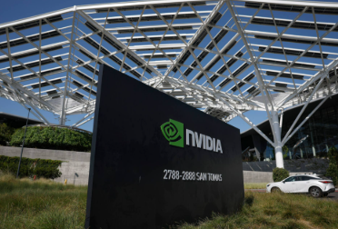
Company Overview
Founded in 1993
AI & GPU leader
Mission
Vision
USP

Slide 3

Products & Services
GeForce RTX
AI Chips
CUDA
DGX Systems
Automotive AI

Slide 4

Business Environment
PESTEL Analysis
Political
Economic
Social
Technology
Legal
Environmental

Slide 5
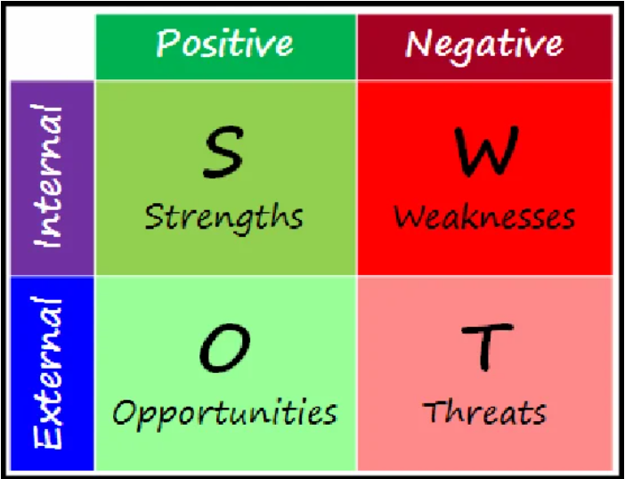
SWOT Analysis
Strengths
Weaknesses
Opportunities
Threats

Slide 6
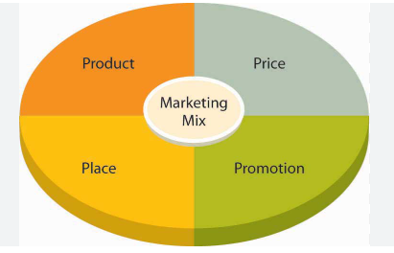
Marketing Strategy
Market Segmentation
Target Customers
4Ps (Product, Price, Place and Promotion)

Slide 7

Online Marketing
Social Media
Website
Developers
Content Marketing
Events (GTC)

Slide 8
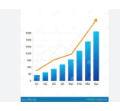
Financial growth
1993 → Today
Revenue Growth
IPO
AI Boom

Slide 9
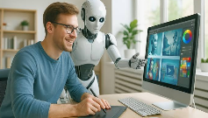
recommendations
Continue AI investment
Strengthen cybersecurity
Expand globally
Diversify the supply chain

Slide 10

Thank you for your listening!

