Slide 1
Data Mining & Visualisation
Cluster Identification
Dr Nik Whitehead

Slide 2
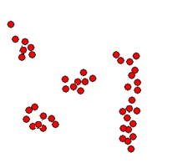
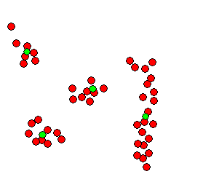
Problem of Cluster Detection
What is cluster detection?
  Cluster: a group of objects known as members
  The centre of a cluster is known as the centroid
  Members of a cluster are similar to each other
  Members of different clusters are different
  Clustering is a process of discovering clusters
: centroids

Slide 3
Problem of Cluster Detection
Outputs of cluster detection process
  Assigned cluster tag for members of a cluster
  Cluster summary: size, centroid, variations, etc.
Cluster 2: Size: 5
Centroid:(130, 51)
Variation: σ_{bodyHeight} = 10,
σ_{bodyWeight} = 14.48
Cluster 1: Size: 6
Centroid:(154, 90)
Variation: σ_{bodyHeight} = 5.16
σ_{bodyWeight} = 5.32

Slide 4
Problem of Cluster Detection
Basic elements of a clustering solution
  A sensible measure for similarity, e.g. Euclidean
  An effective and efficient clustering algorithm, e.g. K-means
  A goodness-of-fit function for evaluating the quality of resulting clusters, e.g. SSE
?
?
?
Inter-cluster distance
Internal variation
Good or Bad?

Slide 5
Problem of Cluster Detection
Requirements for clustering solutions
  Scalability
  Able to deal with different types of attributes
  Able to discover clusters of arbitrary shapes
  Minimal requirements for domain knowledge to determine input parameters
  Able to deal with noise and outliers
  Insensitive to order of input data records
  Able to deal with high dimensionality
  Incorporation of user-specified constraints
  Interpretability and usability

Slide 6
Measures of Proximity
Basics
  Proximity between two data objects is represented by either similarity or dissimilarity
  Similarity: a numeric measure of the degree of alikeness, dissimilarity: numeric measure of the degree of difference between two objects
  Similarity measure and dissimilarity measure are often convertible; normally dissimilarity is preferred
  Measure of dissimilarity:
    Measuring the difference between values of the corresponding attributes
    Combining the measures of the differences

Slide 7
Categories of Clustering Solutions
Prototype-based Clustering
  Partition-based, e.g. the K-means
  Fuzzy clustering, e.g. Fuzzy C-means
  Relationship clustering, e.g. self-organising map
Density-based Clustering
  Centre-based density, e.g. DBSCAN
  Region-based density, e.g. Clique
  Transformation-based, e.g. WaveCluster
Model-based Clustering
  Expectation-maximisation, e.g. GMM
Graph-based Clustering
  Spanning tree, e.g. MST
  Dynamic modelling, e.g. Chameleon

Slide 8
K-means, a Basic Clustering Method
Outline of main steps
  Define the number of clusters (k)
  Choose k data objects randomly to serve as the initial centroids for the k clusters
  Assign each data object to the cluster represented by its nearest centroid
  Find a new centroid for each cluster by calculating the mean vector of its members
  Undo the memberships of all data objects. Go back to Step 3 and repeat the process until cluster membership no longer changes or a maximum number of iterations is reached.

Slide 9
K-means, a Basic Clustering Method
Illustration of the method:

Slide 10
K-means, a Basic Clustering Method
Strengths & weaknesses
  Strengths
    Simple and easy to implement
    Quite efficient
  Weaknesses
    Need to specify the value of k, but we may not know what the value should be beforehand
    Sensitive to the choice of initial k centroids: the result can be non-deterministic
    Sensitive to noise
    Applicable only when mean is meaningful to the given data set

Slide 11
K-means, a Basic Clustering Method
Overcoming the weaknesses:
  Using cluster quality to determine the value of k
  Improving how the initial k centroids are chosen
    Running the clustering a number of times and select the result with highest quality
    Using hierarchical clustering to locate the centres
    Finding centres that are farther apart
  Dealing with noise
    Removing outliers before clustering?
    K-medoid method, using the nearest data object to the virtual centre as the centroid.
  When mean cannot be defined,
    K-mode method, calculating mode instead of mean for the centre of the cluster.

Slide 12
K-means, a Basic Clustering Method
Choosing initial k centroids
  Running the clustering many times (only trial and error)
  Using hierarchical clustering to locate the centres (why partition based?)
  Finding centres that are farther apart

Slide 13
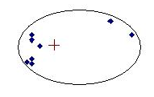
Limitations of Basic Solutions
Limitations of the K-means Method
  Effects by the outliers
  Unable to detect clusters of different sizes
  Unable to detect clusters of arbitrary shapes
Centroid affected by outliers
points are closer to centre of another cluster
Only detecting clusters of convex shapes

Slide 14
The Agglomeration Method
Outline of main steps
  Take all n data objects as individual clusters and build a n x n dissimilarity matrix. The matrix stores the distance between any pair of data objects.
  While the number of clusters > 1 do:
    Find a pair of data objects/clusters with the minimum distance
    Merge the two data objects/clusters into a bigger cluster
    Replace the entries in the matrix for the original clusters or objects by the cluster tag of the newly formed cluster
    Re-calculate relevant distances and update the matrix

Slide 15
The Agglomeration Method
Illustration of the method

Slide 16
The Agglomeration Method
Agglomeration schemes
  Single link: the distance between two closest points
  Complete link: the distance between two farthest points
  Group average: the average of all pair-wise distances
  Centroids: the distance between the centroids

Slide 17
The Agglomeration Method
Strengths and weaknesses
  Strengths
    Deterministic results
    Multiple possible versions of clustering
    No need to specify the value of a k beforehand
    Can create clusters of arbitrary shapes (single-link)
  Weaknesses
    Does not scale up for large data sets
    Cannot undo membership like the K-means
    Problems with agglomeration schemes (see Chapter 5)

Slide 18
Limitations of Basic Solutions
Limitations of the Agglomeration Method
  With different merging schemes
A
B
C
D
A
B
C
D
A
C
B
single-link favours merging A and B because of closeness
Group-average-link favours merging A and B because of connectivity
single-link favours merging A and B because of closeness

Slide 19
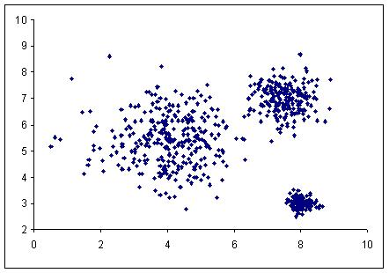
Categories of Clustering Solutions
Illustration (Partition and Density based)
Partition-based
Density-based
: Dense areas

Slide 20
Density-based Clustering
Treating data as points in a N-dimensional space
Density: centre-based or region-based
Dense regions with high concentration of points are likely to be clusters
DBSCAN: a density-based algorithm
  Centre-based density
  Classifying data points as core, border or noise
  Incomplete clustering (not all data are members of a cluster)
Enough neighbours within the circle?
Dense and sparse regions

Slide 21
DBSCAN Algorithm
Types of Data Points
  Given:
    Eps: the radius
    MinPts: the minimum number of data points within Eps
  Core point c: |N_{Eps}(c)| ≥ MinPts
  Border point b: |N_{Eps}(b)| < MinPts and
  b ∈ N_{Eps}(c) and |N_{Eps}(c)| ≥ MinPts
  Noise point n: Outside Eps of any core and |N_{Eps}(n)| < MinPts
N_{Eps}(t)
Eps
t
Noise
Border
Core

Slide 22
DBSCAN Algorithm
Density Reachable
  Density reachable
  Direct density reachable
d
b
c
f
a
Points a and d are density reachable while points a and f are not.
Point a is direct density reachable by point b, but not by point c.

Slide 23
DBSCAN Algorithm
Algorithm Outline
  Scan the data set and label each data record as core, border or noise;
  All noise points are labeled as members of the default noise cluster;
  Scan through all core points and assign core points that are direct density reachable to the same cluster. Core points that are not direct density reachable are assigned to different clusters;
  Scan through all border points and assign density reachable border points to the cluster of their core points.

Slide 24
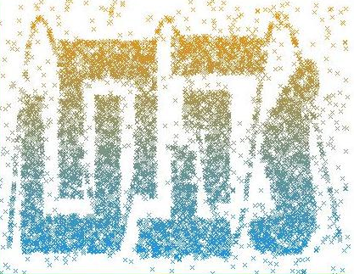
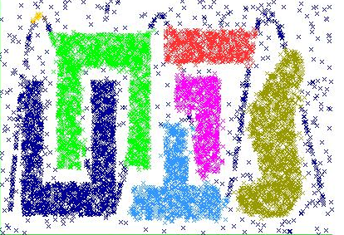
DBSCAN Algorithm
Illustration (DBSCAN in Weka)
Original Data
Result Clusters
Eps=0.0225, MinPts=15

Slide 25
Expectation Maximisation/GMM
Background of Model-based Clustering
  Data set as the result of a statistical process. Clustering is to find the best-fit statistical model
  Mixture Model Approach represents the model in terms of a collection of multivariate distributions
  Each distribution (represented by mean and covariance) describes a cluster of ellipsoidal shape.

Slide 26
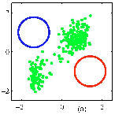
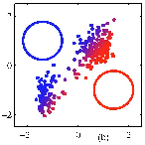
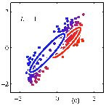

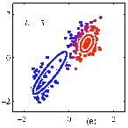
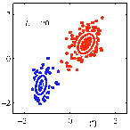
Expectation Maximisation/GMM
Algorithm Illustration:
Initialisation
Expectation
Re-estimates
Expectation
Re-estimates
Converge
Adapted from Source: http://www.slideshare.net/butest/lecture-18-gaussian-mixture-models-and-expectation-maximization

Slide 27
Cluster Evaluation & Interpretation
Cluster quality
  Principle:
    High-level similarity/low-level variation within a cluster
    High-level dissimilarity between clusters
  The measures
    Cohesion: sum of squared errors (SSE), and sum of SSEs for all clusters (WC)
    Separation: sum of distances between clusters (BC)
    Combining the cohesion and separation, the ratio BC/WC is a good indicator of overall quality.
Cluster tendency
  Cluster tendency: do clusters really exist?
  Measures for tendency:
    Quality measure: when BC and WC are similar, it means clusters do not exist.

Slide 28
Cluster Evaluation & Interpretation
Cluster quality illustrated
Cluster c₂
Cluster c₁
∴ C₁ is a better quality cluster than C₂.

Slide 29
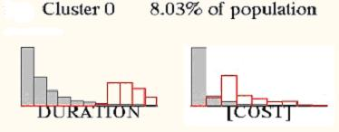
Cluster Evaluation & Interpretation
Cluster interpretation
  Within cluster
    How values of the clustering attributes are distributed
    How values of supplementary attributes are distributed
  Outside cluster
    Exceptions and anomalies
  Between cluster
    Comparative view
Value distributions for the cluster
Value distributions for the population
Value distributions for the population
Value distributions for the cluster

Slide 30
Proximity Measures Revisited
Problems of Pairwise Proximity Measures
  Measurement may not be effective in
    Data are more scattered in high dimensionality spaces
    Data densities may be of different degrees
    Certain types of data such as time-series
b
A
a
b
b
a
c
B
Is b really that much closer to a than c?
Should b belong to cluster A or B?
Should a and b belong to the same cluster?
Are the two waves really that different?

Slide 31
Proximity Measures Revisited
Shared Nearest Neighbours (SNN)
  Similar data objects share common nearest neighbours
  The more common nearest neighbours there are, the more similar the two data objects are
    e.g. Points A and B have 4 common nearest neighbours (out of 7)
A
B
Adopting SNN in clustering algorithms

Slide 32
Proximity Measures Revisited
Time-Series and Sequential Data
  A time-series or sequential data record consists of measurements at a sequence of time points
  Direct comparison of the measurements of two time-series records at the time points fail to show true similarity
    e.g. Time-series A and B similar peaks, valley and plateau.
A
A
B
B
time
time
Using a distance function on fixed time points, A and B are quite different.
Using a distance function but aligning peaks and valleys, A and B are very similar.

Slide 33
Clustering in Practice
Process of a Clustering Project
  Data Prepration;
  Selecting a sensible proximity function;
  Selecting a suitable clustering solution;
  Selecting clustering attributes
  Conducting clustering with specific settings of parameters;
  Evaluating cluster quality
  Attempting to interpret the meaning of the clusters

Slide 34
Clustering in Practice
Factors Influencing Solution Selection
  Completeness of clustering results (all data records, all possible clusters, all attributes involved?)
  Cluster characteristics (shapes, sizes, densities, etc)
  Cluster descriptors and description constraints
  Data characteristics (types, presence of outliers, etc.)
  Considerations given to algorithms (e.g. capability of determining the number of clusters, capability of determining relevance of attributes to clusters, algorithm performances, etc.)

Slide 35
Summary
Basic clustering methods have their limitations
Density-based algorithms treat clusters as regions where there is a greater concentration of data points
Graph-based algorithms consider clusters as subgraphs where data points are connected more closely than elsewhere
Model-based algorithms consider clusters as distributions that can be described in terms of mean point and variations
Subspace clustering algorithms find clusters in subspaces of a multi-dimensional space
Proximity should be measured differently in situations such as high dimensionality and special types of data (e.g. time-series)
EM and DBSCAN are available in Weka

Slide 36
Summary
A clustering solution must provide a sensible proximity function, effective algorithm and a cluster evaluation function
Proximity is normally measured by a distance function that combines measures of value differences upon attributes
The K-Means method continues to refine prototype partitions until membership changes no longer occur
The agglomeration method constructs all possible groupings of individual data objects into a hierarchy of clusters
Good clustering results mean high similarity among members of a cluster and low similarity between members of different clusters

Slide 37
Useful Further References
Chapter 5 of the main text book
Tan, P-N., Steinbach, M. and Kumar, V. (2006), Introduction to Data Mining, Addison-Wesley, Chapters 8 and 9
Han, J. and Kamber, M. (2006), Data Mining: Concepts and Techniques, 2nd ed. Morgan Kaufmann, Chapter 7

