Slide 1
INTRODUCTION TO PHYSIOLOGY
INTRODUCTORY LECTURE TO PHYSIOLOGY
Mumtaz Goolam

Slide 2
ATTENDANCE!!!
&
PARTICIPATION

Slide 3
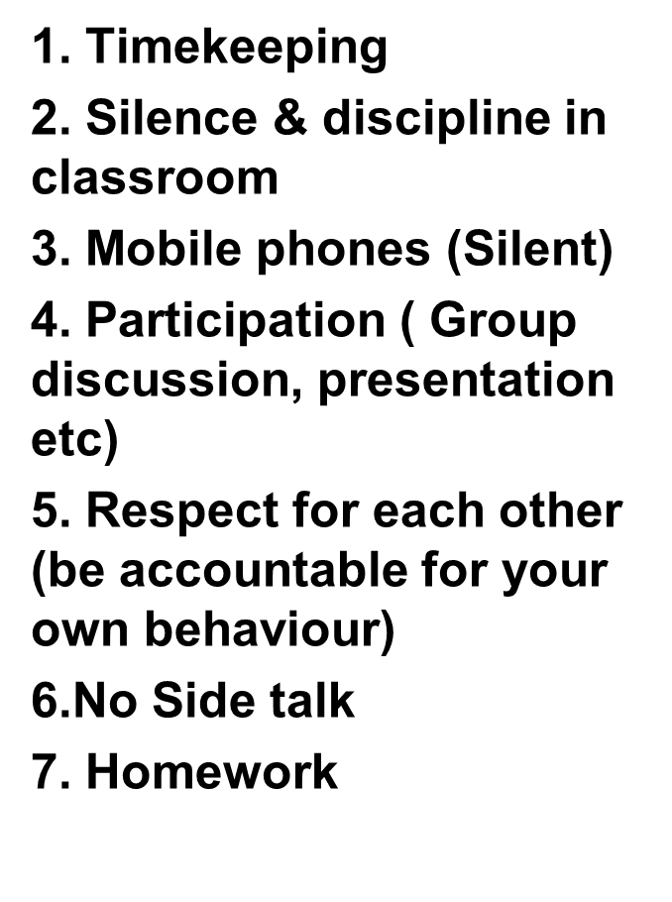
GOUND RULES
Listen &respond appropriately to each other
Respect each other’s boundaries
Do not interrupt the learning
Organise your learning resource
What is said in the classroom, stays in the classroom

Slide 4
Introduction to the Module
Housekeeping ( General Health and safety; equality and diversity)
Ground rules
Q&A
Introduce the module handbook
Introduce today’s lessons
Q&A

Slide 5
WEEK ONE
SESSION 1
INTRODUCTORY OVERVIEW

Slide 6
AIMS AND OBJECTIVES OF THE LESSON
At the end of the lesson students should be able to:
Define the terms “anatomy” and “physiology”.
Outline the anatomical regions of the human body.
Outline the anatomical organisation from cells to the organism

Slide 7
ANATOMY AND PHYSIOLOGY
The following video introduces us to the key explanation of what Anatomy and Physiology are.
It also explains the relationship between these two subjects.
Lets watch the video and discuss what we understand from it:
https://www.youtube.com/watch?v=6_BKeoFXOdo

Slide 8
Anatomy
This is the study of the body parts and their relationship
MACROSCOPIC (GROSS) ANATOMY
Study of large body structures/organs e.g. heart, lungs, kidneys and bones. This can further be divided into:
Regional anatomy- all parts within a particular region.
Systemic anatomy-system by system by system e.g. blood circulatory system & respiratory system
Surface anatomy-surface landmarks which correspond to deeper structures

Slide 9
Microscopic Anatomy
Study of very tiny structures that can not be seen by a naked eye.
Cytology-study of body cells
Histology-study of body tissues

Slide 10
PHYSIOLOGY
Is the study of the way in which a living organism or bodily part functions.
Medical physiology-study of physiological problems and diseases.

Slide 11
Group Discussion
As healthcare providers, why is it important for us to understand problems associated with physiological dysfunction.
In your own opinion does a change in physiological status affect care provision for clients in a residential care home?

Slide 12
Levels of organisation
Atom: The smallest unit of any pure substances examples are oxygen, hydrogen, carbon and nitrogen.
Compound: Two or more atoms combined together for example hydrogen and oxygen combine to form water.
Cell: is the smallest independently functioning unit of a living organism.
Tissue: is a group of many similar cells (though sometimes composed of a few related types) that work together to perform a specific function.

Slide 13
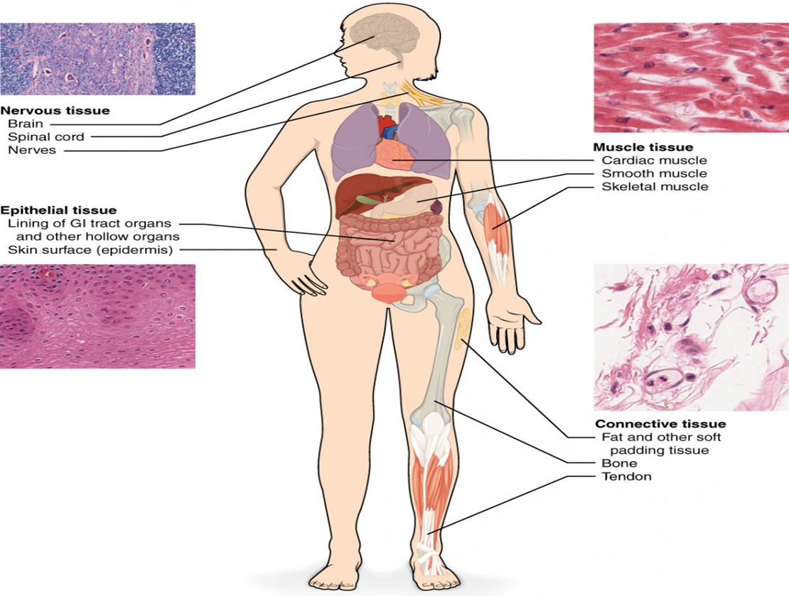
https://courses.lumenlearning.com

Slide 14
Levels of organisation…cntd
Organ: is an anatomically distinct structure of the body composed of two or more tissue types.
System is a group of organs that work together to perform major functions or meet physiological needs of the body.
There are 10 major systems in physiology

Slide 15
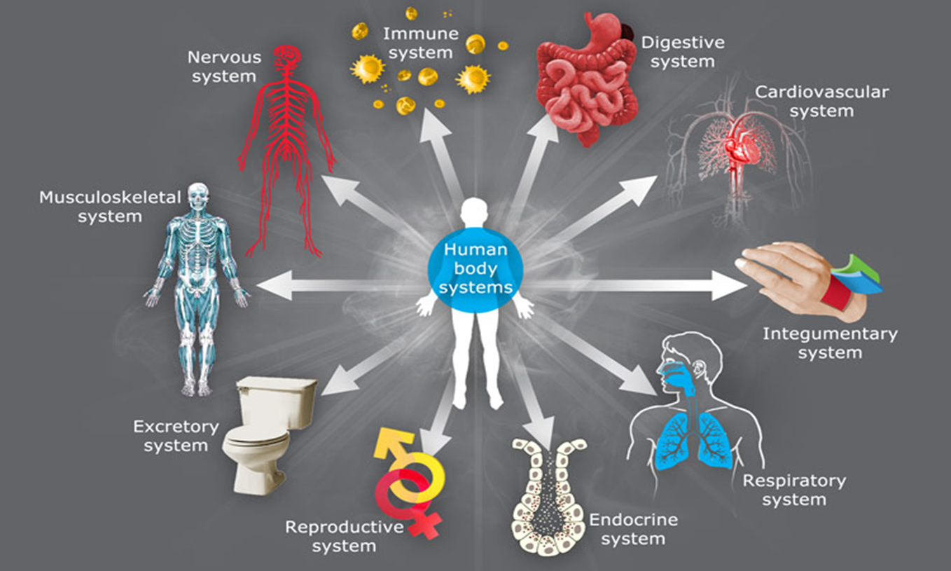
(sciencelearn.org.nz)

Slide 16
THE SKIN COVERS THE GROSS STRUCTURE OF THE HUMAN BODY
FUNCTIONS OF THE SKIN
Protection. Microorganism, dehydration, ultraviolet light, mechanical damage.
Sensation. Sense pain, temperature, touch, deep pressure.
Allows movement. Allows movement muscles can flex & body can move.
Endocrine. Vitamin D production by your skin.
Excretion.
Immunity.
Regulate Temperature.

Slide 17
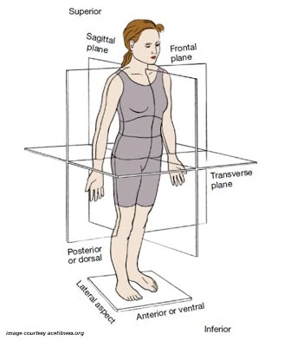

Slide 18
GROSS FEATURES OF THE BODY
The following video outlines the gross features of the body
https://www.youtube.com/watch?v=8kvnPaPN6GA
From the video what do you understand by the terms: (a) dorsal cavity
(b)ventral cavity

Slide 19
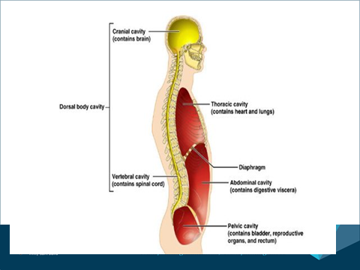

Slide 20
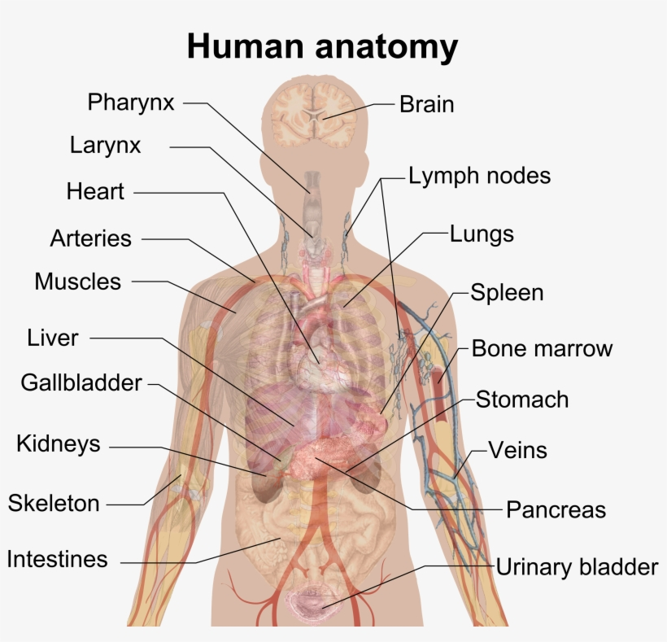

Slide 21
In-class activity 1
Complete Worksheet Exercise 1 (10 mins)
Lets have a class discussion on the in-class exercise

Slide 22
THANK YOU
ANY QUESTIONS???

