Slide 1
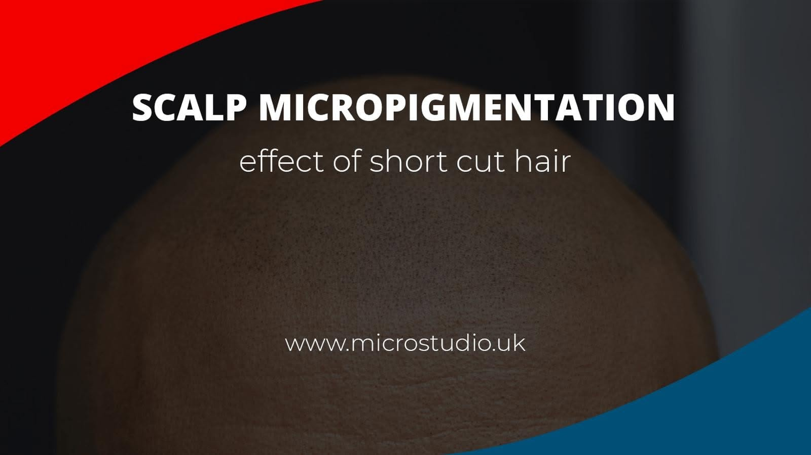
Student Name: Waldemar Kozlowiecki
Student ID: 2512379
Lecturer's Name: Dr Chung Lai Johnny Wan
Program of Study: Certificate in Higher Education Business Skills for the Workplace
Module Code: LCLM 4006
Module Name: Enterprise and Entrepreneurships
Component 2: Presentation

Slide 2
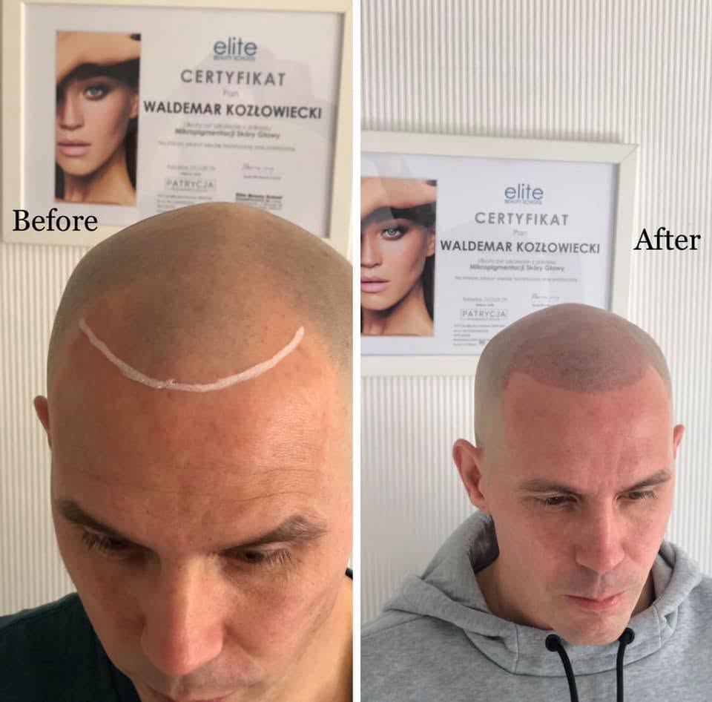
Overview of the business idea
What We Will Cover Today
Introduction to Micro Studio and SMP
Why I want to start this business
PESTEL analysis of the UK market
Marketing strategy (Instagram & Facebook)
Funding and startup expenses

Slide 3
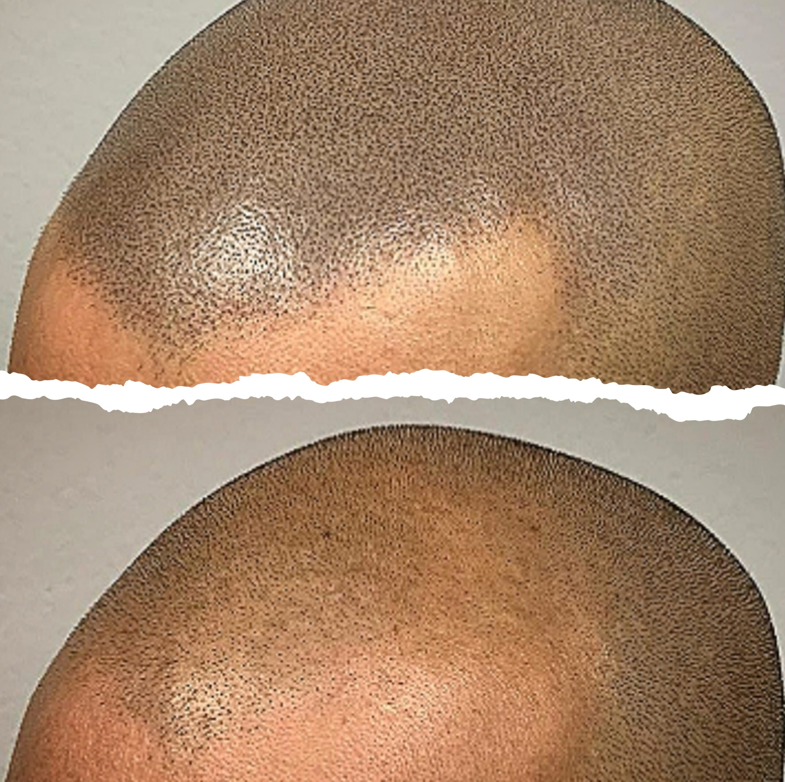
What is SMP?
Non-surgical hair restoration treatment
Uses cosmetic tattooing to replicate hair follicles
Creates a shaved head look or adds hair density
Immediate results, safe and affordable

Slide 4

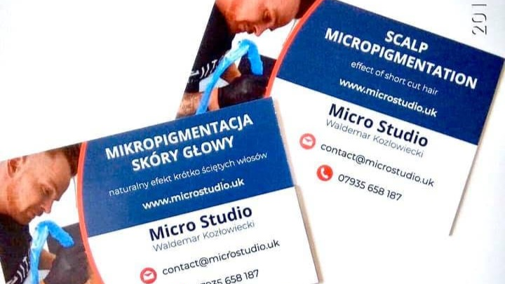
Our Location
Based in the United Kingdom
Located in a busy city center with high foot traffic
Private, modern and comfortable studio room
Easily accessible by public transport

Slide 5
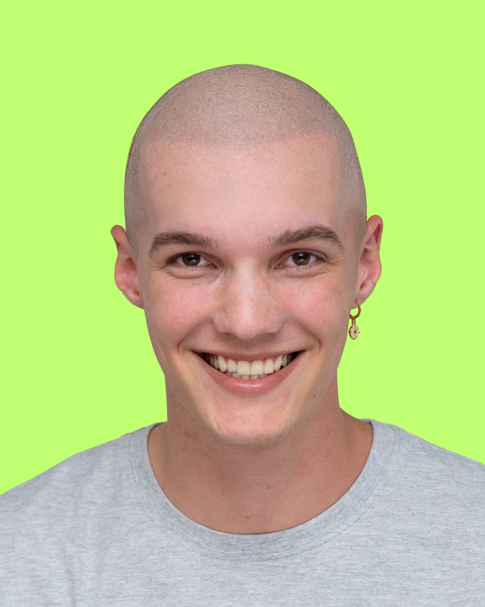
Why I Want to Start This Business?
For a smile like that
High Market Demand in the UK
Hair loss affects over 15 million people in the UK
40% of men show hair loss by age 35
50% of women suffer from thinning hair
Huge and growing group of potential customers

Slide 6
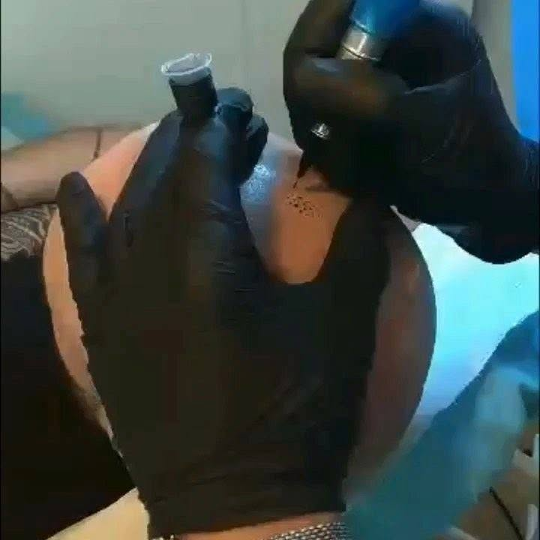
SMP is the Best Alternative
Hair loss pills have bad medical side effects
SMP is cost effective and 100% safe
Clients see visual results after first session

Slide 7
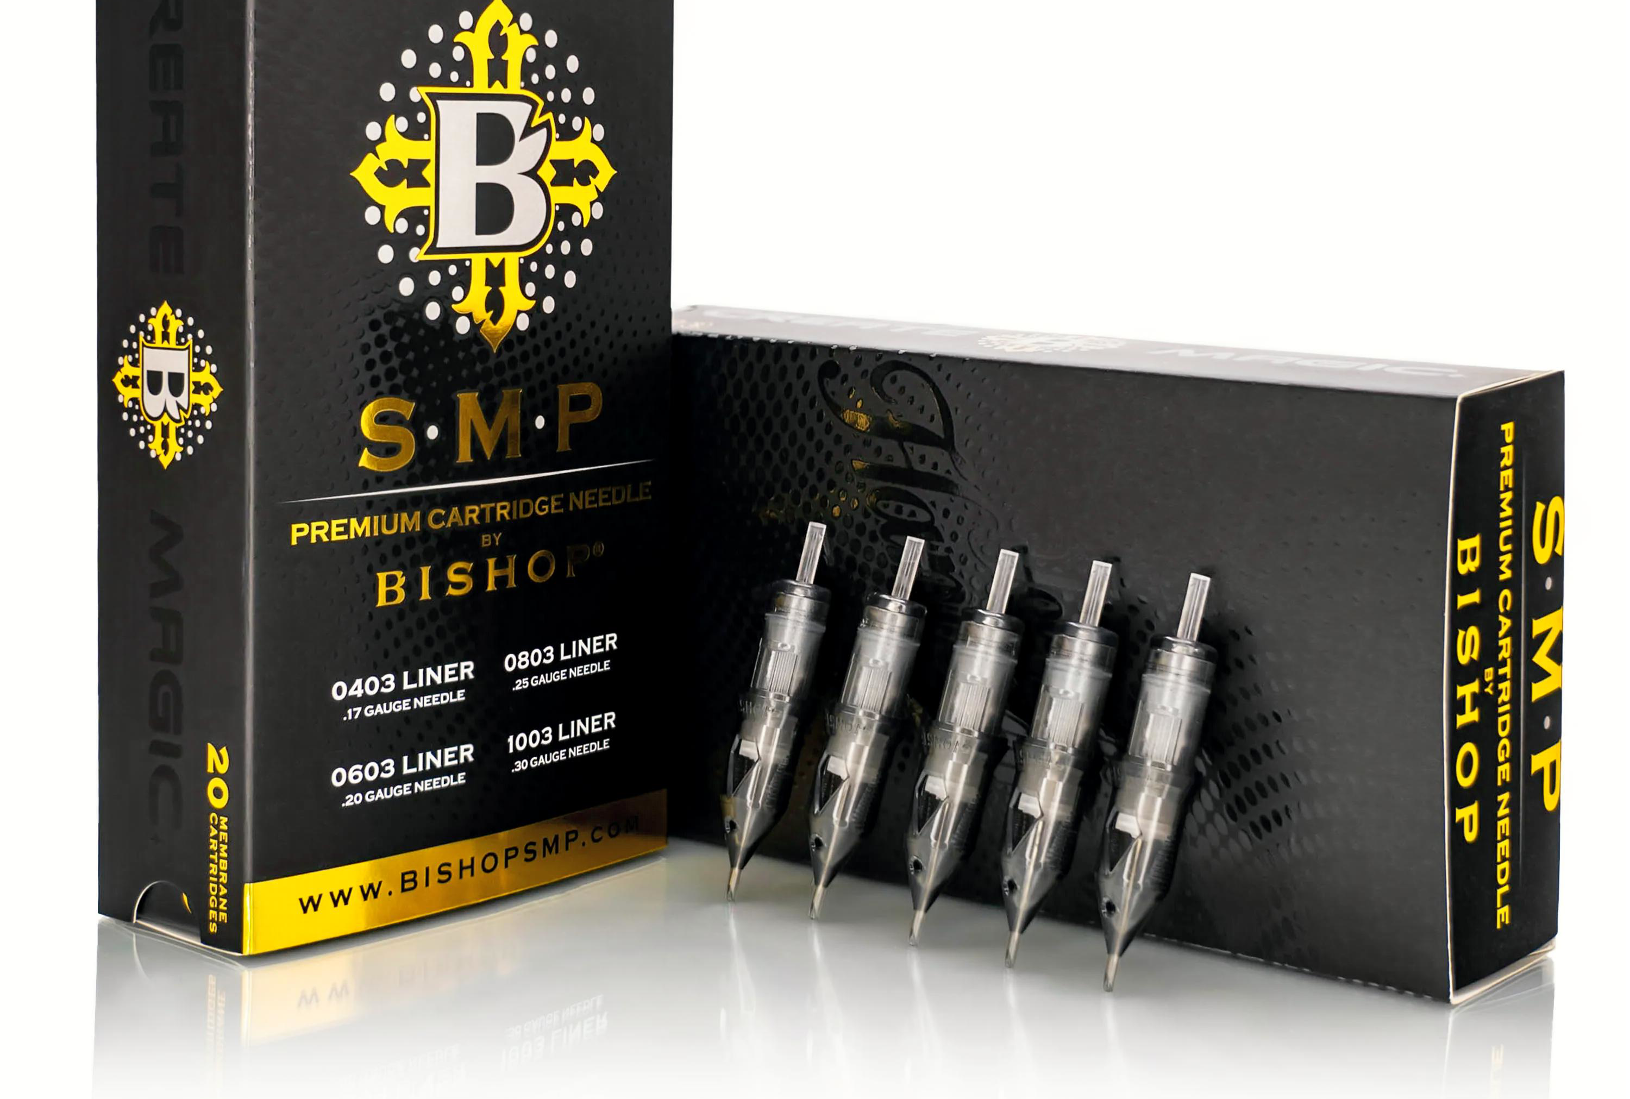
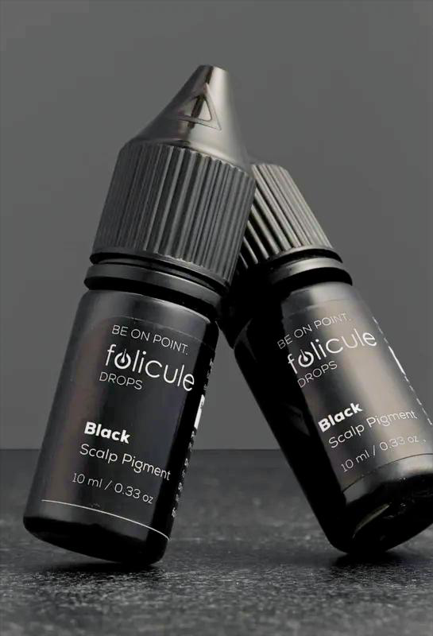
High Profit Margins
Low running costs (mainly pigment, needles and rent)
High price per treatment (£1,200)
Fast break-even point (portable in Month 1)
Business can easily grow in the future
www.microstudio.uk

Slide 8
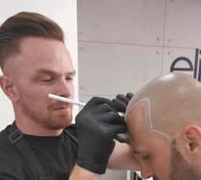

(PESTEL) Social
Men's grooming and aesthetics are highly popular now
High social acceptance for the clean-shaved look
People are willing to invest money to boost their confidence

Slide 9

(PESTEL) Economic
Cost of living crisis in the UK makes clients look for cheaper options
SMP is a fraction of the cost of clinical surgeries
Flexible pricing option make our treatment accessible

Slide 10
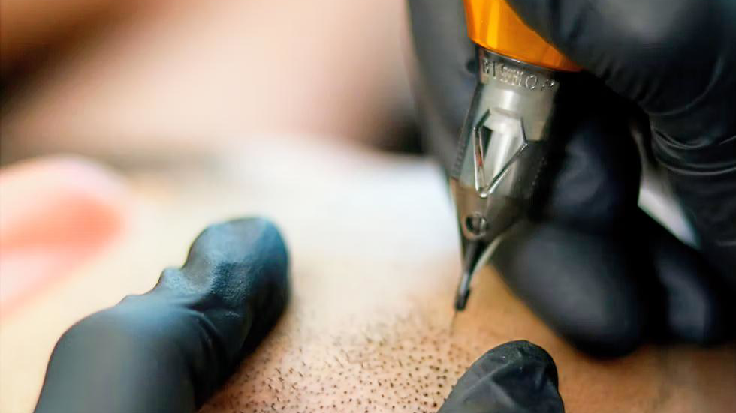
(PESTEL) Technological
Modern, organic pigments that do not change colour
Ultra fine needles matching real hair thickness
Advanced digital booking and payment software

Slide 11
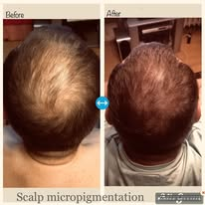
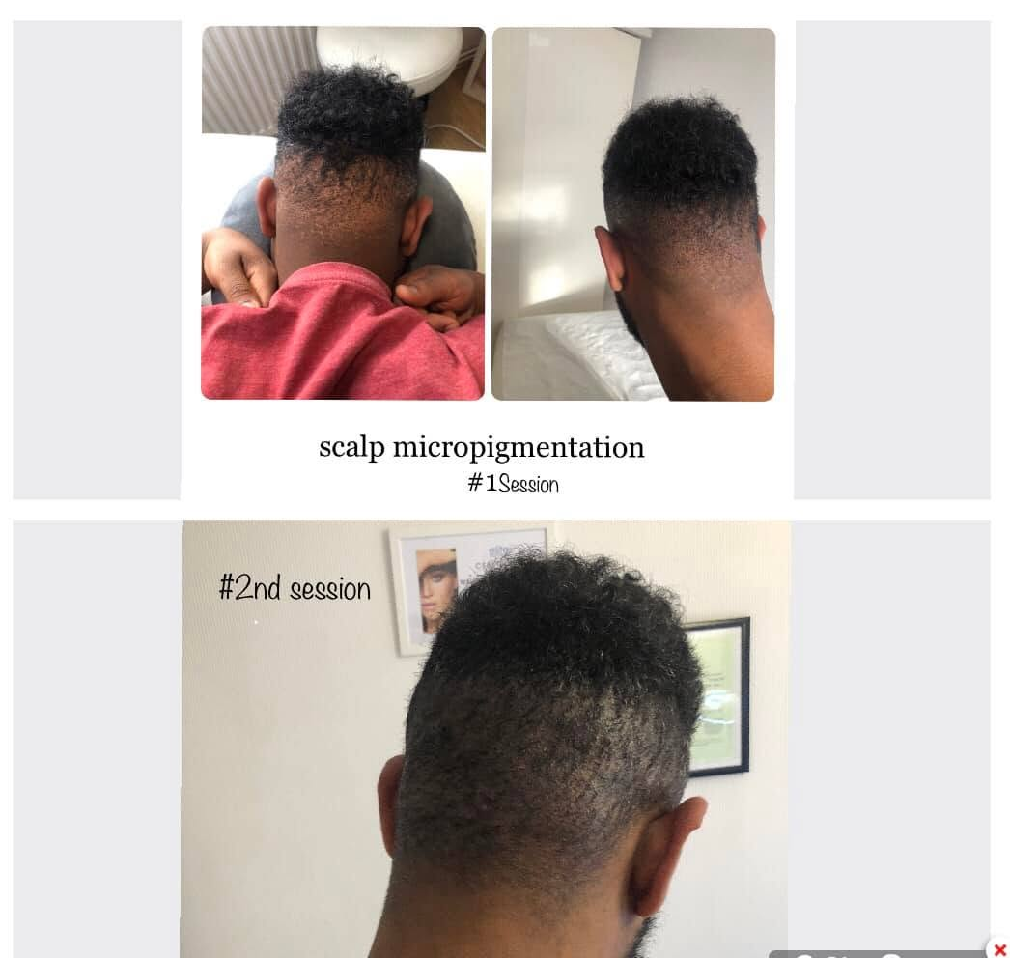
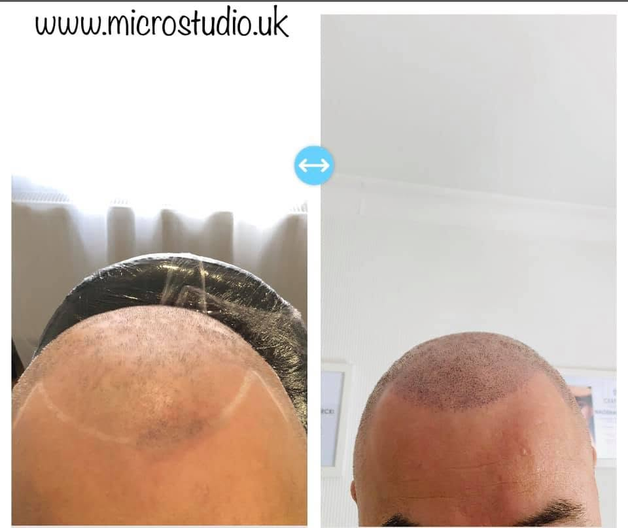


Social Media
Instagram
Posting high-quality "Before & After" photos and reels
Focus on visual proof and real customer transformation
Facebook
Easy direct messaging for booking free consultation
Targeting local groups and running local community adds

Slide 12

K
E
Y
S
T
A
R
T
U
P
E
X
P
E
N
S
E
S
Startup Funding Needed
Marketing Launch £2,000
Total Funding Needed:
£15,000 (10,000 Gov Loan + 5,000 Savings)
Equipment
SMP machines & needles £3,000
Pigments & Hygiene supplies
£1,000
Studio Rent & Deposit £2,500

Slide 13


