Slide 1

Employee engagement
University of Wales Trinity Saint David’s – Swansea
Hotel Placement
Operating Hotel Facilities BMIH4006
Roxana Elena Belu (2120013)
Tutor : Ffion Cumberpatch

Slide 2

Introduction
’Take care of your employees and they’ll
take care of your customers ’
(J. W. Marriott, 1997, p. 34)
A workplace tactic resulting in the correct condition for the employees of a company to offer their best every day, devoted to their company goals and values, encouraged to contribute to the company triumph, with an increase sense of their own well-being (Engage for Success Organization).
Employees engagement is the extent to which employees are personally involved in the success of the organisation. Something that employees must provide and cannot be required as part of the employee contract (Bridger, 2018, p.8).

Slide 3

Importance of employee engagement
1. Employee engagement reduce turnover
The hospitality industry is facing a high employee turnover levels that causing huge costs incurred because of recruiting and training new replacements (Corey, 2018, p.4). According the statistics the employee turnover rate stands at 86.3% and this cost the hospitality industry £4,543 per lost employee ( Blake, 2022 ) .
2. Engaged employee are more productive
Employees who are more dedicated in their job are generally more productive because they are motivated beyond personal facts, and they work more efficiently and with the success of the organization in mind. Statistics show that companies with increase employee engagement level report 22% higher productivity (Southern, 2022).
3. Employee engagement produce more revenue
Increased levels of employee engagement can lead to improved revenue growth and profit margins. IES demonstrated in a study that increased employee engagement improved company potential to increase sales trough three routes ( Bridger, 2018, p. 24).

Slide 4

Benefits of employee engagement:
Lower turnover
Decreased burnout
Great employee commitment
Improved collaboration
Safer workspace
Increased sales
Better employee health
More effective leadership
Reduced employee stress
Increased productivity
Lower absenteeism
Better customer service
Fewer mistakes
Higher revenue
Higher stock prices
Stronger recruiting platform
(Emeritus Institute of Management, 2022)

Slide 5


Statistics :
( Haillo, 2022)
(Gallup, 2017)
Organisations with highly
engaged employees archive
18% difference
in turnover
Organisations with highly
engaged employees realise an
81% difference
in absenteeism

Slide 6

Common practice used to increase employee engagement
employees motivation
Financial Rewards
Non-financial rewards
The force of individuals needs
Positive Reinforcement
The force of goals and expectation
The force of equity
Appreciation Programs
Making the work Enjoyable
Making the job exciting
(Sturman, et. al, 2011, p. 142 )

Slide 7
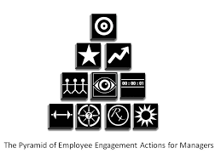
The Zinger Theoretical Model
1. Bottom row - the necessities :
Enhance well-being
Enliven energy
Make meaning
Leverage strengths
2. The second row – uniting the company
Build relationships
Foster recognition
Master moments
3. Third row – boosting performance:
Maximize performance
Mark progress
4. Top row – Achieving results
(Zinger, 2022)

Slide 8
IES model of engagement
Training, Development and Career
Immediate management
Feeling valued and involved
Performance & Appraisal
Communication
Engagement
Equal opportunities and fair treatment
Pay and Benefits
Health & Safety
Co-Operation
Family friendness
Job Satisfaction
(Robinson, Perryman and Hayday, 2004)

Slide 9
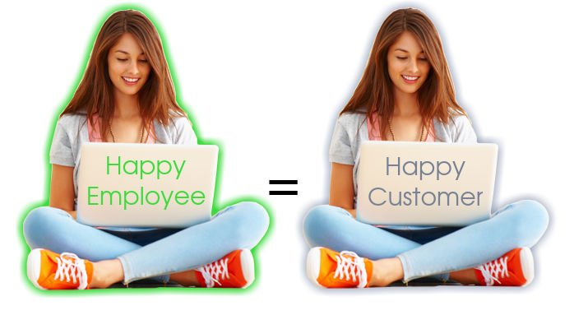
Conclusions:
Hospitality is a sector where something unexpected always comes up. Is impossible to predefine procedures for all the guest situations that’s why employee engagement is something essential in this industry. Employees are responsible with taking care of the guest and providing them a grate experience, they can bring the success or the failure (Sturman et. al., 2011, p.143) .

Slide 10
Reference:
Blake, L. (2022) Operating Hotel facilities – week 8. University of Wales Trinity Saint David.
Bringer, E. (2018) Employee engagement: a practical introduction. Second edition. London: KoganPage
Corey, D. (2018) Staff Turnover in Hospitality Industry. HR – Human resource Management. Great Britain: Amazon.
Emeritus Institute of Management (2022) [blog] Why Employee Engagement Is Important in Today’s Workplace: 16 Benefits. 4 Aug. Available at: https://emeritus.org/blog/why-employee-engagement-is-important-benefits/(accessed: 27.11.2022)
Engage for success organisation( 2021) What is employee engagement. Available at: https://engageforsuccess.org/what-is-employee-engagement/ (accessed: 27.11.2022)
Gallup.com (2022) 'Employee Engagement vs. Employee Satisfaction and Organizational Culture’. Available at: https://www.gallup.com/workplace/236366/right-culture-not-employee-satisfaction.aspx (accessed: 02.12.2022)
Haiilo, (2022) [blog] '8 Employee Engagement Statistics You Need to Know in 2022’. Available at: https://haiilo.com/blog/employee-engagement-8-statistics-you-need-to-know/ (accessed:02.12.2022)
Marriott, J. and Brown, A. (1997) The spirit to serve. Marriott's Way. Snowball Publishing

Slide 11
Robinson D, Perryman S, Hayday S. (2014) The drivers of employee engagement – Report 408. Institute of employment studies. Available at: https://www.employment-studies.co.uk/report-summaries/report-summary-drivers-employee-engagement (accessed: 19.11.2022)
Southern, M. (2022) How employee engagement boots productivity levels. Oakengage, 6 May.
Available at: https://www.oak.com/blog/employee-engagement-and-productivity/#:~:text=Well%2C%20employees%20who%20are%20more,of%20the%20organisation%20in%20mind.( accessed: 30.11.2022)
Sturman, M.C. et al. (2011) The Cornell School of Hotel Administration on hospitality : cutting edge thinking and practice. Hoboken, N.J: Wiley.
Zinger, D. (2022) [blog] Zinger model. Available at: https://www. davidzinger.com/zinger-model/ (accessed:20.11.2022)

