Slide 1


MBA Change module 2023
Producing the Report:
Key Considerations

Slide 2

Preparing your report

Slide 3


Reminder – key points
Review the assignment brief in detail: make sure you understand what is required
Review and incorporate the presentation feedback
Ensure that your material is well organised and presented
Take advantage of the pre-submission draft opportunity and 1-2-1 tutorial session – book via email
Proof read your final draft before submission
Ensure submission on time – don’t be late – 1st July 11:59pm.

Slide 4
Assignment brief - Report
REPORT: ANALYSIS/EVALUATION/CRITIQUE
The specific objectives of the module should be met with clear aims and objectives that are fully addressed throughout the assignment. The discursive content of the assignment should be supported by pertinent facts and figures. There should be a critical focus on analysis and evaluation based on effective critique of business practice using theoretical concepts and ideas on change management.
Build on the work undertaken for the presentation. Link theory with practice and present evidence to support conclusions reached. The conclusion should be informative and cogently structured. Recommendations should be relevant in relation to the information and analysis produced in the main body of the assignment.
The assignment content should be evaluative, analytical, have a strong business case, strategic focus and customer orientation so as to re-enforce the business case for change.

Slide 5
Report
Your analysis and evaluation should make reference to theoretical models, ideas and concepts, focusing on organisational development, the socio-psychology of resistance to change and sustaining organisational effectiveness.
Utilise a variety of data sources, which might include primary data, to inform the reader and support your analysis, conclusions and recommendations.

Slide 6
Report
Please note the following when completing your report:
Writing: Written in English in an appropriate business/academic style
Focus: Focus only on the tasks set in the assignment.
Length: see brief
Formatting: Typed on A4 paper in Times New Roman or Arial font 12 with at least 2.5 centimetre space at each edge, double spaced and pages numbered.
Document format: In business report format, with a clear title, course, and name or ID number on a cover sheet and including a bibliography using Harvard referencing throughout.
Research: Research should use reliable and relevant sources of information e.g. academic books and journals that have been peer reviewed. The research should be extensive.
The use of a range of information sources is expected – academic books, peer reviewed journal articles, professional articles, press releases and newspaper articles, reliable statistics, company annual reports and other company information.

Slide 7
Assessment Brief
A 3500 written report addressing the question and application of change management theories to illuminate the case study analysis.
Task:
Acting as a nominated change agent, advise the default case study or an organisation of your choice which has undertaken a large or incremental change programme using a suitable change management framework. Be mindful of all aspects of change and identify and explore key theme in your report in particular the possible impact on future business post pandemic and Brexit.
Give a brief introduction and background to the organisation and the reason for change
Critically appraise the key change management models – planned and emergent change
Outline how the models can be utilised when considering incremental (small scale) or a large scale change programme
Consider the driver factors for change (Culture, Leadership, Power, Digitalisation, competition etc)
Consider how you would identify and deal with resistance factors to the change
Clarify how you would know when the change programme has been completed and how you might assess its effectiveness

Slide 8
Use Relevant models/ theories
Discuss typologies of change applicable to your organisation and explain?
How it happens
Planned
Emergent
Contingency
Magnitude
Incremental
Transformational
Focus
Strategic
Operational
Level
Individual
Team
Organisation

Slide 9
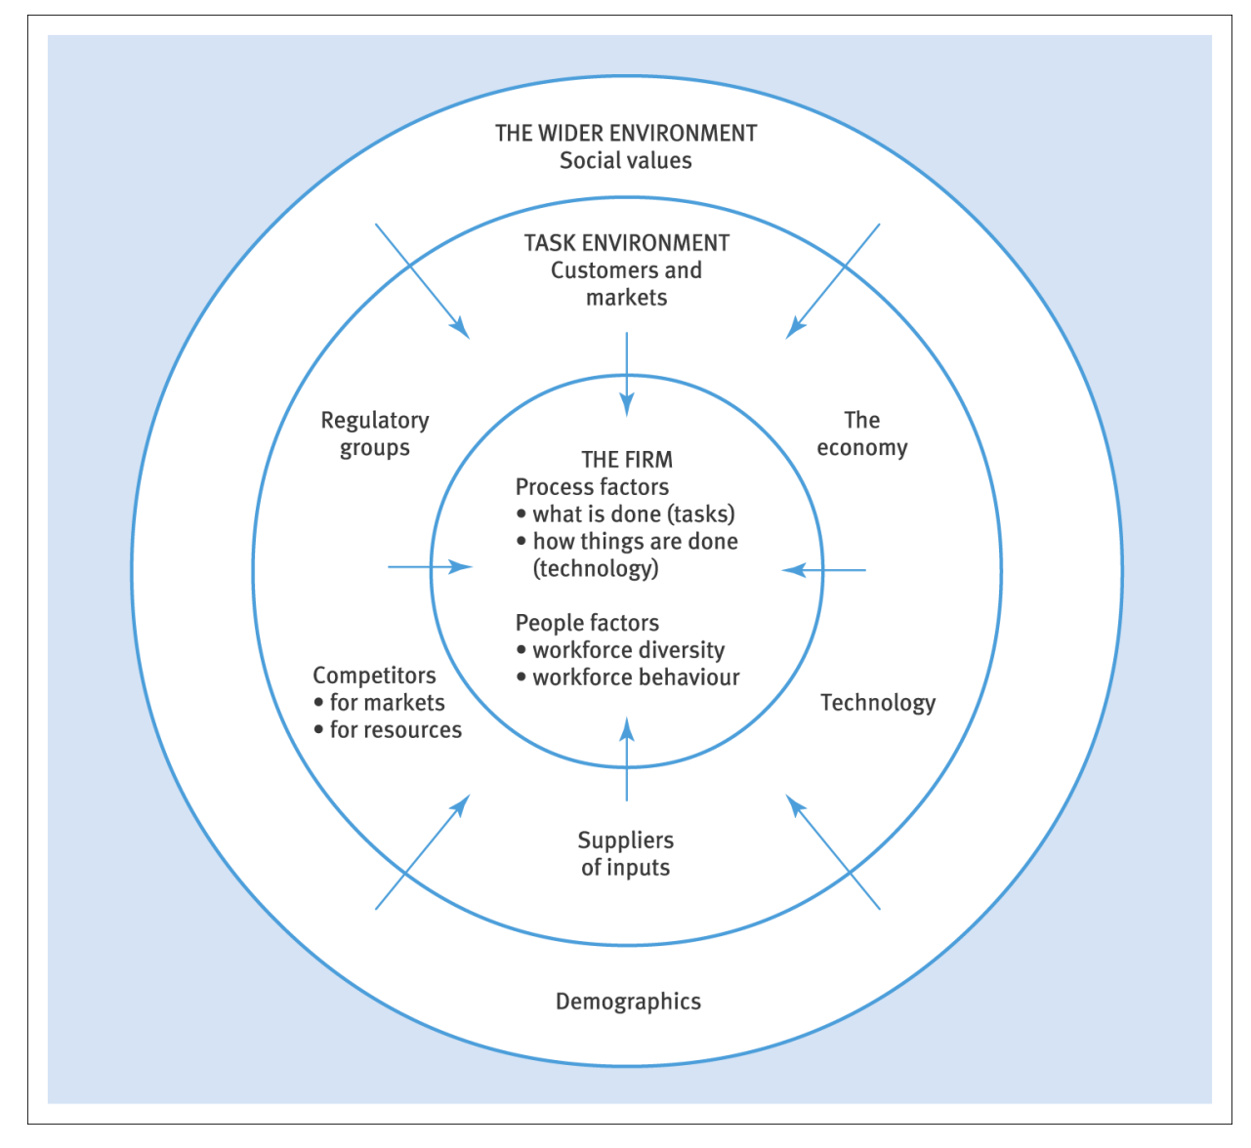
Consider triggers of Change
External / Internal (refer to PESTLE)

Slide 10
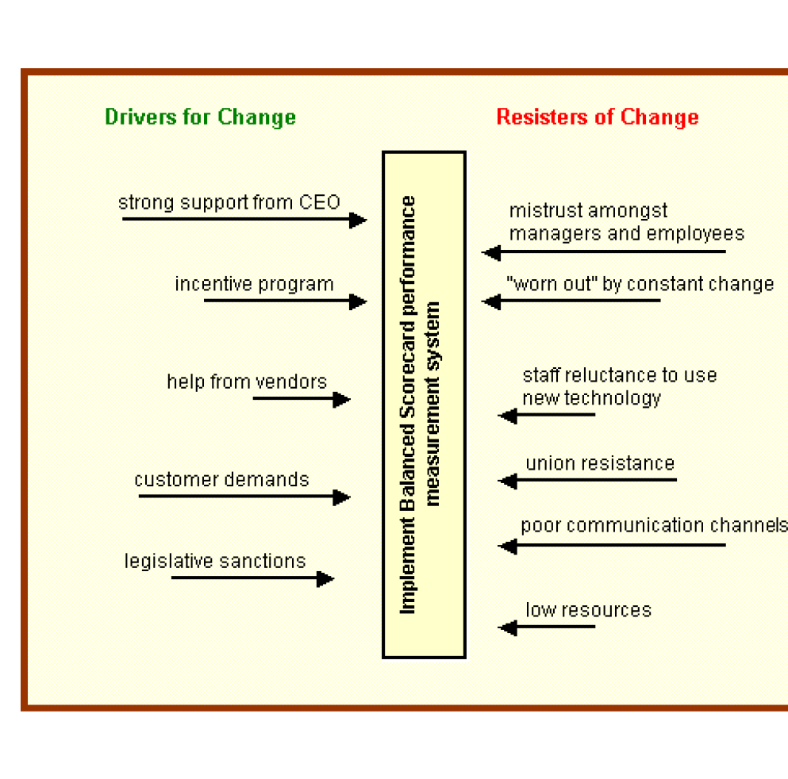
Kurt Lewin’s Force Field Analysis

Slide 11
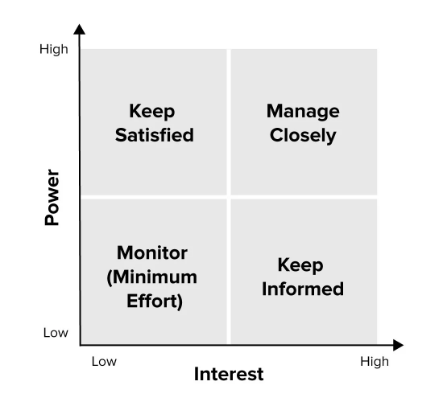
Stakeholders Analysis/ Mapping
Using this technique to address possible resistance to change as well as identifying and strengthening support for change

Slide 12
Explore key themes and Critically analyse:
What roles did leaders play in the change process?
How did leaders adapt their style and focus to suit different phases of change? (Autocratic, Democratic, Laissez-Faire)
Consider the driver factors for change (Culture, Digitalisation, competition etc)
Using the Stake holders analysis identify Powerful stakeholders and blockers
How was leadership used to drive change and overcome residence (leadership styles)?
Approaches to Change adopted (Behavioural, Cognitive, Psychodynamic (Kubler Ross), Humanistic Psychology Approaches and explore limitations)

Slide 13
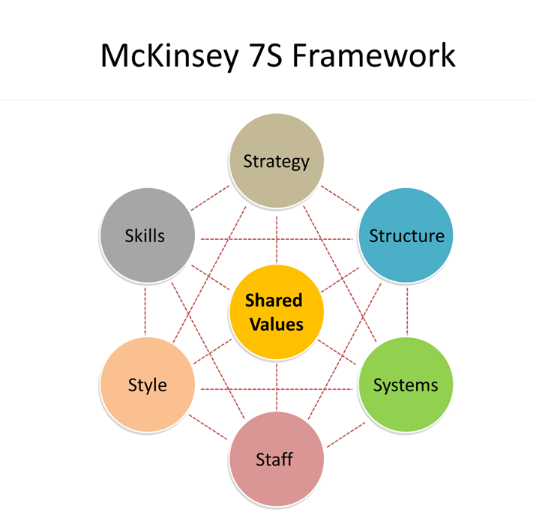
Cultural Web
The Paradigm
stories
symbols
Power structures
Organisational structures
Rituals & routines
Control systems
Notes:
Jerry Johnson's Cultural web explores 6 elements of cultural web which leaders can use to bring about change the paradigm / pattern of working environment.
Stories – history /past events /stories that set a reputation of the organisation and people talk about inside and outside the organisation and to bring about a change leaders can create new stories and myths to bring about a change
Rituals & routine – daily behaviours the acceptable behaviour and determines what is expected to happen in given situation and what management expect
Symbols – visible representation of the company logos/ offices
Organisational structure – not just who is who but who is valued
Control systems- i.e financial systems, reporting system – the way in which people are measured, the way in which rewards are distributed so to aling with the change objectives will enable the change to occur smoothly
Power – who are the key decision maker, influencers

Slide 14
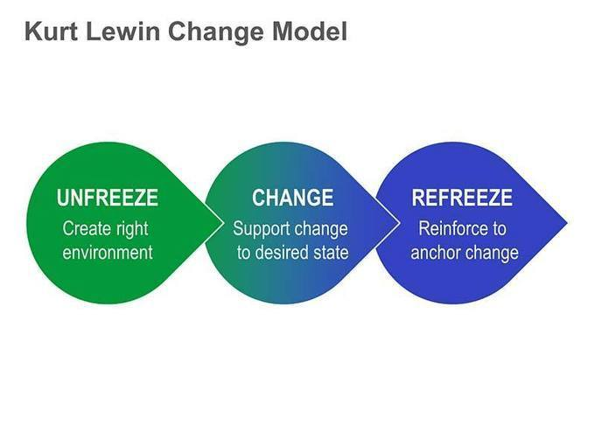
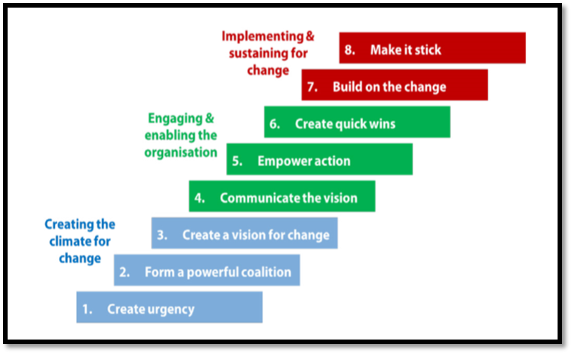
Implement Change model on organisational change(s)
Kotter’s 8 step model
Notes:
Cultural change can be approached by using Mckinsey’s 7 S Model – by shaping the 7 S and their interactions. It is a useful way of assessing the infrastructure of the organisation and how to maintain effective performance.
Staff – important categories of people within organisation (looking at their potential/ retention and maximising their potential)
Skills – distinct capabilities and experiences of key people
Systems – Processes (IT/ HR/ Management Systems)
Style – Management style and culture
Strategy – organisational goals, plans use of resources
Structure – Roles, responsibilities accountability
Shared values – guiding principles
Strategy, structure and systems – are most tangible hence people concentrate on these when managing change. These are also interconnected and when changing these.. It will effect other aspects as well. Using the 7s – we can identify the right structures that will enable the change to be moved forward.
The 7 S can be used to diagnose the current internal state and what needs to be done to get to desired future state.

Slide 15
Evaluate success of change
Based on research findings and linking it with relevant academic theories – conclude the effectiveness of change management process
Recommendations for future change management processes

Slide 16
Conventions
Writers should adhere to various conventions when writing up research:
Referencing follow the Harvard referencing system, sources are also needed for work place reports where relevant (see university guide on referencing/library)
Layout of document & order of material – follow guidelines; a conventional report format should be followed
Writing style - use the third person, past tense & correct grammar & spelling. Check work manually e.g. to avoid their/there, an/at & ensure work makes sense!
Presentational issues – link sections logically, use headings/subheadings, consider page layout, main sections numbered, sub sections point numbered, adopt a consistent style for graphs & charts

Slide 17

Report structure
“ A report is a statement of the results of an investigation or of any matter on which definite information is required”
(Oxford English Dictionary)
All reports have a similar format or structure
Although the structure may vary slightly depending on the intended audience and complexity of the material there will be:
  a preliminary section
  the main text
  the end matter

Slide 18

A. Preliminary section will contain:
Title page containing report title, author’s name, date, P number, classification e.g. private/confidential
b. Executive summary i.e. synopsis of research & findings – last thing to be written. Should be short, sharp, to the point & contain main details of the WHOLE report.
c. Contents page - lists each section with page numbers, may also list sub-sections
d. List of tables and figures - with locations

Slide 19

B. Main text (body of the work) will contain:
a. Introduction -
Brief context – situational details, statement of change scenario researched, how information was collected
b. Research Methods - What form did the research take? Primary/secondary research; Data collection methods e.g. questionnaires/interviews/focus groups/observation/other. Measurements, selection, analysis?
Scoping Presentation was what you planned to do. Update here with what you actually did
c. Findings – present the data & show what the research has uncovered plainly & simply. Use graphs, pie & bar charts, diagrams but be selective, don’t cloud the issue

Slide 20
B. Main text (body of the work) will contain:
Discussion & analysis – findings are scrutinised, discussed, analysed & interpreted. Theory, application, example, analysis. ‘Rolling application of theory’ rather than ‘blocking’ sections of theory separately to the analysis. Apply don’t repeat theory. Introduce concept briefly then apply it with researched examples. This is an applied case study so your organisation’s change scenario needs to be the focal point throughout. This should occupy the majority of the report as it is the key section.
e. Conclusions - draws together the threads of the research & arrives at conclusions. If the case has been reasoned effectively then the readers should already be following your train of thought. Address the task set directly and summarise your arguments – no new information here. Make sense of the report.
g. Recommendations - should be brief points only & relate to the main conclusions. Should include recommendations/guidelines for moving forward

Slide 21

C. The Final Section will contain:
References/Bibliography - essential to show sources & avoid accusations of plagiarism. You need to meet the brief’s key requirements. Mixture of books, journals, company information, articles. Cover both theory and case specific material. Always source theory from academic sources not generalised websites.

Slide 22
Summary
Follow the assignment brief carefully
Ensure you address all required components
Retain a clear focus on this throughout
Stick to the word count specified
Show evidence of adequate research using a range of credible and academic sources
Follow a recognised report structure – Use the Template provided

