Slide 1
Building information modelling
Research methods
Connor Parry-Walters
P151238
Notes:
Hello everyone, this is a short PowerPoint on building information modelling known as bim and the use of bim in the construction industry and specifically the use associated with building surveyors

Slide 2
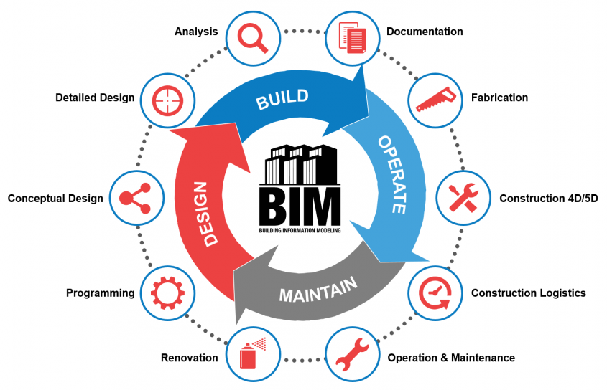
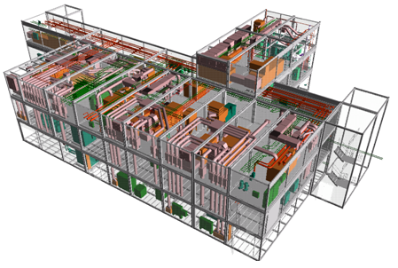
What is Bim ?
Notes:
BIM is not a single piece of software or model, but a new form of information processing and collaboration, with data embedded within the model (Allison, 2015), it is used at all stages from early design to final handover and future maintenance. The aim of bim is to be able to manage projects in a more efficient way using the insight and tools to more efficiently plan, design, construct, and manage buildings and infrastructure (Autodesk, 2018). Bim contains all details from the project and shows the data in various ways from 3d modelling in the design stage to maintenance schedules after the handover is complete.

Slide 3
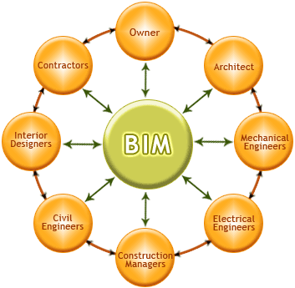
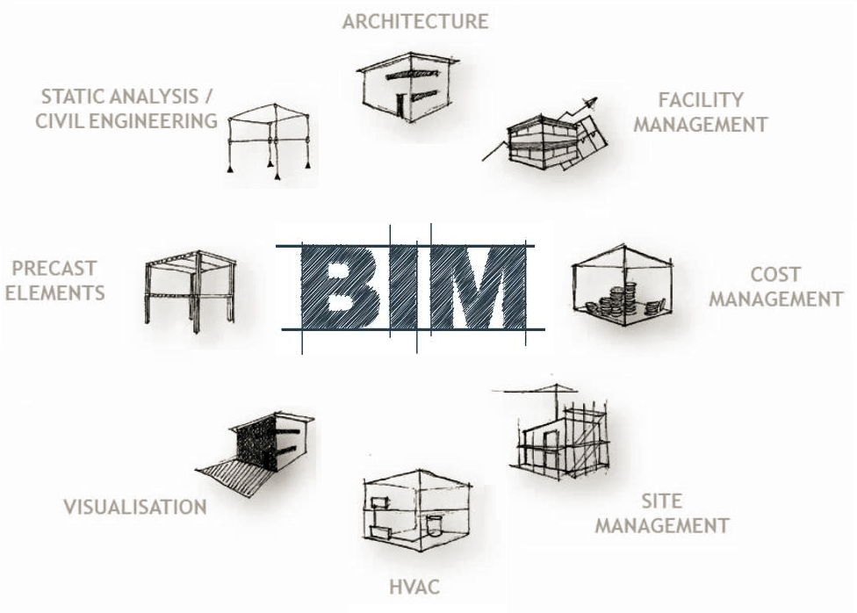
the use of Bim
Notes:
When BIM is being used in a project it is used by everyone in that construction projects, the photo on the left can show you how each sector including the owner is linked by BIM and they can receive any information needed via the BIM format. BIM has many functions which can benefit a project such as cost management and structural analysis, some of these can be seen in the right-hand side photo. The use of bim is becoming widely used across the UK with the government looking to mandate BIM level 3 in the distant future (NBS, 2016)

Slide 4
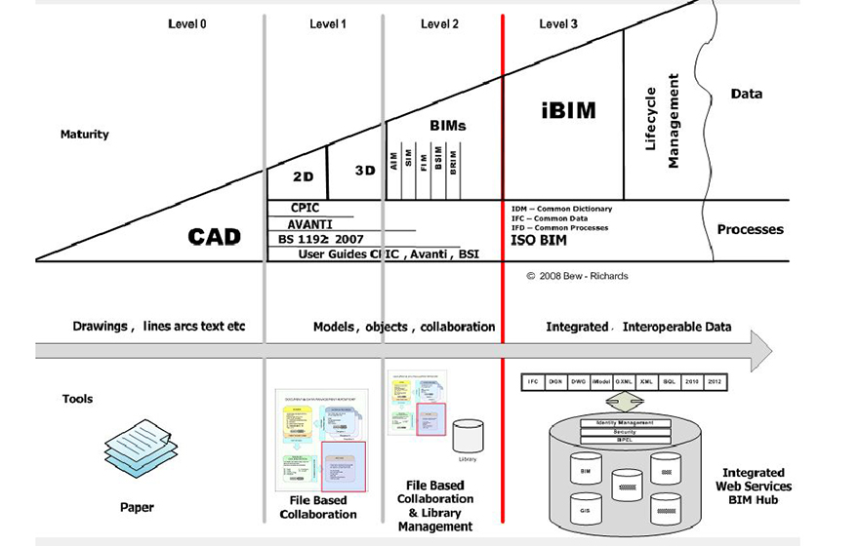
bim in construction
Notes:
BIM has many levels within construction ranging from zero to three, the photo can show briefly what can be entailed with each level, level zero involving very little engagement with some drawings between client and design, and then ranging to level 3 with a larger involvement from more people through-out the process from design, construction, completion and making all that information easier to access and manage. The uk government is looking to mandate level 3 for any public-sector projects with already currently implementing level 2.

Slide 5
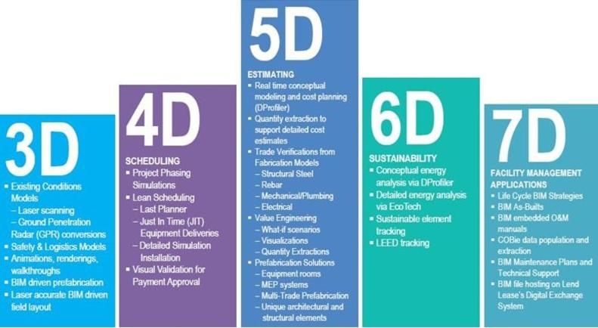
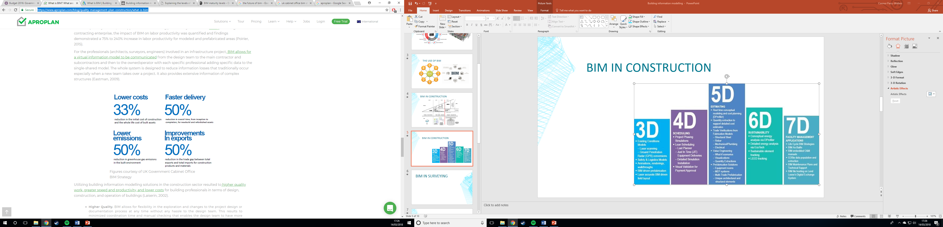
Bim in construction
Notes:
BIM has maturity measures for what is including included in the basic BIM levels and this may sound confusing but BIM has uses 2D,3D,4D,5D,6D,7D and 8D, these refer to certain elements that are almost infinite (Goubau, 2014). The government construction strategy 2016-2020 looks at fully embedding the level 2 BIM into the current use however with no clear maturity measures set or enforcement for use. (HM Treasury and Cabinet Office, 2016)

Slide 6
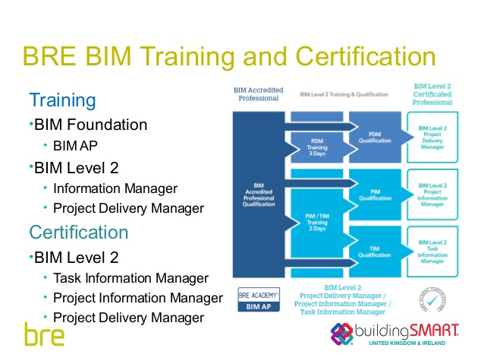
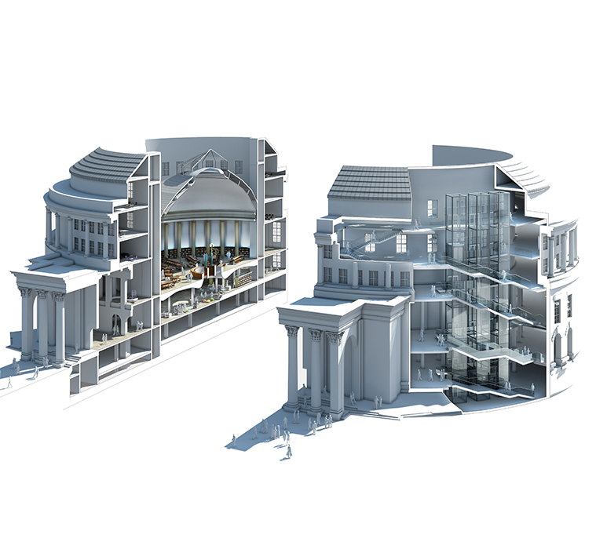
bIm for building surveying
Notes:
As a building surveyor it will not be uncommon to be asked to also take role as a designer and in larger cases another building surveyor may be appointed as an information manager. BIM will change the way surveyors manage the information as they will have to create an environment where there is common data to all parties working within a project and creating plans for the project and asset information (RICS, 2016). As BIM is implemented more widely it is needed for building surveyors to be trained in the area of information manager and any other area that will require a surveyor to do so.

Slide 7
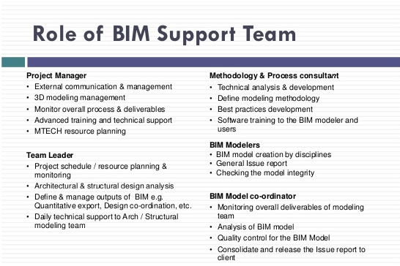
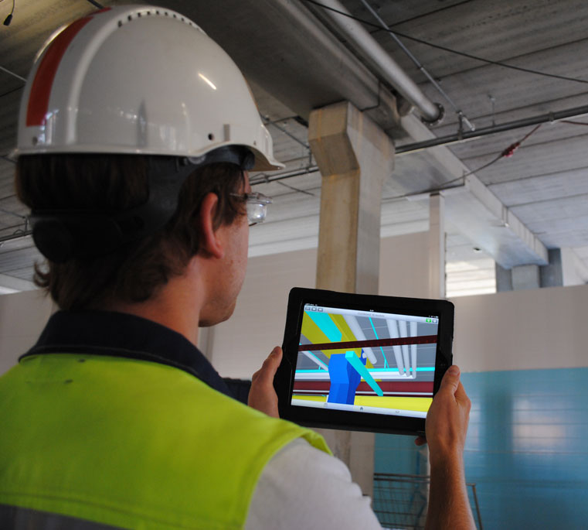
Bim for building surveying
Notes:
Building surveyors can be asked to take a number of roles in projects, they can be asked to lead manager and appoint sub-contractors. It will be the choice of the companies chosen which will have a great effect on the project as it will be important to choose companies who can deliver efficiently while still having a good BIM system, however there can be cases where the a surveyor will have to provide support to a company that can specialise in that area and not however have extensive BIM experience, this should all be set out in a bim execution plan so all parties are aware of the procedure. (RICS, 2016)

Slide 8
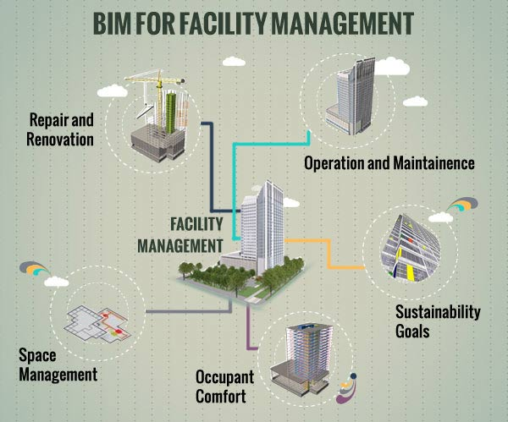
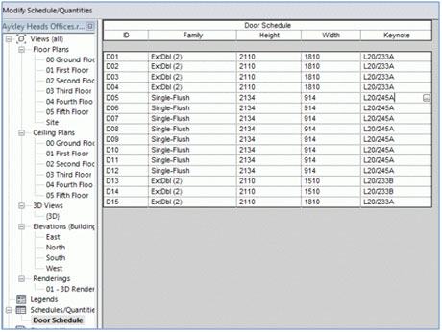
Bim for building surveying
Notes:
A huge part of the construction industry now relies on maintenance of existing buildings. The use of bim will bring all information needed when surveying a building making it much easier to access information that would otherwise be almost unattainable. The plans and documents available on bim will give a surveyor important information for maintenance of buildings being able to produce a schedule of dilapidations easily if one has not already been created with bim, as the products will have lifespan, date of installation and any other relevant information needed to make a judgement on the condition of parts of a building.

Slide 9
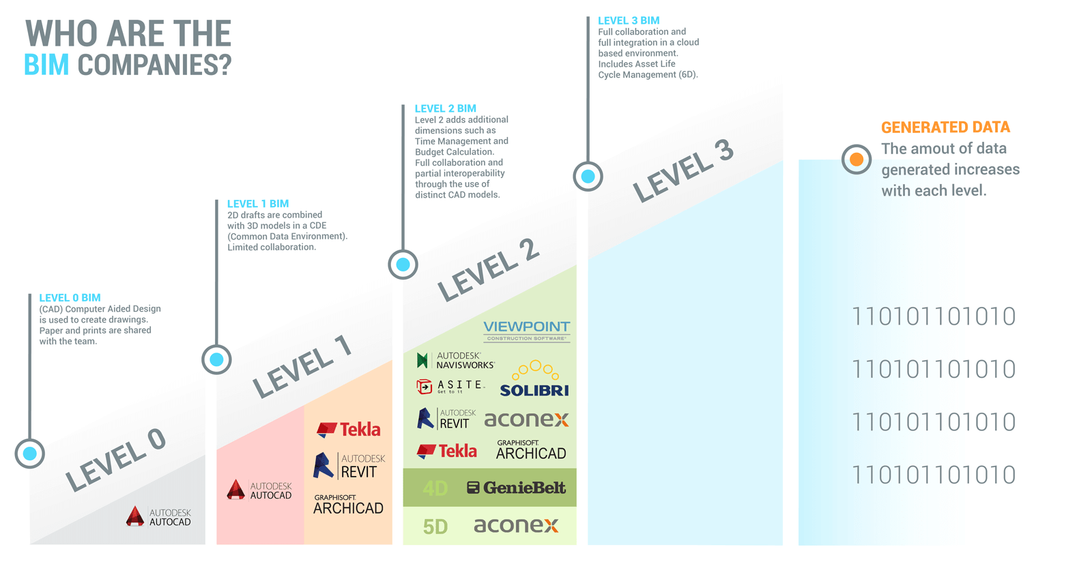
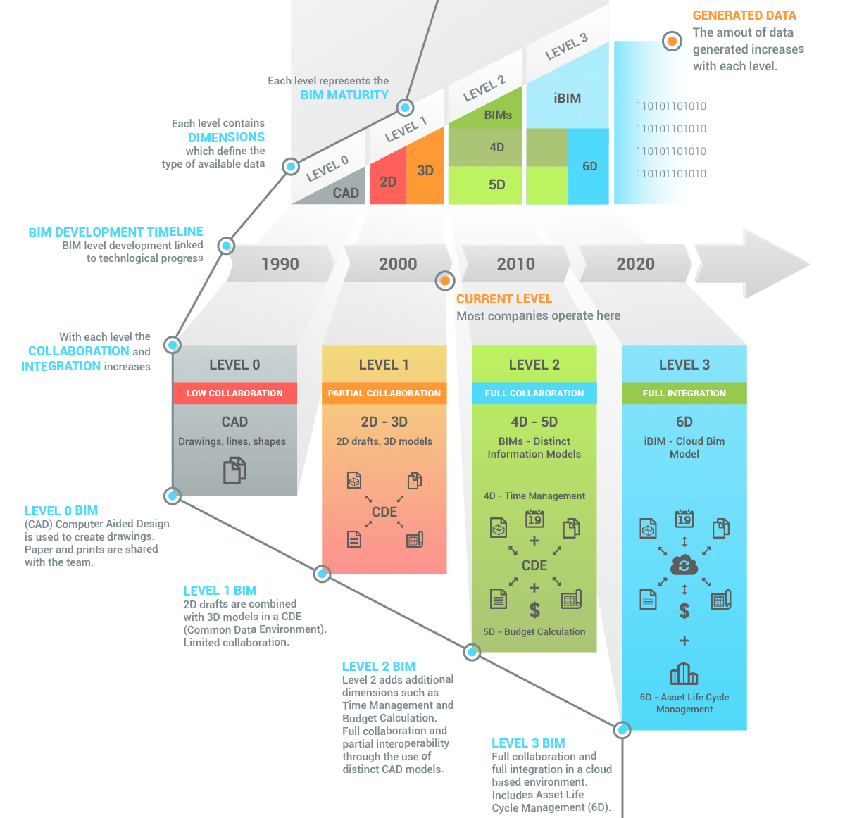
The future of Bim
Notes:
As bim is becoming more widely accepted it is creating new opportunities for work. The future of bim looks towards setting higher levels reaching for level 3 in the next 5-10 years and looking beyond towards level 4, Level 4 will be introducing the concepts of improved social outcomes and wellbeing. As Bim is developed further it will boost productivity in construction allowing for higher quality buildings which have more to offer to the people that engage with them (GenieBelt, 2017)

Slide 10
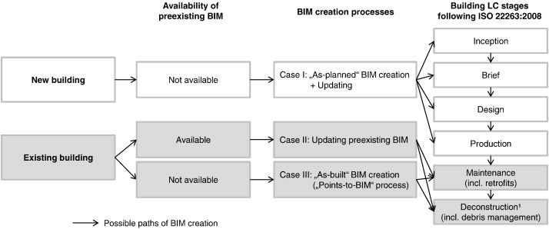
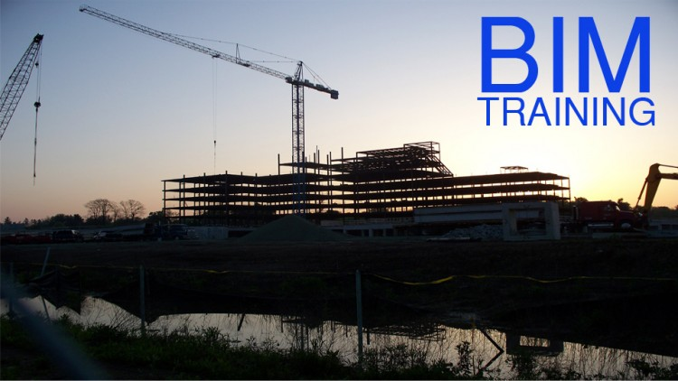

The future of Bim for surveyors
Notes:
For surveyor’s the majority of building surveying appointments will be concerned with an existing building which is often occupied and is to be either extended or altered (RICS, 2016). As BIM will be involved in the appointment of work it will change the way data and the details are stored with BIM. This area in future will possibly create a whole new market sector as it becomes more widely used, creating new roles and seeing companies develop into specialising in BIM. The new roles that can be taken by building surveyors will see a whole new area of training that will be required and possibly create a new system for completing surveyors.

Slide 11
References
References
Allison, P. R. (2015, 03). How building information modelling is changing the construction industry. Retrieved 03 12, 2018, from ComputerWeekly.com: http://www.computerweekly.com/feature/How-building-information-modelling-is-changing-the-construction-industry
Autodesk. (2018). BIM AND THE FUTURE OF AEC. Retrieved 03 13, 2018, from Autodesk.co.uk: https://www.autodesk.co.uk/solutions/bim/overview
GenieBelt. (2017, 05 09). The Future Of Construction – BIM. (A. Koutsogiannis, Editor) Retrieved 03 14, 2018, from GenieBelt: https://geniebelt.com/blog/bim-maturity-levels
Goubau, T. (2014). What is BIM ? What are its benefits to the construction industry? Retrieved 03 13, 2018, from APROPLAN: https://www.aproplan.com/blog/quality-management-plan-construction/what-is-bim
HM Treasury and Cabinet Office. (2016). Government Construction Stratergy 2016-20. Retrieved 03 14, 2018, from https://www.gov.uk/government/uploads/system/uploads/attachment_data/file/510354/Government_Construction_Strategy_2016-20.pdf
NBS. (2016, 03). Budget 2016: Government to push ahead on Level 3 BIM. Retrieved 03 13, 2018, from NBS: Construction Knowledge, Specification and Services: https://www.thenbs.com/news/budget-2016-government-to-push-ahead-on-level-3-bim
RICS. (2016). BIM for building surveyors. Royal Institution of Chartered Surveyors (RICS). Retrieved 03 14, 2018, from http://www.rics.org/Global/RICS_BIM_for_building_surveyors_1st_edition_PG_guidance.pdf

