Slide 1

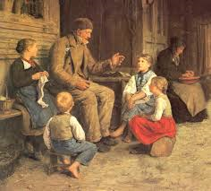
Using Children’s Literature
Learning and Teaching in the Primary School
Language, Literacy & Communication
Session 2
2018-2019
Notes:
Complete register

Slide 2
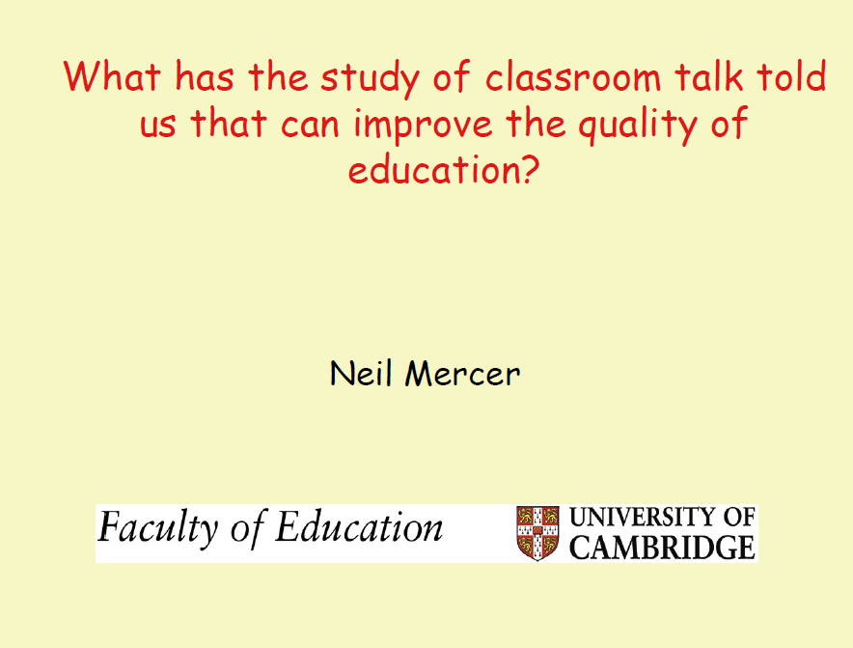

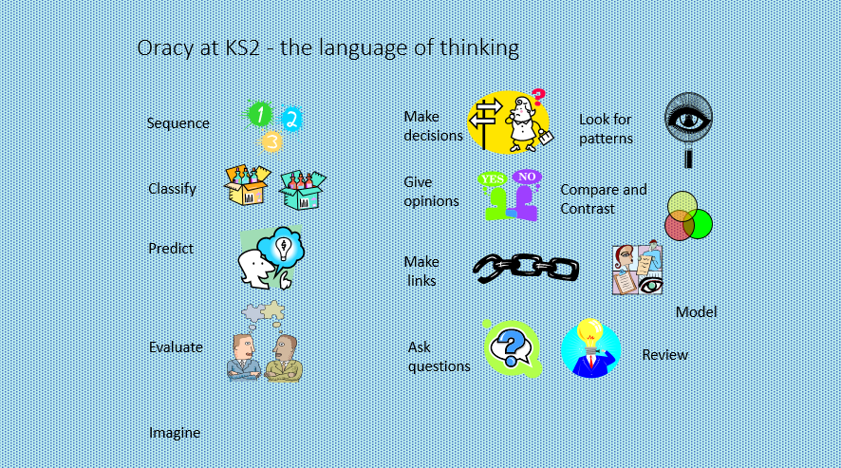
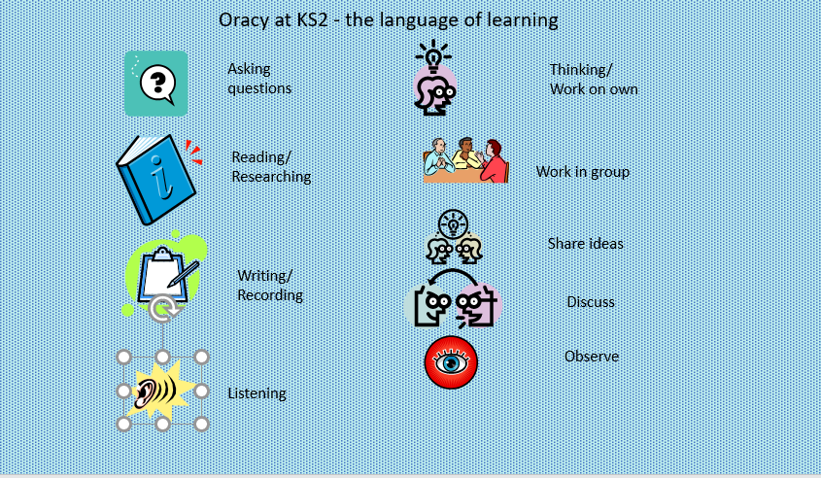
Directed Study: read the material in the folder on Moodle named “Dialogic Learning”.
Notes:
Activity: revisiting the directed study task
In groups, write 3 things they learnt from the Neil Mercer slide show & make a list of as many of the learning activities as they could think of.
Explain that we will be using what they learnt later today and in the coming weeks………. but now we are going to look at today’s focus…..
Notes
Dialogic means relates to or is characterized by dialogue and its use. A dialogic is communication presented in the form of dialogue. Dialogic processes refer to implied meaning in words uttered by a speaker and interpreted by a listener. Dialogic works carry on a continual dialogue that includes interaction with previous information presented.
Dialogic pedagogy is a term used by a growing number of scholars, practitioners and policy-makers to describe learning processes in which teacher and pupils critically interrogate the topic of study, express and listen to multiple voices and points of view, and create respectful and equitable classroom relations.

Slide 3
Aims of this lecture
1 | For you to think about the range of children’s literature that exists and that you begin to develop a repertoire of stories that you can use in the classroom;
2 | For you to gain an understanding about why stories are so important to us as human beings;
3 | For you to identify the characteristics of a good story teller;
4 | For you to start developing those skills yourself;
5 | For you to begin to think about how stories can be used to develop children’s thinking.
Notes:
Today’s focus is children’s literature. We are going to look at existing literature. We are going to think about how it can be used and why we should read to children. We are also going to look at how to tell stories and how to use them to develop children’s literacy and thinking skills in the classroom.

Slide 4
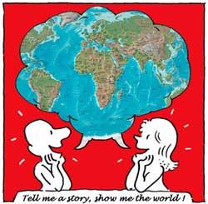
Why are stories important?
No matter what we are talking about, whether it is about a science experiment or a funny incident, we tend to tell it as a story. Telling a story is a basic skill which underlies all other forms of language, so its important that students are very familiar with it;
Good stories engage and motivate students;
Stories help us to empathise with other people. They are important in our development as human beings;
Stories help students become familiar
with language;
As students think about stories, they are developing their thinking skills;
Stories help students develop their vocabulary;
Stories help us to empathise with other people. They are important in our development as human beings;
The material in stories can be used as a stimulus for speaking, listening and writing;
Stories give us a window on the world.
Notes:
Activity
Pose the question and get some responses.
This is a slide that will be read, but each point can be expanded upon. This is especially true of the last point, “window on the world”, and reference can be made to Spufford’s book “The Child that Books Made”.

Slide 5
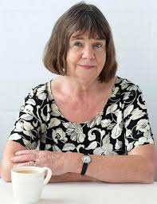
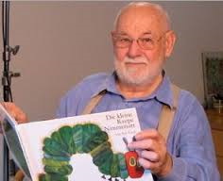
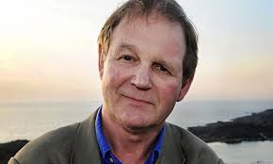
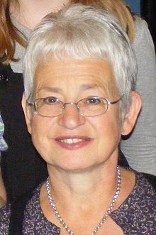
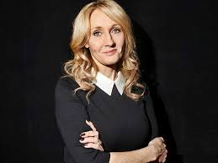

It is so important that you read children’s literature
What are you reading now?
https://padlet.com/jayne_morgan1/fypcco3wzu3a
Notes:
The point of this slide is to encourage students to read as much as possible.
Activity: quick quiz
Jacqueline Wilson
Julia Donaldson
JK Rowling
Eric Carle
Michael Morpurgo
Ask what they are reading at the moment?!

Slide 6

Why is storytelling important?
Notes:
Story telling is one of the oldest ways of communicating ideas;
Traditional tales in particular have an important role in our collective consciousness;
Learners will often relate their own life and experiences to a story;
Story telling allows for opportunities to express thoughts and possible anxieties;
Sharing books with children across the primary age range is strongly related to language growth;
“Reading a book aloud, explaining vocabulary at each reading means that ‘children can acquire 8-12 word meanings per week at school which is enough to maintain average vocabulary gains” (Biemiller, 2007)
Bruner refers to story telling as the way in which we translate our understanding of what is happening internally, externally;
AND stories are a great stimulus for all kinds of learning in the classroom!

Slide 7

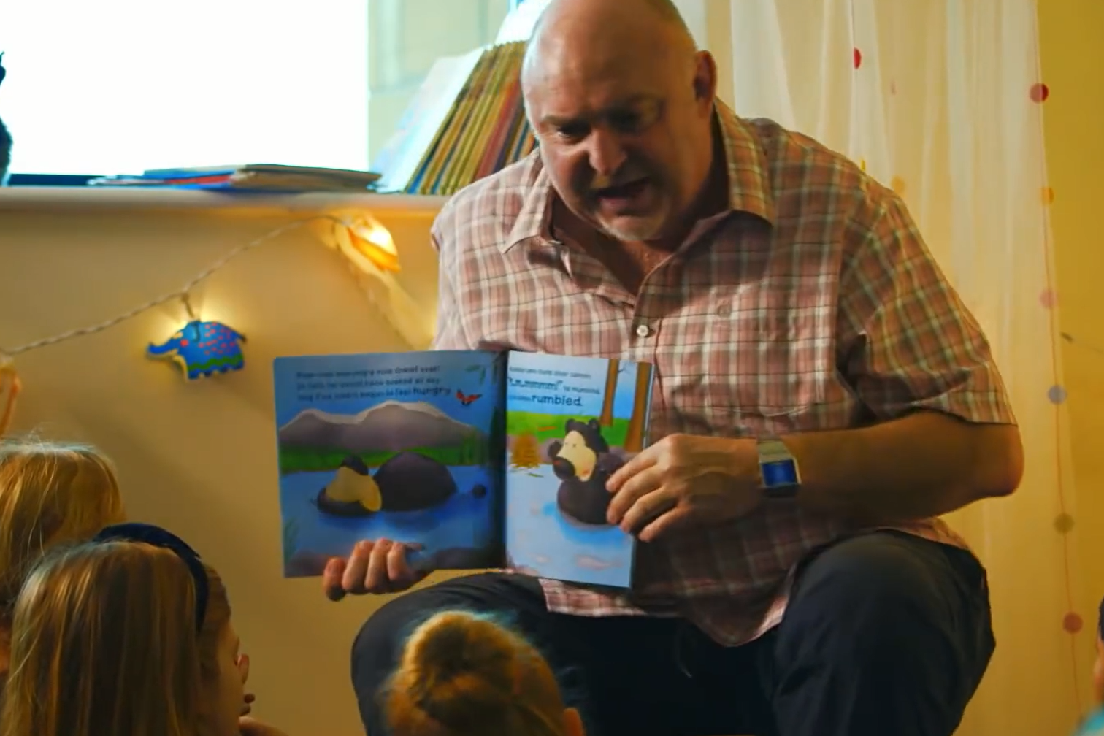
What the characteristics of a great storyteller?
https://www.youtube.com/watch?v=hEgREFpqFfA
Notes:
Activity: watch video and makes notes;
Each group to make a list of characteristics;
Personalization: Tell the pupils how you feel about the story.
Sharing enjoyment: Tell the pupils why you enjoy the story and show them that you enjoy the story.
Scene setting: Talk about what might have happened before the story begins, or the place, or the people.
Body language: Use your body to help you tell the story by explaining the meaning of words through gesture, showing characters’ feelings by changing you posture, and so on.
Facial expression: Look scared, happy, sad in accordance with the story, or express a character’s feelings through expression.
Voice tone and volume: Use an angry voice, or a happy voice and so on: varying the volume to gain attention and add expression and interest.
Changes of pace: The story will dictate this to some extent; if it moves quickly, for instance, you can increase the pace at which you are telling the story.
Vocal expression: This can make a huge difference to children’s understanding of the text, and their enjoyment too. Think about the meaning of each word, or phrase, and how you can convey that meaning.
Anticipation: Make it exciting, think about the way you turn the pages over.
Prediction: Get the pupils to think about what might happen during the next part of the story.
Props: If a particular object is mentioned in a story it may be worth getting hold of a similar object to use as you tell the story.
Familiarity with the story: You need to have gone through the story before you start reading.
Using illustrations: Good quality children’s books usually have excellent illustrations which help tell the story. Draw pupils’ attention to this because it will help them understand, make the words more memorable and increase their enjoyment of the story.
Sound effects: You can make these yourself and get the children to join in.
Actions: This makes the story more memorable for the children and reinforces the meaning of words.
Ad-libbing: You can add bits to the story, if you wish. Don’t be afraid to change the words either if you think your pupils will find the vocabulary too hard.
Character development: This is worth doing because it’s important that pupils can identify how characters are different and how they develop during a story. The easiest way to develop characters is by using a different voice when the characters are talking.

Slide 8
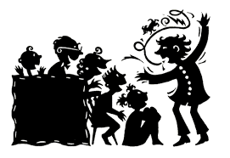
Now it’s your turn …..
Notes:
Activity
Students to have a go at storytelling to each other and to the whole group. Exact arrangements will depend on numbers and books brought

Slide 9
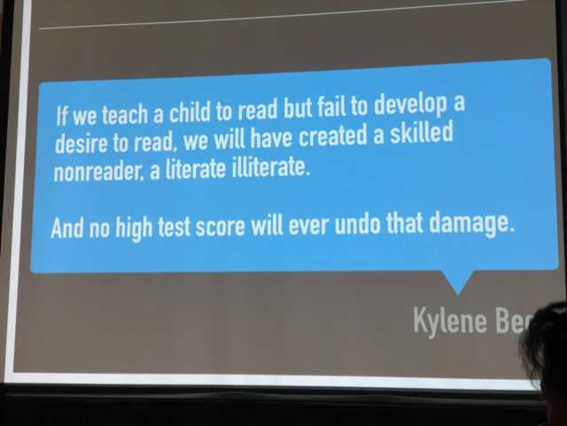

Something to think about – key idea
Notes:
Activity
Students to discuss this in groups

Slide 10

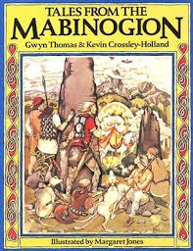
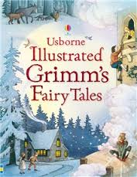
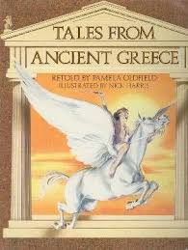
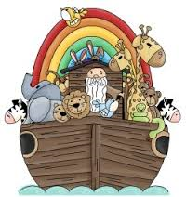
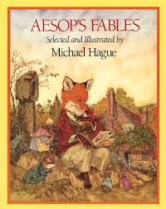
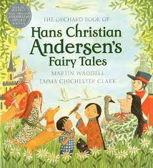
Using stories in the classroom
Notes:
First, simply remind students about these different sources of stories that they may choose to use.
Notes
A myth: traditional story, especially one concerning the early history of a people or explaining a natural or social phenomenon, and typically involving supernatural beings or events;
A legend: a traditional story sometimes popularly regarded as historical but not authenticated.
IL to give students an example of how to use a story.

Slide 11
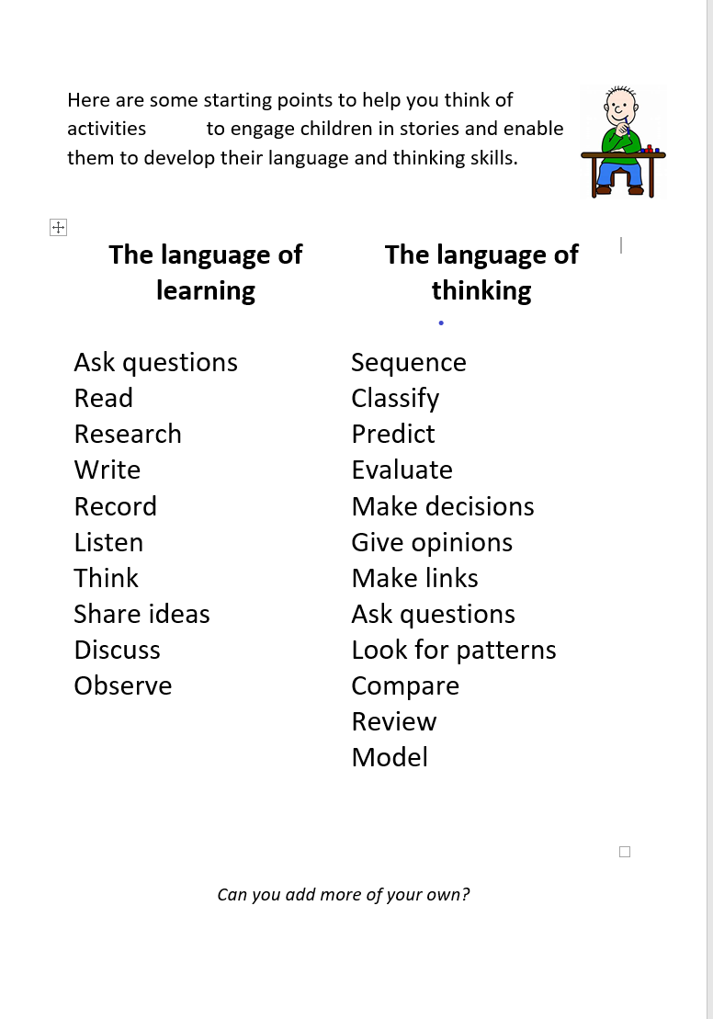


Directed study - Using books and stories in the classroom to develop oracy skills
https://padlet.com/jayne_morgan1/sbkzqy5dld50
Notes:
Activity
Students to use the lists of activities they were given for directed study to generate ideas for classroom activities linked to a story.
Students to share ideas on Padlet?

Slide 12

To conclude ……..
2. Now reduce that to 5 key words…
1. Write 5 sentences summarising today’s topic.
3. And finally to one word….
Notes:
Activity
Allow students time to jot down their answers.
Then summarize:
Literature / stories are important
Teachers should read
Teachers should show enjoyment of literature
Telling a story well is important
?
READ

Slide 13
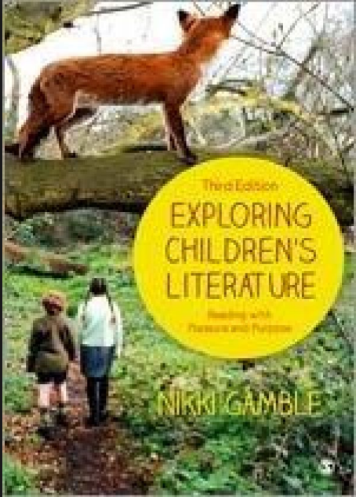
References
Biemiller A. Teaching vocabulary: Early, direct, and sequential. American Educator. 2001;25:24–28.
Bruner, J.
Gamble, N.
Meek, M (1988) How Texts Teach What Readers Learn Thimble Press
Spufford, F. (2003) The child that books built. London: Faber and Faber.
Recommended
Read

Slide 14













