Slide 1
Salem cubed
A Reimagining of Salem using Minecraft
Francesca Quieros

Slide 2
MY PROPOSAL
A digital project – a reimagining of Salem, Massachusetts during the 17th century. Included within my research are agriculture, architecture, geography, industry, and religion. My proposal represents my ideas for a finished product.
The project would be completed on the video game Minecraft.
Not an exact replica, but a ‘reimagining’; this is due to certain limitations that will be addressed.
The intended audience would be able to interact with this world to whatever extent they liked; the player can walk through, or role-play with others online, or live out their game as if they are a Salem citizen.

Slide 3
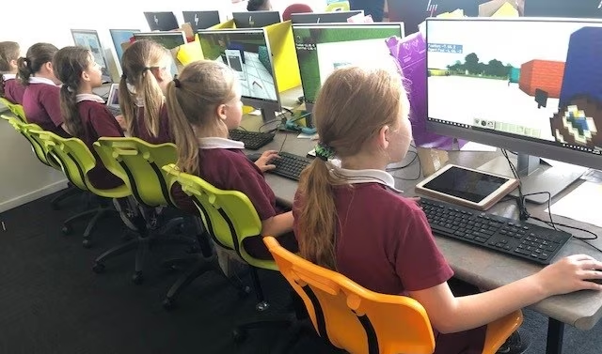
PROJECT AIMS
Make history and the archaeological record more accessible to those outside of academic circles
Motivate and inspire the younger generation to learn about history
Acknowledge those who learn more effectively through non-traditional methods
Communicate the idea that technology can be a valuable asset to the studies of history and archaeology
FIG. 1. Children using ‘Minecraft: Education Edition’ in a classroom. 2019. Minecraft

Slide 4
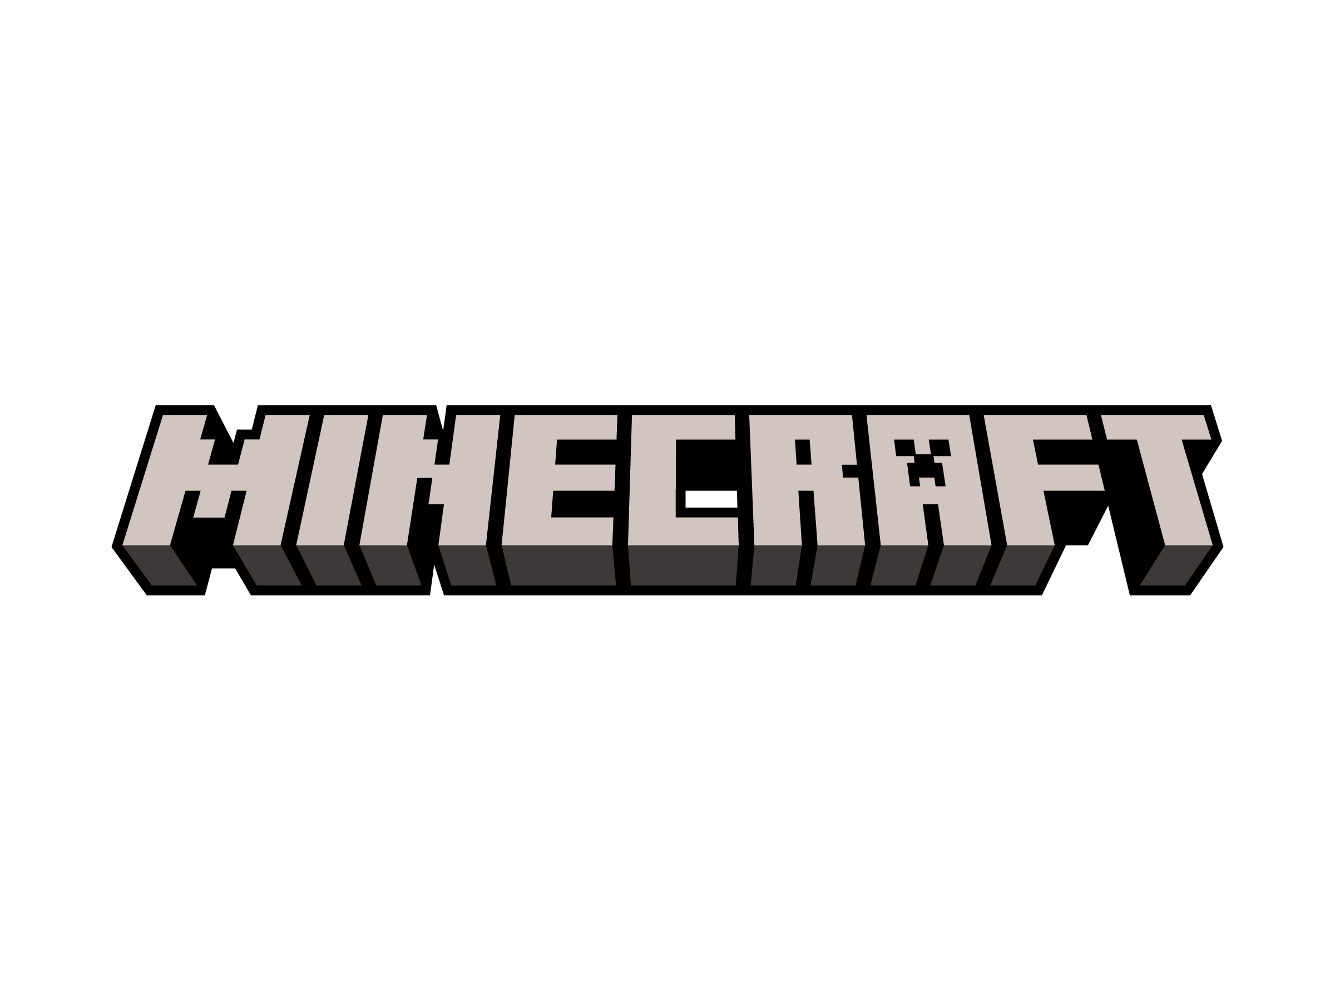
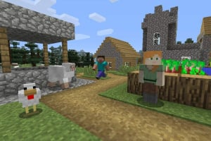
WHAT IS MINECRAFT?
A 2009 video game that can be played as many different ways as there are players
The objective is to survive, and build up your world
“Explore and craft your way through an infinite world that’s yours to shape, one block at a time”¹. –Minecraft
Incredibly popular with millennial, Gen Z and Gen Alpha – 300 million copies sold²
FIG. 2. Screenshot of Minecraft gameplay. Nintendolife.
1 Mojang, ‘What Is Minecraft?’, Minecraft.net, 2020 https://www.minecraft.net/en-us/about-minecraft> [accessed 10 December 2024]
2 David Curry, ‘Minecraft Revenue and Usage Statistics (2020)’, Business of Apps, 2021 https://www.businessofapps.com/data/minecraft-statistics/ [accessed 10 December]

Slide 5
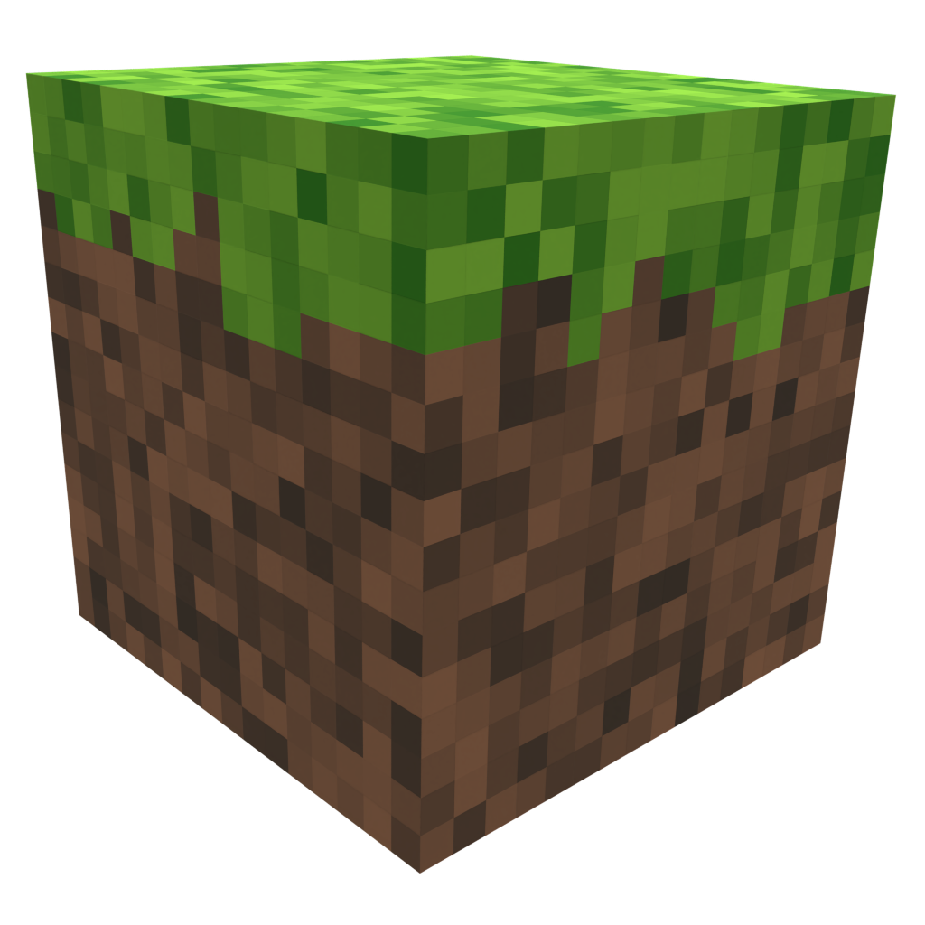
MINECRAFT AS A MEDIUM
The game has limitless potential in terms of building¹
It appeals, and is familiar to younger audiences
Building is not complex and does not require a professional education to do so, like game engines such as Unreal
Widely available, inexpensive, can be played on multiple forms of technology
Alternative take on a historical setting, unique blend of modern technology and history
Has been used as a learning tool (Minecraft Education Edition)
1 Mojang, ‘What Is Minecraft?’, Minecraft.net, 2020 https://www.minecraft.net/en-us/about-minecraft [accessed December 2024]

Slide 6
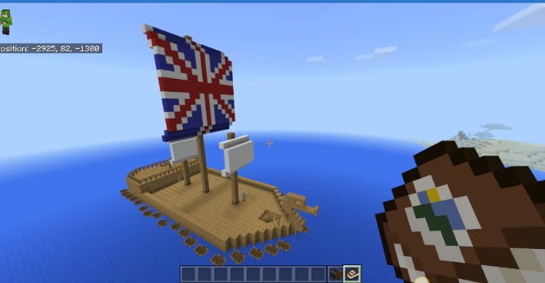
Minecraft as a Learning Tool
A 2019 study was done by Minecraft, in collaboration with the Queensland University of Technology’s Digital Media Research Centre to determine the effectiveness of Minecraft: Education Edition in the classroom. The results, based off data gathered from 307 students and 14 teachers across Queensland showed:
‘Minecraft provides another kind of motivation and creative way to demonstrate knowledge…Minecraft: Education edition should be used as a creative way to collaborate and communicate knowledge and understanding of ideas.’¹
Educator
Minecraft: Education Edition has an expansive variety of lessons to be used in classroom settings. In the ‘History and Culture’ subsection, they have recreated historical environments, which appeal to a visual, and interactive learning style. An example of this is ‘Jamestown Settlement’, wherein the lesson asks the students to build a protective fortress, and complete the survival tasks for the development of a successful colony².
1 Unnamed Educator, ‘New Study: Understanding the Impact of Minecraft in the Math Classroom | Minecraft Education Edition’, Education.minecraft.ne, n.d. https://education.minecraft.net/en-us/blog/new-study-understanding-the-impact-of-minecraft-in-the-math-classroom [accessed 10 December]
2 ‘Jamestown Settlement’, Education.minecraft.net, 2024 <https://education.minecraft.net/en-us/lessons/jamestown-settlement> [accessed 10 December 2024].
FIG. 3. Screenshot taken by student in the ‘Jamestown Settlement’ lesson. Trish Cloud. 2019. Minecraft.

Slide 7
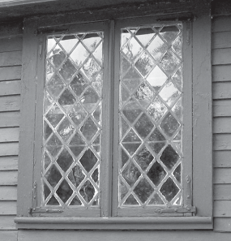
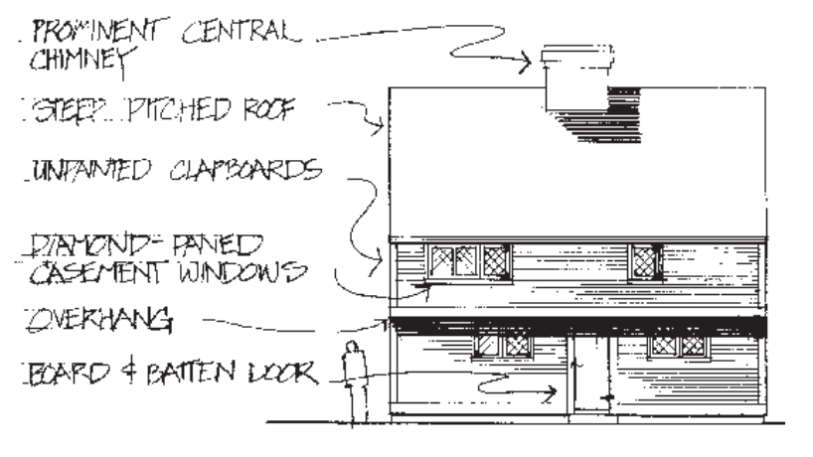
architecture
I recognise the evolving nature of Salem as an expanding colony – the changes to the town throughout the centuries must be considered, therefore it was necessary to narrow the period within a century. For my project, I have chosen the mid-to-late 17th century.
17th century architecture is known as First Period.
Roof steeply pitched, many gables.
The exterior walls would be unpainted clapboard. An overhang at the front, and a lean-to at the back was also typical.
FIG. 4. Replica diamond casement windows, John Wood house. Historic Salem, Inc.
Doors and diamond-paned windows were placed asymmetrically. The front door would be located in front of the chimney, and were of board-and-batten.
Typically one room deep with a central chimney. Timbers are visible throughout interior.
FIG. 5. Elements of a First Period house. Historic Salem, Inc.
1 ‘Architecture in Salem: A Guide to Four Centuries of Design’. National Park Service: U.S Department of the Interior. n.d. p. 2 <https://www.npshistory.com/publications/sama/brochures/salem-architecture.pdf> [accessed 10 December 2024].

Slide 8
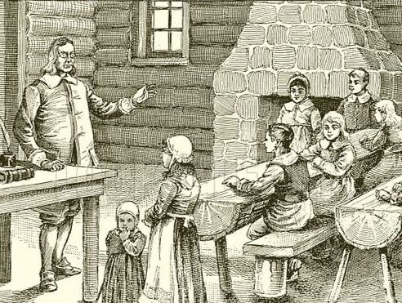
CULTURE
FACT
HOW WILL I REPRESENT?
New England literacy rates were almost universal¹
Books on these subjects will be added to chests, and chiselled bookshelves in homes.
The magistrate’s house will be complete with the Bible, and other Puritan readings. There will be printed posters in the town’s public spaces that remind of punishment for sacrilegious behaviours.
Personal letters will be written and placed in homes between townspeople, discussing negative and positive behaviours of others in accordance with these ideals.
Puritan ideals informed one’s lifestyle: hard work, good deeds, active in the community, frequenting church²
Education was imbued with religious sentiments and teachings
Printed literature ranged from pamphlets on romantic advice, religious instructive manuals, higher debates of the ‘invisible world’, and the nature of God
The town school will have religious iconography inside, as well as textbooks on the history of Puritanism, Christianity, and biblical teachings
Institutional power was deeply Puritan. Lawmakers and town leaders regularly consulted with the clergy.³
Build a town school, and include books in each house, as well as writing implements. Signage and posters will feature in the town also.
1 E. Jennifer Monaghan, ‘Literacy Instruction and Gender in Colonial New England’, American Quarterly, 40.1 (1988), p. 18, doi:10.2307/2713140.
2 Isaac Reed, ‘Why Salem Made Sense: Culture, Gender, and the Puritan Persecution of Witchcraft’, Cultural Sociology, 1.2 (2007), pp. 209–34, doi:10.1177/1749975507078188.
3 Ernest W. King and Franklin G. Mixon, ‘Religiosity and the Political Economy of the Salem Witch Trials’, The Social Science Journal, 47.3 (2010), pp. 678–88, doi:10.1016/j.soscij.2010.01.008.

Slide 9
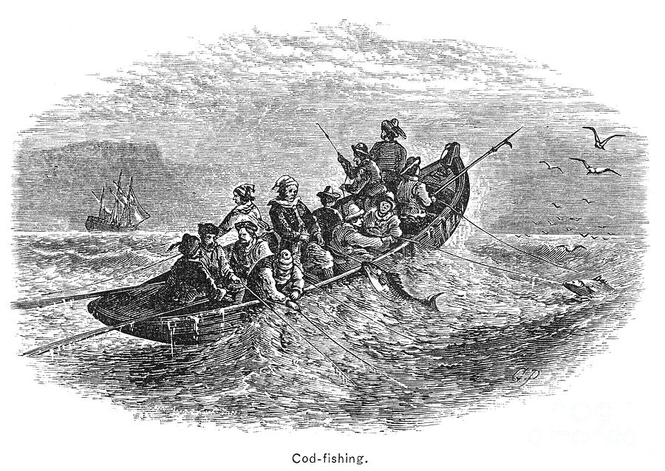
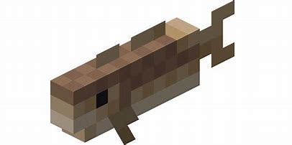
Industry
FIG. 7. Cod-fishing, 17th century. A wood engraving. 1876
^{FIG. 6. Minecraft Cod.}
Arguably influenced course of American history more so than any other fish
Abundant all year, and salted for taste and to avoid spoiling
Fishing merchants lived in Boston and Salem, for the Bay Colony
Cod was the most lucrative trade of colonial New England
Cod was fished in local waters by early 17th century
First product shipped outside of colonial Massachusetts¹
Salem Cubed will feature fishing ports, as well as fishing fleets – single masted vessels loaded with barrels of fish for trade.
Fishing market selling salted cod
1 John J. Ryan, ‘The Cod Family and its Utlization’, Marine Fisheries Review, 41.11 (1979) pp.25-36 (p.25), https://spo.nmfs.noaa.gov/sites/default/files/pdf-content/mfr41112.pdf#:~:text=By%20the%20early%2017th%20century%2C%20the%20New%20England,catch%20of%20cod%20from%20Georges%20Bank%20was%20landed

Slide 10
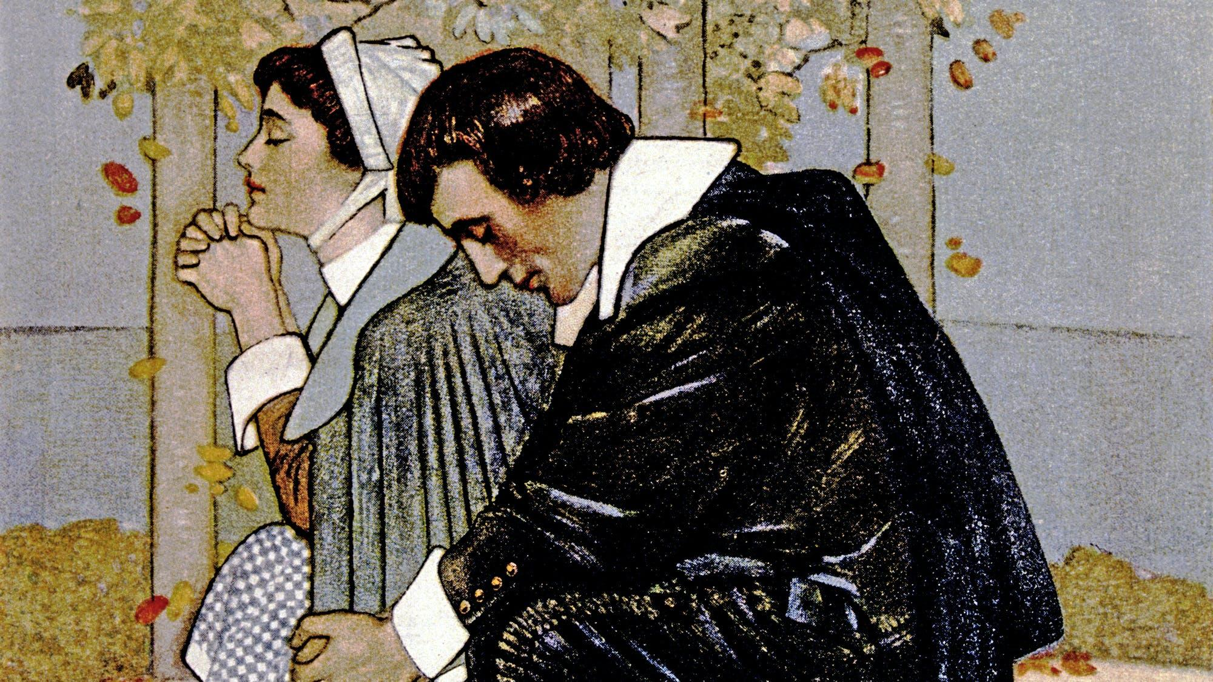
RELIGION
To represent as many aspects of Salem’s religion as possible, a Puritan church should be built in Salem Cubed, complete with posters around town that remind of the punishment for non-attendance. A whipping post will also be built, with redstone to represent blood pools/trails.
Every house and place of business should include an element of Puritanism.
The Salem Witch Trials began in 1692, so were not happening during the time Salem Cubed is roughly set – mid-to-late 17th century. However, religious attitudes that influenced these trials were still prevalent and are central, and important to communicate in this project.
17th century Salem can be considered as a Calvinist theocracy, and adherence to legalistic religious rules were non-negotiable. Punishments for challenging Puritan law, or spreading heretical ideas could range from excommunication, whipping, branding, ear-lobbing etc.
Puritanism did face challenges however, with the Quaker movement encroaching onto Salem between 1655-62, attracting converts and destabilising Puritan authority. This was a time of religious uncertainty, and theistic authoritarianism. This, intermingled with misogynistic attitudes of the time, brought on the Witch Trials.¹
1 Ernest W. King and Franklin G. Mixon, ‘Religiosity and the Political Economy of the Salem Witch Trials’, The Social Science Journal, 47.3 (2010), pp. 678–88, doi:10.1016/j.soscij.2010.01.008.

Slide 11
limitations
Minecraft only has a certain number of blocks and materials. Substitutes would have to be accepted to prioritise the aesthetic of Salem over accurate materials.
Getting permission from Mojang and Minecraft
May need to update the world in accordance with Minecraft updates
Audience would need to be considered when representing violent or upsetting aspects of Salem’s past. Is censorship an issue to the accuracy of this project?
Certain intricacies may not be possible to recreate using this medium

Slide 12
REFERENCE LIST
Architecture in Salem: A Guide to Four Centuries of Design’. National Park Service: U.S Department of the Interior. n.d. p. 2 <https://www.npshistory.com/publications/sama/brochures/salem-architecture.pdf> [accessed 10 December 2024]
Curry, David, ‘Minecraft Revenue and Usage Statistics (2020)’, Business of Apps, 2021 https://www.businessofapps.com/data/minecraft-statistics/ [accessed 10 December]
Educator, Unnamed, ‘New Study: Understanding the Impact of Minecraft in the Math Classroom | Minecraft Education Edition’, Education.minecraft.ne, n.d. https://education.minecraft.net/en-us/blog/new-study-understanding-the-impact-of-minecraft-in-the-math-classroom [accessed 10 December]
Jamestown Settlement’, Education.minecraft.net, 2024 <https://education.minecraft.net/en-us/lessons/jamestown-settlement> [accessed 10 December 2024]
King, Ernest W. and Mixon, Franklin G., ‘Religiosity and the Political Economy of the Salem Witch Trials’, The Social Science Journal, 47.3 (2010), pp. 678–88, doi:10.1016/j.soscij.2010.01.008.
Mojang, ‘What Is Minecraft?’, Minecraft.net, 2020 https://www.minecraft.net/en-us/about-minecraft> [accessed 10 December 2024]
Monaghan, Jennifer E., ‘Literacy Instruction and Gender in Colonial New England’, American Quarterly, 40.1 (1988), p. 18, doi:10.2307/2713140
Reed, Isaac, ‘Why Salem Made Sense: Culture, Gender, and the Puritan Persecution of Witchcraft’, Cultural Sociology, 1.2 (2007), pp. 209–34, doi:10.1177/1749975507078188.
Ryan, John. J, ‘The Cod Family and its Utlization’, Marine Fisheries Review, 41.11 (1979) pp.25-36 (p.25), https://spo.nmfs.noaa.gov/sites/default/files/pdf-content/mfr41112.pdf#:~:text=By%20the%20early%2017th%20century%2C%20the%20New%20England,catch%20of%20cod%20from%20Georges%20Bank%20was%20landed

