Slide 1
Component 2 Individual Presentation
MODULE:COMMUNITY CARE AND MANAGEMENT OF LONGER-TERM CONDITIONS
LECTURER: AISHAT BAKRE
MODULE CODE: LCSH7003
STUDENT NAME: NAGINA BEGUM
STUDENT NUMBER: 2215742

Slide 2
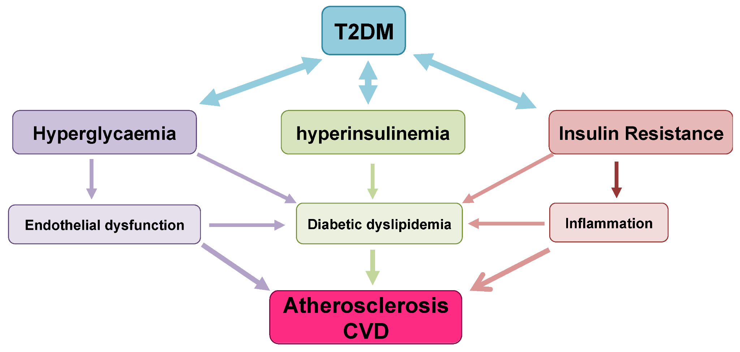
DEFINITION of Type 2 Diabetes
Type 2 diabetes is a chronic metabolic condition characterised by insulin resistance (the body’s inability to effectively use insulin). (NICE, 2015)
Insulin resistance → reduced glucose uptake in muscle and adipose tissue.
Compensatory hyperinsulinemia maintains glucose initially, then β-cell fatigue ensues (Galicia-Garcia et al. 2020).
Chronic hyperglycaemia causes oxidative stress and endothelial dysfunction.
Inflammation + dyslipidaemia accelerate atherosclerosis → CVD.
Driven by genetic, obesity-related, and environmental influences
(NATIONAL HEALTH SERVICE, 2025)
Notes:
Type 2 diabetes is a chronic metabolic condition characterized by insulin resistance (the body’s inability to effectively use insulin) and relative insulin deficiency, leading to elevated blood glucose levels (hyperglycaemia). It is commonly associated with obesity, physical inactivity, and other cardiovascular risk factors, and is linked to long-term microvascular and macrovascular complications (NICE, 2015; WHO, 2024)
Central to this is insulin resistance or the inability of insulin-responsive tissues like skeletal muscle, liver and adipose tissues to respond to normal insulin concentrations. The pancreas responds to this by secretion too much insulin, leading to hyperinsulinaemia. This eventually results in the exhaustion of β-cells, the decreased production of insulin and the persistent hyperglycaemia (Galicia-Garcia et al. 2020).
Hyperglycaemia facilitates endothelial dysfunction through oxidative stress and advanced glycation end-products (Galicia-Garcia et al. 2020). All these processes come together to hasten atherosclerosis and CVD, which are still the leading causes of morbidity and mortality among individuals with T2DM.

Slide 3
Symptoms
Progressive metabolic disorder: Resistant to insulin + deteriorating beta-cells.
The most frequent symptoms are polyuria, polydipsia, fatigue, blurred vision, and delayed wound healing (Devi et al. 2023).
Unexplained weight loss (National Health Service, 2025)
Frequent urination (NHS, 2025)
Notes:
Diabetes type 2 is a progressive disease in which insulin sensitivity decreases and pancreatic beta-cells become progressively incapacitated to cause chronic hyperglycaemia. The GPs often deal with undiagnosed cases that are usually given non-specific signs. Deprivation, poor access to healthy food, and poor health literacy are social determinants that increase the onset. Primary care identification is done at an early stage, which averts complications and helps in managing them on time. Opportunistic testing is essential in the patient with risk factors like obesity, family history. Gp must have a high suspicion index and interfere in the initial stage with lifestyle changes, systematic education and proper inquiries.

Slide 4
Aetiology
Genetic and ethnic – family history and certain backgrounds
lifestyle_- obesity and physical inactivity are major contributors to insulin resistance
Unhealthy diet- high sugar intake and processed foods
Age- 70 years plus significantly increases the risk
Duration of diabetes- longer disease duration is linked with a higher risk of complications
(ROSANA ET AL., 2025)

Slide 5
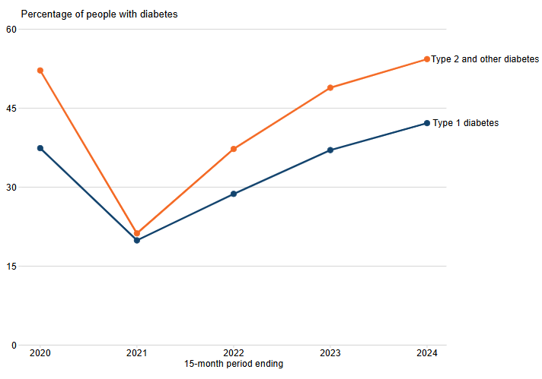
Prevalence & High-Risk Groups
UK: Nearly 4.3 million diabetic; Nearly 90 percent Type 2.
Pre-diabetes is 2 million; the incidence is on the increase among the younger adults (Kumar et al. 2021).
Risk groups: South Asian, Black African /Caribbean, obese, and deprived population.
Global: >530m adults affected.
Notes:
These statistics indicate the magnitude of the problem of primary care. The growing prevalence among the younger generation raises the risks of comorbidities in the long-term and health care requirements. Inequality based on ethnicity and socio-economic status is a contributor of an earlier onset and worse outcomes. In the case of GPs, specific case-identification, culturally sensitive recommendations and active screening among the high-risk groups are mandatory. The involvement of patients in prevention programmes, community education and lifestyle support can go a long way in the delay or prevention of Type 2 Diabetes. Annual monitoring and early diagnosis as well as constant observation are thus key functions of the general practice.

Slide 6
PREVALENCE WORLDWIDE
OVER 589 MILLION ADULTS (20-79) ARE LIVING WITH DIABETES THIS NUMBER IS PROJECTED TO RISE TO 853 MILLION BY 2050 (INTERNATIONAL DIABETES FEDERATION, 2025)
80% PEOPLE WITH DIABETES LIVE IN LOW AND MIDDLE-INCOME COUNTRIES, WHICH MAKES ACCESS TO DIAGNOSIS AND TREATMENT LIMITED (WHO, 2024)
DIABETES CAUSED 3.4 MILLION DEATHS IN 2024 (WHO, 2024)
GLOBAL EXPENDITURE RELATED TO DIABETES REACHED $1 TRILLION MARKING A 338% INCREASE OVER THE LAST 17 YEARS (IDF,2025)

Slide 7
Economic Burden
Diabetes takes nearly one out of every ten percent of NHS spending (Thelancet.com, 2025).
Preventable complications cost: CVD, CKD, amputations and blindness.
Social effects: Decreased working ability, mental distress, and lowered quality of life.
Deprivation and lack of access to care contribute to the widening of the disparities in health.
Notes:
The burden is primarily triggered by complications and not routine care. Ineffective glycaemic control enhances hospitalization, cardiac incidents and chronic impairment. This impacts on work, mental health and independence in the case of patients. Primary care, thus, is essential in lowering the future expenses as a result of systematic check-up, initial optimisation of therapy, and assisting self-management. The solutions to deprivation and provision of equal access to education, footwear, retinal screening and provision of medication should be addressed, as a way of averting the further increase in health disparities. Successful GP-led prevention eases the NHS pressures in the long term.

Slide 8
SOCIAL BURDEN
MENTAL AND EMOTIONAL STRAIN- PEOPLE WITH DIABETES STRESS ABOUT NOT GETTING THE ADEQUATE CARE, DELAYED ROUTINE CHECK-UPS
UNEQUAL ACCESS TO CARE PROCESS- THE PERCENTAGE OF PEOPLE GETTING THE 9 RECOMMENDED CARE PROCESS VARIES WIDELY IN AREAS, 38% OF PEOPLE WITH TYPE 2 DIABETES RECEIVED FULL CARE
PARTICIPATION IN STRUCTURED EDUCATION- 27% INCREASE IN DIABETES EDUCATION, BUT IT STILL REMAINS SIGNIFICANTLY LOW
(NHS, 2025

Slide 9
Diagnosis
Diagnosis: HbA1c ≥48 mmol/mol (6.5%) or fasting plasma glucose ≥7.0 mmol/L (Washirasaksiri et al. 2022).
Baseline testing BMI, BP, cardiovascular risk, foot examination, UACR, renal profile, lipids.
Lifestyle factors, mental health, and smoking.
Write down individual ambitions and protection requirements.
Notes:
NICE is encouraging the use of HbA1c as a first-line diagnostic test with clinical presentation. Having diagnosed, it is necessary to begin a detailed baseline examination to determine complications and future risk. This is to be found in foot checks, renal, retinopathy referral, lipid profile, blood pressure, and lifestyle evaluation. Record individualised goals, communication styles and obstacles favored e.g. money or language. Screening Mental health screening is essential because depression is more prevalent in diabetes and can restrict self-management. The risk-stratification and planning of holistic, individualised care by GPs is possible through early and careful evaluation.

Slide 10
Initial Assessment
INDIVIDUAL CARE- ASSESS PERSONAL NEEDS, PREFERENCES, AND CIRCUMSTANCES
CONSIDER COMORBIDITIES, RISK FACTORS, AND CULTURAL CONTEXT
CLINICAL ASSESSMENT-CONSIDER RECORD BMI, BLOOD PRESSURE, AND SMOKING STATUS
ASSESS CARDIOVASCULAR RISK (INCLUDING LIFETIME RISK FOR THOSE UNDER 40)
LABORATORY TESTS-MEASURE HBA1C FOR GLYCAEMIC CONTROL,CHECK LIPID PROFILE, RENAL FUNCTION (EGFR), AND URINARY ALBUMIN:CREATININE RATIO
CLINICAL ASSESSMENT-CONSIDER LIVER FUNCTION TESTS IF INDICATED
(NICE, 2025)

Slide 11
COMPLICATION SCREENING-ASSESS FOR NEUROPATHY, RETINOPATHY, AND FOOT RISK.
REFER FOR EYE SCREENING AND FOOT EXAMINATION
LIFESTYLE AND EDUCATION
OFFER STRUCTURED EDUCATION PROGRAMMES
PROVIDE ADVICE ON DIET, PHYSICAL ACTIVITY, AND SMOKING CESSATION
MEDICATION REVIEW
DISCUSS FIRST-LINE THERAPY (USUALLY METFORMIN, UNLESS CONTRAINDICATED)
CONSIDER CARDIOVASCULAR BENEFIT DRUGS (E.G., SGLT2 INHIBITORS) FOR HIGH-RISK PATIENTS
(NICE.ORG.UK)

Slide 12
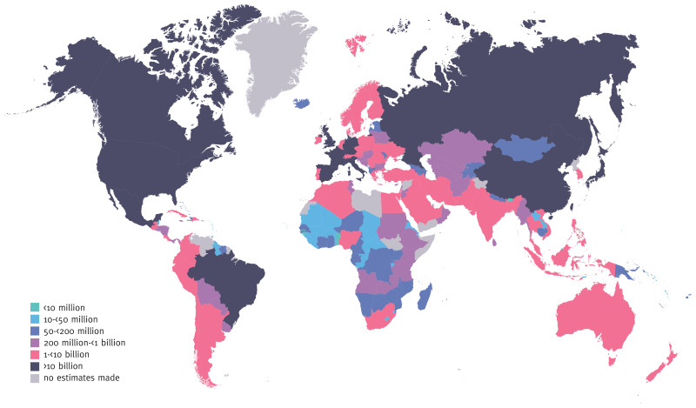
Management Framework (NICE & Models of Care)
In line with NICE NG28, QOF indicators and annual structured reviews.
Multidisciplinary services: GP, nurse, pharmacist, dietitian, podiatrist, retinal screening (Andersen et al. 2023).
Formal education: DESMOND, lifestyle education, online technologies.
Collective decision-making and individualised objective.
(WORLD HEALTH ORGANIZATION, 2025)
Notes:
Registers, recall systems and digital reminders should be utilized in primary care to make sure that annual reviews and interim checks are done. Management is closely associated with practice nurses, dietitians, podiatrist and retinal screening services. Structured education is effective in aiding behaviour change and increases glycaemic control and self-management confidence. It is also essential to combine the decision-making and especially in the selection of medications and realistic goal setting. By applying the Chronic Care Model, the GPs will be able to organize proactive and planned care instead of reactive, crisis-oriented care. Coding of high quality and continuity enhances safety and outcomes.

Slide 13
UK Specific Guidelines
NICE NG17 (Diagnosis, 2015, updated 2022):
Use HbA1c ≥48 mmol/mol as a diagnostic threshold.
Consider fasting glucose or OGTT when results are unclear (NICE, 2022a).
NICE NG28 (Management, 2015, updated 2022):
Structured education at diagnosis (DESMOND).
Review annually for complications, comorbidities, and psychosocial needs (NICE, 2022b).
NHS Long Term Plan (2019):
Prevention and personalised care are central to the diabetes strategy (NHS Long Term Plan, 2025).
QOF Indicators:
HbA1c <58 mmol/mol; BP <140/80 mmHg; annual foot & retinal screening
Notes:
NICE NG17 and NG28 together form the cornerstone of UK diabetes care, providing primary guidance for the management of Type 1 and Type 2 diabetes (Tahir et al. 2025). Ng17 emphasizes early, accurate diagnosis through the HbA1c or fasting glucose testing; however, it also urges attention to high-risk populations such as people coming from South Asian or African descent. At the same time, NG28 expands this framework into a comprehensive management which includes structured education, annual multidisciplinary review and personalised care planning.
The NHS Long Term Plan (2019) is able to reinforce prevention, which is helpful in having knowledge about obesity reduction and lifestyle support as system priorities (NHS Long Term Plan, 2025). The Quality and Outcomes Framework (QOF) operationalised these principles within primary care, connecting clinical performance indicators such as glycaemic and blood pressure control to practice for remuneration (Brown et al. 2024). Therefore, these guidelines make sure that GPs provide evidence-based and patient-centred diabetes care that might help in improving outcomes and decreasing health inequalities.

Slide 14
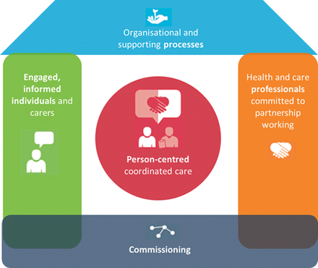
House of Care Model (Image)
BRJCARDIOL, 2023)
Notes:
NHS House of Care framework visualises the way of how integrated diabetes care should work (Reidy, 2019). The foundation represents empowered patients who are prepared by means of education and self-management tools. The left wall represents the image of skilled, well-working healthcare professionals, including GPs, nurses, pharmacists, and dietitians, who effectively communicate with patients and respect their expertise in their own conditions.
The right wall is a symbol of strong organisational systems, such as recall systems, data sharing and audit systems that facilitate continuity. Lastly, there is the roof, which is commissioning and policy: local and national frameworks, such as NICE and QOF, which put a structural backbone on the model (Sattar et al. 2022). With all components in equilibrium, the house works, but when one of them becomes weak, the care becomes disjointed. This image is an example of a whole-systems approach that is the core part of long-term coping with such a problem as Type 2 Diabetes.

Slide 15
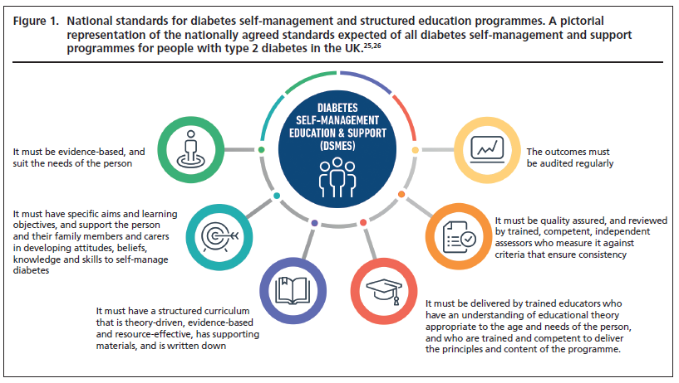
Integrating the House of Care with T2DM
COMPONENT | INTEGRATION WITH T2DM MANAGEMENT
ENGAGED PATIENT | DESMOND EDUCATION, DIGITAL GLUCOSE TOOLS, CULTURALLY TAILORED MATERIALS.
COLLABORATIVE PROFESSIONALS | GP, NURSE, PHARMACIST, DIETITIAN, AND PODIATRIST MDT REVIEWS.
ORGANISATIONAL SYSTEMS | RECALL, RISK REGISTERS, ANNUAL REVIEWS, AND DATA AUDITS.
COMMISSIONING ENVIRONMENT | NHS LONG TERM PLAN FUNDING PREVENTION AND STRUCTURED EDUCATION BY EXPANDING PERSONALISED CARE ROLES, SUCH AS HEALTH AND WELLBEING (ANDERSON ET AL. 2021).
(Abucevicz-Swick, 2024)
Notes:
The House of Care has to be integrated into diabetes practice through synergy of all four elements. Self-efficacy and glycaemic control are better with the empowerment of patients via education, DESMOND programmes or by self-monitoring via the internet (Abucevicz-Swick, 2024). The medical, nutritional and psychosocial sides of care should be interconnected, with healthcare workers working as a team; a GP-led multidisciplinary review has to be carried out. This coordination is supported by organisational systems based on patient registers, annual foot or eye check alerts, and integrated IT systems, which allow continuity in data

Slide 16
Case Study: Mr. R (55, South Asian, BMI 33)
Presentation: Fatigue, excessive thirst, and frequent urination.
Investigations: HbA1c 52 mmol/mol → Type 2 Diabetes diagnosis.
Management:
Metformin initiation + referral to DESMOND.
Dietitian & social prescribing to local walking groups.
Digital glucose tracking.
Outcome (6 months): HbA1c ↓ to 46 mmol/mol; 6 kg weight loss; improved motivation.
(Alfred and Chedgy, 2022
Notes:
The case of Mr R displays a combined primary care intervention in the early Type 2 Diabetes among a high-risk group. Being an obese 55-year-old South Asian male, he is a representative of the group with three to four time’s higher risks of developing T2DM. NG17 criteria were used in early diagnosis due to timely opportunistic testing (Alfred and Chedgy, 2022).
His GP applied metformin and formal structured lifestyle education with DESMOND following NICE NG28. Social determinants of health were tackled by referring to a dietitian and local walking group, and self-monitoring was also supported by the use of digital tracking (Misra and James, 2025).
The outcome data indicated that there was a significant increase in HbA1c and weight, which proves that the combination of medical therapy, self-management education, and community support may produce measurable outcomes.

Slide 17
Treatment Options
First-line: metformin and lifestyle change (Grammatiki et al. 2021).
Second-line: SGLT2 inhibitors, DPP-4 inhibitors, GLP-1 agonists, sulfonylureas.
Take into account renal and cardiovascular advantages.
Insulin is administered when oral therapy fails to work or in the case of symptomatic hyperglycaemia.
Notes:
The intervention must begin with lifestyle change guided by formal education and weight-management programmes. Metformin is the first-line unless it is contraindicated. SGLT2 inhibitors or GLP-1 agonists are suggested by NICE as additional protection to cardiovascular or renal disease patients in addition to glucose lowering. Patient preference, comorbidity, risk of hypoglycaemia and renal functioning should be reflected as treatment decisions. Periodic observation is made to make sure that therapy is effective and safe. There is a possibility of insulin initiation in the case of severe hyperglycaemia or progressive beta-cell failure. Regular reviews of medications prevent the occurrence of side effects and polypharmacy.

Slide 18
Comorbidities
Comorbidities refer to the presence of one or more additional diseases or conditions that coexist with a primary illness in the same individual, often complicating diagnosis, treatment, and overall patient management (Brown & Thorsteinsson, 2020; Dadan, 2023)
comorbidities Hypertension, dyslipidaemia, CKD, IHD, stroke, NAFLD, depression
Multimorbidity leads to cardiovascular risk and polypharmacy (Villen et al. 2022)
Demands combined control and specific objectives
Periodic complications screening
Notes:
Comorbidities refer to the presence of one or more additional diseases or conditions that coexist with a primary illness in the same individual, often complicating diagnosis, treatment, and overall patient management (Brown & Thorsteinsson, 2020; Dadan, 2023).The primary cause of Type 2 Diabetes mortality is comorbidities. Blood pressure control, statins, ACE-I/ARB therapy to protect the kidneys, and optimum cardiovascular risk factors should be incorporated in the integrated primary care. Depression is prevalent and can cause a lack of motivation to self-manage. Through person-centred reviews that are holistic, GPs should be able to evaluate treatment burden and ensure that they concentrate on what is most important to the patient. Serious complications are prevented by regular checking of feet, renal and retinopathy screening. Close teamwork between GP, pharmacy, cardiology and nephrology enhances positive outcomes.

Slide 19
Prevention
Population-level: Obesity prevention, physical exercise, nutritious food conditions (Bodhini et al. 2023).
Personal care: weight reduction of more than 5-10 percent, systematic lifestyle modification.
Refer patients with pre- diabetes to the NHS Diabetes Prevention Programme.
Routine screening of the high-risk groups.
Notes:
The most critical part of preventing the long-term NHS demand reduction is prevention. Patients with impaired glucose regulation can be recommended to the NHS Diabetes Prevention Programme by GPs, which can decrease the conversion to diabetes by coaching, diet change and physical activity support. Primary care interventions that are limited in time in terms of their life aspects are effective, especially when culturally oriented. Small, realistic, weight-loss goals will yield substantial glycaemic benefits. Early detection is possible through opportunistic HbA1c testing on an individual with obesity, high blood pressure or of a high-risk ethnicity. Preventing complications and costs is less expensive.

Slide 20
Co-productive Care Skills
Risk communication- MAKING SURE TO CONVY THE INFORMATION CORRECTLY TO PATIENTS AND FAMLIES
insulin initiation- Competence in starting insulin therapy safely, including dose calculation and patient education on administration techniques, monitoring
motivational interviewing- A COUNCILING TECNIQ THAT ENHANCES MOTIVATION
deprescribing – The systematic discontinuing medications that ARE NO longer beneficial or could cause harm, particularly in polypharmacy cases
(Nih.gov, 2025)
Notes:
Co-productive care involves clinicians collaborating with patients but not merely telling them. Motivational interviewing is used to assist patients to address ambivalence and make a realistic commitment to lifestyle change. Effective work with diverse communities can be achieved only because of cultural competence. The involvement in decision-making fosters compliance and trust. Reflective practice enables clinicians to adjust communication and to deal with unconscious bias. Co-productivity enhances relationships and better outcomes especially when dealing with people with complex needs. The behaviours can assist in the development of person-centred care and the subsequent alignment of NHS priorities.

Slide 21
Values
CULTURAL COMPETENCE- UNDERTSANING DIVIRSE CULTURES AND BELIEFS TO PROVIDE ADQUETE PERSONSLISED CARE
DIGNITY- TREATING EVERY PATIENT WITH WORTH, MAINTAING PRIVACY AND BEING RESPECTUFUL
RESPECT- VALUING PATIENT PREFERENCES, PERSPECTIVES, AND RIGHTS IN ALL HEALTH DECISIONS.
EQUITY- ENSURING FAIR ACCESS TO HEALTH, TREATMENT

Slide 22
Behaviours
REFLECTIVE PRACTICE- ALWAYS MONTIOR HEALTH DECISIONS AND COMMUNICATION STRAGIE TO IMRPOVE FURTURE CARE
PROACTIVE FOLLOW UP- ACTIVLY MONITOR PATEINTS AND INTERVENE EARLY WHERE NEEDED
MDT COORDINATION- COLLABORATE EFFECTIVELY WITHIN A MULTIDISCIPLINARY TEAM (MDT) TO INTEGRATE EXPERTISE FROM NURSING, PHARMACY, DIETETICS, AND SOCIAL CARE FOR HOLISTIC PATIENT MANAGEMENTS
SHARED DECISION-MAKING- ENGAGE THE PATIENT IN EVERY STEP

Slide 23
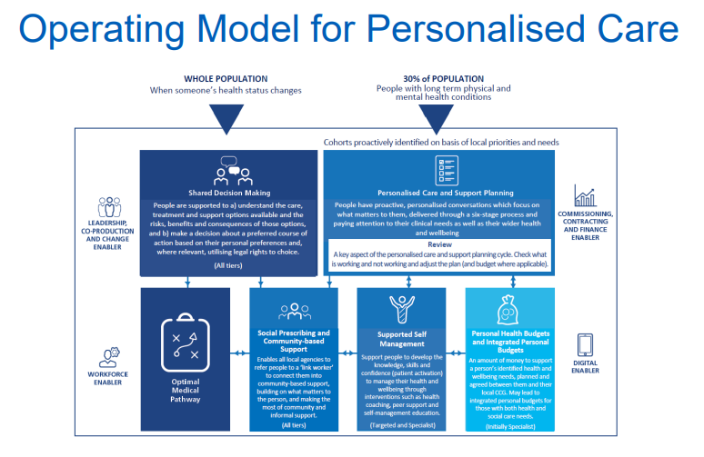
Comprehensive Model of Personalised Care (Image)
Comprehensive Model of Personalised Care (CMPC) is a national NHS strategy that ensures the care is in line with the patient's individual needs and preferences (Toffanin and Magni, 2023).
It is in line with the Long Term Plan objective of ensuring that 2.5 million people have personalised care by 2024 (NHS England, 2025).
(NHS England, 2025
Notes:
Comprehensive Model of Personalised Care (CMPC) is a national NHS strategy that ensures the care is in line with the patient's individual needs and preferences (Toffanin and Magni, 2023). It is in line with the Long Term Plan objective of ensuring that 2.5 million people have personalised care by 2024 (NHS England, 2025).
The six interdependent components it has help to empower patients and make systems more efficient. The patient is at the heart of the decisions made through shared decision-making and personalised care planning. Health literacy and social determinants are addressed by supporting self-management and social prescribing. Local and flexible interventions are made possible through community-based support and personal budgets.
In the case of diabetes, this model prompts the professionals to co-produce care plans with their patients so that they can manage diet, medications and physical activity levels, in addition to addressing barriers to care such as mental health or financial stress.

Slide 24
Integration of Six Components with T2DM
COMPONENT | DIABETES INTEGRATION EXAMPLE
SHARED DECISION-MAKING | CHOOSE BETWEEN ORAL AGENTS OR GLP-1 AGONISTS; DISCUSS RISKS AND BENEFITS.
PERSONALISED CARE PLANNING | ANNUAL GP REVIEWS CO-DESIGNED WITH THE PATIENT; SET HBA1C AND WEIGHT GOALS.
SUPPORTED SELF-MANAGEMENT | DESMOND, MYDIABETES APP, PEER SUPPORT GROUPS.
SOCIAL PRESCRIBING | REFERRALS TO DIET CLUBS, EXERCISE CLASSES, DEBT OR MENTAL HEALTH SUPPORT.
COMMUNITY-BASED SUPPORT | DIABETES UK GROUPS, LOCAL ETHNIC FOOD WORKSHOPS.
PERSONAL HEALTH BUDGETS | TAILORED FOR EQUIPMENT, TRAVEL, OR LIFESTYLE PROGRAMMES.
Notes:
The six CMPC components incorporated into the practice of diabetes can be considered truly holistic care. Shared decision-making appreciates patient autonomy, which is vital in the selection of medication courses, such as GLP-1 or SGLT2 inhibitors, depending on cardiovascular risk and lifestyle (Sannidhi et al. 2025).
A personalised care plan will transform the annual diabetes review into a conversation with goals that are realistic, measurable, and meaningful. Supported self-management fosters self-confidence, and social prescribing connects clinical care and community well-being.
Gaps in understanding and trust are closed by means of community-based resources, such as culturally specific education sessions. Personal health budgets are not universal, but they offer freedom in the process of choosing services. Together, these elements realise the promise of the NHS to patient-centred, fair management of diabetes.

Slide 25
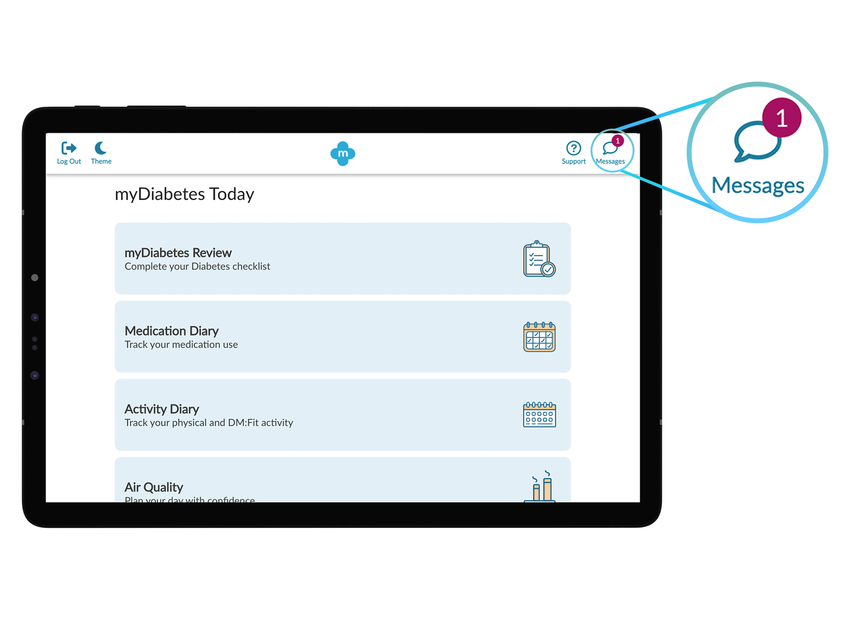
Self-Management Support
Empowerment through education: DESMOND and MyDiabetes digital platforms (My mHealth, 2025).
Behaviour change: Motivational interviewing and peer coaching.
Monitoring: HbA1c tracking, home glucose logs, wearable tech.
Outcomes: Better glycaemic control, lower hospitalisation rates
Notes:
The long-term care of diabetes is based on self-management support, which empowers individuals to manage their condition through a combination of daily behaviours actively (Rees et al. 2021). The use of education programmes such as DESMOND offers a well-organized lifestyle and disease education, which contributes to self-efficacy and adherence (Nguyen, 2025).
Digital instruments that include the MyDiabetes app and wearables that monitor glucose provide feedback in real-time and encourage interactions (My mHealth, 2025). Sustainable behavioural change is promoted by motivational interviewing and peer-led groups.
The GPs are in the middle of making these interventions stronger, which means establishing realistic goals, celebrating progress, and troubleshooting setbacks. Through making self-management a priority, health professionals can shift towards facilitation and become co-productive and person-centred, which is in line with the concept of co-productive and person-centred care.

Slide 26
Evidence-Based Six Components
Personalised care tools improve satisfaction and self-efficacy (Johnson et al. 2025).
MDT coordination reduces hospital admissions and costs (Andersen et al. 2023).
Tailored lifestyle interventions reduce diabetes onset by 40% (Bodhini et al. 2023).
Supported self-management linked to improved glycaemic control as it empowers individuals to switch from diabetes to actively managing their conditions through lifestyle choices (An et al. 2023).
Integrated primary care reduces mortality from chronic conditions by 15% (Zhang et al. 2025)
Notes:
Emerging evidence supports the six-component personalised care approach. Structured care planning and joint decision-making have a substantial impact on raising patient satisfaction and self-confidence (Johnson et al. 2025). Multidisciplinary teams are more effective when working as coordinated teams, leading to better continuity and reduced hospitalization (Andersen et al. 2023).
The efficiency of customized lifestyle programmes in the prevention or delay of T2DM, which supports the significance of prevention as part of personalised care (Bodhini et al. 2023). NHS and WHO statistics prove that integration of self-management and primary care not only enhances the outcome but also saves the system costs and mortality. All these results confirm the change to co-productive, whole-person models of care in practice in the UK.

Slide 27
Personalised Care Model & Recommendations
Implement the Comprehensive Model of Personalised Care:
  Individualised care and support planning.
  Shared decision-making.
  Social prescribing.
  Supported self-management.
  Individualised budgets (where possible).
  Workforce development (Johnson et al. 2025).
Measure improvement by audit results.
Notes:
Personalised care can be integrated into the annual diabetes review and MDT discussions within practices of GP. The agreed goals, medicines, lifestyle strategies and social support must be written down in care and support plans. The workers can be connected through social prescribing to combat loneliness, financial problems and physical activity. Self-management is improved with the help of digital tools and organized education. The development of the workforce will make the staff equipped with behaviour change and insulin titration skills. HbA1c, foot ulcer, admission, and patient-reported outcome audit can be used to prove the improvement, and inform future service development.

Slide 28
Conclusion
Type 2 Diabetes: preventable yet rising public health burden.
Primary care is vital in early detection, prevention, and long-term management.
Co-productive and personalised care enhances engagement and outcomes.
Holistic, evidence-based, and culturally competent strategies sustain the NHS vision.
Notes:
Type 2 Diabetes is a significant health issue, as well as an excellent prospect of innovation within community care. The model of personalised care frameworks integrated in the UK, including NICE NG17 and NG28, the house of care, and the Comprehensive Model of Personalised Care, enables the GPs to provide whole-person management in a proactive way.
Co-production enables patients to assume an active role in the treatment process, thus influencing their treatment trajectories. Evidence-based education and social prescribing can be used to bridge the gap between clinical excellence and lived experience by means of personalised care approaches.

Slide 29
References
Abucevicz-Swick, K. (2024). A Structured Diabetes Continuous Glucose Monitor Education Program to Improve Patient Knowledge and Self-Efficacy. West Virginia University. https://search.proquest.com/openview/2f1a0bf7b1ae95cc6a7fe80007a6d058/1?pq-origsite=gscholar&cbl=18750&diss=y
Alfred, S. and Chedgy, F. (2022). A retrospective, comparative study between Plenvu and Moviprep as bowel preparation agents for colonoscopy. Clinical Medicine, 22(Suppl 4), pp.1-1. https://ns-iframe.ggwebcast.com/rcp/medicine2022/abstracts/booklets/Med22_Clinical_abstracts_booklet.pdf
An, L., Yeh, K.C., Liu, Y., Wang, D., Li, X., Tang, Q. and Lu, J. (2023). An online structured diabetes self-management education and support programme improves glycaemic control in young adults with type 1 diabetes. Journal of Multidisciplinary Healthcare, pp.2641-2654. https://www.tandfonline.com/doi/abs/10.2147/JMDH.S414102
Andersen, J.D., Jensen, M.H., Vestergaard, P., Jensen, V., Hejlesen, O. and Hangaard, S., (2023). The multidisciplinary team in diagnosing and treatment of patients with diabetes and comorbidities: a scoping review. Journal of multimorbidity and comorbidity, 13, p.26335565231165966. available at: https://journals.sagepub.com/doi/pdf/10.1177/26335565231165966
Anderson, M., O'Neill, C., Clark, J.M., Street, A., Woods, M., Johnston-Webber, C., Charlesworth, A., Whyte, M., Foster, M., Majeed, A. and Pitchforth, E. (2021). Securing a sustainable and fit-for-purpose UK health and care workforce. The Lancet, 397(10288), pp.1992-2011. https://www.thelancet.com/journals/lancet/article/PIIS0140-6736(21)00231-2/abstract
Bodhini, D., Morton, R.W., Santhakumar, V., Nakabuye, M., Pomares-Millan, H., Clemmensen, C., Fitzpatrick, S.L., Guasch-Ferre, M., Pankow, J.S., Ried-Larsen, M. and Franks, P.W., (2023). Impact of individual and environmental factors on dietary or lifestyle interventions to prevent type 2 diabetes development: a systematic review. Communications medicine, 3(1), p.133. available at: https://www.nature.com/articles/s43856-023-00363-0.pdf
Brown, V.T., Hayre, J. and Ford, J. (2024). Opting out of the Quality and Outcomes Framework (QOF) and impact on practices’ performance. Public Health in Practice, 8, p.100526. https://www.sciencedirect.com/science/article/pii/S2666535224000636
Devi, K.B.L., Meitei, K.T. and Singh, S.J., (2023). Prevalence of type 2 diabetes and its signs and symptoms among the Meiteis of Manipur, India. Journal of the Anthropological Survey of India, 72(1), pp.59-70. Available at: https://www.researchgate.net/profile/Soibam-Jibonkumar/publication/366514519_Prevalence_of_Type_2_Diabetes_and_Its_Signs_and_Symptoms_Among_the_Meiteis_of_Manipur_India/links/63a483b8c3c99660eb972e80/Prevalence-of-Type-2-Diabetes-and-Its-Signs-and-Symptoms-Among-the-Meiteis-of-Manipur-India.pdf
Galicia-Garcia, U., Benito-Vicente, A., Jebari, S., Larrea-Sebal, A., Siddiqi, H., Uribe, K.B., Ostolaza, H. and Martín, C., 2020. Pathophysiology of type 2 diabetes mellitus. International journal of molecular sciences, 21(17), p.6275. https://www.mdpi.com/1422-0067/21/17/6275
Grammatiki, M., Sagar, R. and Ajjan, R.A., (2021). Metformin: is it still the first line in type 2 diabetes management algorithm?. Current Pharmaceutical Design, 27(8), pp.1061-1067. Available at: https://www.ingentaconnect.com/content/ben/cpd/2021/00000027/00000008/art00008
APA PsycNet (2025). https://psycnet.apa.org/record/2020-93379-001.

Slide 30
References
Johnson, L., Clark, B., Court, L., Kirk, H., Wood, M., Jackson, S. and Portillo, M.C., (2025). What instruments are available to aid or evaluate personalised care delivery, from the perspectives of healthcare practitioners and service users? A narrative scoping review. PLoS One, 20(7), p.e0325833. available at: https://journals.plos.org/plosone/article/file?id=10.1371/journal.pone.0325833&type=printable
Kumar, P., Srivastava, S., Mishra, P.S. and Mooss, E.K., (2021). Prevalence of pre-diabetes/type 2 diabetes among adolescents (10–19 years) and its association with different measures of overweight/obesity in India: a gendered perspective. BMC endocrine disorders, 21(1), p.146. available at: https://link.springer.com/content/pdf/10.1186/s12902-021-00802-w.pdf
Misra, R. and James, D. (2025). The role of dietary tracking on changes in dietary behaviour in a community-based diabetes prevention and management intervention. Public Health Nutrition, 28(1), p.e73. https://www.cambridge.org/core/journals/public-health-nutrition/article/role-of-dietary-tracking-on-changes-in-dietary-behavior-in-a-communitybased-diabetes-prevention-and-management-intervention/E6ABA37637328B0F395A53C44095FDB3
My mHealth, (2025), myDiabetes: The diabetes app that helps you take control. Available at: https://mymhealth.com/mydiabetes [Accessed on 10/11/2025]
Nguyen, H. (2025). The impact of lifestyle changes and self-management on type 2 diabetes. https://www.theseus.fi/handle/10024/893569
NHS England, (2025), Personalised care. Available at: https://www.england.nhs.uk/personalisedcare/ [Accessed on 10/11/2025]
NHS Long Term Plan, (2025), NHS Long Term Plan. Available at: https://www.longtermplan.nhs.uk/ [Accessed on 10/11/2025]
NICE, (2022a), Type 1 diabetes in adults: diagnosis and management. Available at: https://www.nice.org.uk/guidance/ng17 [Accessed on 10/11/2025]
NICE, (2022b), Type 2 diabetes in adults: management. Available at: https://www.nice.org.uk/guidance/ng28 [Accessed on 10/11/2025]
Nih.gov, (2025). How Patients with Type 2 Diabetes Mellitus Respond to Motivational Interviewing. Available at: https://pmc.ncbi.nlm.nih.gov/articles/PMC3686502/#:~:text=Patients%20generally%20prefer%20a%20patient,patient%2C%20encouraging%20hope%20and%20optimism. [Accessed on 9th October, 2025]
Rees, J., Tuijt, R., Burton, A., Walters, K. and Cooper, C. (2021). Supporting self-care of long-term conditions in people with dementia: A systematic review. International Journal of Nursing Studies, 116, p.103432. https://www.sciencedirect.com/science/article/pii/S0020748919302391
Reidy, C (2019). The factors that support people living with Type 1 diabetes to incorporate an insulin pump into their everyday lives. https://www.researchgate.net/figure/The-House-of-Care-Model-NHS-England_fig10_348555512
Rosana, M. et al. (2025) 'Risk factors for peripheral arterial disease in type 2 diabetes mellitus patients: A systematic review and meta-analysis,' Diabetes Research and Clinical Practice, 224, p. 112170. https://doi.org/10.1016/j.diabres.2025.112170.
Sannidhi, D., Abeles, R., Andrew, W., Bonnet, J.P., Vitale, K., Niranjan, V., Gulati, M., Pauly, K., Moran, R., Alexander, L. and Le, C. (2025). Lifestyle Medicine for Obesity in the Era of Highly Effective Anti-Obesity Treatment. Nutrients, 17(14), p.2382. https://www.mdpi.com/2072-6643/17/14/2382
Sattar, Z., Young-Murphy, L., Craig, L., Steven, A. and Wilson-Menzfeld, G. (2023). Frailty nurse and GP-led models of care in care homes: the role of contextual factors impacting Enhanced health in care homes framework implementation. BMC geriatrics, 23(1), p.69. https://link.springer.com/article/10.1186/s12877-023-03742-3
Tahir, W., Beba, H., Fortes-Mayer, G., Kar, P., Khan, N., Milne, N., Moore, J., Saha, S. and Atkin, M. (2025). Expert consensus on solutions to improve implementation of NICE type 2 diabetes guideline (NG28) by health systems in England: a Delphi panel by the INNOVATE-28 Working Group. BMJ open, 15(6), p.e093955. https://bmjopen.bmj.com/content/15/6/e093955.abstract
Thelancet.com, (2025). Diabetes-related complications: a toll too high. Available at: https://www.thelancet.com/journals/landia/article/PIIS2213-8587(24)00246-8/fulltext#:~:text=According%20to%20research%20from%20the,effects%20on%20people%20with%20diabetes. [Accessed on 6th October, 2025]
Moran, G.M. et al. (2022) 'Type 2 diabetes: summary of updated NICE guidance,' BMJ, 377, p. o775. https://doi.org/10.1136/bmj.o775.

Slide 31
References
Toffanin, C. and Magni, L. (2023). Personalized constrained MPC for glucose regulation. IFAC-PapersOnLine, 56(2), pp.9648-9653. https://www.sciencedirect.com/science/article/pii/S2405896323006237
Villén, N., Roso-Llorach, A., Gallego-Moll, C., Danes-Castells, M., Fernández-Bertolin, S., Troncoso-Mariño, A., Monteagudo, M., Amado, E. and Violán, C., (2022). Polypharmacy patterns in multimorbid older people with cardiovascular disease: longitudinal study. Geriatrics, 7(6), p.141. available at: https://pmc.ncbi.nlm.nih.gov/articles/PMC9777651/pdf/geriatrics-07-00141.pdf
Washirasaksiri, C., Srivanichakorn, W., Borrisut, N., Sitasuwan, T., Tinmanee, R., Kositamongkol, C., Ariyakunaphan, P., Auesomwang, C., Sayabovorn, N., Chaisathaphol, T. and Phisalprapa, P., (2022). Fasting plasma glucose and HbA1c levels predict the risk of type 2 diabetes and diabetic retinopathy in a Thai high-risk population with prediabetes. Frontiers in pharmacology, 13, p.950225. available at: https://www.frontiersin.org/journals/pharmacology/articles/10.3389/fphar.2022.950225/pdf
WORLD HEALTH ORGANIZATION (2001) Surveillance of risk factors for noncommunicable diseases
Zhang, Y., Stokes, J., Anselmi, L., Bower, P. and Xu, J. (2025). Can integrated care interventions strengthen primary care and improve outcomes for patients with chronic diseases? A systematic review and meta-analysis. Health Research Policy and Systems, 23(1), p.5. https://link.springer.com/article/10.1186/s12961-024-01260-1

Slide 32




