Slide 1


BUSINESS PLAN
Student name: Marin Karakolev ID 2029731
Lecturer name: Essa Bah

Slide 2

Our mission statement:
“Our company uses a professional approach to the services we provide, and the result is quality landscapes created with individual attention. Working with a hands-on approach based on our knowledge we offer individual attention with a personalized touch.”

Slide 3

"Landscaping Business” located at Walsall offers residential and commercial landscaping care and maintenance services.
We will provide various landscaping care and maintenance services.
Small-scale landscape design
Tree cultivation and management
Pruning
Lawn protecting
Lawn mowing
Spring maintenance
Leaf removal

Slide 4
Legal format of the company.
“Landscape business” is a Sole Trader company. One of the advantages of a sole trader is the ease of starting and managing the business. There is no need to create a board of directors. Sole traders can take money out of the business when they need it. These drawings can be entered as wages in the self-assessment tax return (Tuchbands, 2023).
Management of the company
The owner of the company Marin Karakolev will be the director of the company. In the beginning, the owner will work alone. The company will not have commercial premises, it will be a home-based business. The company will not hire an accountant in the beginning, the owner will make accounting using his previous experience. The company will pay some web designers to make the company website.

Slide 5
SWOT is a popular 4 component framework used for analysis and development strategy. The acronym SWOT comes from Strengths, Weaknesses, Opportunities, and Threats (Sarsby, 2016).
A SWOT analysis is a business strategy tool allowing to make a comparative assessment of an organization against the competition (Teoli, 2022).

Slide 6
Strengths: High demand for landscaping services in the area due to an increase in new home construction. Usually, the profit margins are high for this business. The business provides the opportunity to build long-term relationships with customers, which can create a source of regular income through support contracts. There is potential to expand the services offered in the future. | Weaknesses: Intense competition. Seasonal business. Opportunities for differentiation in a crowded market are limited. Overhead costs are high.
Opportunities: Entering new markets such as ecological landscaping. Connecting with potential customers through social media and building a website. Expansion of the offered services depends on the demand and needs of the customers. Introducing a referral program. | Threats: Economic fluctuations in the real estate market. The intense competition in the market from old and reputable companies as well as from new entrants. Changes in water use regulation and environmental standards. Increase in labour and equipment maintenance costs.

Slide 7
The marketing mix consists of four components that must be analysed before launching a new product. These are product, price, place, and promotion (Singh, 2012).
Product: The business must offer high-quality services, using ecological and sustainable materials, offer customized solutions and comply with the specific wishes of each customer. | Price: Pricing is an essential element of the marketing mix. Our business, analysing the prices and quality of competitors, must offer competitive prices without compromising on the quality of services. This way we will attract a large customer base.
Promotion: We will use various strategies to promote the business such as social media advertising, email marketing, using referral programs, and participating in various local events. | Place: We need to reach out to potential customers in our community by using social media, handing out flyers, and meeting potential customers face-to-face to promote our business.

Slide 8
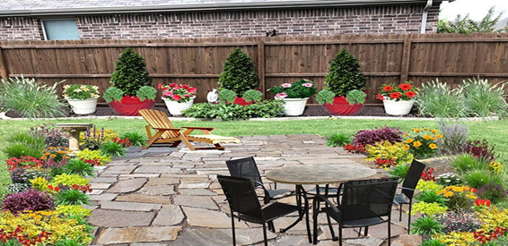
(Calloway's, 2022)
Target market.
A target market is a group of clients from a demographic area that can be identified as the users of the company's service (Team, 2023).
Landscaping's target market may vary depending on the services offered and the location. any of these target markets include:
1. Homeowners who need care and maintenance of their outdoor spaces.
2. Commercial customers, these are various shopping centers, office buildings, hotels, etc.
3. Government sites, such as public green spaces, parks, and recreation areas
4. Companies for the management of residential buildings and other properties.
5. Companies engaged in organizing various events such as weddings, company gatherings, etc.

Slide 9

Marketing strategies
Creating a website
Unique services that are rarely offered by our competitors
Distribution of advertising leaflets
Introducing a referral program
Competitive prices
Social media advertising

Slide 10

References:
1. Calloway's (2022) Calloway's Landscape Design & Installation Services, Calloway's Nursery. Available at: https://www.calloways.com/garden-services/landscape-design-installation-services/ (Accessed: February 20, 2023).
2. Sarsby, A. (2016) SWOT ANALYSIS: A GUIDE TO SWOT for business studies students. Spectaris Ltd.
3. Singh, M. (2012) “Marketing mix of 4P’s for competitive advantage,” IOSR Journal of Business and Management, 3(6), pp. 40–45. Available at: https://doi.org/10.9790/487x-0364045.
4. Teoli, D. (2022) Europe PMC. StatPearls Publishing, Treasure Island (FL). Available at: https://europepmc.org/article/MED/30725987 (Accessed: February 24, 2023).
5. Tuchbands (2023) 7 key advantages to working as a sole trader, Bytestart. Available at: https://www.bytestart.co.uk/advantages-sole-trader-versus-limited-company (Accessed: February 19, 2023).
( Calloway's 2022 )

