Slide 1
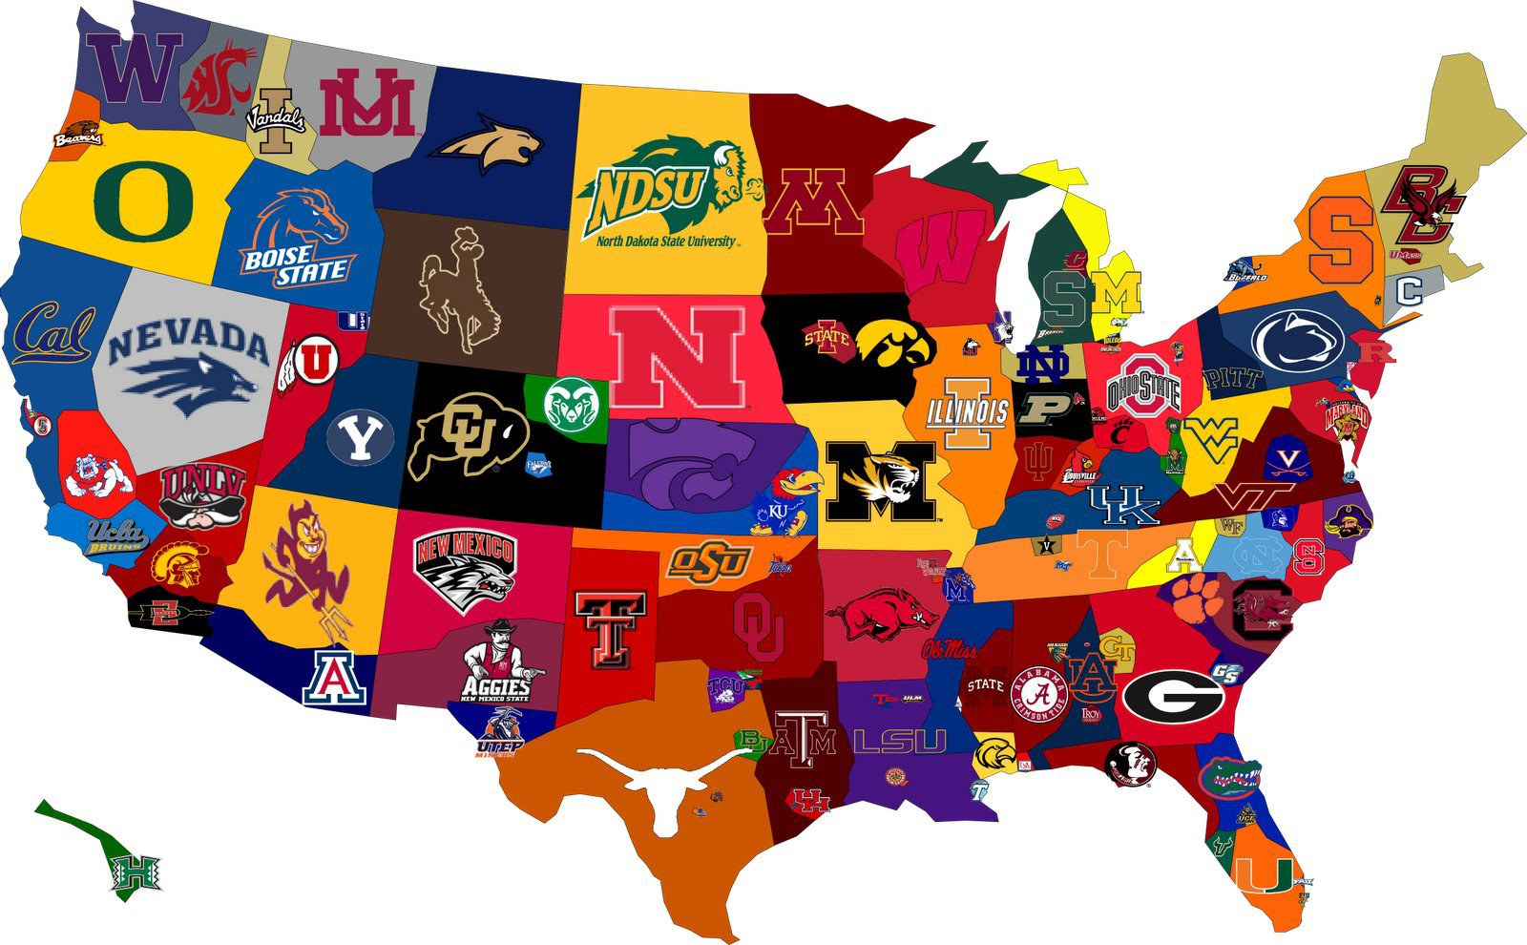
USA College Sport

Slide 2

Last Week
Past, Future and Present Facilities
Technology in Sport and Stadiums.
Students to present back findings- Man UTD / Lakers

Slide 3
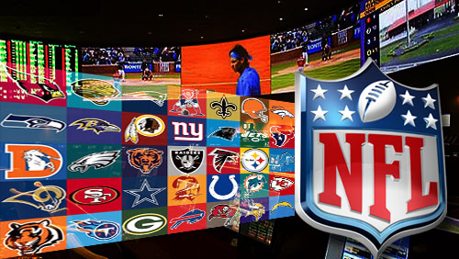
Today’s Lesson
An overview into college sport and the NCAA
A basic understanding of the transition process between college sport and major leagues
The financial implications of the NCAA
A debate involving student athletes wages.

Slide 4










Sport In North America

Slide 5
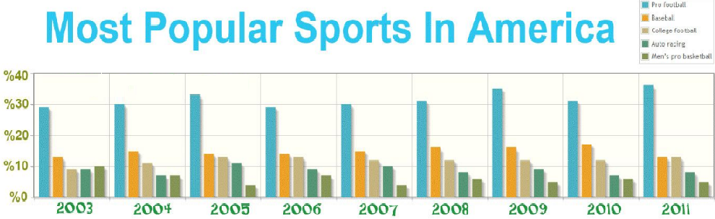

Slide 6
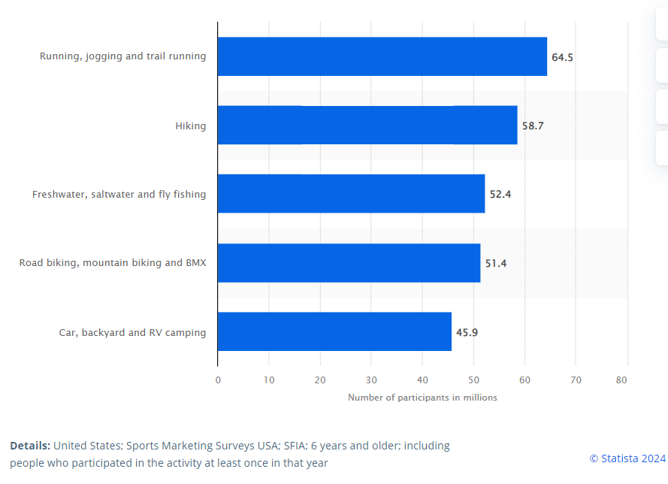

Slide 7
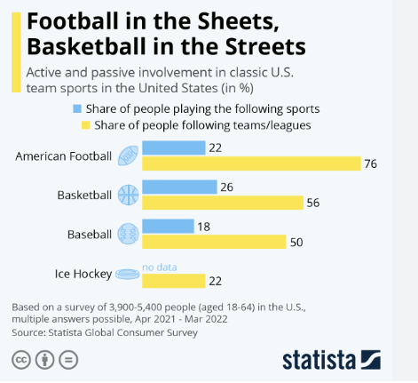

Slide 8
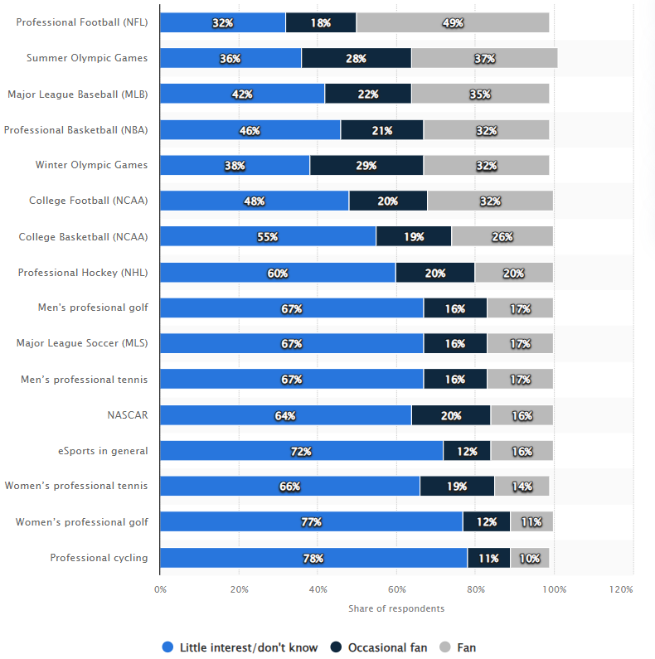
Level of interest in selected sports in the United States as of February 2022

Slide 9
USA College Sports vs UK Sport
Highly structured
Commercialised
Students input is minimal
Paid professional staff
Somewhat structured
Commercialised, non-profit
All input is student -led
Coaches are usually students.
This is changing slowly

Slide 10
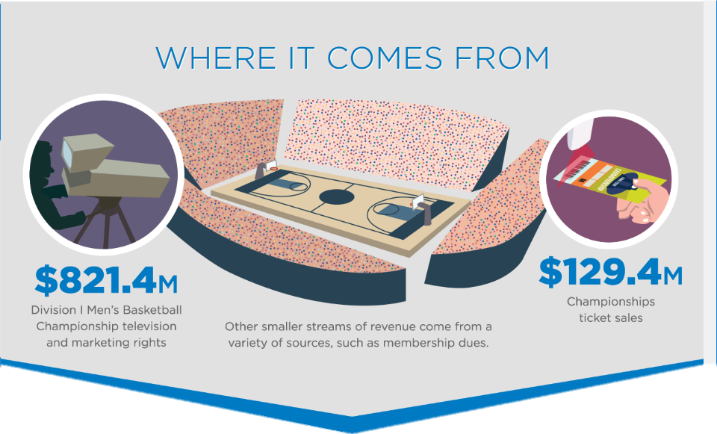
NCAA
National Collegiate Athletic Association
Governing body of Intercollegiate Athletics
  Field Hockey, Volleyball, Water Polo, Bowling, Gymnastics, Skiing, Cross Country, Fencing, Wrestling, Golf, Lacrosse, Rowing and Tennis.
Not for Profit Organisation
  Controversial

Slide 11
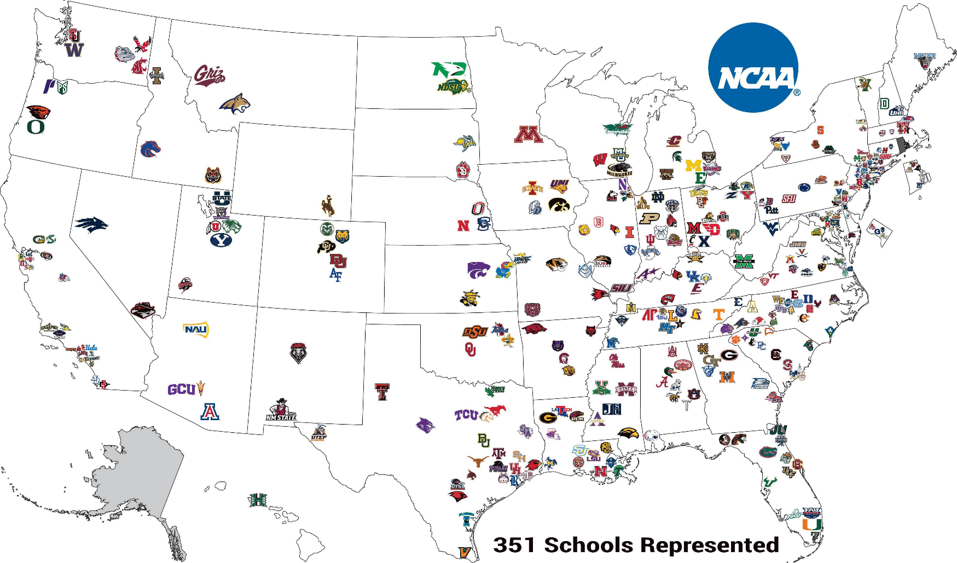
NCAA Divisions
Division I
  Division I schools generally have the biggest student bodies, manage the largest athletics budgets and offer the most generous number of scholarships
  Over 350 colleges. 6,000 athletic teams. Opportunities for more than 170,000 student-athletes to compete in NCAA

Slide 12
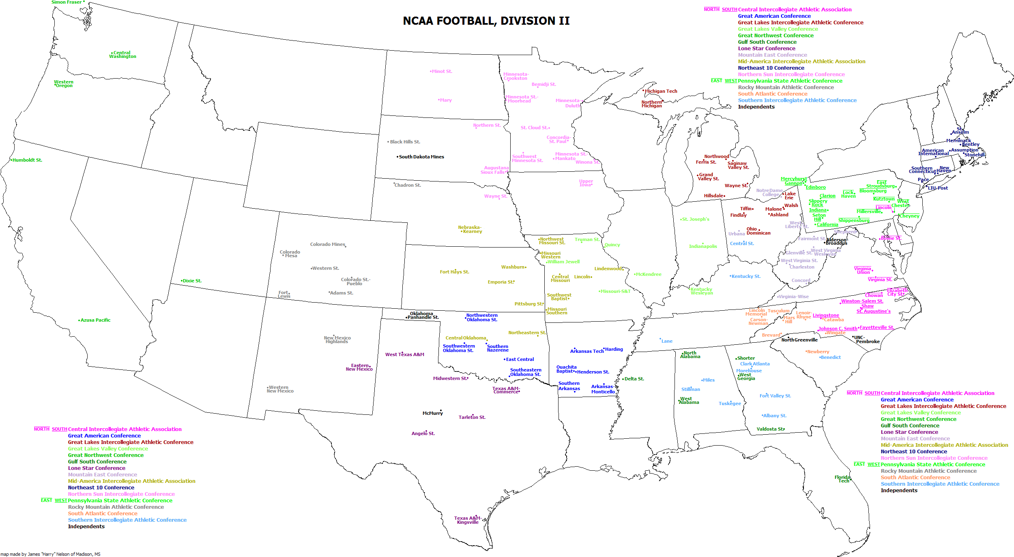
NCAA Division II
More than 300 NCAA colleges and universities that provide thousands of student-athletes the opportunity to compete at a high level of scholarship athletics while excelling in the classroom and fully engaging in the broader campus experience.
Institutions in Division II generally don’t have the financial resources to devote to their athletics programs or choose not to place such a heavy financial emphasis on them.

Slide 13
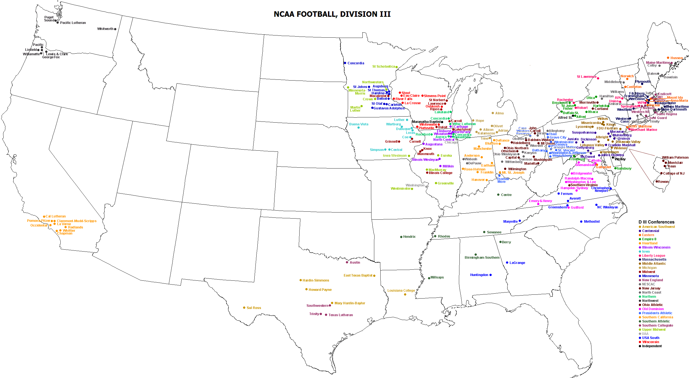
NCAA Division III
More than 190,000 student-athletes at 450 institutions make up Division III, the largest NCAA division both in number of participants and number of schools.
The division minimizes the conflicts between athletics and academics and helps student-athletes progress toward graduation through shorter practice and playing seasons and regional competition that reduces time away from academic studies

Slide 14
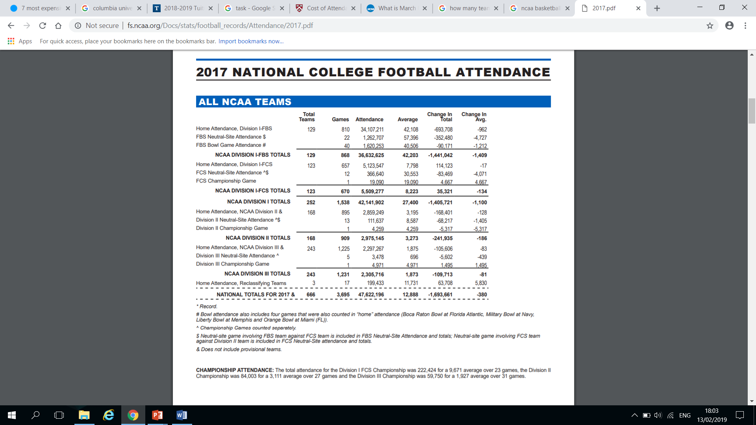

Slide 15
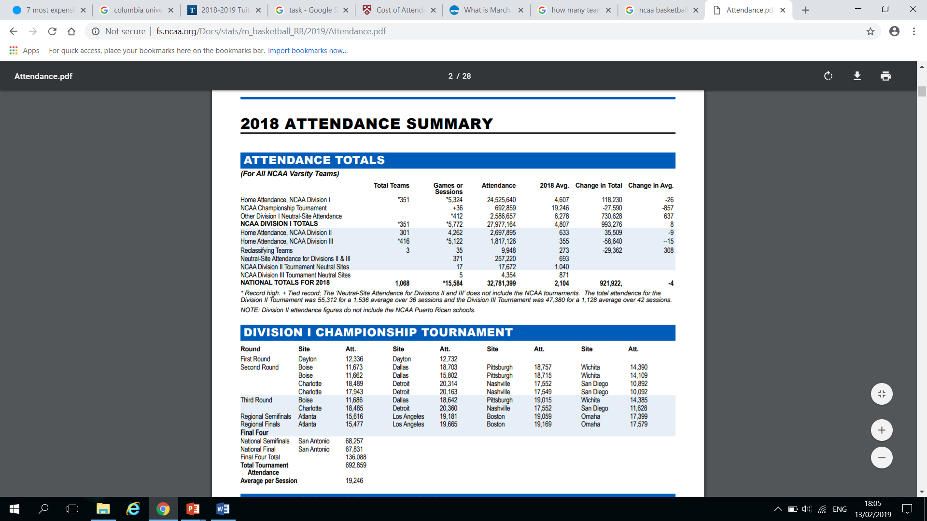
Basketball

Slide 16

Swansea vs Cardiff
30 sporting events
Average of 30,000 a year.
Sport Swansea is growing and there are big future plans
Cardiff MET- Recent UEFA Europa League
Changes are coming
Pandemic?

Slide 17

Cost of Colleges Task
Have a guess- What are the top 5 most expensive colleges in America and what price they might be to attend on a annual basis.

Slide 18





Costs of colleges (Top 5 2018)
Including Tuition Fees, Room and Board, Books and supplies and any other expenses.
$54,340
$71,710
34%
Acceptance
National ranking: 44
$48,759
$78,852
8%
Acceptance
National ranking: 3
$56,331
$76,953
13%
Acceptance
National ranking: 12
$56,130
$72,750
28%
Acceptance
National ranking: 12
$57,208
$74,173
6%
Acceptance
National ranking: 5

Slide 19



Case Studies Tuition Fees
$37,128
$49,352
51.3%
Acceptance
National ranking: 66
$35,478
$51,870
74%
Acceptance
National ranking: 102
$29,230
$50,032
54%
Acceptance
National ranking: 129

Slide 20
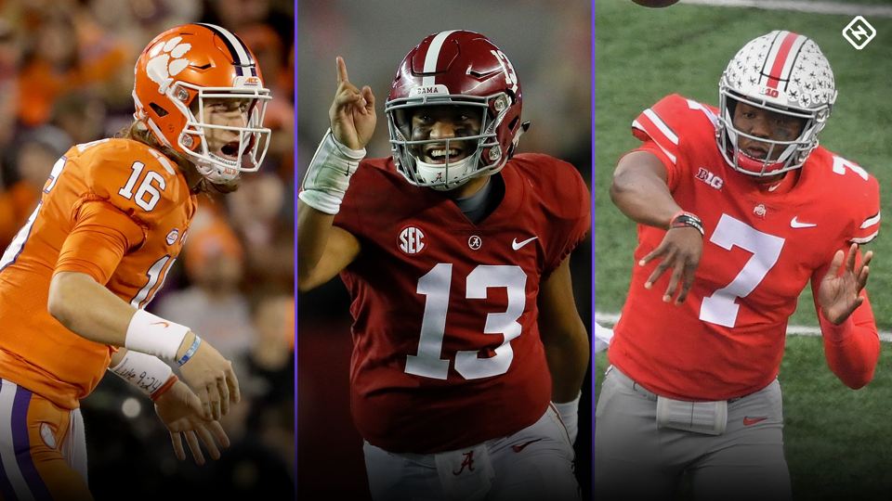
NCAA College Football
4 levels of college football in the NCAA.
  Football Bowl Subdivision (FBS)
    124 Teams
    11 Conferences
    Southeastern Conference (SEC) – reputation as being the best. (14 members – Alabama)
  Football Championship Subdivision (FCS)
  Division II
  Division III
  1.6% make it to Pro.

Slide 21
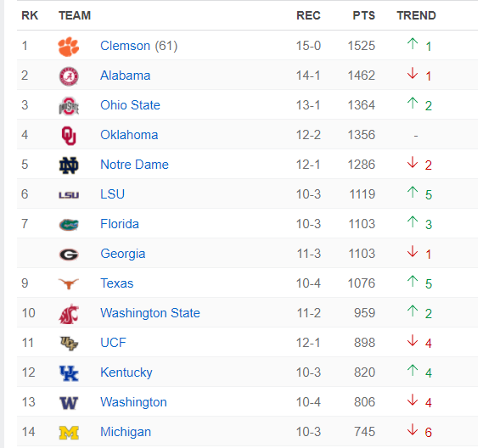
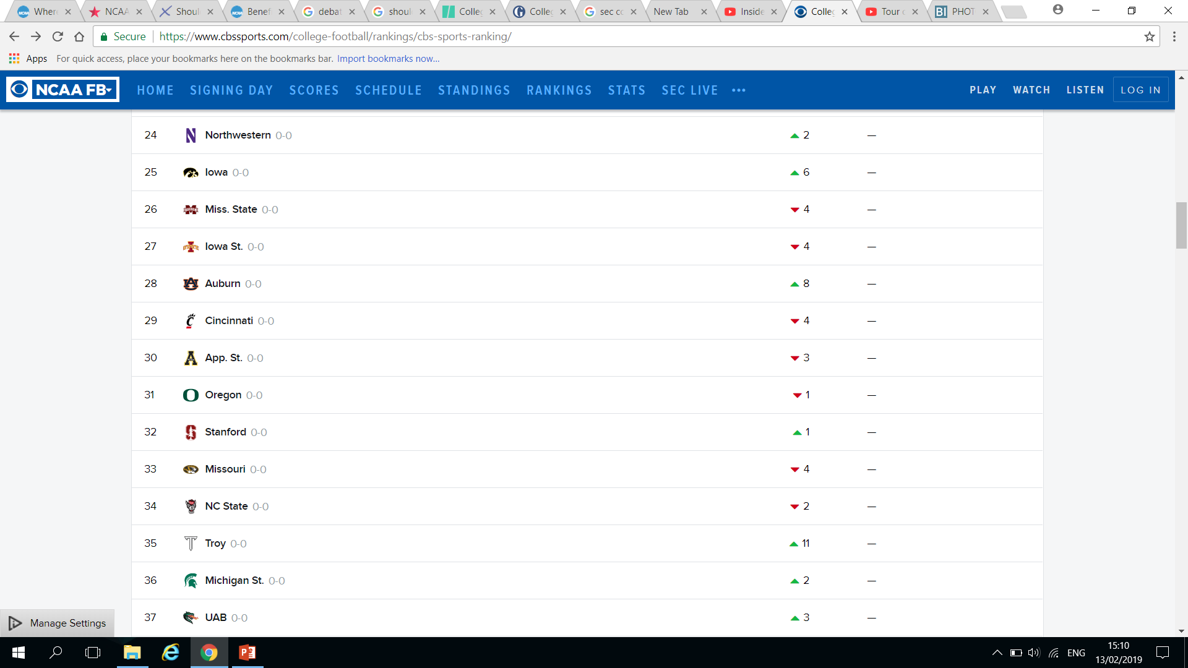
FBS Rankings – Playoff National Championship
Alabama lost against Clemson. 44-16 (7.01.2019)
2015 – Alabama
2016– Clemson
2017 – Alabama
2018 – Clemson
2019-LSU
2020-Alabama
2021-Georgia

Slide 22

Facilities
https://www.youtube.com/watch?v=Rwy0ccHjfg0
2017, $55 million.
2017 came 1st
2018 came 2nd
https://www.youtube.com/watch?v=-xSlBX32jx0
2013, $68 million
2014 came 2nd

Slide 23

Alabama
https://www.youtube.com/watch?v=Ivz6cUkltFI (stop at 2.49minutes)
Stadium go from 101,821 seats to sub 100,000 with a new video board.
$600 million plan to upgrade the facilities
  $75.5million for part of Phase I starting in 2019, changing seats for technology in the football stadium

Slide 24


UK – USW case study
£15m Sports Park ($19m)
4G playing field
Strength and conditioning laboratory with 12 stations
Observation area overlooking the pitches
Cardiff Academy base
Welsh FA – Training centre
Newport Gwent Dragons
Regional and national squads

Slide 25

NFL Draft System
32 clubs receive 1 pick
7 rounds of the NFL draft
Order of selection is determined by the reserve order of finish in the previous season.
https://www.youtube.com/watch?v=Q9TwotB878w

Slide 26
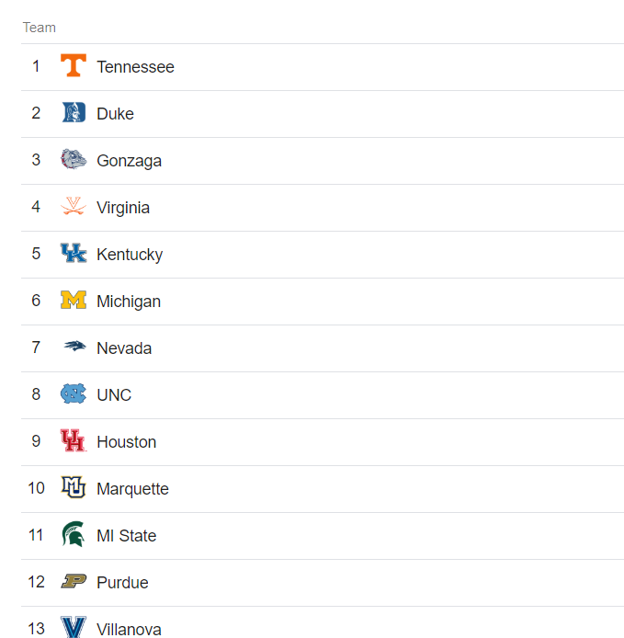
NCAA Basketball
347 Division I college basketball teams.
Each team offers 13 scholarships
4,511 Division I college basketball players
NCAA senior players drafted by an NBA team; Less than one in 75, or 1.3 percent.
68 teams make it to March Madness

Slide 27

NCAA Basketball – March Madness
Single –elimination tournament of 68 teams.
2019 – March 17th to April 6th /8th
2018 – Villanova
2017- North Carolina
2016- Villanova
2015- Duke
CBS and Time Warner’s Turner $8.8 billion broadcasting deal until 2032.
https://www.youtube.com/watch?v=qQJNMlvSLek

Slide 28
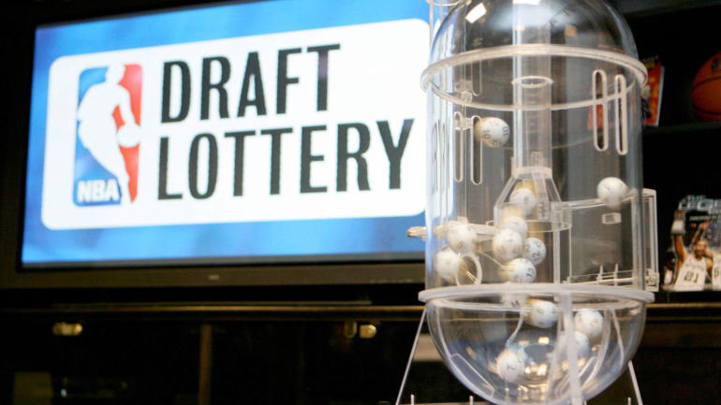
NBA Lottery Draft Pick
14 Balls, one combination to assign 1st pick
The lottery is used for the 14 teams that did not make the playoffs.
The team with the worst records will pick no lower than fourth
After 1st, 2nd and 3rd get picked, the lottery teams will continue to pick in reverse order of their season record.

Slide 29

NCAA Funding
$821.4M (March Madness) $129.4M (Ticket sales)
$210.8M Division I Sponsorship and Scholarship Funds
$160.5M Division I Basketball Performance Fund
$96.7M Division I championships (travel, food, accommodation)
$82.2M Student Assistance Fund
$42.3M Division II Allocation
$28.2M Division III Allocation

Slide 30
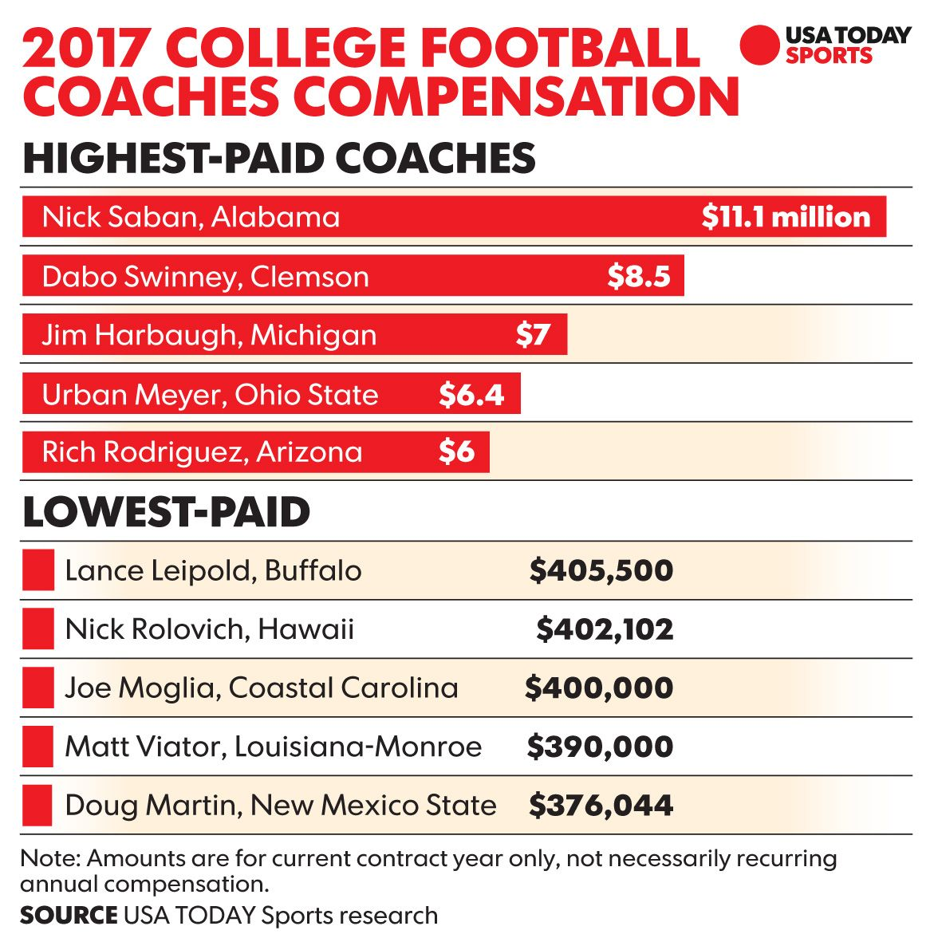
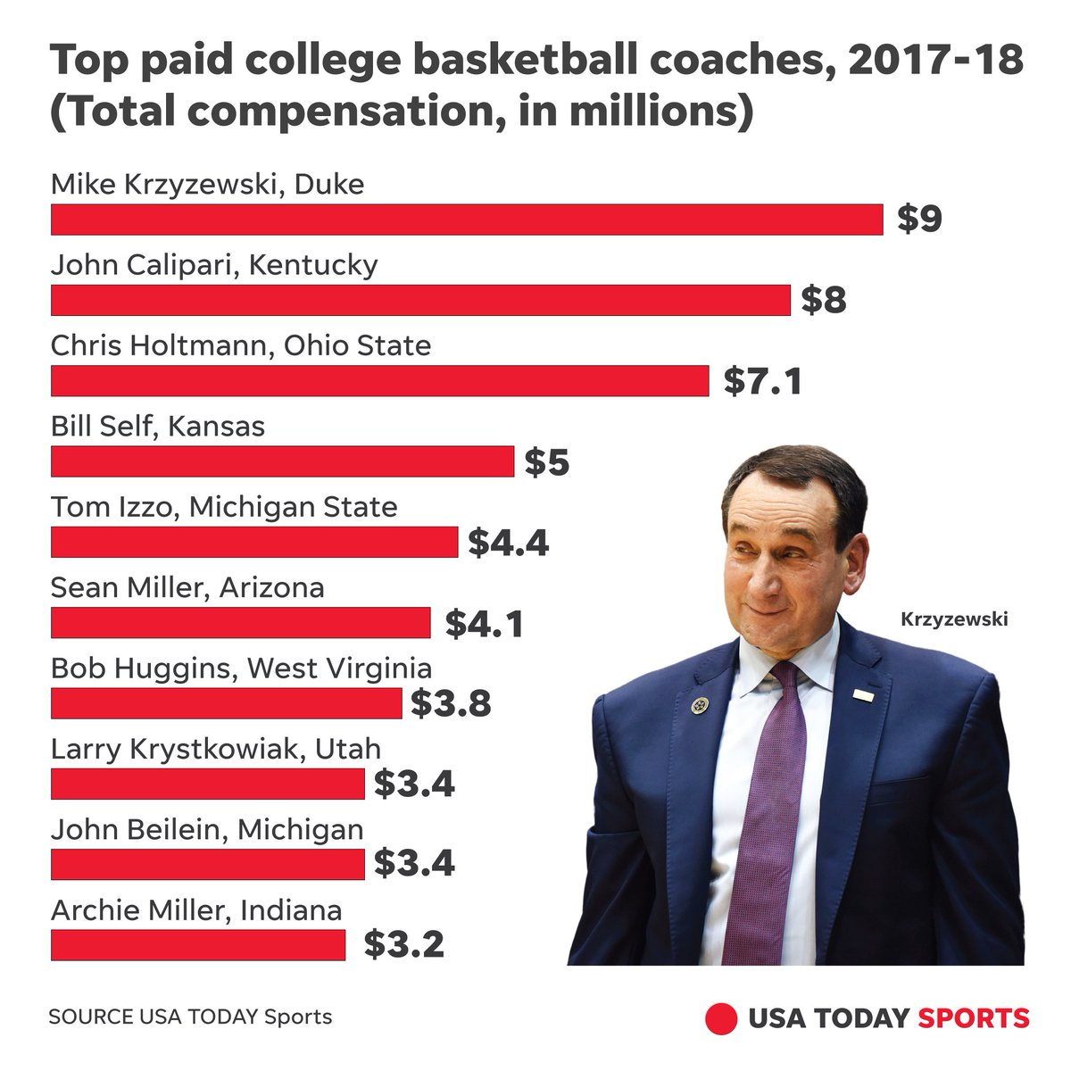
Coaches Salaries

Slide 31
Student Athlete “Salaries”
1. College Education. NCAA research shows 15 percent of Division I student-athletes are first-generation college students.
2. Academic Success. College student-athletes graduate at rates higher than college students in general.
3. Scholarships. A full men’s basketball scholarship can be worth at least $120,000 per year
4. Student Assistance Fund. Clothes, training gear and family tragedies.
5. Academic and Support Services. Technology and tutoring.
6. Medical care.
7. Elite Training Opportunities. Facilities, equipment and coaching.
8. Healthy Living. Free food, nutritionist and dieticians.
9. Exposure and Experiences. Travelling for competitions and conferences.
10. Preparation for Life. Leadership, Time management and collaboration.

Slide 32
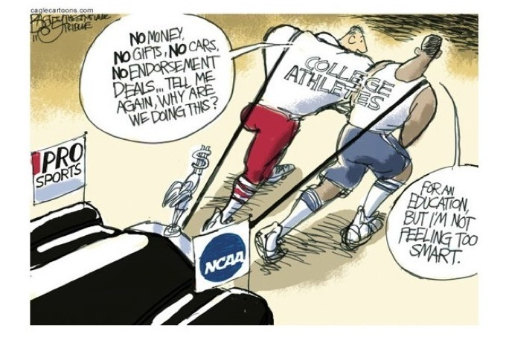
Should Students- athletes get paid?
Being an athlete on its own is a full time job – weight room, court/field and competitions.
Athletes miss college for competitions and national television time.
Athletes are the ones represented in the advertising deals.
Coaches and universities administrations are the ones making money from the athletes games.
Coaches also receive bonuses for breaking records, reaching the off season and winning big games. And the players do not.

Slide 33

Should student –athletes get paid?
Taking into consideration the funding and money provided to the NCAA, do you think student-athletes should get paid?
2x Teams
Write down points for / against students getting paid
You have 20 minutes.

Slide 34
Assignment
TASK A (5000 maximum)
Students will submit an individual report.
Critically evaluate the Professional Team Sport environment and ascertain the differences between the US and the UK model? Additionally, consider if their relationship is getting closer or more distant.
NOTE: Traditionally we have thought of the English model as being characterised by ‘utility maximisation’ (winning on the pitch) and the American by ‘profit maximisation’.
Consider the following key emerging themes:
Club ownership
League Structure
Merchandising and sponsorship
TV Broadcasting rights
Globalisation
Stadiums
Report format required with a structured contents page and
A range of references from a variety of credible sources.

