Slide 1
Cofrestru a Rheoleiddio’r Gweithlu

Slide 2
Trosolwg
CGA a rheoleiddio er budd y cyhoedd
Cofrestru ymarferwyr
Cod Ymddygiad ac Ymarfer Proffesiynol
Dyfarnu SAC
Gwasanaethau eraill gan CGA

Slide 3












Rheoleiddio er budd y Cyhoedd
3

Slide 4
CGA: Swyddogaethau Statudol
Cynnal ffydd a hyder y cyhoedd, a diogelu dysgwyr, rhieni a’r cyhoedd
  Cadw Cofrestr
  Cod Ymddygiad ac Ymarfer Proffesiynol
  Ymchwilio a gwrando achosion am ymddygiad ac ymarfer
Achredu rhaglenni cychwynnol Athrawon Ysgol
Cyngor i Lywodraeth Cymru am grwpiau cofrestreion ac addysgu a dysgu
Gwaith ychwanegol ar ran Llywodraeth Cymru
  Dyfarnu SAC a Sefydlu. Apeliadau Sefydlu
  Gweinyddu systemau ariannu a chofnodi ar gyfer Sefydlu a’r MYA
  Pasbort Dysgu Proffesiynol
  Hyrwyddo gyrfaeodd
  Ysgrifenyddiaeth annibynnol IWPRB
  Arall e.e. prosiectau ymchwil, dadansoddi data
4

Slide 5
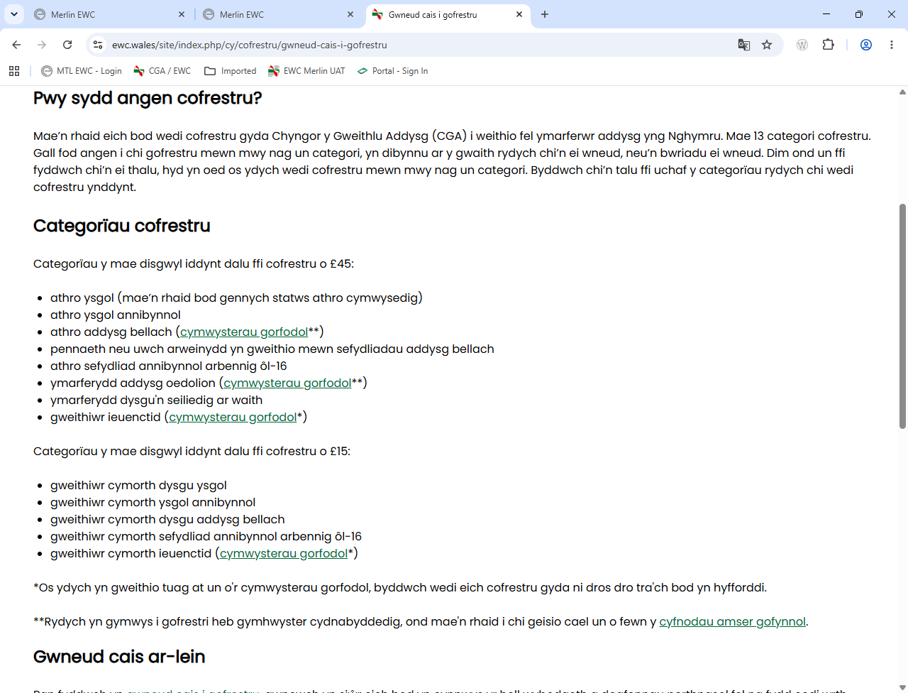
Categoriau Confrestru CGA

Slide 6
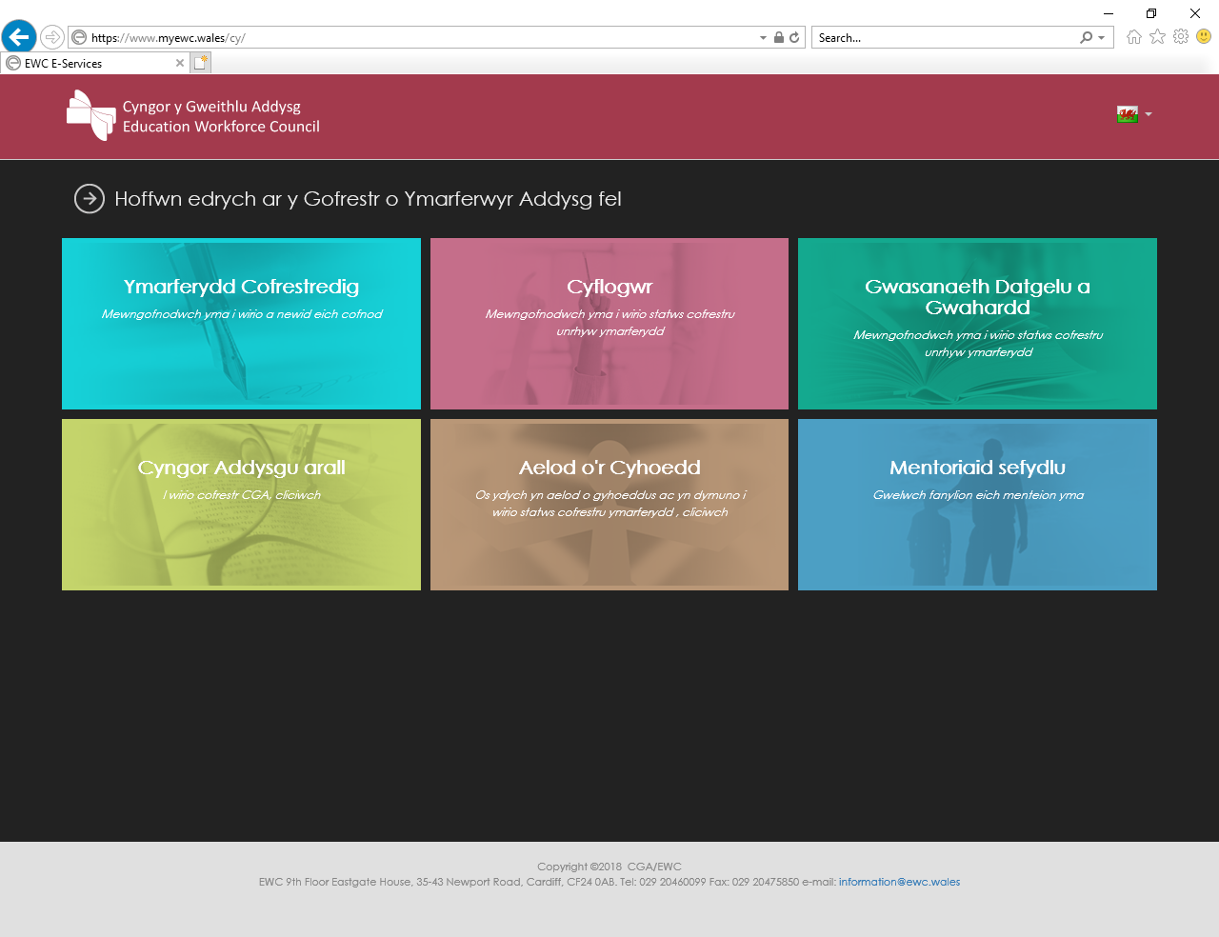
Y Gofrestr
Eich cofnod (Manylion personol, cyflogaeth, cymwysterau, datblygiad proffesiynol)
Mynediad i ymarferwyr a chyflogwyr – gan gynnwys drwy’r we
Mynediad cyhoeddus i wirio statws cofrestru
Diogelwch a datgelu
Ffynhonnell werthfawr o wybodaeth ar gyfer llunio polisi
6

Slide 7
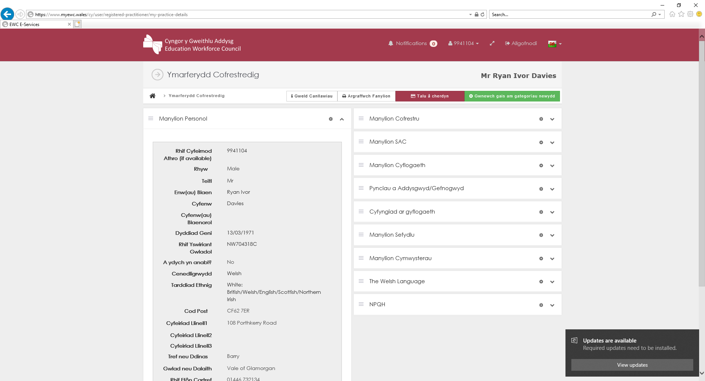
Dyfarnu Statws Athro Cymwysedig (SAC)
E-bost yn darparu eich Rhif Cyfeirnod Athro i chi.
Does dim Rhif Aelodaeth/Cofrestru.
Mewngofnodi i’n gwefan i wirio/newid eich manylion a chael mynediad i’r Pasbort Dysgu Proffesiynol (PDP).
1 Awst – Danfonir eich tystysgrif SAC trwy e-bost.
7

Slide 8
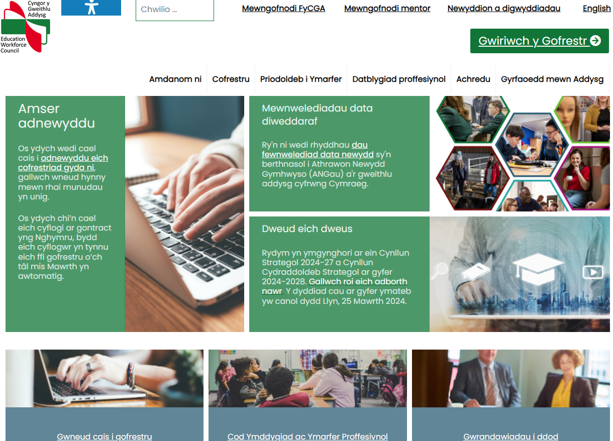
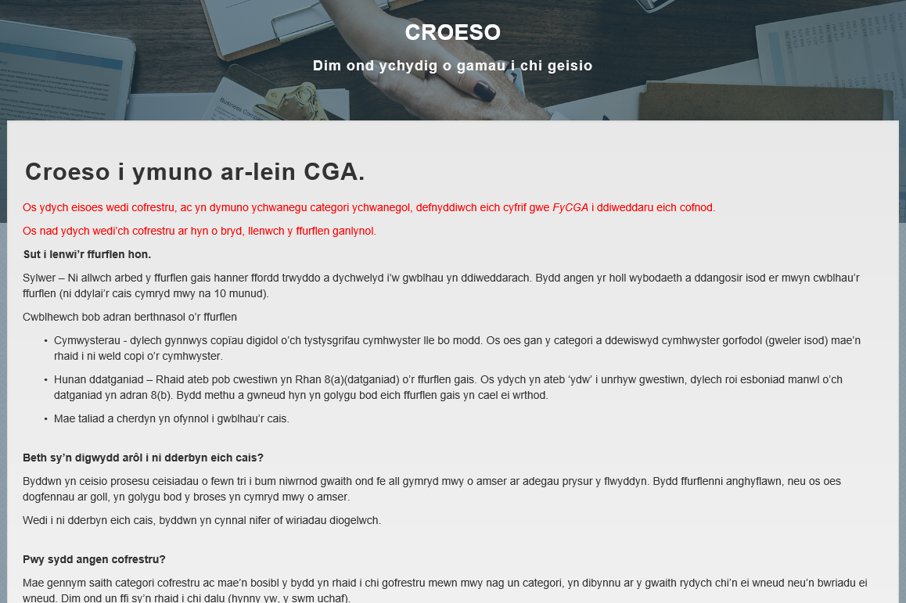

Ymunwch Ar-lein
8

Slide 9
Cofrestru gyda’r CGA, pwy sydd angen cofrestru?
A ydych yn bwriadu gweithio yng Nghymru?
Os Nac ydw yw’r ateb, yna nid oes angen i chi gofrestru gyda’r CGA.
Os Ydw yw’r ateb, yna gyflwynwch gais i gofrestru fel Athro Ysgol a Gweithiwr Cymorth Dysgu Ysgolion.
Bydd y CGA yn:
Eich ychwangeu at gofrestru ymarferwyf y CGA fel Gweithiwr Cymorth Dysgu Ysgolion i gychwyn, ar ôl derbyn eich ffurflen (gan gynnwys taliad o £45)
Cwblhau’r cais i gofrestru fel Athro Ysgol wedi i’r SAC gael ei ddyfarnu ar 1 Awst
Yna rydych:
Yn gymwys i ymgymryd â Gwaith mewn Ysgol cyn mis Medi fel Gweithiwr Cymorth Dysgu Ysgolion
Yn gymwys i weithio fel Athro Ysgol o fis Medi
Rhaid i chi gofrestru gyda’r CGA cyn i chi ddechrau eich rôl yng Nghymru
Gellir cwblhau ffurflen gais ar-lein trwy ymweld â www.cga.cymru

Slide 10
Sut i Gofrestru
Os ydych chi’n bwriadu gweithio yng Nghymru,
rhaid i chi gofrestru gyda’r CGA cyn i chi ddechrau eich rôl
£45 Hoffwn gofrestru fel Athro Ysgol a Gweithiwr Cymorth Dysgu Ysgol. Byddwn yn eich cofrestru yng nghategori Gweithiwr Cymorth yn y lle cyntaf er mwyn i chi ymgymryd â gwaith mewn ysgol cyn dyfernir SAC. Bydd cofrestru fel Athro Ysgol yn cael ei gwblhau yn awtomatig unwaith y bydd SAC wedi’i ddyfarnu. Rydym yn argymell y dewis hwn.
£45 Hoffwn gofrestru fel Athro Ysgol yn unig. Bydd cadarnhad o gofrestriad yn cael ei darparu unwaith y dyfernir SAC. NODER - Os byddwch yn dymuno cofrestru fel Gweithiwr Cymorth Dysgu Ysgol yn ddiweddarach, bydd angen i chi gyflwyno ffurflen gais i gofrestru mewn categori ychwanegol.
£30 Rwyf eisoes wedi cofrestru fel Gweithiwr Cymorth Dysgu Ysgol ac yn dymuno cofrestru fel Athro Ysgol. Ysgrifennwch ‘cais ychwanegol ‘ ar y ffurflen neu yn eich e-bost.
£15 Hoffwn gofrestru fel Gweithiwr Cymorth Dysgu Ysgol yn unig. NODER – Os hoffech gofrestru fel Athro Ysgol yn ddiweddarach, bydd angen i chi gyflwyno ffurflen gais i gofrestru mewn categori ychwanegol a thalu’r £30 ddyledus.
£0 Ni fyddaf yn gweithio yng Nghymru.
Gellir cwblhau cais i gofrestru ar-lein at www.cga.cymru
10

Slide 11


Y Cod
Beth ydyw?
Nodi’r egwyddorion allweddol ymddygiad ac ymarfer da
Dylech arwain eich barn a’ch penderfyniadau
Hysbysu rhieni, gwarcheidwaid, dysgwyr a’r cyhoedd am y safonau y gallant eu disgwyl gennych
Beth all digwydd?
Gall methu â chydymffurfio â’r Cod fedru codi amheuaeth am gofrestriad person.
Help i’w ddeall – Canllawiau Ymarfer Da
Proffesiynoldeb wrth ymarfer
Bod yn weithiwr proffesiynol agored a gonest
Perthnasau Gwaith cadarnhaol
Defnyddio’r cyfryngau cymdeithasol yn gyfrifol
Cynnal perthnasau proffesiynol gyda dysgwyr
Profi, asesu, cynnal arholiadau a goruchwylio
Cyswllt corfforol priodol â dysgwyr a phobl ifanc
Mynd i’r afael â hiliaeth
Arweinwyr mewn addysg
Iechyd meddwl a lles

Slide 12
Enghreifftiau o geisiadau cofrestru a wrthodwyd
Diswyddo – Ysgol yn Lloegr
Honiadau yn ymwneud ag anonestrwydd. Heb ddatgan i CGA
Collfarnau lluosog
60+ o euogfarnau – byrgleriaeth, ymosod, twyll, lladrad, trefn gyhoeddus, drylliau a throseddau
Ymddygiadau blaenorol
Defnydd o gyfryngau cymdeithasol, ymddygiad tuag at ffigurau “awdurdod”, troseddau
Euogfarn, 3 blynedd o garchar am ‘Dwyll drwy gamddefnyddio swydd’
£700,000+, twyll – cymerodd lwgrwobr i ddyrannu cytundeb
Wedi’i ddileu gan Health and Care Professions Council:
Ffugio cofnodion
Anonestrwydd
Methiant i gadw cofnodion
Euogfarn am dwyll, twill ac anonestrwydd. £150,000+ - 18 mis o garchar yn dal i fod ar brawf.

Slide 13
Atgyfeirio achosion i CGA
Troseddau
Heddlu (6.6%)
Diswyddo neu ymddiswyddo
Cyflogwr (73.7%)
Arall
Cwynion; CGA, hunan-atgyfeirio (19.7%)

Slide 14
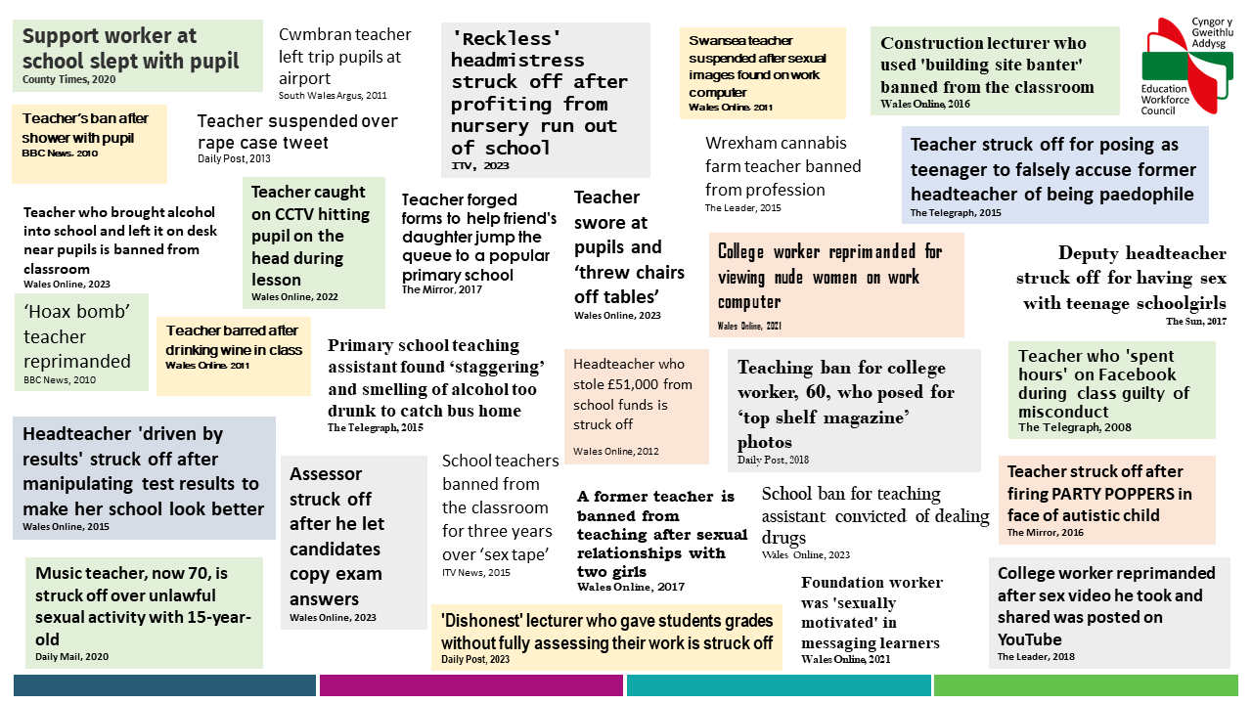
UPDATE SLIDE

Slide 15
Cyflogwyr ac Asiantaethau
Gofynion cyfreithiol:
  Cofrestru – y cyflogwr / yr ymarferydd
  Rhaid gofrestru cyn dechrau gwaith
  Cyfeiro achosion at CGA lle mae aelod o staff (cofrestredig) yn cael ei ddiswyddo / ymddiswyddo o dan rai amgylchiadau
  Didynnu ffioedd cofrestru – blynyddol (os oes gennych cytundeb gyda’r Sir). Mae Athrawon llanw yn adnewyddu yn uniongyrchol.
Cod Ymddygiad ac Ymarfer Proffesiynol
Rydym yn darparu:
  Mynediad ar-lein i’r gofrestr
  Arweiniad i gyflogwyr
  Cyfarfodydd
15

Slide 16



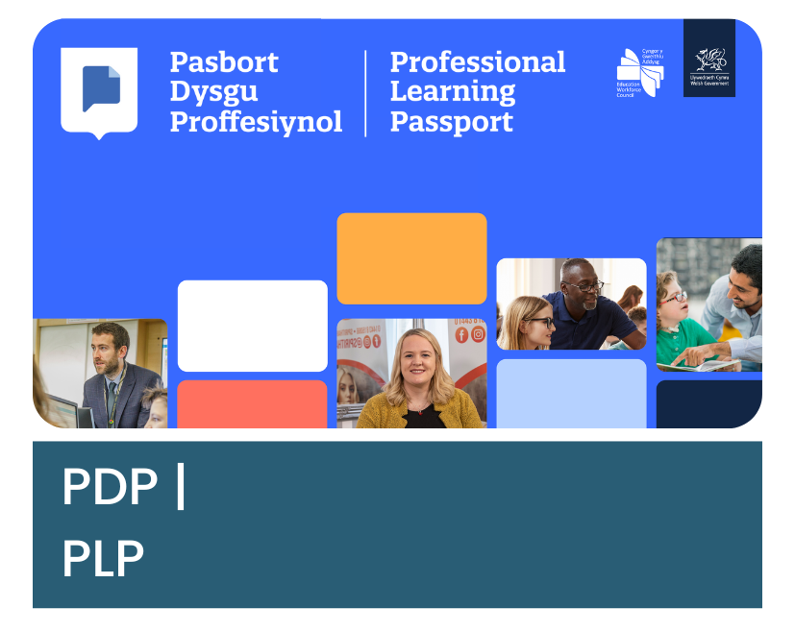


Canllawiau, adnoddau, a gwasanaethau proffesiynol
Guidance, resources, and professional services
Notes:
(Updated 30 January 2025)
STAFF TRAINING
Registrants
We deliver training and workshops, both in person and online.
Our expertise covers a range of topics related to our work, such as:
the EWC Code of Professional Conduct and Practice
using social media responsibly
professional responsibilities and ethics
the Professional Learning Passport
We can also take part in conference keynotes, panel sessions, and attend your event’s marketplace. Just get in touch with the office.
Employers/providers
We deliver training and workshops to both registrants and stakeholders including school governors, training institutions, and regional education consortia. These are available both in person and online.
Our expertise covers a range of topics related to our work, such as:
the EWC Code of Professional Conduct and Practice
using social media responsibly
professional responsibilities and ethics
the Professional Learning Passport
We can also take part in conference keynotes, panel sessions, and attend your event’s marketplace. Just get in touch with the office.
In addition to our live sessions, we are starting to offer some on-demand resources around topics such as the Code and social media. They can be found by visiting our YouTube channel.
EWC PODCAST
Our podcast, ‘Sgwrsio with the EWC’ features lively conversations on topics which matter to you. In our latest episode, our panel of experts wellbeing and how both registrants and organisations can support registrant wellbeing. If there is a topic you would like us to cover on Sgwrsio, please contact the team (media@ewc.wales).
EDUCATORS WALES
Registrants
Funded by Welsh Government and delivered by the Education Workforce Council (EWC), Educators Wales is the go-to website for those seeking new job opportunities. Boasting 100’s of vacancies in Wales’ education sector, it gives you instant access to a diverse range of positions from across Welsh schools and further education colleges, adult/work-based learning providers, youth work organisations, and more.
Set up your profile now to create tailored alerts for specific jobs and locations.
Schools/colleges (excluding FE colleges)
Funded by the Welsh Government and delivered by the EWC, Educators Wales is the go-to website for those posting the latest job opportunities. Free of charge for schools and further education colleges, posting your advert on Educators Wales couldn’t be easier, but can save you £1000’s each year. Already advertise your vacancies through your local authority? Then you’re covered as all LA jobs automatically appear on Educators Wales.
Upload your vacancy onto the biggest website dedicated to the education sector in Wales, today.
All other organisations
Funded by the Welsh Government and delivered by the EWC, Educators Wales is the go-to website for those posting the latest job opportunities. Free of charge for schools and further education colleges, posting your advert on Educators Wales couldn’t be easier, but can save you £1000’s each year.
Upload your vacancy onto the biggest website dedicated to the education sector in Wales, today.
PROFESSIONAL LEARNING PASSPORT (PLP)
Registrants
The Professional Learning Passport (PLP) is a fully bilingual, flexible, online tool that is available to all EWC registrants. It’s packed with features that are designed to support you in capturing, reflecting upon, sharing, and planning your learning with the ultimate aim of improving your practice. You can also use the reflections and evidence you’ve captured to feed into the performance management cycle.
Organisations
The Professional Learning Passport (PLP) is a flexible online tool which can support both individuals to record their professional development, and schools with the performance management cycle. The team are available to work with you to develop templates, tailored to the needs of your school, which will support practitioner professional development and reflection. Contact us to find out more about how the PLP can support your organisation (professionaldevelopment@ewc.wales).
ANIMATIONS
We have a collection of short, informative animations which summarise the key things you need to know about the EWC and our role, the Code of Professional Conduct and Practice, the PLP, and more. You can find them all now via our YouTube channel.
EBSCO/MEDDWL MAWR
EBSCO is the world’s largest full-text research database for education professionals covering all levels and specialities. EWC registrants have free access to EBSCO via the PLP. Registrants can also sign up to Meddwl Mawr, our book and journal club which sends monthly recommendations to EBSCO content. For more information, visit www.ewc.wales/professionaldevelopment.

Slide 17




Manylion Cyswllt
cofrestru@cga.cymru
www.cga.cymru
029 2046 0099
Tanysgrifio i’n cylchlythyr

