Slide 1
LCMB7006
International Marketing
Week 1
The Micro and Macro Environment

Slide 2
The Marketing Environment
The marketing environment consists of forces

Slide 3
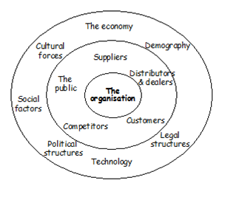
Diagram: The Micro and Macro Environment

Slide 4
The Micro Environment
The Micro environment refers to the environment which is in direct contact with the business organisation and can affect the routine activities of business straight away. It is associated with a small area in which the firm functions.

Slide 5
The Main Elements in the Micro Environment
The company
Suppliers

Slide 6
The Main Elements in the Micro Environment
Customers
Distributors

Slide 7
The Main Elements in the Micro Environment
Competitors
The public

Slide 8
The Macro Environment
The macro environment consists of external forces outside of the organisation that can create opportunities and/or threats.

Slide 9
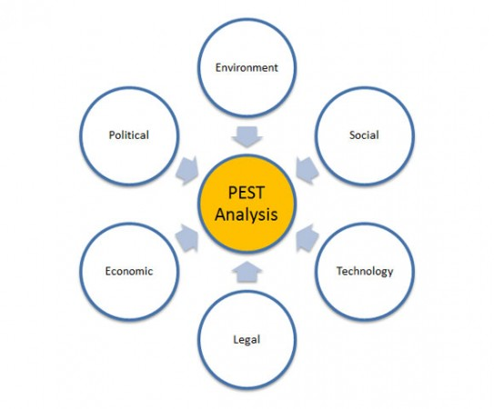
Diagram: The Macro Environment

Slide 10
The Main Elements in the Macro Environment
Social/Cultural forces
Legal forces

Slide 11
The Main Elements in the Macro Environment
Economic forces
Political forces

Slide 12
The Main Elements in the Macro Environment
Technological forces
Environmental

Slide 13
Conclusion
Environmental scanning
Environmental analysis

Slide 14
Exercise
Pick a company that makes it’s product available in at least two different countries and compare the macro environment with the two different countries stating whether each force is favourable or un favourable and why.

