Slide 1
Wilcoxon Signed Rank Test and Independent t test.
Dr Stuart Jones

Slide 2
Background
Parametric Test | Non-Parametric Test
It is used when information about the population parameters (measurable aspects) is completely known | It is used when there is no or few information available about the population parameters
It assumes that the data is normally distributed | It makes no assumption about the distribution of the data.
Interval scale or ratio scale | Nominal or ordinal scale
It uses the mean | It uses the media
More powerful than non-parametric | Less Powerful than Parametric
Examples – Independent Samples T-Test, Paired Samples T-Test, One-Way Anova. | Examples – Mann Whitney Test, Wilcoxon Signed Rank Test, Kruskal-Wallis Test.

Slide 3

Choosing Statistical Procedures

Slide 4
The Wilcoxon Signed-rank test.
The Wilcoxon Signed-rank test is a non-parametric statistical hypothesis test to compare two related (or dependent) samples on a single sample to assess whether their population mean ranks differ.
So, it measure the difference between pairs but fitting the criteria of a non-parametric test (see previous slide).
It can be used as an alternative to the paired samples t-test when the population cannot be assumed to be normally distributed and/or the data is NOT interval or ratio in nature.

Slide 5
Carrying out the Wilcoxon Signed-rank Test
Example……
Researcher is looking to explore the effectiveness of a new drug that has been designed to reduce repetitive behaviours in children affected with autism. A total of 10 children with autism take part and the amount of time that each child engages in repetitive behaviour during a three-hour observation period is noted both before treatment and then again after taking the new medication for a period of one week.
The data is on the next slide.

Slide 6
Data
Participant Number | Before Treatment | One Week after Treatment
1 | 85 | 75
2 | 70 | 50
3 | 40 | 50
4 | 65 | 40
5 | 80 | 20
6 | 75 | 65
7 | 55 | 40
8 | 20 | 25
9 | 45 | 15
10 | 80 | 55

Slide 7
Step 1 – Compute the Difference between the scores.
Condition 1 minus Condition 2.
Before Treatment | After Treatment | Difference (Before minus After)
85 | 75 | 10
70 | 50 | 20
40 | 55 | -15
65 | 40 | 25
80 | 20 | 60
75 | 65 | 10
55 | 40 | 15
20 | 25 | -5
45 | 15 | 30
80 | 55 | 25

Slide 8
Step 2 - Order the difference scores (ignoring the sign) from lowest to highest
NB – Whilst ignoring the sign, it is important to take a note of it (as you will need it later
Difference
10
20
-15
25
60
10
15
-5
30
25
Order | Orders Scores (absolute values)
1 | -5
2 | 10
3 | 10
4 | -15
5 | 15
6 | 20
7 | 25
8 | 25
9 | 30
10 | 60

Slide 9
Step 3 - Assign ranks to absolute values of difference scores.
But things to consider whilst doing this.
What to do if the difference = 0.
Whilst in this example this hasn’t happened, but it CAN happen. What you need to do is IGNORE such observations (delete them from the data) and adjust the number of participants accordingly.
E.g. if you originally had 10 participants, but the difference between condition 1 and 2 was 0 from one the participants – delete the data and then just work with the remaining nine participants.

Slide 10
Step 3 - Assign ranks to absolute values of difference scores.
What to do if there is a tie in the scores (as there is in this example).
Average the rank across the tied observations.
Example if ranks 2 and 3 have the same difference then its rank will be the average. 2 + 3 = 5. 5/2 = 2.5.

Slide 11
Step 3 - Assign ranks to absolute values of difference scores.
Once again – ignoring the sign, but making a note of it (as you will need it later)
Orders Scores (absolute values) | Rank
-5 | 1 (Minus)
10 | 2.5 (tied rank) 2 +3 = 5 / 2 = 2.5
10 | 2.5 (tied rank) 2 +3 = 5 / 2 = 2.5
-15 | 4.5 (minus) (tied Rank) 4 +5 = 9 / 2 = 4.5
15 | 4.5 (tied Rank) 4 +5 = 9 / 2 = 4.5
20 | 6
25 | 7.5 (tied rank) 7+8 = 15 / 2 = 7.5
25 | 7.5 (tied rank) 7+8 = 15 / 2 = 7.5
30 | 9
60 | 10

Slide 12
Step 4 - Attach the signs of observed differences to each rank
Ranks | Signed Ranks
1 (Minus) | -1
2.5 (tied rank) 2 +3 = 5 / 2 = 2.5 | 2.5
2.5 (tied rank) 2 +3 = 5 / 2 = 2.5 | 2.5
4.5 (minus) (tied Rank) 4 +5 = 9 / 2 = 4.5 | -4.5
4.5 (tied Rank) 4 +5 = 9 / 2 = 4.5 | 4.5
6 | 6
7.5 (tied rank) 7+8 = 15 / 2 = 7.5 | 7.5
7.5 (tied rank) 7+8 = 15 / 2 = 7.5 | 7.5
9 | 9
10 | 10

Slide 13
Step 5 - Calculate W+ (positive Ranks) and W- (negative Ranks)
Signed Ranks
-1
2.5
2.5
-4.5
4.5
6
7.5
7.5
9
10
W+ = 2.5 + 2.5 + 4.5 + 6 + 7.5 + 7.5 + 9 + 10 = 49.5
W- = 1 + 4.5 = 5.5
We can check here that the sum of the ranks is equal to n(n+1)/2) - always good to check this.
10 x 11 = 110. 110 / 2 = 55.
49.5 + 5.5 = 55.

Slide 14
Step 6. Determine which W is the smaller value
W + = 49.5
W - = 5.5
W – is the smaller value. So in this example W = 5.5.

Slide 15
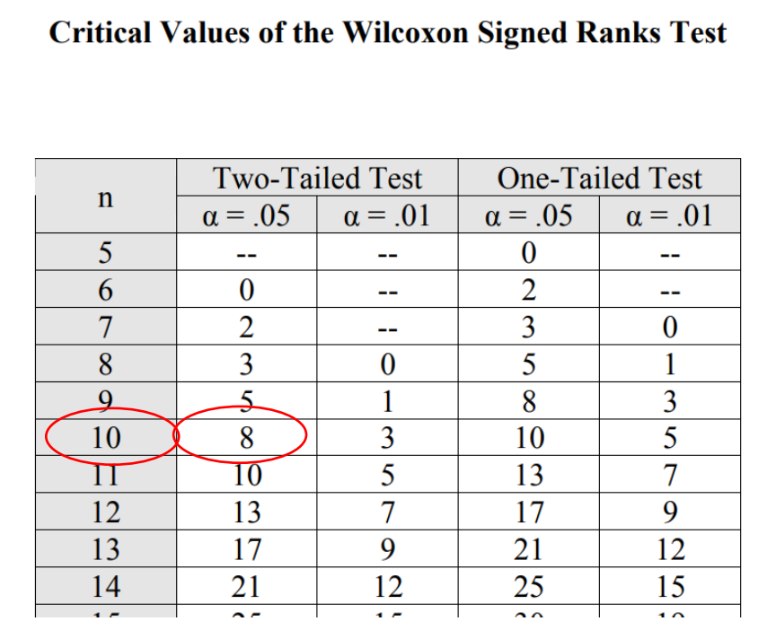
Step 7. Compare against the critical value table of W.
N = 10, alpha = .05
Critical value = 8.
Our calculated W = 5.5 which is smaller than the critical value here (8)
Therefore we can determine that there is a significant change occurring.
As calculated W is LESS than the critical value.

Slide 16
Step 8 – Indicate Significance and Acceptance or rejection of null hypothesis
The null hypothesis can be rejected, there is a significant change occurring in the behavioural symptoms of the children following treatment. The The median score before treatment was 67.5, whereas the median score post-treatment was 45 demonstrating that the group performed better post-treatment.

Slide 17
Choosing Statistical Procedures

Slide 18
When to use the Independent t-test
The independent t-test (sometimes also known as independent samples t-test or unrelated t-test) is probably the most used test in statistics.
It is used to compare differences between separate groups.
These groups are often composed by randomly assignment participants into one of two conditions.
  E.g. Comparing two different types of therapy – Group 1 will try CBT only, Group 2 will try DBT only.
BUT also this test can be used to explore differences in naturally occurring groups.
  E.g. Differences between Males and Females in Depression Scores.

Slide 19
What other things do we need to consider…
Why independent t-test and not another test.
So sample needs to be two INDEPENDENT groups – no more, no less.
One Independent Variable (IV) and One Dependent Variable (DV).
  Gender (Male / Female) is One IV with 2 Groups.
  Depression Scores is One Dependent Variable (DV).
Data is Parametric in Nature.
  Interval or Ratio.
Assume Normal Distribution.
If Data is not Parametric and / or not normally distributed, then the equivalent test is the Mann Whitney U test

Slide 20
So an example of an independent t-test on SPSS.
The aim of the study is to explore if there are gender differences (IV) in depression scores (DV) using the Center for Epidemiologic Studies Depression Scale Revised (CESD-R10). With this scale you calculate the scores for the 10 items. A score of 10 or more is considered depressed and the higher the score the more depressive symptoms that individual is experiencing.

Slide 21
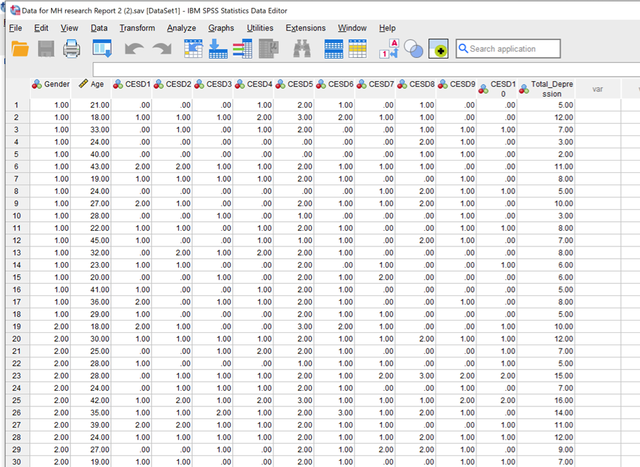
Welcome to SPSS
We have individual scores of each question from each participant, the Total Depression Scores (the DV), we also have the age of the participant, and the Gender of the participant (the IV) in this case – 1 = Male and 2 = Female.

Slide 22
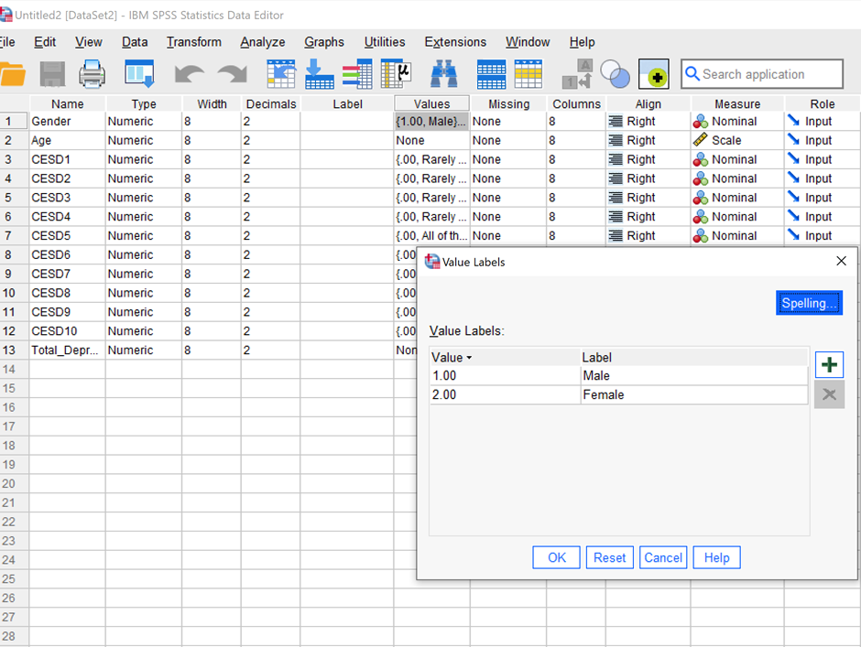
Variable View in SPSS…
An important view as this guides SPSS to give the numbers meaning – for example without using variable view to tell SPSS that the for the gender role the every 1 = Male and every 2 = Female – SPSS wouldn’t know what they represent. We need to input this.

Slide 23
SPSS
So now we have our data looking in a good order – we can run the Analysis.
So back to data view – we click on analyse….. then compare means and proportions, then Independent Samples T-Test

Slide 24
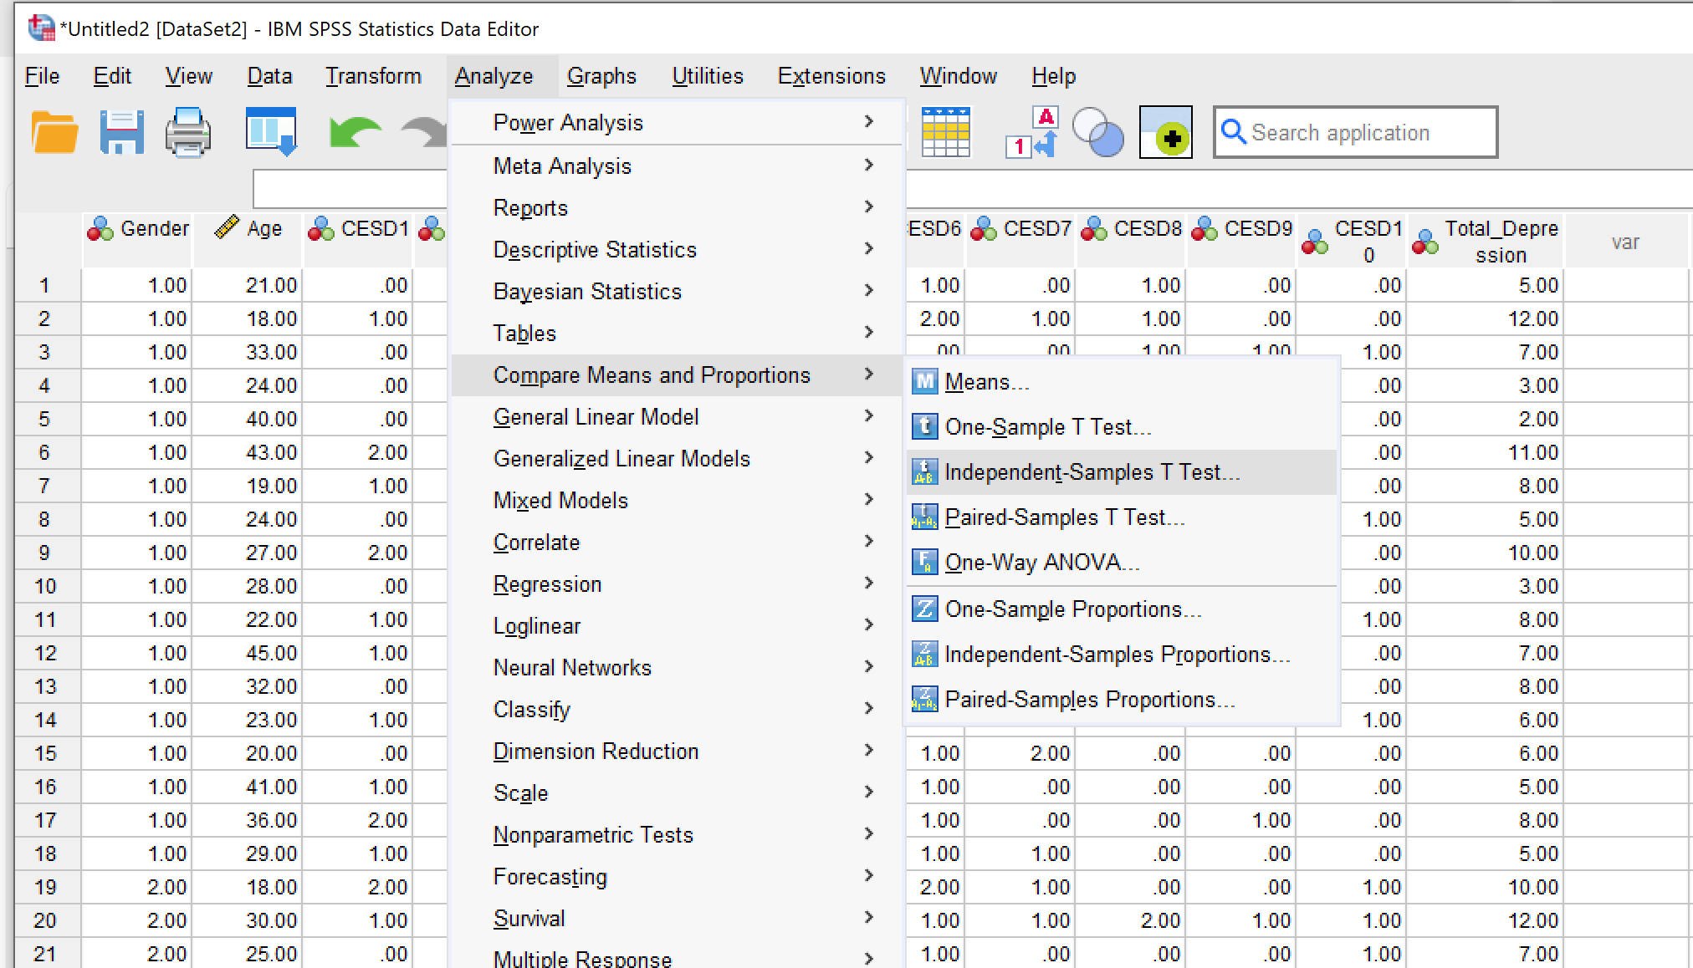

Slide 25
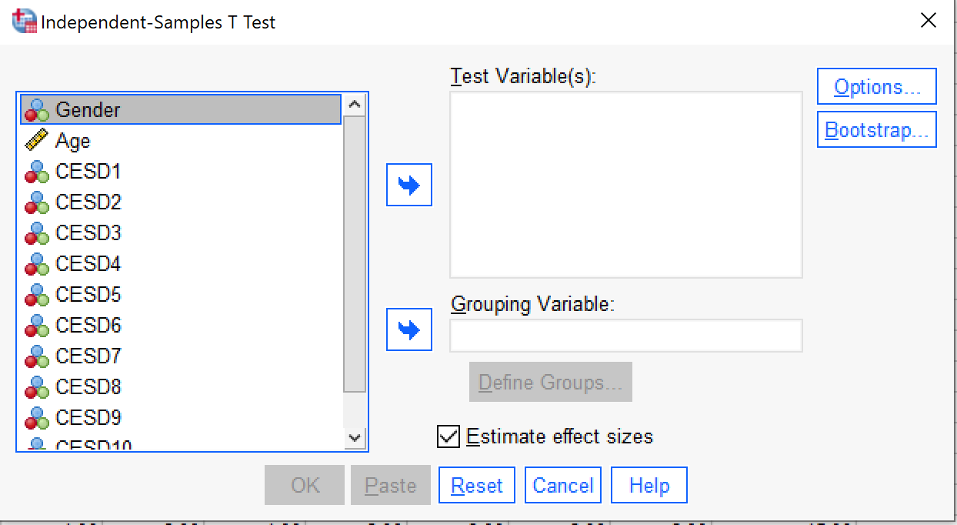
In the box on the left, there is the list of variables in your data file.
The test variable is basically the dependent variable in your study, so, the total depression scores. Select this by clicking over total_depression and then move it to the test variable(s) box using the arrow button next to this box.
The grouping variable is the independent variable in your study. So, this is gender. Select gender and move this to the Grouping Variable box using the arrow button next to this box:
This is will give the following dialogue box.

Slide 26
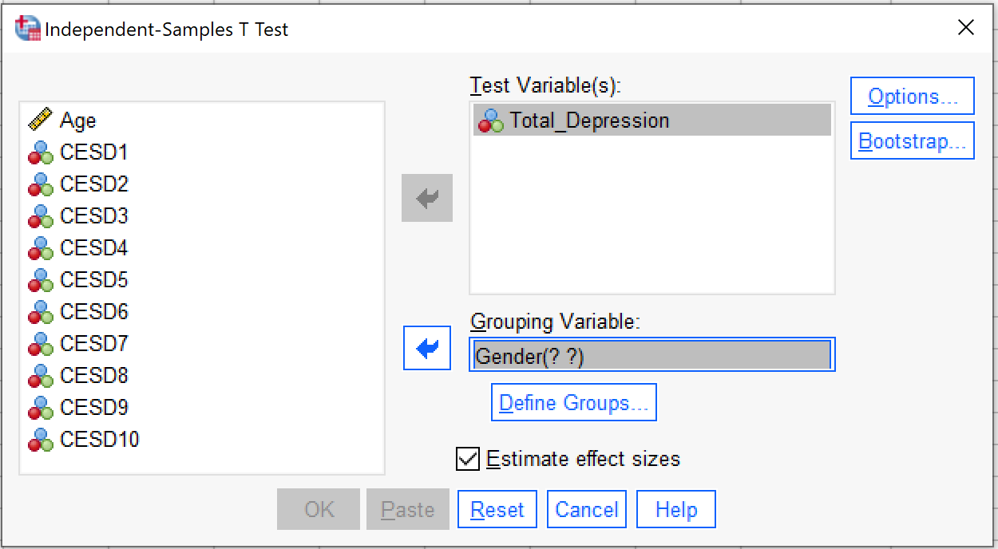
Notice that now, the ‘define groups’ button has become active – you need to specify the values used for each group, so click on this button to get the following dialogue box:

Slide 27
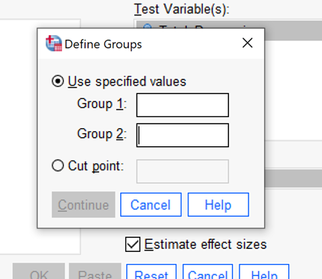
This is quite simple, group 1 (Males) is represented by the value ‘1’, group 2 (Females) is represented by the value ‘2’. So simply type in these values in the two boxes and click continue:

Slide 28
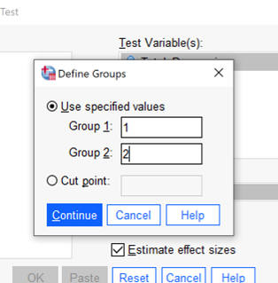
This will return you to the main dialogue box

Slide 29
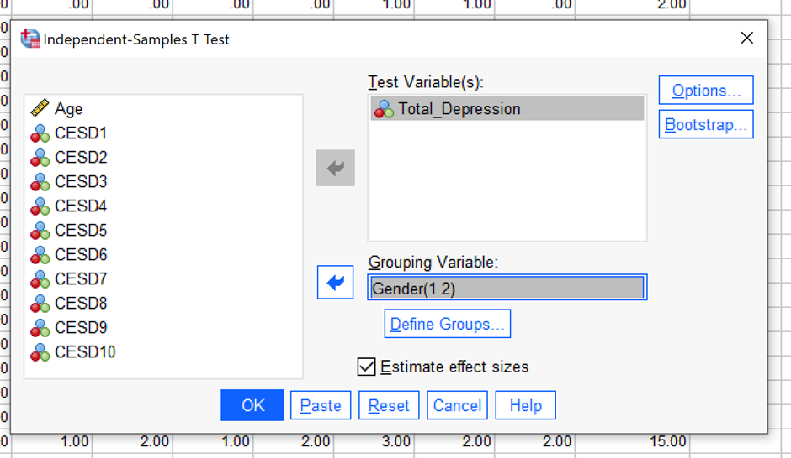
To get SPSS to do the t-test, just click OK and SPSS will do the analysis

Slide 30
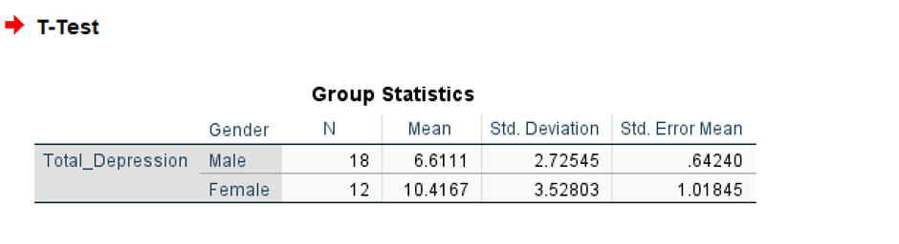
SPSS Analysis – SPSS Output.
The first part of the output is a table of Group Statistics: which allows you to see the direction of the difference between the two groups (Males and Females). We can see that, the males (group ‘1’) have a lower mean total depression score (Mean = 6.61, SD = 2.73) than the female (group ‘2’, mean score of 10.42, SD = 3.53).

Slide 31
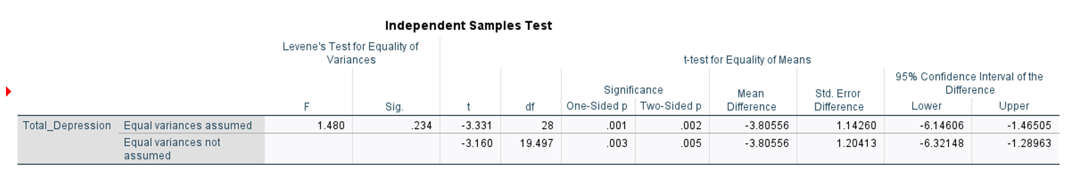
Next Table = The t-test.
There are quite a lot of details in this table, most of which can be ignored. For your purposes, you just need to note the following:
The figures you need for your results are in the ‘Equal variances assumed row’
You just need to note the values of ‘t’, ‘df’ (the degrees of freedom) and ‘sig (2-tailed)’
The ‘t’ value (-3.331) is the test statistic. The degrees of freedom is the figure that you need if you are going to check the significance of your result manually using the statistical tables. The sig (2-tailed) value is the exact probability that your results occurred by chance alone

Slide 32
How do I check if the result is significant?
Look at the sig (2-tailed). The rule for interpreting this is simple: if your sig (2-tailed) value is less than or equal to .05, then the difference between your two groups is statistically significant. The value of sig here (.002) is less than .05 indicating a statistically significant result.
However, note that the sig value is for a two-tailed test (i.e. cases where the research hypothesis is two-tailed). What happens if you employed a one-tailed (directional) hypothesis? This is very easy, you can look at the “one sided significance” figure at the table or you can just simply divide the two-tailed value by two. In this case, .002/2 = .001, again a significant result.
Remember though it is important to check the means score so you can confirm the direction of the significance was in the direction you were predicting. So to conclude, the results of the t-test indicate that the difference between the two groups was statistically significant. To report the t-test results, just quote the t-value, the degrees of freedom (df), whether or not the significance level was less that .05 and whether a one or two-tailed test was employed. This can be done in just one sentence:

Slide 33
An unrelated t-test indicated that the difference between the two groups was statistically significant (t = -3.331, df = 28, p=.002, two-tailed test)

Slide 34
Descriptive Statistics in SPSS

Slide 35
Another useful tool of SPSS is to check through the descriptive statistics, so this might give us additional useful information about the study (e.g. the mean age of the participants).

Slide 36
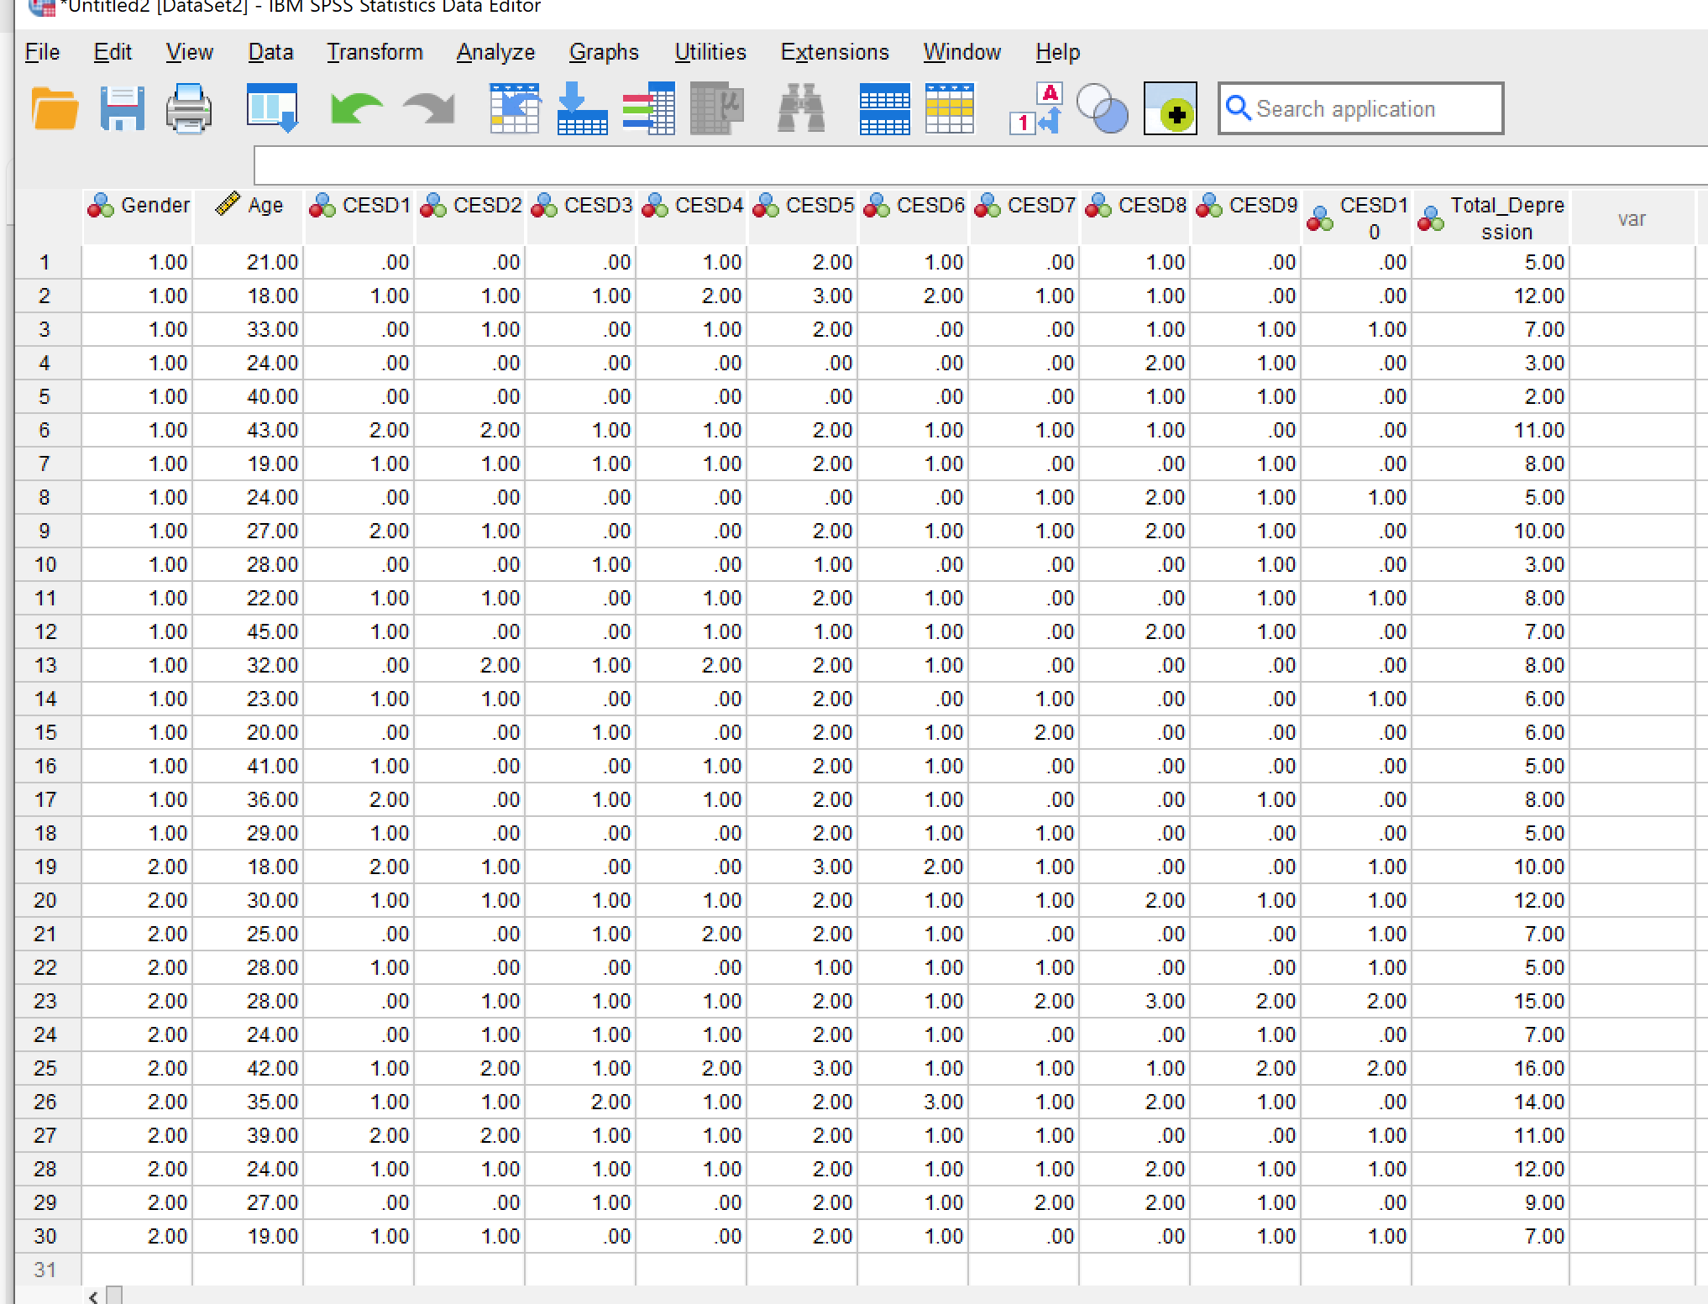
So here we have our data set again, but this time we want to find out descriptive statistics on the age of the participants.

Slide 37
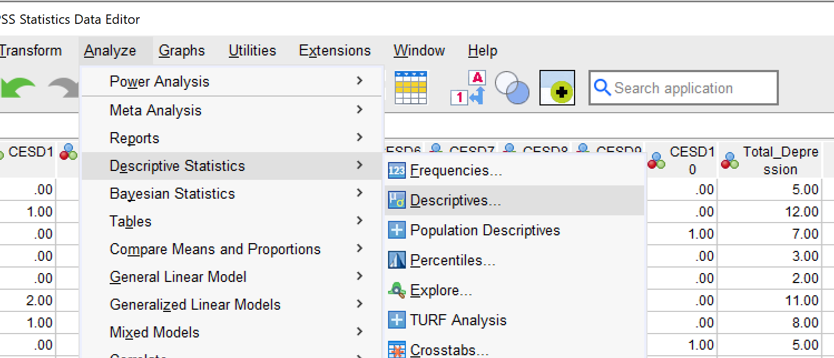
So we go.
Analyse
Descriptive Statistics
Descriptives.

Slide 38
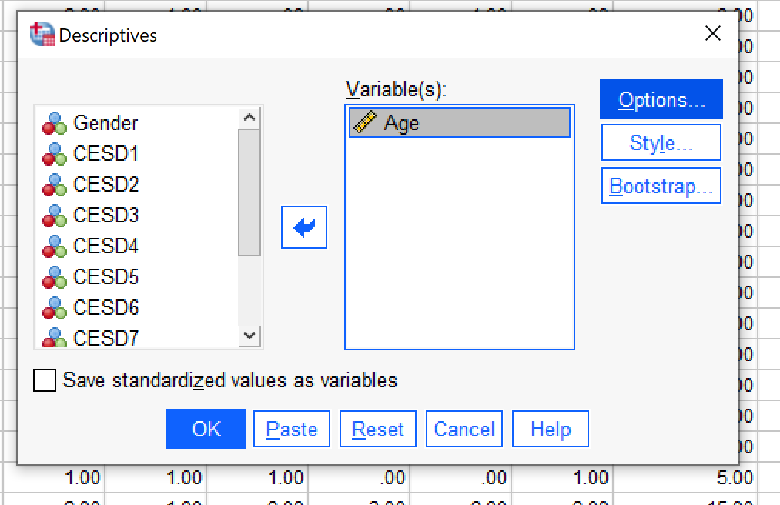
The following dialogue box below will pop up. In this case we want to find out more descriptive information about the age of the participants.
Select Age from the box on the left and using the arrow key in the centre place the age into the Variable(s) box and then click options (NOT OK JUST YET!)

Slide 39
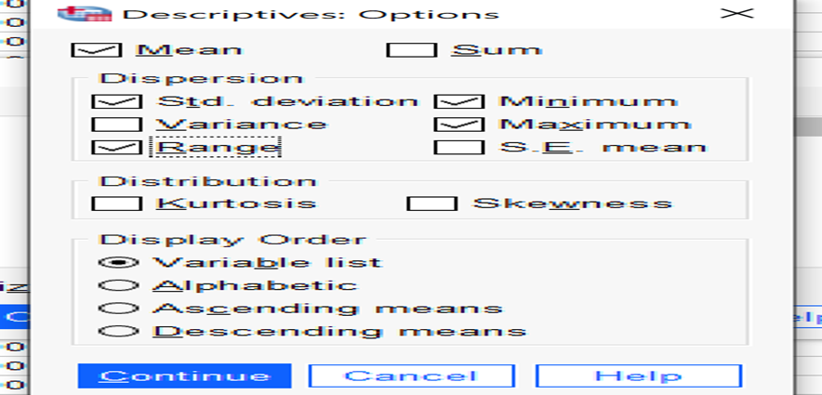
As default – Mean, Std. Deviation, Minimum and Maximum are selected. It is recommended to also select range and then click continue.

Slide 40
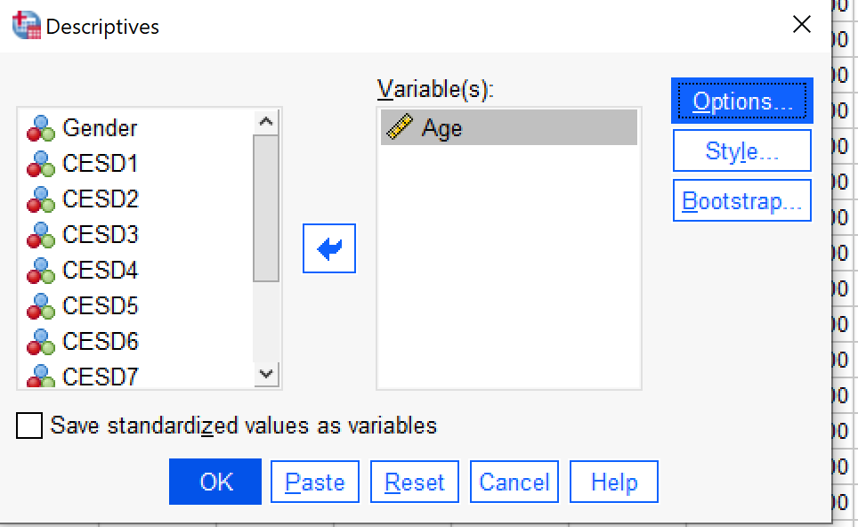
Now click ok…

Slide 41
And Bob’s your uncle…..
Here you can see the mean age (28), Standard Deviation – (8.08), Minimum age (18), Maximum age (45) and the Range (27) of the 30 Participants.

