Slide 1

Sourcing Marketing Knowledge for the development of a CDS (Chemical Detector System)
ACPA 7006 – Managing New Product Development
Teifi - Lindsey Williams & Laura Davies

Slide 2
Scenario
The aim of this exercise is to gather market knowledge, and use this to develop market understanding, in order to determine which new product should be developed, how, and to whom it should be marketed and how in order to be most effective

Slide 3
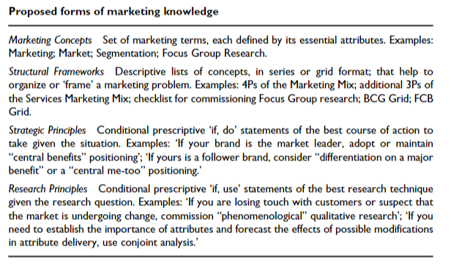
Marketing Knowledge
MIS
MR
MI
MI+
Source: Rossiter, 2001
Notes:
Market research & customer data analysis – informs segmentations/customer needs and target market – gives market segmentation definition, persona development, customer experience requirements
Demand analysis – informs target marketing/evaluate and select target segments – informs select online targeting/target segments/online revenue contribution for each segment/customer lifecycle targeting

Slide 4
What marketing knowledge is likely to be required for this development?
Market Research | Brand Positioning | Product Positioning | Demand Analysis | Market Awareness | Competitive Analysis
Is there a demand for this product?
Is there a potential customer base – who is this? Is the demographic relevant?
Who is the end user of this product – is it easy for them to use?
What market are we aiming to sit within? Can we move to adjacent markets?
Is the price to the end user a concern? Can we make this product work with our profit margins?
Is location a concern (supply of parts/manufacturing abilities/logistical considerations etc.)?
What legal/clinical/safety standards will this product need to meet – in the UK, and the rest of the world?
What usage limitations might there be? Is there the potential for regulatory changes that prohibit or promote its use?
Notes:
These strategies will lead us to the answers to these questions…

Slide 5
What will it do differently – how will it be ‘new’? What is it’s USP?
Can we extend its potential use even further?
What should be the R&D focus?
What is the current closest rival for this product – is it successful, and is it in demand?
Why doesn’t this exist already? Has it been tried, and failed?
Why are we doing this?
Does a previous version have issues we can learn from?
Is a competitor working on this at present? How are they doing it? Is there a patent granted/pending?
How does the development and manufacturing of this product fit with our brand identity and corporate values – is there a conflict of interest?
What is required in terms of:
  Financial resource (both initial outlay and ongoing)
  Skillset (both developers and end users)
  Tangible resources – e.g. use of new/alternative materials, production facilities
  Intangible resources – emergent technologies, theories etc.

Slide 6
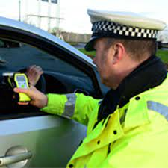
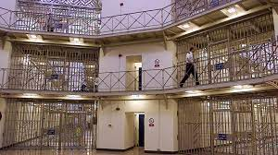
2. What business are we in?
Producer of electronic breathalyser systems. Currently providers to law enforcement –
POLICE- e.g. roadside alcohol detection
and SECURITY FORCES e.g. testing of Prison inmates

Slide 7
Open Innovation
While Chesbrough (2003) originally coined the phrase 'Open Innovation' ,Tidd (2014) proffers a wider definition
…firms should acquire valuable resources from external firms and share internal resources for new product/service development…
Cited in Tynnhammar (2017)
The company have demonstrated open innovation by linking in with a local university while also running inhouse R&D projects.

Slide 8
3. What businesses could we be in?
Hallil, & Heidari, H. (2020) indicate that the "key interests driving the bio‐chemical sensors market across the world are occupational safety health, hazards detection, environment pollution control, air quality analysis, food safety and quality, healthcare device and biomedical applications."
This information identifies potential markets, customer base and describes a demand.
The existing product can be effectively adapted to detect other organic materials using similar technology and enter several of the markets as outlined above.

Slide 9
Hallil, & Heidari, H. (2020) describe a rise in appetite for high performance chemical sensors but an “unmet market demand”.
They refer to sensors in several areas, including; materials, technology and applications (e.g. food spoilage monitoring, odour, medical and environmental)
The company will need to ensure that they develop products that have a “fast response, high‐sensitivity and selectivity, large dynamic range, and low‐cost to be considered as viable products.”
The new chemical detector system could be developed to provide;
biothreat detection
environmental monitoring
and epidemic disease control.
These represent a significant deviation from current operations, into a new area of the market with potentially a new, and differently motivated, customer base.

Slide 10
Selecting a specific new product for development will require further rigorous analysis and comparisons made to identify the most viable option(s)
Prototypes and feedback gained will feed into the decision making process.
The marketing knowledge sources referred to in question 1 will inform the process. As will data from recognised sources.

Slide 11
4. Marketing Sensing Capabilities | Market Understanding
‘The capability to gather and use the information required to commercialise patented innovations from markets’ (Alshanty & Emeagwali, 2019)
That is to say, the capability to fully understand your market through interpreting your market knowledge to allow you to:
Recognise what the market needs/wants
Evaluate how a product/service will be/is received by consumers (‘defining value’)
Determine the most efficient and effective way to make that product a market reality (‘delivering value’)
(Day, 1994; Lankinen et al, 2007; Ardyan, 2016; Harris, 2023)

Slide 12
The
Process
Market Knowledge
MIS/MR/MI/MI+
Market Sensing
EMIC & ETIC
Defining Value
Empathy mapping - what do people want – what will make this product work for them - USP
Creating Value
Delivering Value
  CVP & NPD
  Omni channel interaction & customer development journey

Slide 13
CVP & Value Definition
CVP – ‘immediate qualitative viral detection that can be used by anyone, anywhere’
Can be used by anyone, anywhere – skilled or unskilled, clinical or non-clinical setting (travellers, parents, care homes, pharmacies, schools etc.)
No/minimal training required – immediate results in a clear, easy-to-understand format
Reliable results that can be replicated over small or large scales
Readily accessible in mainstream retailers at an appropriate end-user price point
A trusted brand name, with a product adhering to international quality/safety standards
A product that customers/users of will share/discuss with others

Slide 14
References
Alshanty, A & Emeagwali, O; (2019) Market-sensing capability, knowledge creation and innovation: The moderating role of entrepreneurial-orientation; Journal of Innovation & Knowledge, Vol.4 Issue. 3
Ardyan, E; (2016) Market Sensing Capability and SMEs Performance: The Mediating Role of Product Innovativeness Success; DLSU Business & Ecoomics Review, Vol. 25 Issue 2
Day, G. S; (1994) The capabilities of market-driven organizations; Journal of Marketing
Hallil, & Heidari, H. (2020). Smart sensors for environmental and medical applications (Hallil & H. Heidari, Eds.). John Wiley & Sons, Inc. https://doi.org/10.1002/9781119587422
Harris, J; (2023) Market Intelligence+; UWTSD
Lankinen et al; (2007) Market-sensing capability and market orientation in the food industry: empirical evidence from Finland; 19th Nordic Academy of Management Conference, Norwegian School of Economics and Business Administration
Lion Alcometer 500 User Handbook https://www.lionlaboratories.com/wp-content/uploads/2020/08/500-Mk-IV-RM50737-Rev-3.pdf. Accessed 12.03.23
Rossiter, JR; (2001) Marketing Theory, Volume 1, Issue 1

Slide 15
.Open Innovation and its definitions. Presented at the XXVIII ISPIM Innovation Conference – Composing the Innovation Symphony, Austria, Vienna on 18-21 June 2017.
Weston, M; Mazur, F; Chandrawati, R (2020), "Monitoring of Food Spoilage Using Polydiacetylene‐ and Liposome‐Based Sensors," in Smart Sensors for Environmental and Medical Applications , IEEE2020, pp.81-102, doi: 10.1002/9781119587422.ch5.

