Slide 1
8 week prep program
Sam Sharp
1700888

Slide 2
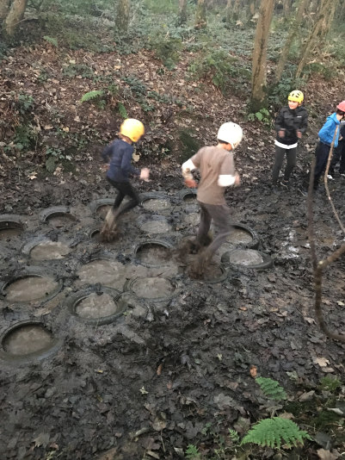
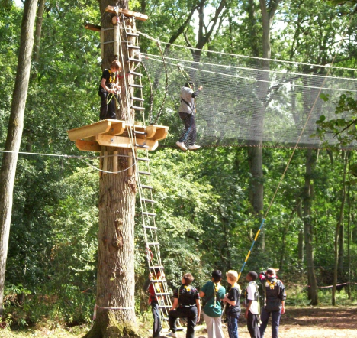
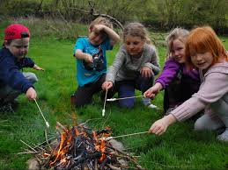
Residential – activities
1 week.
Bushcraft.
Climbing/High ropes.
Timber trail/Low ropes.
Muddy obstacle course.
Multi activity day.

Slide 3
School – preparation
Preparation over 6-8 weeks.
Giving Key stage 3 pupils a taste of what they will be doing.
Time to improve before trying out more challenging activities.

Slide 4
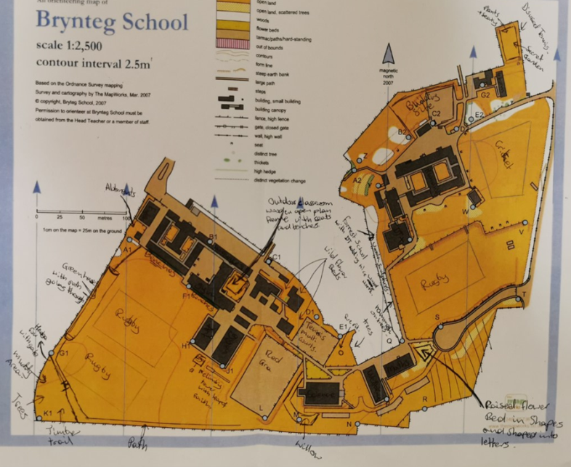
School – activities
Timber trail with muddy obstacle area.
Climbing tower with leap of faith.
Bushcraft, fire pit and willow workshop.
Outdoor classroom.
Some indication to the activities we can offer within the school grounds.

Slide 5
6 – 8 week programme
This will coincide with the pupils PE lessons.
They will get two sessions per week.
For the first 5 sessions we will introduced the five activities that they will be doing.
There will be a strong emphasis on teambuilding exercises.
Including this unit is a great way to make sure we are including all aspects of the curriculum.

Slide 6
Week 1 – 3 activities
Lessons plans to help pupils to progress in their skills and confidence.
Introductions to each activity using the equipment and developments.
First 5 sessions of this block will be introductions to activities.
There will be a specific lesson plan for each activity to make it easy to understand and to progress.

Slide 7
Week 1 – 3 activity plans
We have basic forms of equipment we can use to introduce pupils.
Giving them chance to understand what they will be doing.
Good opportunities to learn new things and be prepared for what the residential will offer.
These plans are to coincide with the curriculum.

Slide 8
Lessons Plan week 1 – 3
Simple introductions don’t need to much planning
Plan
Simply trying out the activities and getting to know the equipment.
Should have a basic understanding of their own ability within the activities.
The next set of sessions can be more specific and link to progression towards the residential.

Slide 9
Week 4 – 8 activities
The lessons plans for this section of the unit will be more focused on pupil progress.
Focusing on pupil ability.
Improving skills that are listed in the curriculum.
For key stage 3 it is all about giving them chances and opportunity to start thinking of their own future and planning for themselves.

Slide 10
Week 4 – 8 activity plans
This will include possibly more challenging or different ways the equipment can be used.
Will look for different ways the equipment can be used.
Will have the same equipment as the school cannot always be developing.
These plans will coincide with the curriculum.

Slide 11
Lesson Plan week 4 – 8
Challenging their abilities on the activities.
To try different ways of completing tasks.
This section of planning will be similar to Kolb's (1984) learning cycle.
Plan
Should understand how the equipment works.
Basic understanding of their abilities.
By the next session should be able to show evidence for personal improvements.

Slide 12
Ready for the residential
At this stage pupils should have an understanding of:
The activities they will be taking part in.
Their own ability within those activities.
How they can progress their own skills to do better.
How they can assess their own ability.

Slide 13
Links to the curriculum
Helps improve skills that are on the curriculum.
Shows key progression from KS2 to KS3 learning from basic skills.
Gives pupils more independence.
Still having good PE lessons while delivering the curriculum and taking part in outdoor activities.

Slide 14
Reference Page
Hwb.gov.wales. (2020). Physical education in the national curriculum for Wales - Hwb. [online] Available at: https://hwb.gov.wales/curriculum-for-wales-2008/key-stages-2-to-4/physical-education-in-the-national-curriculum-for-wales/ [Accessed 17 Jan. 2020].
Kolb, D. (1984). Experiential Learning: Experience as the source of learning and development. Englewood Cliffs, NJ: Prentice Hall.

Slide 15


Slide 16


