Slide 1
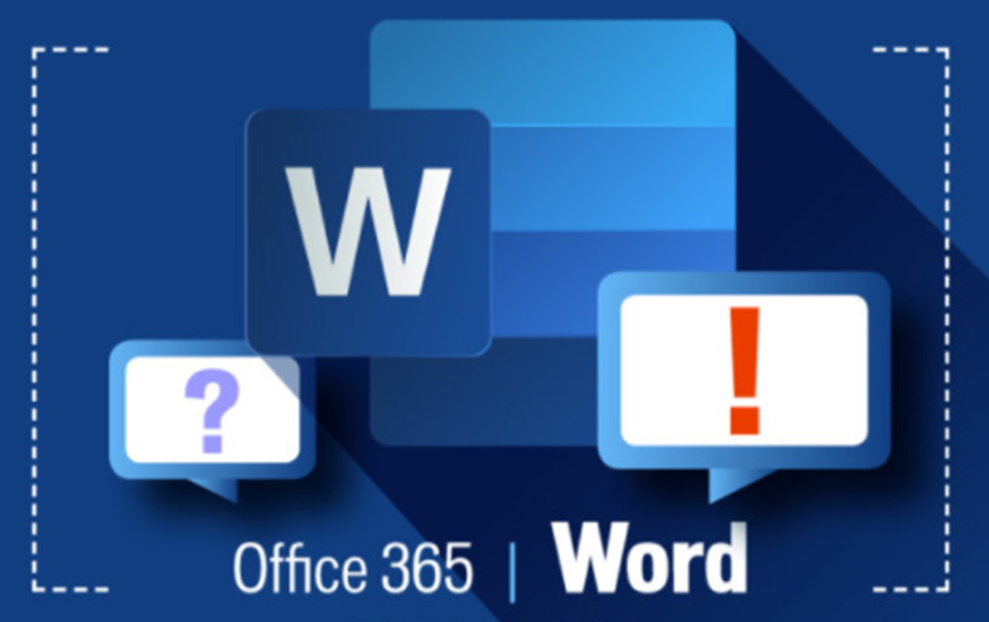

ACCA4031: Software Applications for Business
Documentation
Mr. David A Williams BSc. Hons, MSc., PGCert (TfHE), FHEA, ADG FE/HE, MBCS

Slide 2

Aims: Documentation
Microsoft Word
  Create Documents
  Format
  Tables
  Pictures
  mail merge
Alternative Packages

Slide 3
Word Processing

Slide 4

Word Processor
A word processor is a computer program that provides special capabilities beyond that of a text editor such as the WordPad program in comparison to notepad both of which come as part of Microsoft's Windows operating systems.
Word processors screen the user from structural or printer-formatting mark-up (although the mark-up can be made visible).
It's possible to describe a word processor as having a WYSIWYG (what you see is what you get) user interface.

Slide 5
Microsoft word

Slide 6
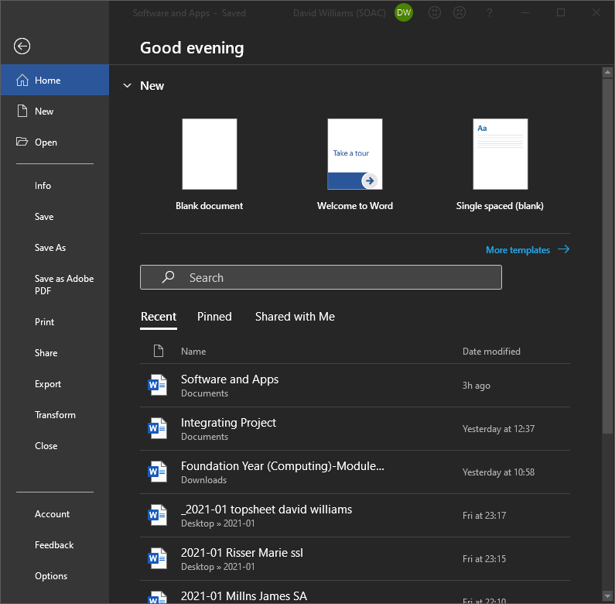
Microsoft word
The file tab allows the user to-
create a new document
save the document
Print the document
Convert the document to other file types
Set the application options

Slide 7
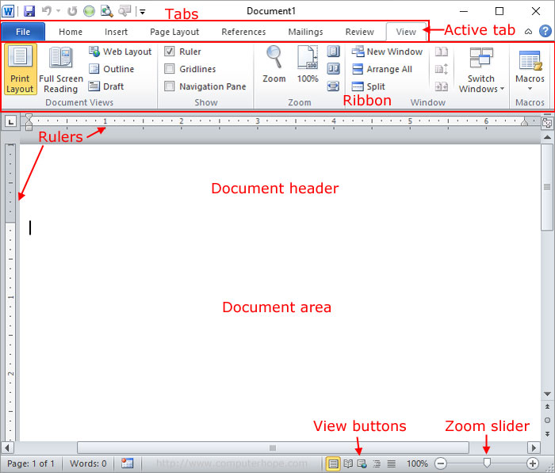
Microsoft word
Sometimes called Winword, MS Word, or Word, Microsoft Word is a word processor published by Microsoft. It is one of the office productivity applications included in the Microsoft Office suite.
Microsoft Word allows you to create professional-quality documents, reports, letters, and résumés. Unlike a plain text editor, Microsoft Word has features including spell check, grammar check, text and font formatting, HTML support, image support, advanced page layout, and more.

Slide 8
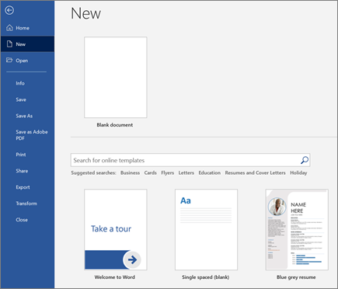
Create a document
Open Word
select File > New.
In the Search for online templates box, enter a search word like letter, resume, or invoice.
Or
select a category under the search box like Business, Personal, or Education.
Click a template to see a preview.
Select Create.

Slide 9
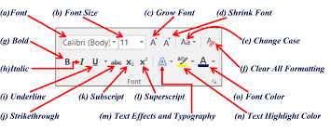
Text formatting
The text used in your document can be formatted into various sizes colours and fonts.
This can be done via the text formatting group on the Microsoft home tab as seen below.

Slide 10
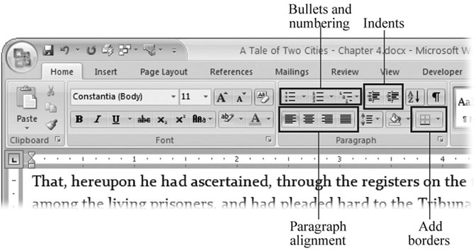
Formatting a paragraph
Bullets indenting alignment and line spacing can all be modified in the paragraph group.
Additional options include
  Shading
  Sorting
  Display mark-up
To get all options in a dialogue window (as with most groups) click the box with an arrow in the bottom-right-hand corner

Slide 11
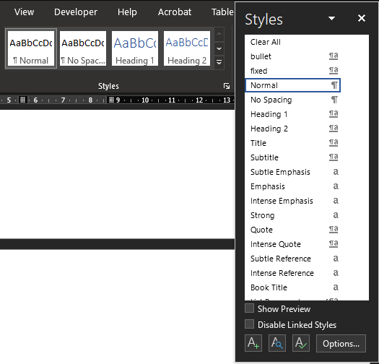
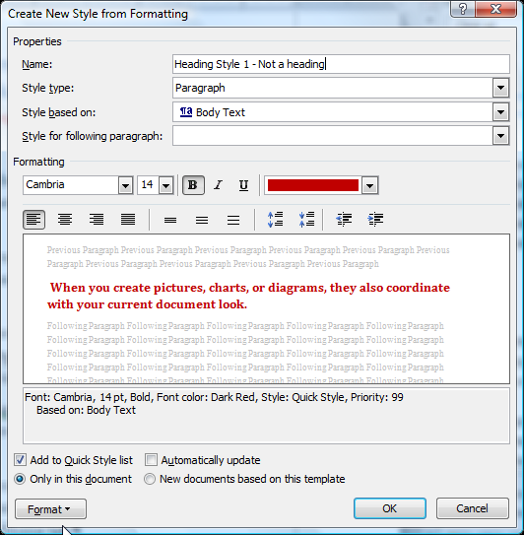
styles
Styles are used to "tag" or identify a documents parts such as
    a heading
    a footnote
    body text
    quotes
Heading styles allow for automated creation of table of contents and document navigation
Caption styles allow for automated creation of table of figures
Styles allow consistency throughout the document

Slide 12
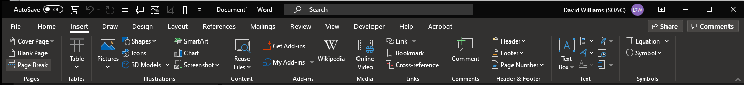
Insert tab
The insert tab allows the insertion of various objects including-
  New pages, page breaks and cover pages
  Tables
  Manipulation of the header and footer of the document
  A variety of media such as images, shapes, charts, comments and equations
When objects are inserted into word additional tabs are generated which allow operations specific to the object in question e.g. insertion and selection of a table will generate the table design and table layout tabs.

Slide 13
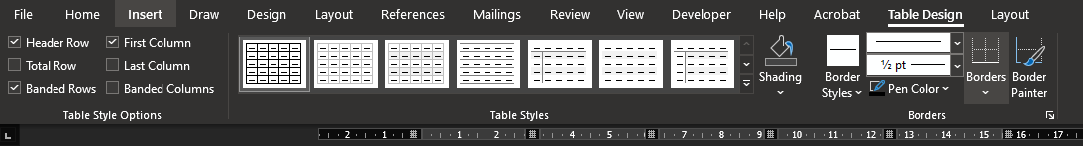
Table design and layout
The two tabs demonstrated below only become available when a table is selected.
They provide elements specific to table operations and cell manipulation

Slide 14
Working with images
When images are inserted and selected, additional options are made available on the tabs above the ribbon- Word has the power to conduct many operations which would have been traditionally associated with desktop publishing software.
In most cases you should reference your images and give them a caption (this will be covered later). Images can be obtained from
Your device
The Internet
Stock images

Slide 15
Working with images
Most of the image controls are self-explanatory, but some of the more interesting ones include-
Crop allows you to remove unwanted areas from the image, by default this will be a rectangular selection area but other options are available
Remove background allows you to just select a give part of the image and remove the rest
Word wrap determines how text arranges itself around the image

Slide 16
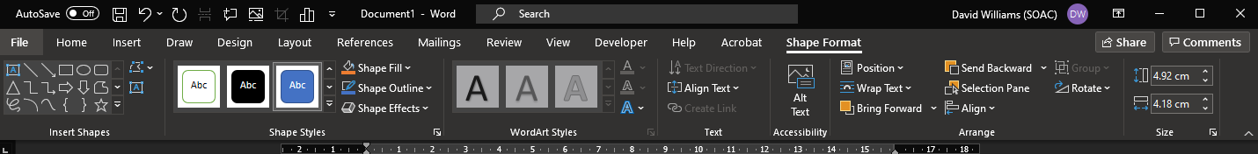
Working with Shapes
When you insert a shape, the options that word will present you with are a hybrid of the options which you are given with a text box and those which are provided for images

Slide 17
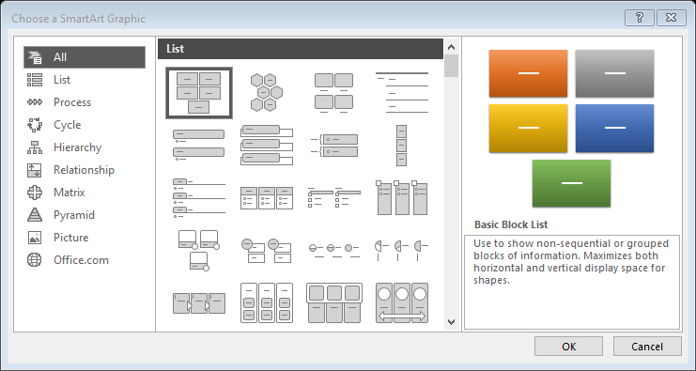
Smart art
Smart art objects are a great way to generate some simple diagram types such as organisational structures cycles or hierarchy diagrams.
These shapes are available in word, publisher and PowerPoint and allow the user to produce these diagram types quickly without need of third-party software such as Visio

Slide 18
Working with equations
Particularly useful for mathematics or science subjects
Inserting equations can be tricky in word when working from scratch, it works on the principle of providing place holders for you to insert the variables and constants.
You can also insert an ink equation by writing free hand with the mouse or touch screen but this has varying levels of accuracy
Word does provide some of the more frequently used equations

Slide 19
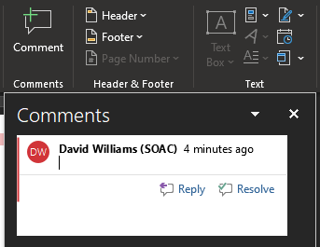
Collaboration with comments
A great way to work together on a document is through use of commenting
Comments can be added through either the insert or review tab
Comments are used when proof reading or making suggestions on the document
When the document is hosted via one drive, it is possible for multiple participants to work on it simultaneously

Slide 20
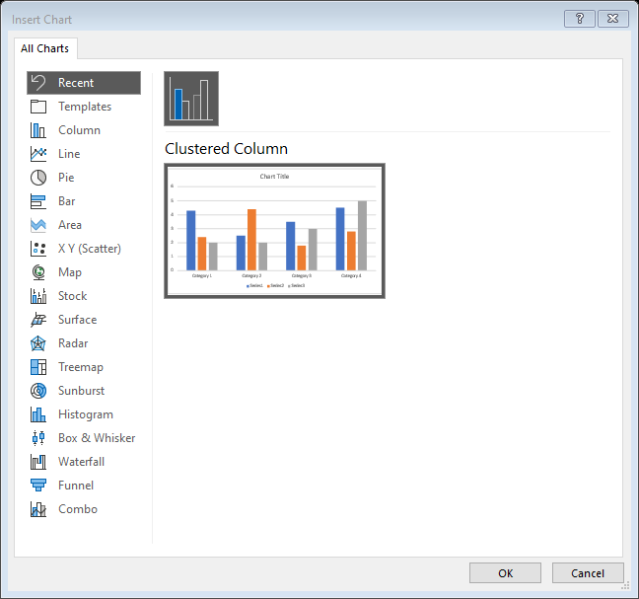
charts
Charts can be inserted into a Word document in two ways.
Via the insert tab
Cut and paste from excel
When a chart is inserted, word will present the user a scaled down version of excel (this will be covered in a future lecture), to manipulate the data.
The same mechanism exists for inserting charts into PowerPoint

Slide 21
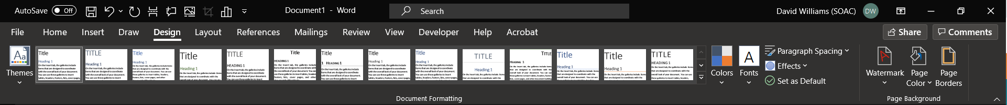
Design tab
This tab takes controls that were previously on the Home, Page Layout and Insert tabs and expands them.
It is primarily about Quick Style Sets and Themes. I don't know that it introduces any new controls.
Here are some of the galleries accessed through this tab:
Themes (formerly on the Page Layout Tab)

Slide 22
Design tab
Themes - (Moved in 2013). Drop-Down. The drop-down contains the commands: Built-in, More Themes on Microsoft Office Online, Browse for Themes and Save Current Theme. The built-in themes are: Office, Apex, Aspect, Civic, Concourse, Equity, Flow, Foundry, Median, Metro, Module, Opulent, Oriel, Origin, Paper, Solstice, Technic, Trek, Urban and Verve. Tooltip indicates the current theme.
The default theme is "Office". Tooltip indicates the current theme. Quick Access to more themes saved down on Microsoft Office Online. Default theme is "Office". Changes the overall design of the entire document inc colours, fonts and effects. This drop-down has an additional command not found in Excel or PowerPoint which is "Reset to Theme from Template".

Slide 23
Design tab
Style Set - (Added in 2013). Change the look of your document by choosing a new style set. Style sets change the font and paragraph properties of your entire document.
Colors - (Moved in 2013). Drop-Down. Displays a list of all the available colors and lets you change the color component of the active theme.
Fonts - (Moved in 2013). Drop-Down. Displays a list of all the available fonts and lets you change the font component of the active theme.

Slide 24
Design tab
Paragraph Spacing - (Added in 2013). Drop-Down. Quickly change the line and paragraph spacing in your document. The drop-down contains the commands: No Paragraph Space, Compact, Tight, Open, Relaxed, Double, Custom Paragraph Spacing.

Slide 25
Design tab
Effects - (Moved in 2013). Drop-Down. Displays a list of all the available effects and lets you change the effect component of the active theme. The drop-down contains the commands: Office, Apex, Aspect, Civic, Concourse, Equity, Flow, Foundry, Median, Metro, Module, Opulent, Oriel, Origin, Paper, Solstice, Technic, Trek, Urban and Verve.
Set As Default - (Added in 2013). Use the current look for all new documents.

Slide 26
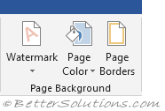
Design tab
Page Background
This group was moved in 2013 from the Page Layout tab.
Watermark - (Moved in 2013). Drop-Down. The drop-down contains the commands: Custom Watermark, Remove Watermark and Save Selection to Watermark Gallery.
Page Color - (Moved in 2013). Drop-Down. Lets you change the background colour of the page. Displays the full theme colour palette.
Page Borders - (Moved in 2013). Displays the "Border and Shading" dialog box.

Slide 27
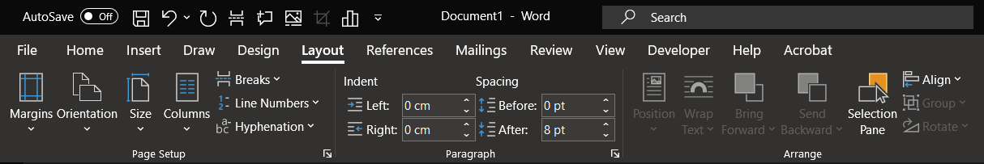
Layout tab
This tab provides quick access to Page Setup options as well as additional paragraph indent and spacing options.
Themes
In 2013 this group was moved to the Design Tab

Slide 28
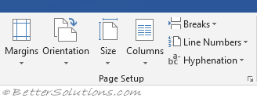
Layout tab
Page Setup
You can display the "Page Setup" dialog box, Margins Tab, by clicking on the dialog box launcher in the bottom right corner of this group.

Slide 29
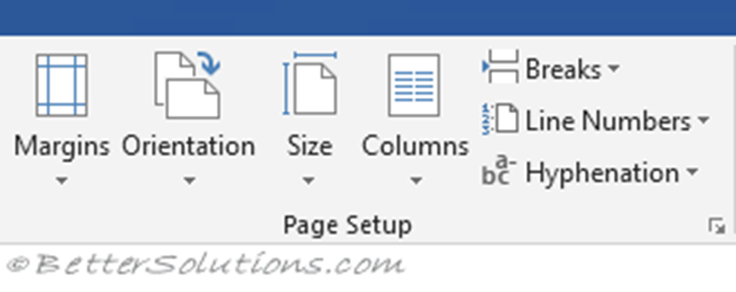
Layout tab
Margins - Drop-Down. Lets you choose from one of the built-in margin settings or lets you customise your own. Similar to Excel but has 2 more options "Moderate" and "Mirrored".
Orientation - Drop-Down. Lets you change the orientation of the current section. The drop-down contains the commands: Portrait and Landscape.

Slide 30
Layout tab
Size - Drop-Down. Lets you select from all the different available paper sizes.
Columns - Drop-Down. The drop-down contains the commands: One, Two, Three, Left and Right and the command More Columns.

Slide 31
Layout tab
Breaks - Drop-Down. The drop-down contains the commands: Insert Page Break, Remove Page Break and Reset All Page Breaks.
Line Numbers - Drop-Down. The drop-down contains the commands: None, Continuous, Restart Each Page, Restart Each Section, Suppress for Current Paragraph and Line Numbering Options.

Slide 32
Layout tab
Hyphenation - Drop-Down. The drop-down contains the commands: None, Automatic, Manual and Hyphenation Options.
The Hyphenation Options displays the "Hyphenation" dialog box.

Slide 33
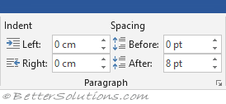
Layout tab
Paragraph
You can quickly display the "Paragraph" dialog box, Indents and Spacing tab, by clicking on the launcher in the bottom right corner of this group.

Slide 34
Layout tab
Indent Left - TextBox. This automatically updates to indicate how much indentation has been applied to the paragraph of the current selection. This can be used to change the left indentation for the current selection.
Indent Right - TextBox. This automatically updates to indicate how much indentation has been applied to the paragraph of the current selection. This can be used to change the right indentation for the current selection.

Slide 35
Layout tab
Spacing Before - TextBox. This automatically updates to indicate how much spacing is defined before the paragraph of the current selection. This can be used to change the spacing for the current selection.
Spacing After - TextBox. The automatically updates to indicate how much spacing is defined after the paragraph of the current selection. This can be used to change the spacing for the current selection.

Slide 36
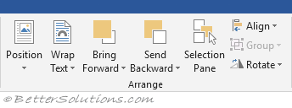
Layout tab
Arrange
This group also appears on the Drawing Tools - Format contextual tab.

Slide 37
Layout tab
Position - Drop-Down. Displays a list of picture positioning options. The drop-down contains the commands: In Line With Text and Text Wrapping.
You can select More Layout Options to display the "Advanced Layout" dialog box.
Wrap Text - (Text Wrapping in 2007). Drop-Down. The drop-down contains the commands: In Line with Text, Square, Tight, Through, Top and Bottom, Behind Text, In Front of Text, Edit Wrap Points and More Layout Options.

Slide 38
Layout tab
Bring Forward - (Bring to Front in 2007). Button with Drop-Down. The button brings the selected object forward one level. The drop-down provides a command to bring the selected object in front of all the other objects.
Send Backward - (Send to Back in 2007). Button with Drop-Down. The button brings the selected object back one level. The drop-down provides a command to send the selected object to the back of all the other objects.
Selection Pane - (Added in 2010). Displays the Selection Pane task pane.

Slide 39
Layout tab
Align - Drop-Down. The drop-down contains the commands
Group - Drop-Down. The drop-down contains the commands: Group, Regroup and Ungroup.
Rotate - Drop-Down. The drop-down contains the commands: Rotate Right 90, Rotate Left 90, Flip Vertical, Flip Horizontal and More Rotation Options.

Slide 40
Layout tab
Arrange
This group also appears on the Drawing Tools - Format contextual tab.

Slide 41
Layout tab
Arrange
This group also appears on the Drawing Tools - Format contextual tab.

Slide 42
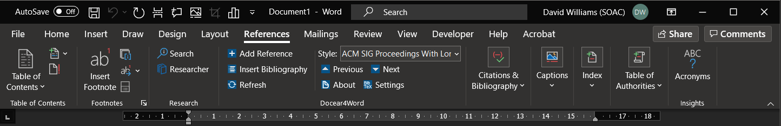
references tab
This tab gives you access to all the commands for creating references within your documents.

Slide 43
references tab- table of contents
Table of Contents - Drop-Down. Provide an overview of your document by adding a table of contents. The drop-down contains the commands: Built-in, Insert Table of Contents and Save Selection to Table of Contents Gallery.
Add Text - Drop-Down. The drop-down contains the commands: Do Not Show in Table of Contents, Level 1, Level 2 and Level 3.
Update Table - Updates the table of contents so that all the entries refer to the correct page numbers.

Slide 44
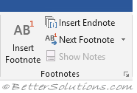
references tab- footnotes
You can quickly display the "Footnote and Endnote" dialog box by clicking on the dialog box launcher in the bottom right corner of this group.
Insert Footnote - (Alt + Ctrl + F). Inserts a footnote at the current position. Footnotes are automatically renumbered as you move text around the document.
Insert Endnote - (Alt + Ctrl + D). Inserts an endnote at the end of the document. End notes are always placed at the end of a document.
Next Footnote - Button with Drop-Down. The button moves to the next footnote. The drop-down provides the commands Next Footnote, Previous Footnote, Next Endnote and Previous Endnote.
Show Notes - Shows where footnotes and endnotes are located.

Slide 45

references tab- footnotes
Research
This group was added in 2016.
Smart Lookup -
Researcher -

Slide 46
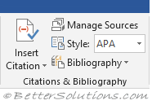
references tab- citations
Insert Citation - Drop-Down. The drop-down contains the commands: Add New Source, Add New Placeholder and Search Libraries.
Manage Sources - Displays a list of all the sources cited in the active document.
Style - Choose the style of citation to use in the document.
Bibliography - Drop-Down. The drop-down contains the commands: Insert Bibliography and Save Selection to Bibliography Gallery.

Slide 47
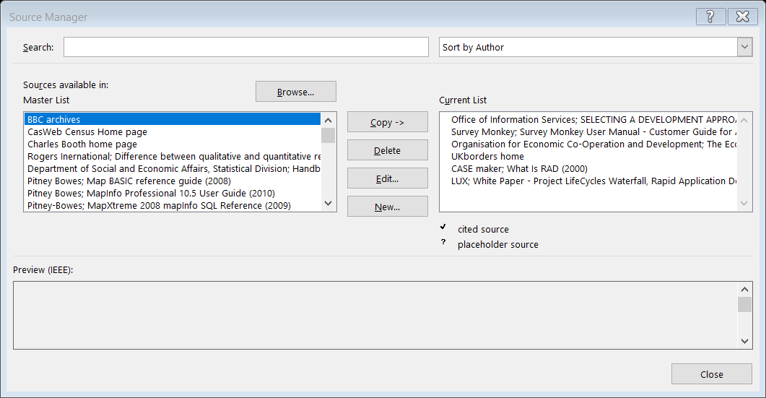
references tab- citations

Slide 48
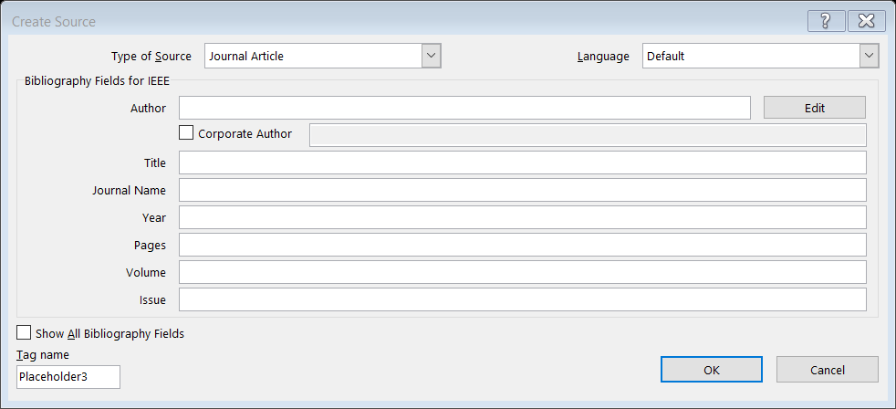
references tab- citations

Slide 49
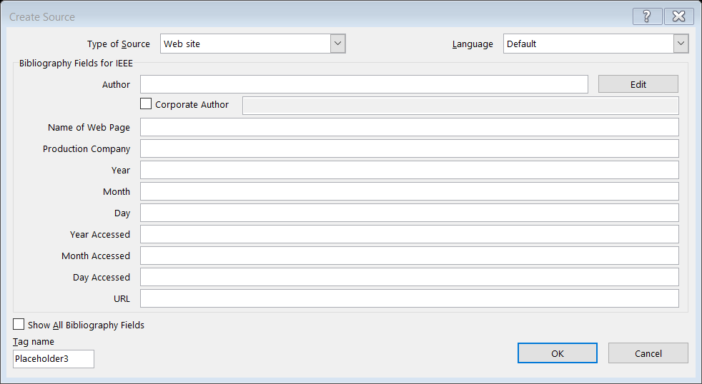
references tab- citations

Slide 50
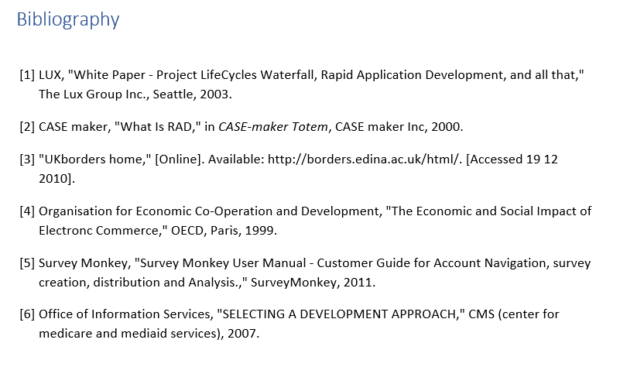
references tab- citations

Slide 51
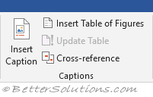
references tab- captions figures and tables
Insert Caption - Insert a caption below a picture or graphic to provide a short description.
Insert Table of Figures - Add a list of captioned objects and their page numbers.
Update Table - Updates the table of figures to include all of the entries in the document.
Cross-reference - Displays the "Cross-reference" dialog box allowing you to insert cross-referencing into your document, for example: turn to page 3 or please refer to page 12. Cross references are inserted as hyperlinks.

Slide 52
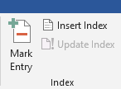
references tab- index
Mark Entry - (Alt + Shift + X). Marks the currently selected text so it will appear in the index of the document.
Insert Index - Add an index listing key words and page numbers they appear on.
Update Index - Updates the index table.

Slide 53
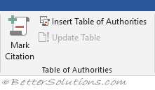
references tab- Table of Authorities
Mark Citation - (Alt + Shift + I). Adds the currently selected text so it will appear in the table of authority.
Insert Table of Authorities - Inserts a table of authorities for cases, statutes and other authorities in the document.
Update Table - Updates the table of authorities to include all the citations in the document.

Slide 54
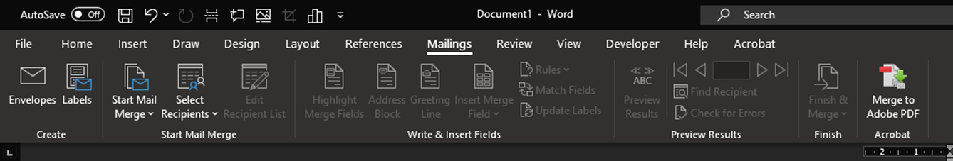
Mail merge
Mail Merge is most often used to print or email form letters to multiple recipients.
Using Mail Merge, you can easily customise form letters for individual recipients.
Mail merge is also used to create envelopes or labels in bulk.

Slide 55
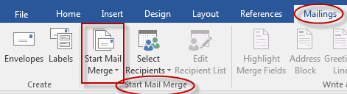
Mail merge
In a blank Microsoft Word document, click on the Mailings tab, and in the Start Mail Merge group, click Start Mail Merge.
Start Mail Merge

Slide 56
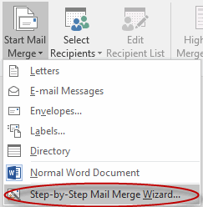
Mail merge
Click Step-by-Step Mail Merge Wizard.

Slide 57
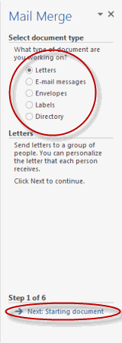
Mail merge
Select your document type. In this demo we will select Letters.
Click Next: Starting document.

Slide 58
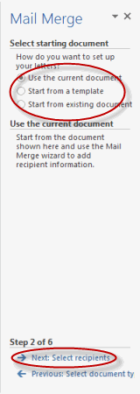
Mail merge
Select the starting document. In this demo we will use the current (blank) document.
Select Use the current document
Then click Next: Select recipients.

Slide 59
Mail merge
Select the starting document. In this demo we will use the current (blank) document.
Select Use the current document
Then click Next: Select recipients.
Note that selecting Start from existing document changes the view and gives you the option to choose your document.
After you choose it, the Mail Merge Wizard reverts to Use the current document.

Slide 60
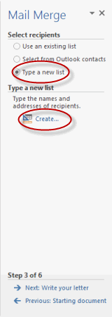
Mail merge
Select recipients.
Select Type a new list
click Create

Slide 61
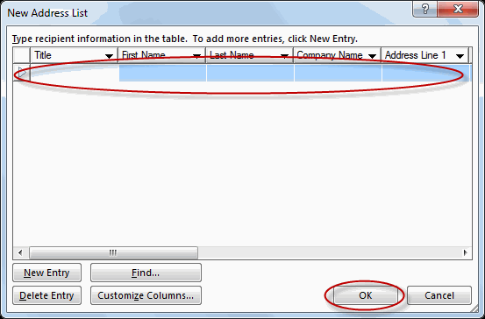
Mail merge
Create a list by adding data in the New Address List dialog box and clicking OK.
Save the list.

Slide 62
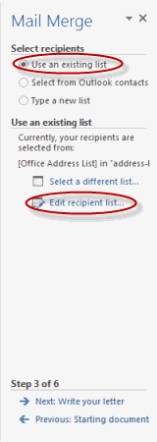
Mail merge
Note that now that a list has been created, the Mail Merge Wizard reverts to Use an existing list and you have the option to edit the recipient list.

Slide 63
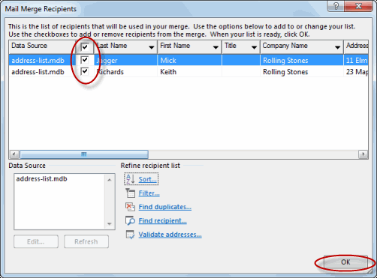
Mail merge
Selecting Edit recipient list opens up the Mail Merge Recipients dialog box, where you can edit the list and select or unselect records.
Click OK to accept the list as is.

Slide 64
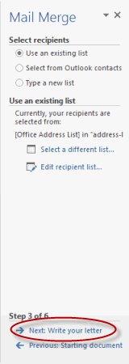
Mail merge
Click Next: Write your letter.

Slide 65
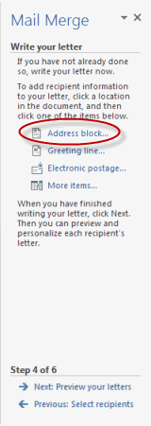
Mail merge
Write the letter and add custom fields.
Click Address block to add the recipients' addresses at the top of the document.

Slide 66
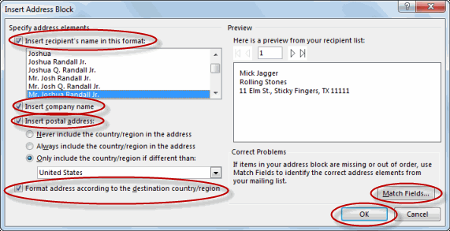
Mail merge
In the Insert Address Block dialog box, check or uncheck boxes and select options on the left until the address appears the way you want it to.

Slide 67
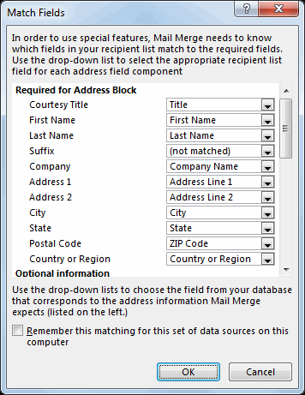
Mail merge
Note that you can use Match Fields to correct any problems.
Clicking Match Fields opens up the Match Fields dialog box, in which you can associate the fields from your list with the fields required by the wizard.

Slide 68
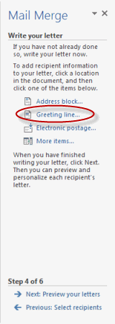
Mail merge
Press Enter on your keyboard
click Greeting line...
to enter a greeting.

Slide 69
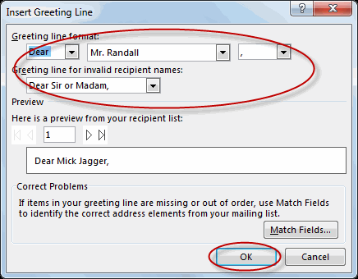
Mail merge
In the Insert Greeting Line dialog box, choose the greeting line format by clicking the drop-down arrows and selecting the options of your choice, and then click OK.

Slide 70
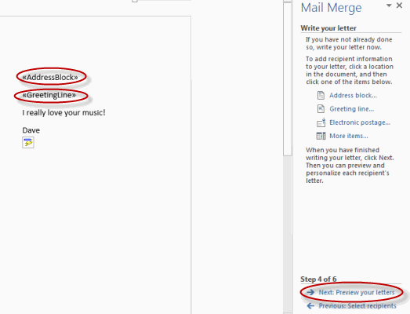
Mail merge
Note that the address block and greeting line are surrounded by chevrons (« »). Write a short letter and click Next: Preview your letters.

Slide 71
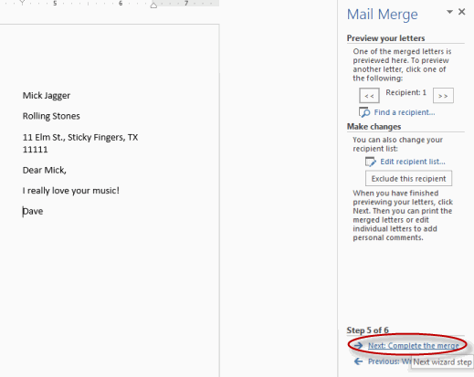
Mail merge
Preview your letter and click Next: Complete the merge.

Slide 72
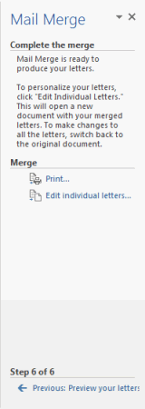
Mail merge
Click Print to print your letters or Edit individual letters to further personalise some or all of the letters.

Slide 73
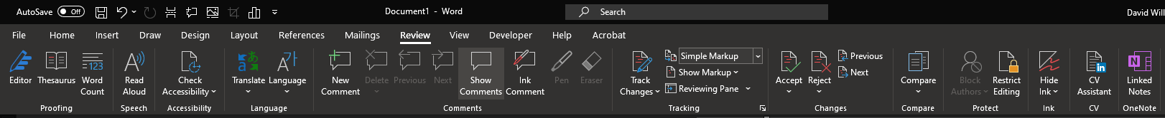
review
This tab provides commands previously found on the Reviewing toolbar, Comments toolbar, Protection toolbar and Tools menu.

Slide 74

review
Spelling & Grammar - Displays the "Spelling and Grammar" dialog box. This allows you to check the spelling and grammar in the active document.
Research - Toggles the display of the Research task pane. Same as Excel.
Thesaurus - Toggles the display of the Research task pane defaulting the research service to the thesaurus. Same as Excel.
Translate -Toggles the display of the Research task pane defaulting the research service to the translation.
Proofing

Slide 75
review
Proofing
Translation ScreenTip - (Moved in 2007). Drop-Down. The drop-down contains the commands:
Set Language - (Moved in 2007). This displays the "Language" dialog box. This dialog box can also be displayed by clicking on the language indicator on the status bar.
Word Count - This displays the "Word Count" dialog box displaying the document statistics. This replaces the Word Count toolbar.
This dialog box can also be displayed by clicking on the word count indicator on the status bar.

Slide 76



review
Speech
This group was added in 2016.
Accessibility
This group was added in 2016.
Language
Translate - Displays the Research task pane. This drop-down contains the commands: Translate Document, Translate Selected Text, Mini Translator and Choose Translation Language.
Language - Set Proofing Language and Language Preferences. Set Proofing Language display the "Language" dialog box. Language Preferences displays the "Options" dialog box, Language Tab.

Slide 77

review
Comments
New Comment - (Shift + F2). Inserts a comment
Delete - Button with Drop-Down. Deletes the selected comment. The button deletes the comment in the active selection.
The drop-down: Delete All Comments Shown and Delete all comments in Document.
Previous - Goes to the previous comment in the active document.
Next - Goes to the next comment in the active document. This is disabled when the document does ot contain any comments.
Show Comments -

Slide 78
Report format tips

Slide 79

Generic report document
Structure
Cover page
Abstract or executive summary
Table of contents
Table of figures and table of tables
Introduction
Investigation – with sub-headings (e.g. research, development, results)
Conclusion
Recommendations
Works cited and/or bibliography
Appendices

Slide 80

Ieee referencing

Slide 81

Harvard referencing

Slide 82
Alternative packages

Slide 83

Open office -
Apache OpenOffice is the leading open-source office software suite for word processing, spreadsheets, presentations, graphics, databases and more.
It is available in many languages and works on all common computers. It stores all your data in an international open standard format and can also read and write files from other common office software packages.
It can be downloaded and used completely free of charge for any purpose.

Slide 84

Open office - writer

Slide 85
Open office - writer
Writer has everything you would expect from a modern, fully equipped word processor.
It is simple enough for a quick memo, yet powerful enough to create complete books with contents, diagrams, indexes, etc.
Wizards take all the hassle out of producing standard documents such as letters, faxes, agendas, minutes, or carrying out more complex tasks such as mail merges. Of course, you are also free to create your own templates, or download templates from our Templates repository.

Slide 86
Open office - writer
Styles and Formatting puts the power of style sheets into the hands of every user.
AutoCorrect dictionary can trap typing mistakes on the fly, checking your spelling as you type. Writer can handle the use of different languages in your document too.
AutoComplete reduces typing effort, it will suggest common words and phrases to complete what you are typing.
Text frames and linking give you the power to tackle desktop publishing tasks for newsletters, flyers, etc. laid out exactly the way you want them to be.
Table of Contents & References - Increase the usefulness of your long, complex documents by generating a table of contents or indexing terms, bibliographical references, illustrations, tables, and other objects.

Slide 87
Open office - writer
Multi-page display - Writer can also display multiple pages while you edit - ideal for complex documents. Works well with large and multiple monitors.
Notes - The notes feature displays notes and comments on the side of the document. This makes notes a lot easier to read. In addition, notes from different users are displayed in different colors together with the editing date and time.
HTML, PDF, MediaWiki formats - Make your documents freely available with Writer’s HTML export to the web, or export in MediaWiki format for publishing to wikis. Publish in Portable Document Format (.pdf) to guarantee that what you write is what your reader sees. The PDF export feature in Apache OpenOffice provides a huge set of formatting and security options; so that PDF files can be customized for many different scenarios, including ISO standard PDF/A files.

Slide 88
Open office - writer
.odt Standard - Save your documents in OpenDocument format, the new international standard for office documents. This XML based format means you’re not tied in to Writer. You can access your documents from any OpenDocument compliant software.
.docx & .doc support - Writer can of course read all your older Microsoft Word documents, or save your work in Microsoft Word format for sending to people who are still using Microsoft products. Writer can also open .docx files created with Microsoft Office 2007 or Microsoft Office 2008 for Mac OS X.

Slide 89

Google docs
Google Docs is a free, web-based word processor offered by Google as part of its complete office suite—Google Drive—to compete with Microsoft Office.
The other main services included in the cloud-based suite are Sheets (Excel) and Slides (Powerpoint).

Slide 90

Google docs

Slide 91
Google docs
Google Docs is available on all devices and platforms; all you need is an internet connection and a web browser (or, in the case of mobile, the applicable apps). Google does the rest and handles the brunt of the heavy lifting while it runs the software in the cloud.
Docs supports several different file types, including .doc, .docx .txt, .rtf, and .odt, making it easy to view and convert Microsoft Office files directly from Google Drive.
Since Docs is an online word processor, you can share and collaborate with multiple people on the same document, tracking revisions, changes, and suggestions all in real time.

Slide 92
Other online alternatives
Etherpad- Etherpad is an online document editor primarily intended for collaborative editing in. It's an open source, highly customisable tool for online document collaboration with friends, fellow students and classmates, or colleagues at work. One of its advantages, especially appealing to users who are reluctant to use services which require email registration, is that there is no sign up with Etherpad.
Zoho- offers around 20 free online applications including Writer for word processing. You can link your Zoho account to your Google and Yahoo accounts, as well. The Writer's interface shouldn't cause anyone problems as it is comfortably familiar.

Slide 93
Other downloadable alternatives
LibreOffice is another open source Microsoft Office alternative and a successor of the OpenOffice.org project (in 2010, Oracle/Apache OpenOffice and LibreOffice projects went separate ways). LibreOffice is distributed as a “monolithic software” consisting of seven components: Writer, Calc, Impress, Draw, Base, Math, and Charts. LibreOffice Writer is a free and powerful word processor available for Windows, Linux, and Mac.
Jarte is based on Microsoft WordPad Engine, but is still free. There is a paid version of the software that adds on some extra functionality, but the free version is more than adequate and fully compatible with Word and WordPad documents.

Slide 94
Other downloadable alternatives
WPS Office is a free document processing suite whose WPS Writer app will serve you well as a Microsoft Word alternative. WPS Office 2016 Free can open and save to a long list of popular file formats native to those applications like docx, doc, and more
SoftMaker FreeOffice- free suite that offers a full featured Microsoft Word alternative. The suite's TextMaker application allows you to focus on creating documents just as you would in MS Word. This suite offers up essential editing features and even a handful of basic templates for creating and editing documents. Tables, charts, shapes and graphics are available along with standard text formatting options. The entire suite is available for Windows, Linux, and Android, so you can keep your document processing tasks going even while away from your desktop.

Slide 95
Tasks

Slide 96
tasks
Create a generic report template which can be adapted to assignments in a variety of subjects.
Decide on a topic appropriate to your employment or study and write a brief report using the various techniques covered on Microsoft word
Write a letter Inquiring about job opportunities. Conduct a mail merge to send to multiple individuals

