Slide 1
Staffing Issues in the NHS and the Impact on Proper Care Staff Management
Presenter Name: Ionela-Diana Bojila(2121819)

Slide 2
Agenda
Topic Introduction
Problem Statement
Macro-Environment Analysis
PESTLE Analysis
Fishbone Diagram
PMI Grid
Recommendation/Decision Implementation
Conclusion

Slide 3

Introduction
Skilled staff (nurses) challenge
41,000 nursing vacancies in the UK
The increase in vacancies has been a potential challenge due to Brexit
Proper Care UK, an adult care provider in the UK
Least operative recruitment and employee management system

Slide 4
Aim
To analyse the potential causes and effects of the workforce shortage on the organisation in light of the strategic analytical frameworks

Slide 5
Problem Statement
Availability of a skilled workforce
NHS is facing severe staffing challenges
Student bursaries caused a substantial decline in the number of students enrolling in the nursing programs
Challenges to the management of Proper Care UK in sustaining the challenge of staff
Need an invigorative and conclusive strategy to strengthen staffing policies

Slide 6
Macro-Environment Analysis
The analysis primarily will be based on
PESTLE
Fishbone
PMI Grid

Slide 7
PESTLE Analysis
Political Factors
Brexit
Employment Contracts
Economic Factors
Austerity Measures
Economic hindrance
Wage inequalities

Slide 8
PESTLE Analysis
Social Factors
Ageing Population
Patient knowledge is yet another social element impacting NHS
Technological Factors
Technological advances in the health care system have greatly improved NHS services
Sophisticated imaging scanners

Slide 9
PESTLE Analysis
Legal Factors
Legal action against health providers is expanding
Environmental Factors
Environmentalists criticise the NHS
Initiatives to minimise medical waste production

Slide 10
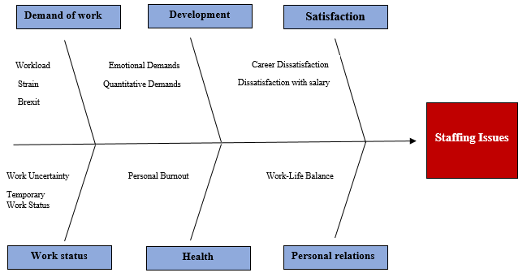
Fishbone Framework Proper Care UK
Walt Disney

Slide 11
Fishbone Framework Proper Care UK
Staff management challenges
Career dissatisfaction
Brexit
Work Uncertainty
Work-Life Balance
Quantitative Demands
Emotional Demands

Slide 12
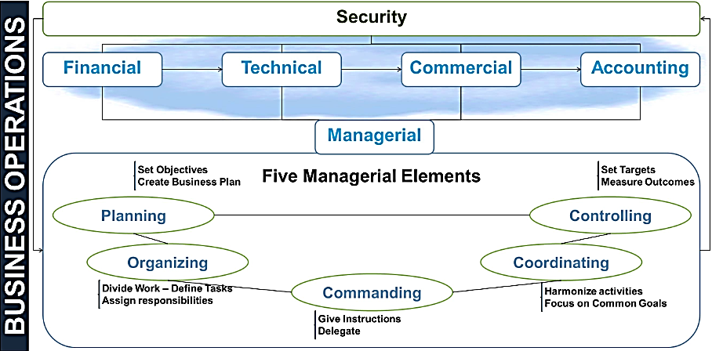
Fayol's Staffing Management Model
During recessive labour environments, service providers must ensure unity of authority, remuneration, centralization, and initiative-building measures to retain skilled staff in order to ensure optimum service standards

Slide 13
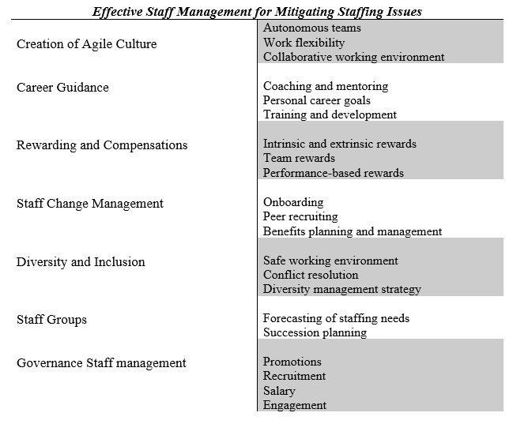
PMI GRID
Autonomous Teams
Work Flexibility
Intrinsic and Extrinsic Rewards
Team Rewards
Peer Recruiting
Safe Working Environment
Conflict Resolution
Succession Planning
Promotions
Recruitment
Engagement

Slide 14
PMI GRID
Inclusive and exclusive well-being of staff is a proven approach to enhance the staff endurance towards the organisation
The nature of the services provided by Proper Care, incorporation of policies to facilitate empowerment, autonomy, flexibility, adaptability, and decisiveness are crucial to sustaining the staffing issues to a manageable level

Slide 15



Decision-Making
Organisation must incorporate employee-oriented management practices
To enhance employee engagement and commitment levels as a tool for staff retention, a performance-based rewarding and compensation framework will be a proven approach to manage staffing issues
Proper Care will need to incorporate a decentralisation approach that will include all the potential facets of an organisation in the decision-making process

Slide 16

CONCLUSION
The growing shortage of competent labour has drastically diminished the UK's healthcare services
Skilled nurses have been confronted with several inherent obstacles in adult healthcare
A large portion of its trained labour has left the country, creating a considerable job vacuum
For Proper Care UK to ensure the continuance of the adult care services, employee-oriented management practices will significantly assist in mitigating staffing issues
It can be concluded that for Proper Care UK to manage nurse shortage issues, it is crucial to implement structural approaches discussed in the PMI grid in light of Fayol's staff management theory and fishbone framework

Slide 17
Thank you

