Slide 1
Education for Sustainable Development and Global Citizenship

Slide 2
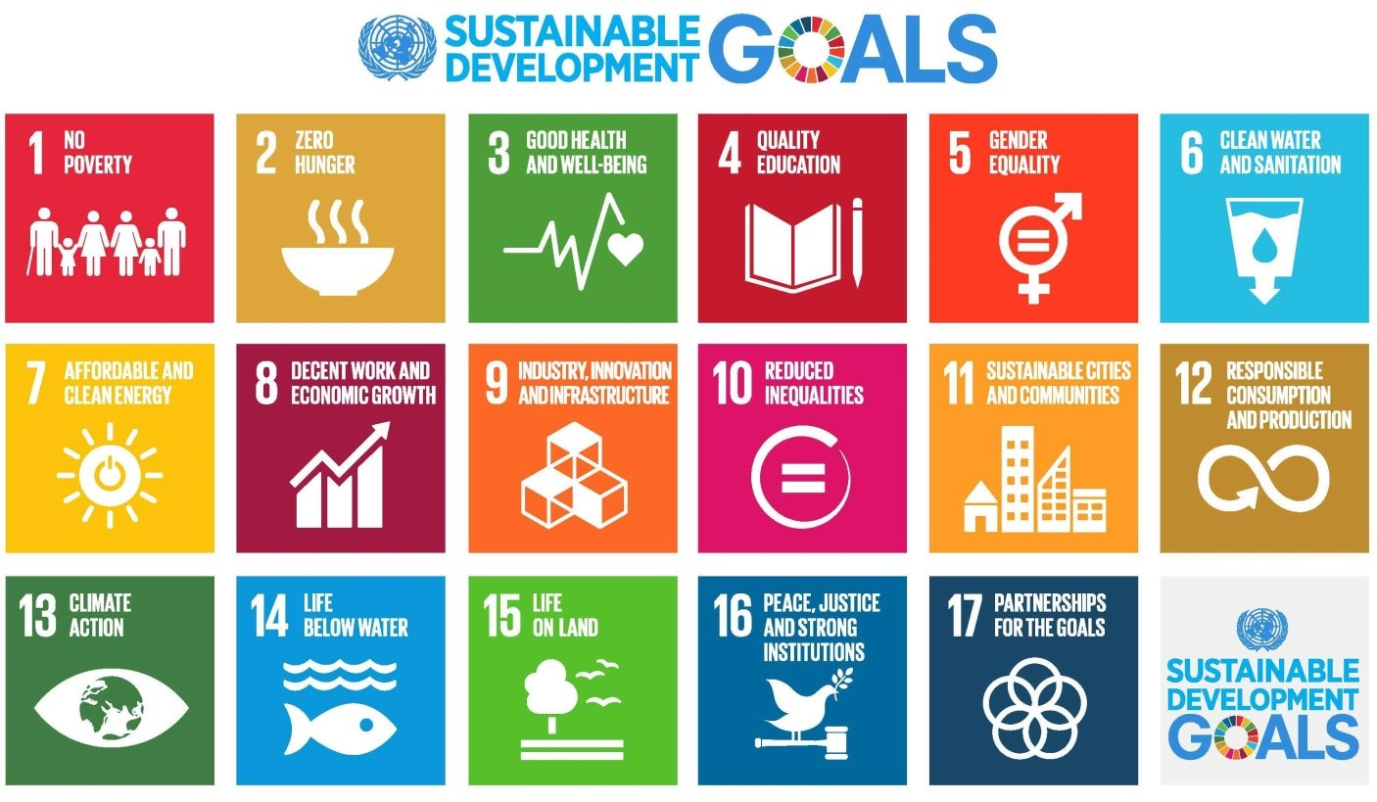
What does ESDGC stand for?
ESDGC stands for "Education for Sustainable Development and Global Citizenship"

Slide 3
What is Sustainability?
The University of California: Los Angeles have defined sustainability as:
"The integration of environmental health, social equity and economic vitality in order to create thriving, healthy, diverse and resilient communities for this generation and generations to come. The practice of sustainability recognizes how these issues are interconnected and requires a system approach and an acknowledgment of Complexity" (UCLA, No Date)

Slide 4
What is the ESDGC about?
Some may say that the ESDGC is in short mainly about what we as people do on a daily basis.
Big challenges that we face in our world
Climate change
Trade
Resource and environmental depletion
Human rights
Conflict
Democracy
Our treatment to the earth and towards each other
Our preparation for our future
(Welsh Government, 2008)

Slide 5
Why is the ESDGC important?
The ESDGC is very important for a number of different reasons
As is said by the Welsh Government in 2012 the ESDGC is important because it
"Emphasizes the role of the individual has as a global citizen and how they can understand these connections and develop the values, attitudes and confidence that can lead to acting responsibly and being committed to a just and sustainable world"

Slide 6
The ESDGC's 7 themes
The 7 themes of the ESDGC that help develop values, attitudes, skills, knowledge and understanding that we need for sustainable living.
The 7 themes are:
Wealth and Poverty
Identity and culture
Choices and decisions
Health
Natural Environment
Climate Change
Consumption and waste
(Welsh Government, 2012)

Slide 7
Global Context of the ESDGC
A global context of the ESDGC is where we consider the world's sustainability. Some examples of a global context include:
Conditions where humans and nature co-exist.
Conditions where societies and biosphere co-exist
The world and the earth co-existing so that we are able to enable productive harmony.
(Cambridge University Press, No Date)

Slide 8
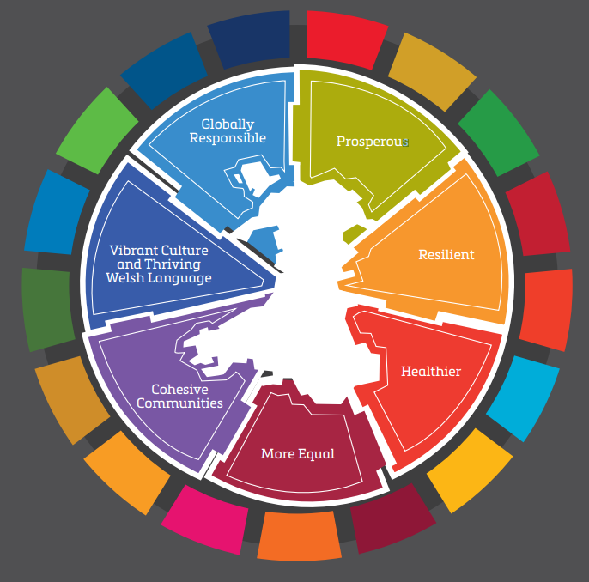
Local Context of the ESDGC
A local context of the ESDGC refers to the area in which a person lives. In this case the 'Welsh Context' of the ESDGC in education is rather helpful.

Slide 9
What is 'The Welsh Context' of the ESDGC?
The Welsh Government have a very clear duty to promote sustainability. This duty was defined and highlighted in the "Government of Wales Act 1998"
Wales hold a significant role when it comes to the 'National Regional Governments for Sustainable Development (NRG4SD)'
The ESDGC in schools:
The ESDGC is something that is considered part of the school's organization.
Is a permanent message on how the school is managed.
Schools must actively do as well as teach to children/young people.
This requires co-ordination and consistency throughout the whole school.
Would be included in an Estyn inspection.
(Welsh Government, 2008)

Slide 10
Reference list:
Welsh Government. (2008) Education for Sustainable Development and Global Citizenship: A Common Understanding for Schools. Available at: https://hwb.gov.wales/api/storage/eaf467e6-30fe-45c9-93ef-cb30f31f1c90/common-understanding-for-school.pdf (Accessed: 10/02/2025)
Welsh Government. (2012) Education for Sustainable Development and Global Citizenship: A Common understanding for the adult and community learning sector. Available at: https://www.gov.wales/sites/default/files/publications/2018-02/education-for-sustainable-development-and-global-citizenship-a-common-understanding-for-the-adult-and-community-learning-sector.pdf (Accessed: 10/02/2025)
Cambridge University Press. (No Date) Scope. Available at: https://www.cambridge.org/core/journals/global-sustainability/about#:~:text=Global%20sustainability%20defines%20the%20conditions,support%20present%20and%20future%20generations. (Accessed: 11/02/2025)
Group. (No Date) Education for Sustainable Development and Global Citizenship. Available at: https://www.t2group.co.uk/esdgc.html#:~: (Accessed: 10/02/2025)
UCLA Sustainability. (No Date) What is Sustainability? Available at: https://www.sustain.ucla.edu/what-is-sustainability/ (Accessed: 10/02/2025)

Slide 11
Reference list:
Kim, J., and Grabowski, C. (2019) Learning Global Citizenship through UN Sustainable Development Goals. Available at: https://teachingsocialstudies.org/2019/01/04/learning-global-citizenship-through-un-sustainable-development-goals/ (Accessed: 22/02/2025)
Welsh Government. (2019) Wales and The Sustainable Development Goals. Available at: https://www.futuregenerations.wales/wp-content/uploads/2019/07/Wales-_-SDGs-_-VNR-_-Supplementary-Report-for-Wales-_-Version-10.1-Final-w-cover-ENG.pdf (Accessed: 22/02/2025)

