Slide 1
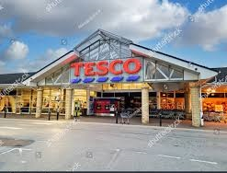
Digital Marketing at TESCO
Luciana Stafi: 2130653
Submission Date: 08 December 2023

Slide 2
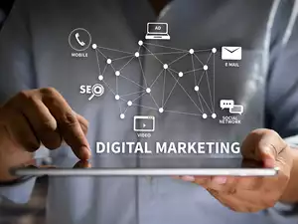
Digital Marketing
"Achieving marketing objectives through applying digital media, data and technology“.
(Chaffey, 2019)

Slide 3
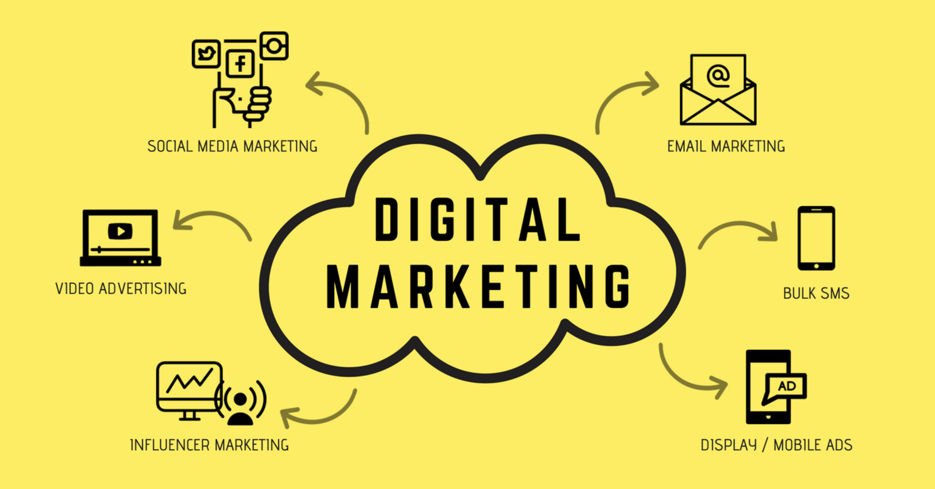

Digital Marketing and Social Media
Digital Marketing
Benefit: “To reach businesses globally” (Design Stallion, 2023).
Disadvantage: “The intense competition in the digital space”
(ReadWrite, 2023).
Social Media
Benefit: “Ability to foster global connectivity” (ROI Minds, 2023).
Disadvantage: “Negative feedback” (WebFX, 2023)​​.

Slide 4
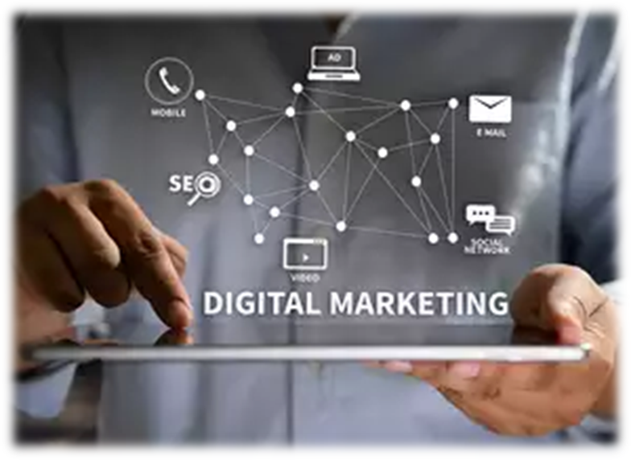
Overview Digital Marketing and TESCO

Slide 5
References List
ROI Minds. (2023). Top Social Media Advantages and Disadvantages of 2023. [online] Available at: https://roiminds.com/social-media-advantages-and-disadvantages/ [Accessed 4 Dec 2023].
Chaffey, D. (2019) Digital Marketing: Strategy, implementation and practice. 7th ed. Harlow i pozostałe: Pearson Education Limited.
Design Stallion. (2023). 11 Benefits of Digital Marketing For Business in 2023. [online] Available at: https://designstallion.com/blog/benefits-of-digital-marketing/ [Accessed 4 Dec 2023].
ReadWrite. (2023). 10 Advantages & Disadvantages of Digital Marketing. [online] Available at: https://readwrite.com/10-advantages-disadvantages-of-digital-marketing-2023/ [Accessed 4 Dec 2023].
ROI Minds. (2023). Top Social Media Advantages and Disadvantages of 2023. [online] Available at: https://roiminds.com/social-media-advantages-and-disadvantages/ [Accessed 3 Dec 2023].
WebFX. (2023). Top 14 Advantages and Disadvantages of Social Media in 2023. [online] Available at: https://www.webfx.com/social-media/learn/social-media-marketing-advantages-and-disadvantages/ [Accessed 4 Dec 2023].

