Slide 1

UNIVERSITY OF WALES Trinity Saint David
PROBLEM SOLVING AND DECISION MAKING
LCLM4004_PRS_OCT2025_A1
LYDA CONTRERAS RAMIREZ; ID 2439999
LECTURER: TOYIN ADISA

Slide 2

INTRODUCTION
GREEN HAVEN FLORISTS
A local florists, a local flower shop struggling with declining in-store sales and rising competition .
It aims to identify the causes of these challenges and recommend ways to modernise the business and improve performance.

Slide 3
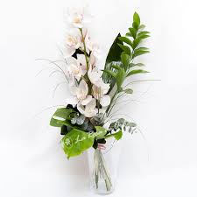
COMPANY BACKGROUND
GREEN HAVEN FLORISTS
Founded in, Establish several years ago as a local family – run florist.
Owner, Liam and Priya
Sells, Fresh flowers and creative floral arrangements, including sustainable and locally sourced blooms wrapped in biodegradable materials
Strong community ties, known locally for quality and creativity, green has long served the community with personalised floral designs for event, gifts, and occasions
Website, is outdate and needs modernisation to attract online customers

Slide 4


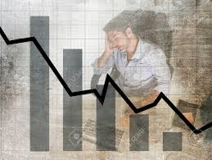
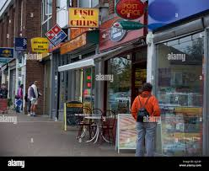


PROBLEM ANALYSIS (5W 2H)
WH0
WHEN
WHAT
WHERE
WHY
GRENN HAVEN , OWNED BY LIAM AND PRIYA
A SIGNIFICANT FALL IN SALES
THEIR HIGH STREET SHOP
OVER THE LAST TWELVE MONTHS
CUSTOMER MOVING TO ONLINE SHOPPING AND WEAK DIGITAL MARKETING
HOW
HOW MUCH
RELYING TOO MUCH ON WALK-INS AND WORD OF MOUTH
ABOUT 30% DROP IN SALES, COMBINED WITH HIGHER COSTS

Slide 5

EXTERNAL FACTORS PESTLE
Politically, import tariffs and trade issues affect the cost of flowers.
Economically, inflation and reduced spending make customers more price-sensitive.
Socially, there’s a clear move towards convenience and online shopping.
Technologically, the business hasn’t kept up – their webside is outdated and lacks online ordering features
Environmentally, green haven promotes sustainability, but eco-friendly materials cost more.
Legally, online trading requires compliance with data protection and consumer rights regulations.

Slide 6
People
Technology
Process
Small team
Slow response to customer messages and online inquiries
Outdate, website no SEO strategy
Owners managing most tasks themselves possible workload stress
Outdate ordering and delivery system
Weak online presence
DECLINE SALES AT GREEN HAVEN FLORISTS
Rising costs of imported flowers and sustainable packaging
Decline in high street foot traffic due to nearby shop closures
Weak social media presence
Competition and economic downturn
Limited variety compared to larger online florists
Marketing
Environment
Materials
ISHIKAWA DIAGRAM

Slide 7

CONCLUSION
In conclusion, Green Haven Florists faces both internal and external challenges-from outdate technology to rising costs and competition.
To recover, I recommend four key actions: redesign the webside with e-commerce, strengthen social –media marketing, offer subscription or delivery services and review supplier costs.

Slide 8
REFERENCES
MSI Certified (2024) 5W2H problem-solving method: free online training. Available at:Slide 4
CIPD(2025) PESTLE analysis,CIPD Knowledge. Available at:
Ishikawa, K (1968) Guide to Quality Control, Juse, TokioSlide 6
Notes:
H

Slide 9




