Slide 1
APPLICATION

Slide 2
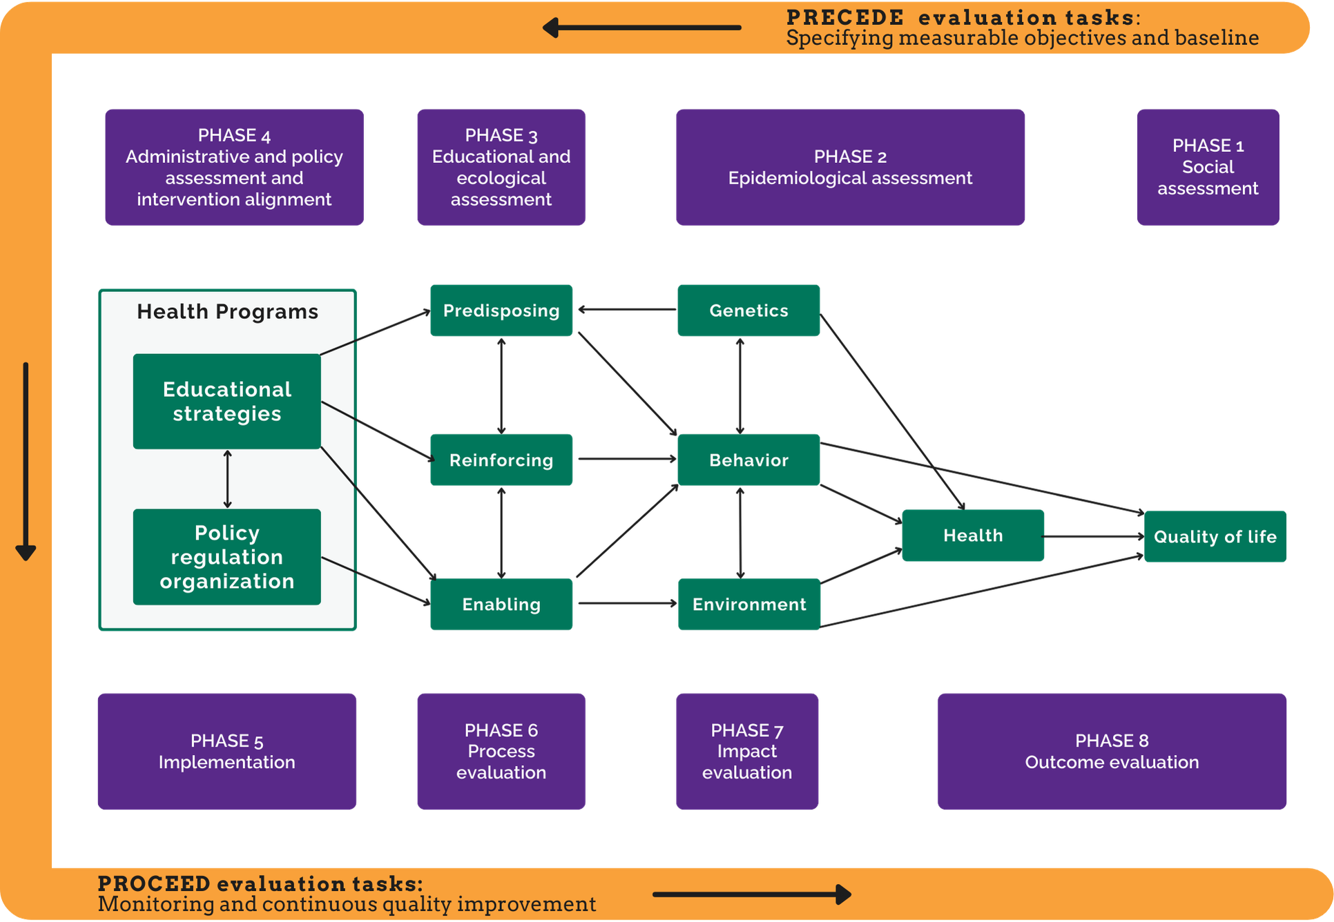
Chosen Planning Model: PRECEDE-PROCEED Model
The PRECEDE–PROCEED Model is a comprehensive health promotion planning framework that guides the systematic assessment, design, implementation, and evaluation of interventions to improve health outcomes.
(Kreuter et al, 2005)

Slide 3
PRECEDE-PROCEED Model
PRECEDE Phase 1: Social Assessment
Application to DiaBand UK
Identify how Type 2 diabetes affects the quality of life of adults aged 25–65 years in the UK (Tarver-Grover, 2017).
Gather community feedback on barriers to healthy eating, physical activity, and diabetes self-management (Omolade et al, 2022).
Explore users' preferences for digital health technologies and wearable devices (Tarver-Grover, 2017).
Use the findings to design an intervention that meets users' lifestyle and health needs (Omolade et al, 2022).

Slide 4

Phase 2: Epidemiological Assessment
Analyse UK data on Type 2 diabetes prevalence, obesity, and physical inactivity (Gold, 2022).
Identify adults aged 25–65 years as the priority population due to their higher risk of developing Type 2 diabetes (Gold, 2022).
Determine key health outcomes, including reducing HbA1c levels, obesity, and diabetes-related complications (Tang et al, 2025).
Establish measurable health objectives to guide the intervention (Tang et al, 2025).

Slide 5

Phase 3: Educational and Ecological Assessment
Identify predisposing factors, including limited knowledge and low motivation for healthy lifestyle behaviours (Nejhaddadgar et al, 2019).
Assess enabling factors, such as access to smartphones, wearable devices, and NHS digital services (Nejhaddadgar et al, 2019).
Identify reinforcing factors, including AI coaching, family support, healthcare professional feedback, and reward systems (Azar et al, 2017).
Design personalised education and behaviour change strategies within the DiaBand UK app (Azar et al, 2017).

Slide 6

Phase 4: Administrative and Policy Assessment
Ensure the intervention aligns with NICE guidance, the NHS Long Term Plan, and the NHS Diabetes Prevention Programme (Azar et al, 2017).
Assess funding requirements, digital infrastructure, staffing, and wearable technology availability (Tang et al, 2025).
Develop partnerships with GPs, diabetes specialist nurses, pharmacists, dietitians, and community organisations (Lei et al, 2025).
Provide training for healthcare professionals to support users in adopting the intervention (Azar et al, 2017).

Slide 7

Phase 5: Implementation
Introduce the DiaBand UK app and wearable device through GP practices, community health centres, and NHS diabetes services (Lei et al, 2025).
Register eligible adults aged 25–65 years and provide personalised onboarding and training (Nejhaddadgar et al, 2019).
Deliver AI-powered health coaching, physical activity tracking, nutrition guidance, medication reminders, and educational content (Nejhaddadgar et al, 2019).
Encourage continuous engagement through goal setting, progress monitoring, and digital reward challenges (Lei et al, 2025).

Slide 8
Phase 6: Process Evaluation
Monitor the number of app downloads, wearable registrations, and active users (Tarver-Grover, 2017).
Assess participation in physical activity challenges and educational modules (Tarver-Grover, 2017).
Collect user feedback on usability, accessibility, and satisfaction (Tang et al, 2025).
Identify implementation challenges and make improvements where required (Azar et al, 2017).
Phase 7: Impact Evaluation
Measure improvements in physical activity, healthy eating, and medication adherence (Tang et al, 2025).
Assess changes in diabetes knowledge, self-management skills, and confidence (Tang et al, 2025).
Evaluate user engagement with AI coaching and wearable monitoring (Lei et al, 2025).
Determine whether short-term behaviour change objectives have been achieved (Lei et al, 2025).

Slide 9

Phase 8: Outcome Evaluation
Evaluate reductions in HbA1c levels and diabetes-related complications (Gold, 2022).
Assess improvements in quality of life and long-term self-management (Omolade et al, 2022).
Measure reductions in hospital admissions and NHS healthcare costs (Gold, 2022).
Use the findings to inform future digital diabetes programmes, policy development, and service improvement (Omolade et al, 2022).

Slide 10

Why the PRECEDE-PROCEED Model?
Provides a systematic, evidence-based framework to assess health needs, plan, implement, and evaluate digital health promotion interventions (Cho et al, 2018).
Focuses on behavioural, environmental, and social factors influencing Type 2 diabetes, enabling tailored strategies for adults aged 25–65 years (Khademi and Kaveh, 2025).
Supports stakeholder involvement and continuous evaluation, ensuring the DiaBand UK intervention is effective, sustainable, and aligned with UK public health priorities (Khademi and Kaveh, 2025).

Slide 11
References
Azar, F.E., Solhi, M., Nejhaddadgar, N. and Amani, F., 2017. The effect of intervention using the PRECEDE-PROCEED model based on quality of life in diabetic patients. Electronic physician, 9(8), p.5024. https://pmc.ncbi.nlm.nih.gov/articles/PMC5614287/
Cho, H., Porras, T., Baik, D., Beauchemin, M. and Schnall, R., 2018. Understanding the predisposing, enabling, and reinforcing factors influencing the use of a mobile-based HIV management app: a real-world usability evaluation. International journal of medical informatics, 117, pp.88-95. https://www.sciencedirect.com/science/article/pii/S1386505618301850
Gold, R.S., 2022. Applications in Communication Technology. Health Program Planning, Implementation, and Evaluation: Creating Behavioral, Environmental, and Policy Change, p.390. https://books.google.com/books?hl=en&lr=&id=OfZSEAAAQBAJ&oi=fnd&pg=PA390&dq=PRECEDE-PROCEED+Model+Application+to+diabetes+mobile+app++&ots=MYmR1A-CNr&sig=PjVRxEzak1NAxlMjV__Tb3sM8Ag
Khademi, K. and Kaveh, M.H., 2025. A pioneering health education strategy based on the PRECEDE-PROCEED model for women’s health challenges: a systematic review and logic framework. BMC Women's Health, 25(1), p.324. https://link.springer.com/article/10.1186/s12905-025-03883-0
Lei, A., Liao, X., Liu, L. and You, H., 2025. Mobile health management needs among infertile patients: a cross-sectional study based on the PRECEDE-PROCEED model. BMC Health Services Research, 25(1), p.1329. https://link.springer.com/article/10.1186/s12913-025-13538-3
Nejhaddadgar, N., Darabi, F., Rohban, A. and Solhi, M., 2019. The effectiveness of self-management program for people with type 2 diabetes mellitus based on PRECEDE-PROCEDE model. Diabetes & Metabolic Syndrome: Clinical Research & Reviews, 13(1), pp.440-443. https://www.sciencedirect.com/science/article/pii/S1871402118303278
Omolade, O., 2022. Digital Marketing and Brand Performance Analysis of Selected Diabetes Apps. https://www.theseus.fi/handle/10024/771152
Tang, Y., Soh, K.L., Gan, W.Y., Zhou, J. and Soh, K.G., 2025. The efficacy of PRECEDE-PROCEED model-based interventions on HbA1c and self-management in type 2 diabetes patients: a systematic review and meta-analysis. BMC Public Health, 25(1), p.1980. https://link.springer.com/article/10.1186/s12889-025-23073-9
Tarver-Grover, S., 2017. HEALTHEDASSIST©-DEVELOPING A FRAMEWORK FOR CREATING, USING AND EVALUATING A MOBILE HEALTH EDUCATION APP. FOR HEALTH EDUCATORS USING THE PREDISPOSING, ENABLING AND REINFORCING FACTORS OF THE PRECEDE MODEL. International Journal of Arts & Sciences, 10(2), pp.627-632. https://search.proquest.com/openview/358de258719f38c02f786767a1063f3e/1?pq-origsite=gscholar&cbl=626342

