Slide 1













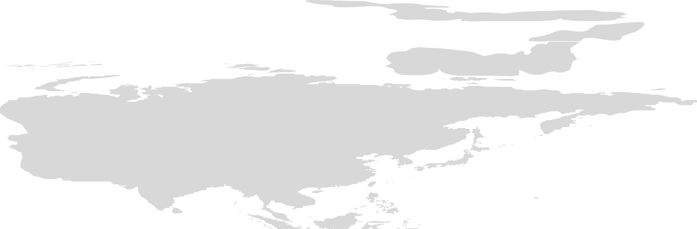









Slide 2




























































Slide 3
Introduction
Tata Communications is a global digital ecosystem enabler headquartered in India. The company provides network, cloud, security, and mobility solutions to businesses worldwide. Managing and developing individuals and teams effectively is a key aspect of Tata Communications' success, as the company operates with diverse teams across countries.
This presentation explores how Tata Communications recruits and manages employees through different interview types and questioning techniques. It also compares traditional and modern recruitment methods, focusing on developing strong and capable teams.

Slide 4













































Slide 5

























Slide 6






























Slide 7

















































Slide 8




































Slide 9






































Slide 10











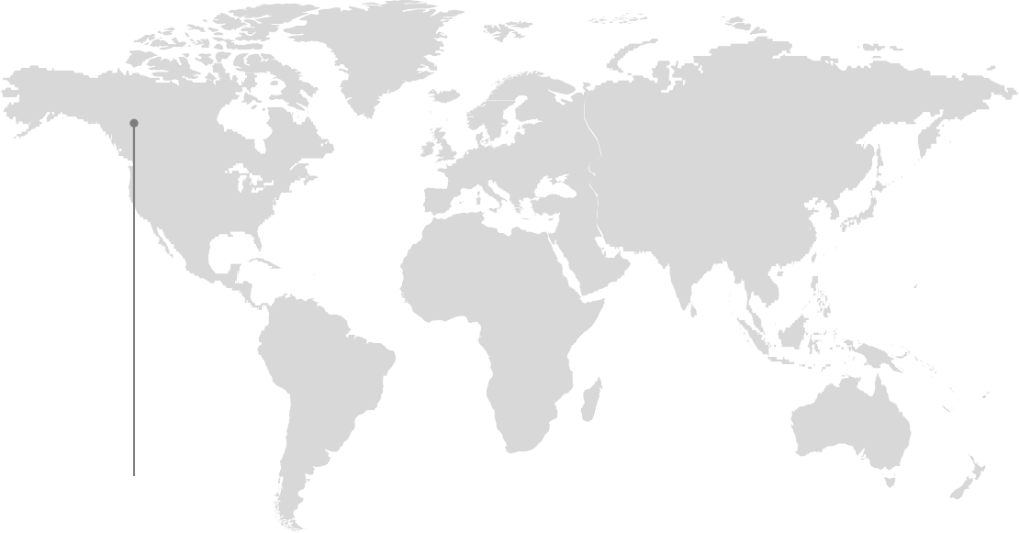










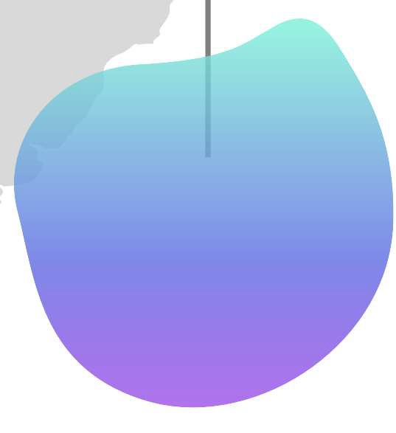
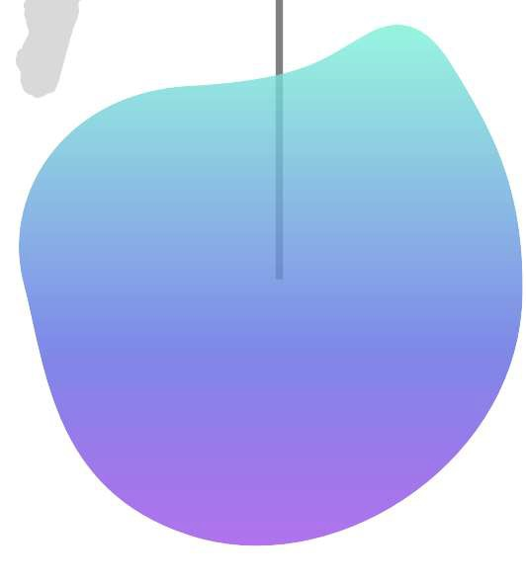
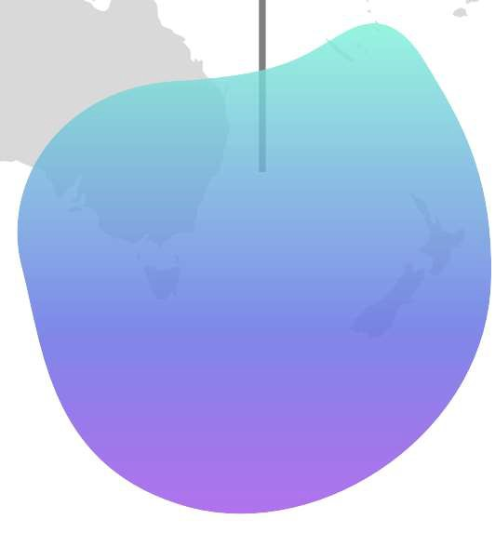



















Slide 11































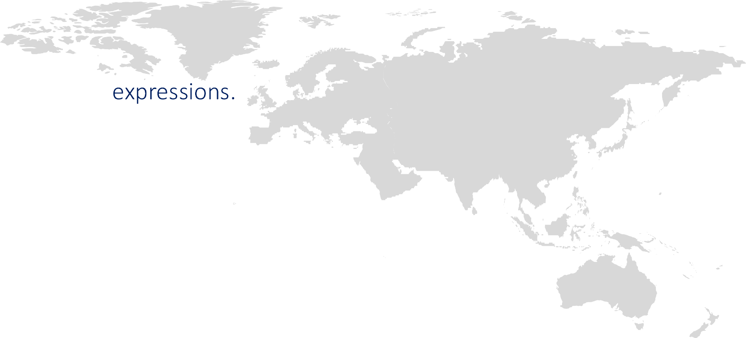
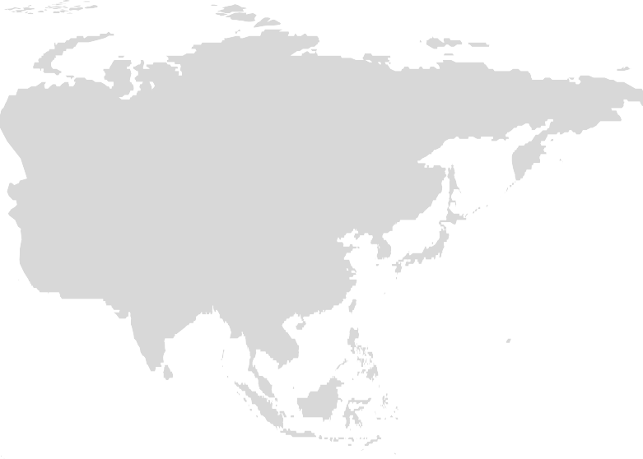


















Slide 12
Conclusion
Tata communications uses clear and organised process to hire the right people.
Different interview types, like panel ,one-on-one, face to face and online, help the company understand each candidate in different ways.
Questioning techniques such as probing, leading and the Socratic method give deeper insight into a person’s skills and thinking.
Using both traditional and modern interview methods allows tata Comm to attract talent from anywhere in the world.
Overall, those approaches helps the company build strong teams and support its global; operations.

Slide 13















