Slide 1


CAREERS
SERVICE
careers@uwtsd.ac.uk
www.uwtsd.ac.uk/careers

Slide 2

London Careers Service
Careers Adviser: Maristela Parfitt

Slide 3
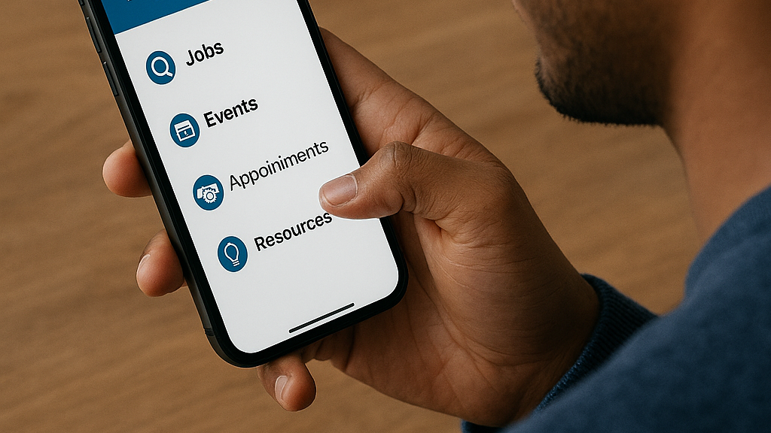
MyCareer

Slide 4


WHAT IS IT & WHY USE IT?
MyCareer is a Careers platform available to all UWTSD students & staff
Can help with everything from career planning to interview preparation
CV builder & cover letter generator, and AI-driven video interview practice
Info on jobs, interview techniques, question types, tests etc.
Very useful resource

Slide 5
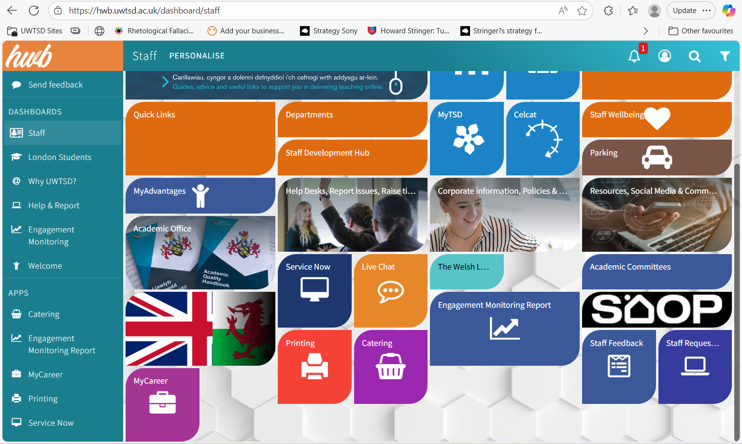

Accessing MyCareer – via the Hwb

Slide 6
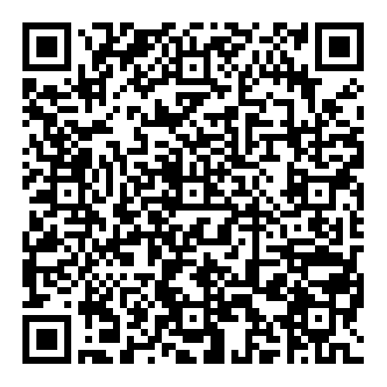
Accessing MyCareer – via the Careers page
Getting started

Slide 7
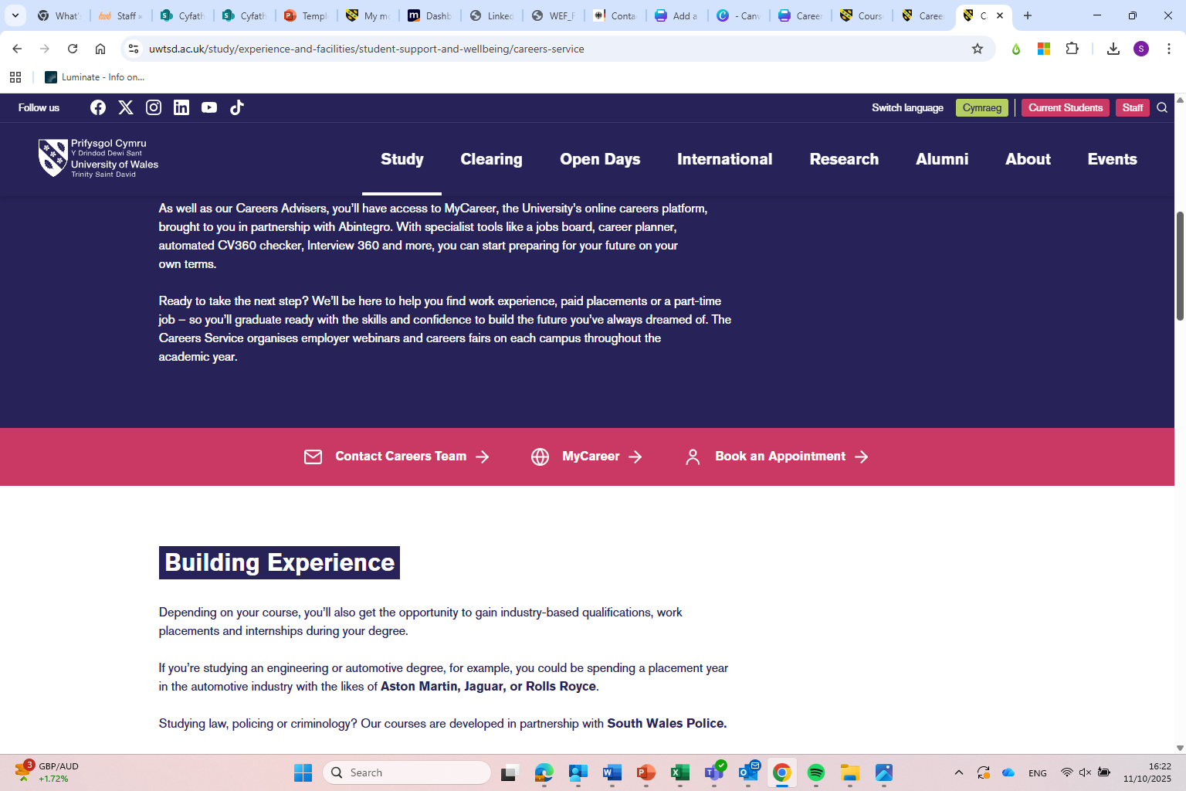

Getting started
2. Scroll down to MyCareer

Slide 8
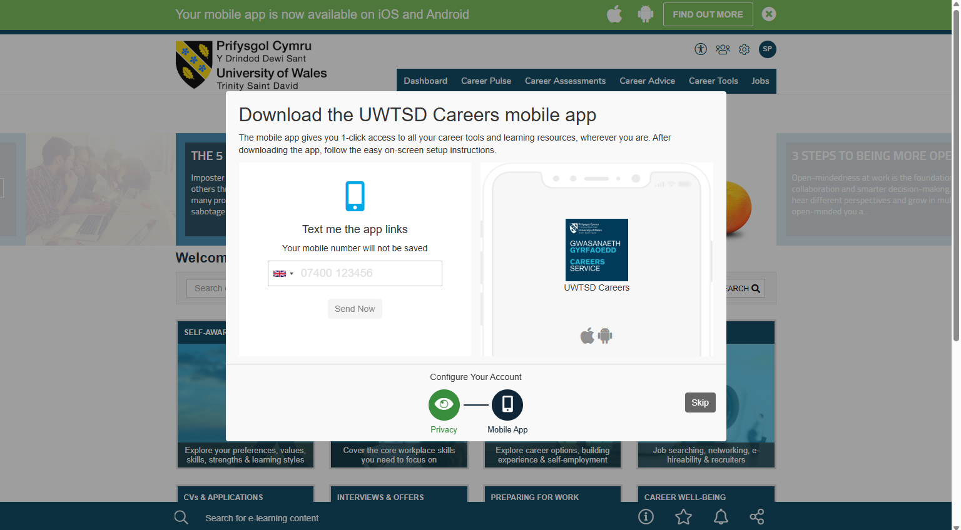

Getting started
3. UWTSD Careers App - Skip

Slide 9
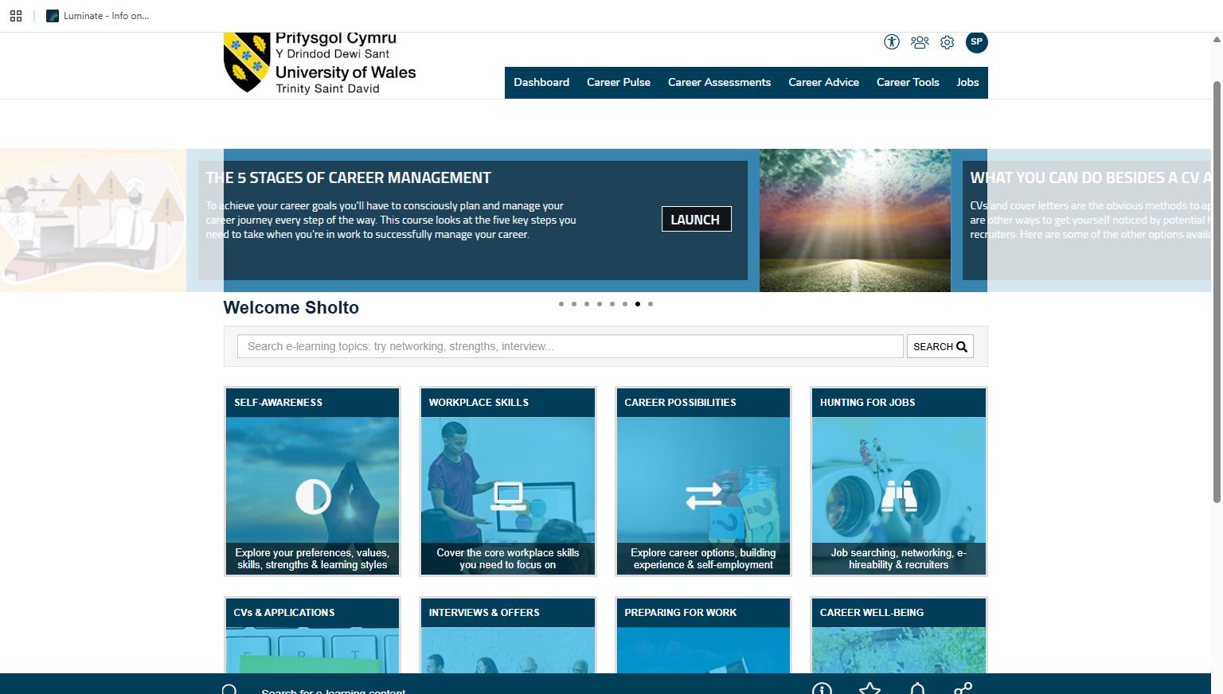
4. Careers Pulse:
How employable are you?
Getting started

Slide 10
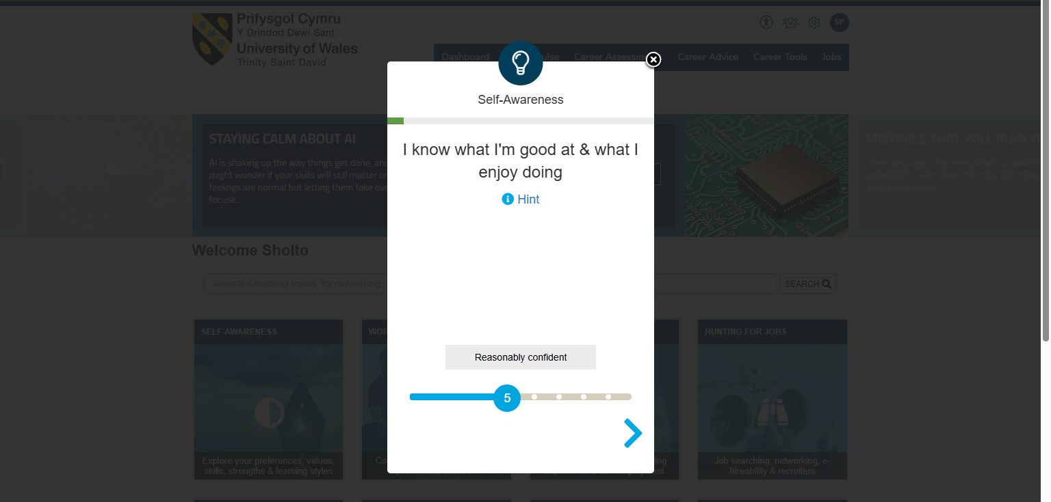
Getting started
5. Careers Pulse – Employability

Slide 11
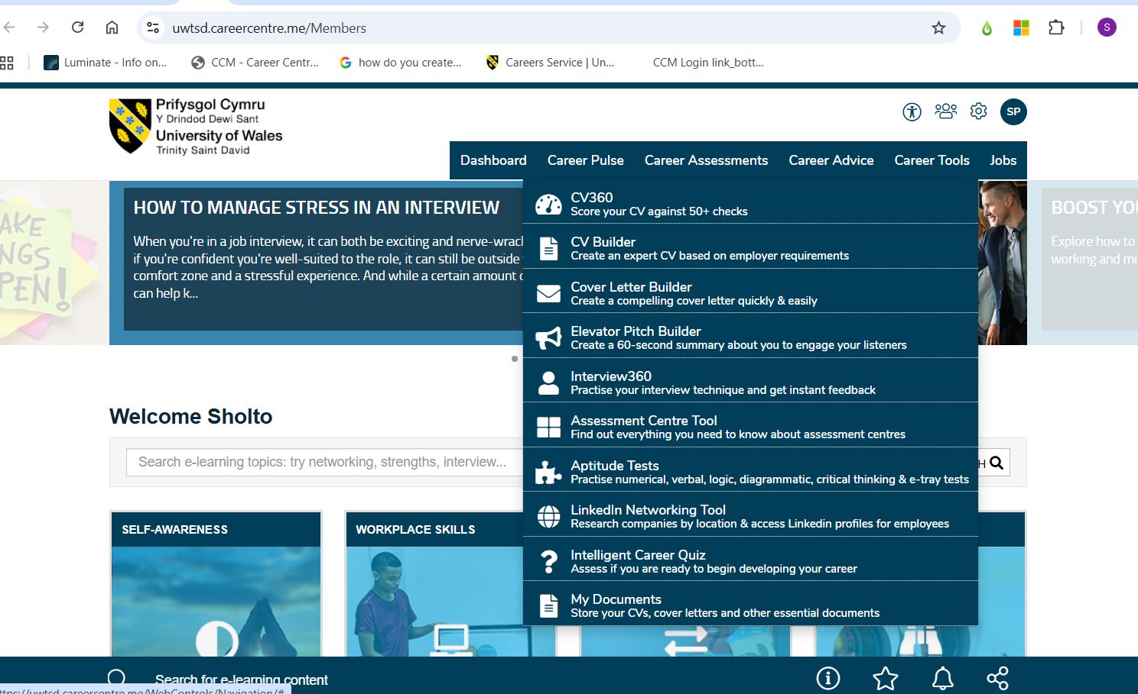
Getting started
6. CV Builder

Slide 12
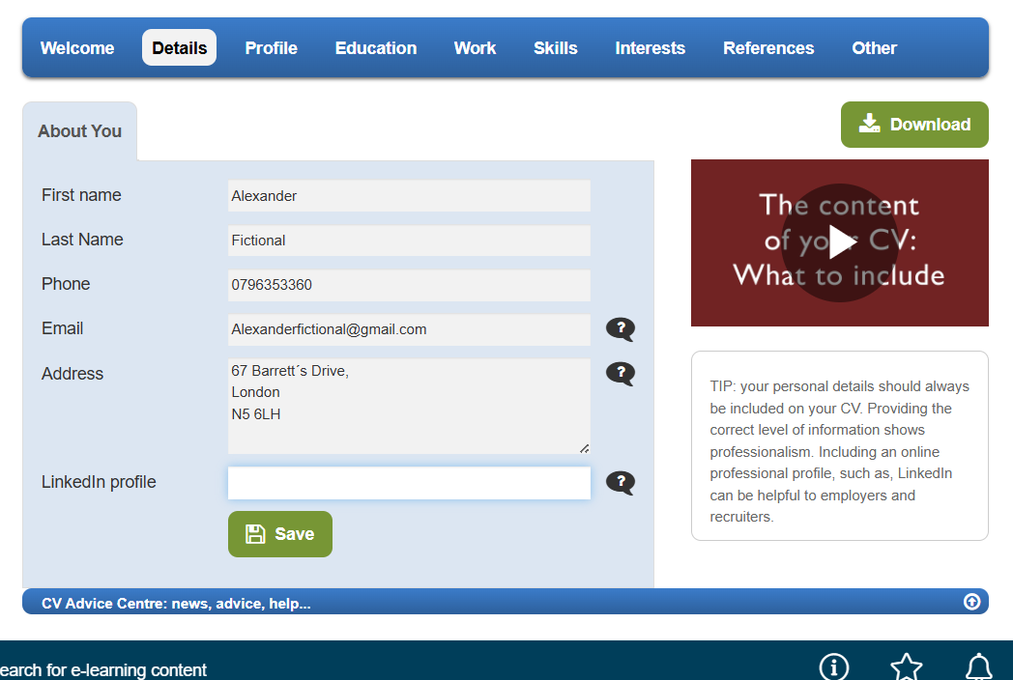
Getting started
7. CV Builder

